Slide 1
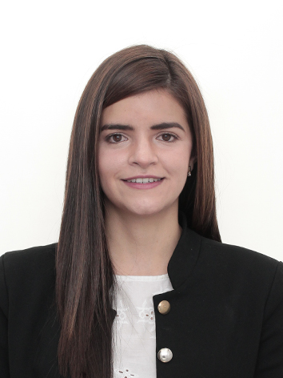

IEEE Aerospace Electronic Systems
AESS - R9 Latin America Report
Giovanna Ramirez R.
Board of Governors Meeting
November 10-11, 2023

Slide 2

2

Slide 3
Agenda
Number of active AESS chapters in R9 - Latin America
AESS student chapters in R9 - Latin America
Growth AESS R9 membership
Progress DSTEI Projects R9
2

Slide 4





AESS chapters in R9 - Latin America
Section chapters
COLOMBIA
Chapter in progress
PERU
EL SALVADOR
MEXICO
2

Slide 5

AESS student chapters in R9 - Latin America
Student chapters
COLOMBIA
PERU
MEXICO
BRAZIL
GUATEMALA
COSTA RICA
ECUADOR
12
4
4
3
2
1
1
2

Slide 6

2

Slide 7
AESS PERU Chapter
Growth AESS R9 membership
Total AESS Members (75) – May 2023
Total AESS Members (92) – October 2023
+ 22% AESS Memberships

Slide 8
Growth AESS R9 membership v
AESS PERU Chapter
+ 21% Members

Slide 9

DSTEI PROJECTS R9
Selected projects from R9- Latin America
Ticanor: Drone Swarm System for Agricultural Surveillance of Coffee Crops in COLOMBIA
Swarm Drones for Forest Fire Monitoring – PERU

Slide 10
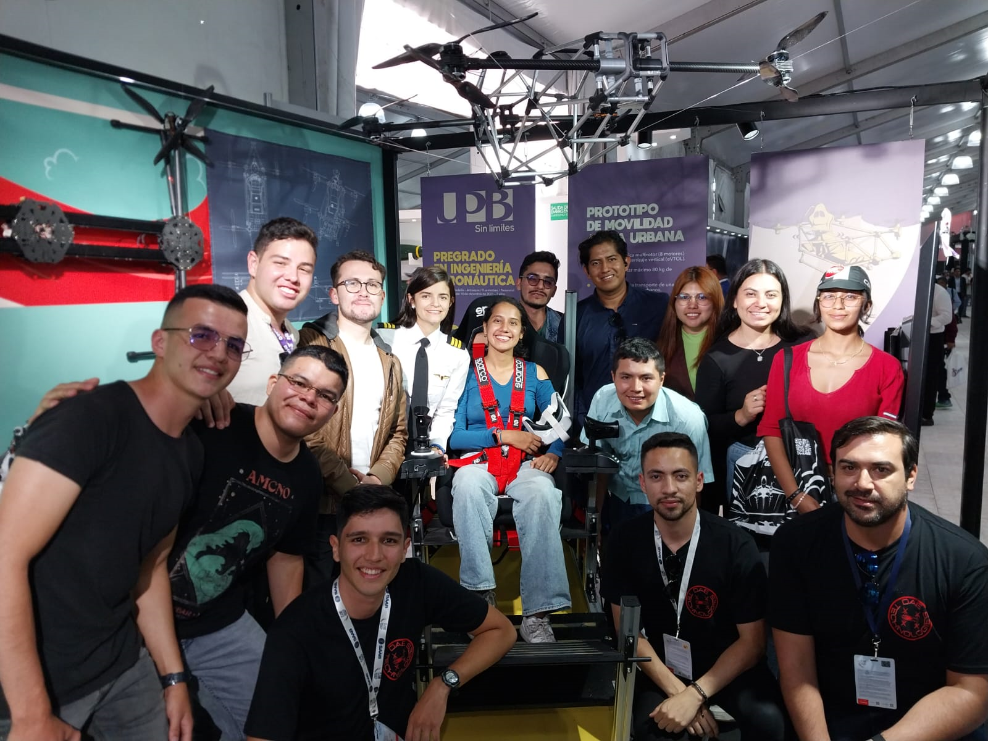
DSTEI PROJECTS R9
Ticanor: Drone Swarm System for Agricultural Surveillance of Coffee Crops in COLOMBIA
University | El Cauca University, Colombia AESS Unicauca
Number of phases | 4 phases
Progress | Phase 1 40%
Budget (25000 USD) | 9200 USD

Slide 11
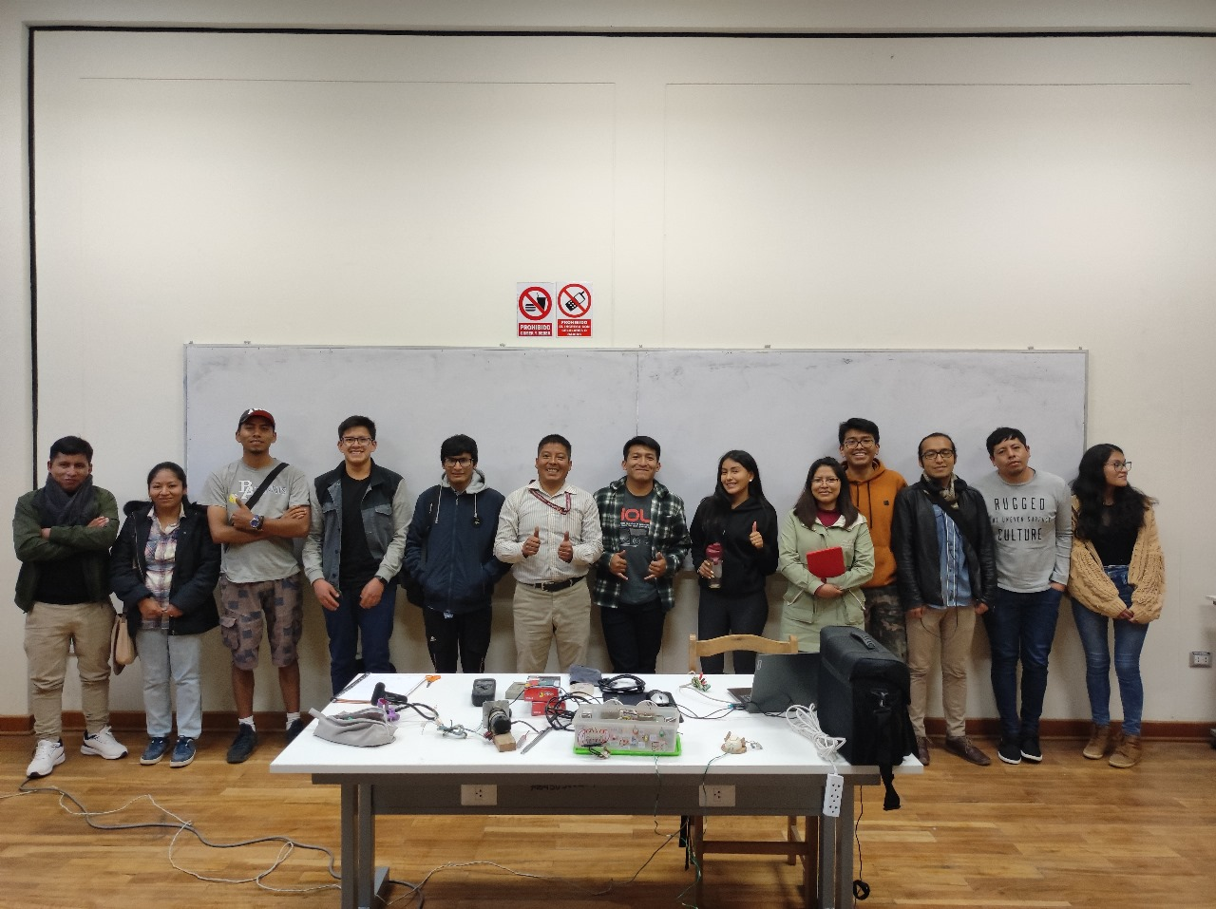
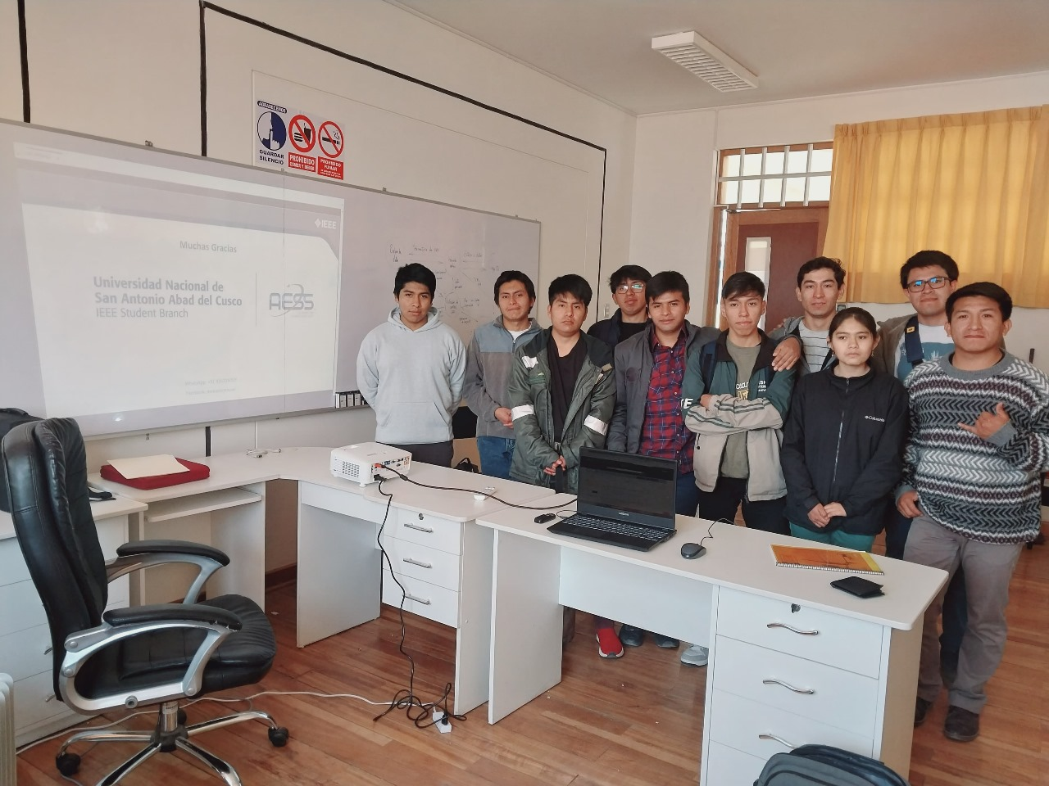
DSTEI PROJECTS R9
Swarm Drones for Forest Fire Monitoring - PERU
University | San Antonio Abad National University of Cusco, Peru
Number of phases | 4 phases planning, design, testing and validation
Progress | Phase 2 60%
Budget (25000 USD) | 4200 USD

Slide 12
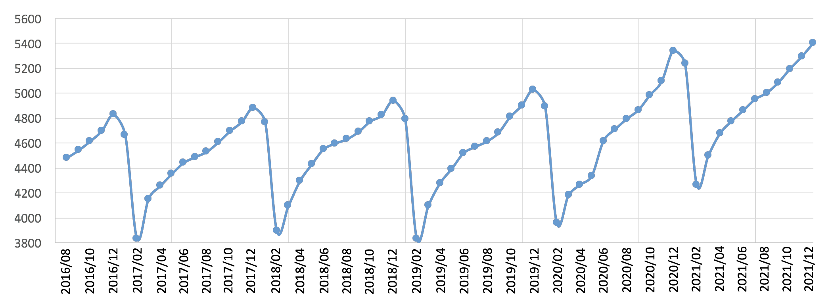
IEEE Membership statistics (II)
AESS Society total
5401
5341
5027
+1.1% YoY,
Even with
the covid
situation
4941
4828
4884
2016
2017
2018
2019
2020
2021
7

Slide 13
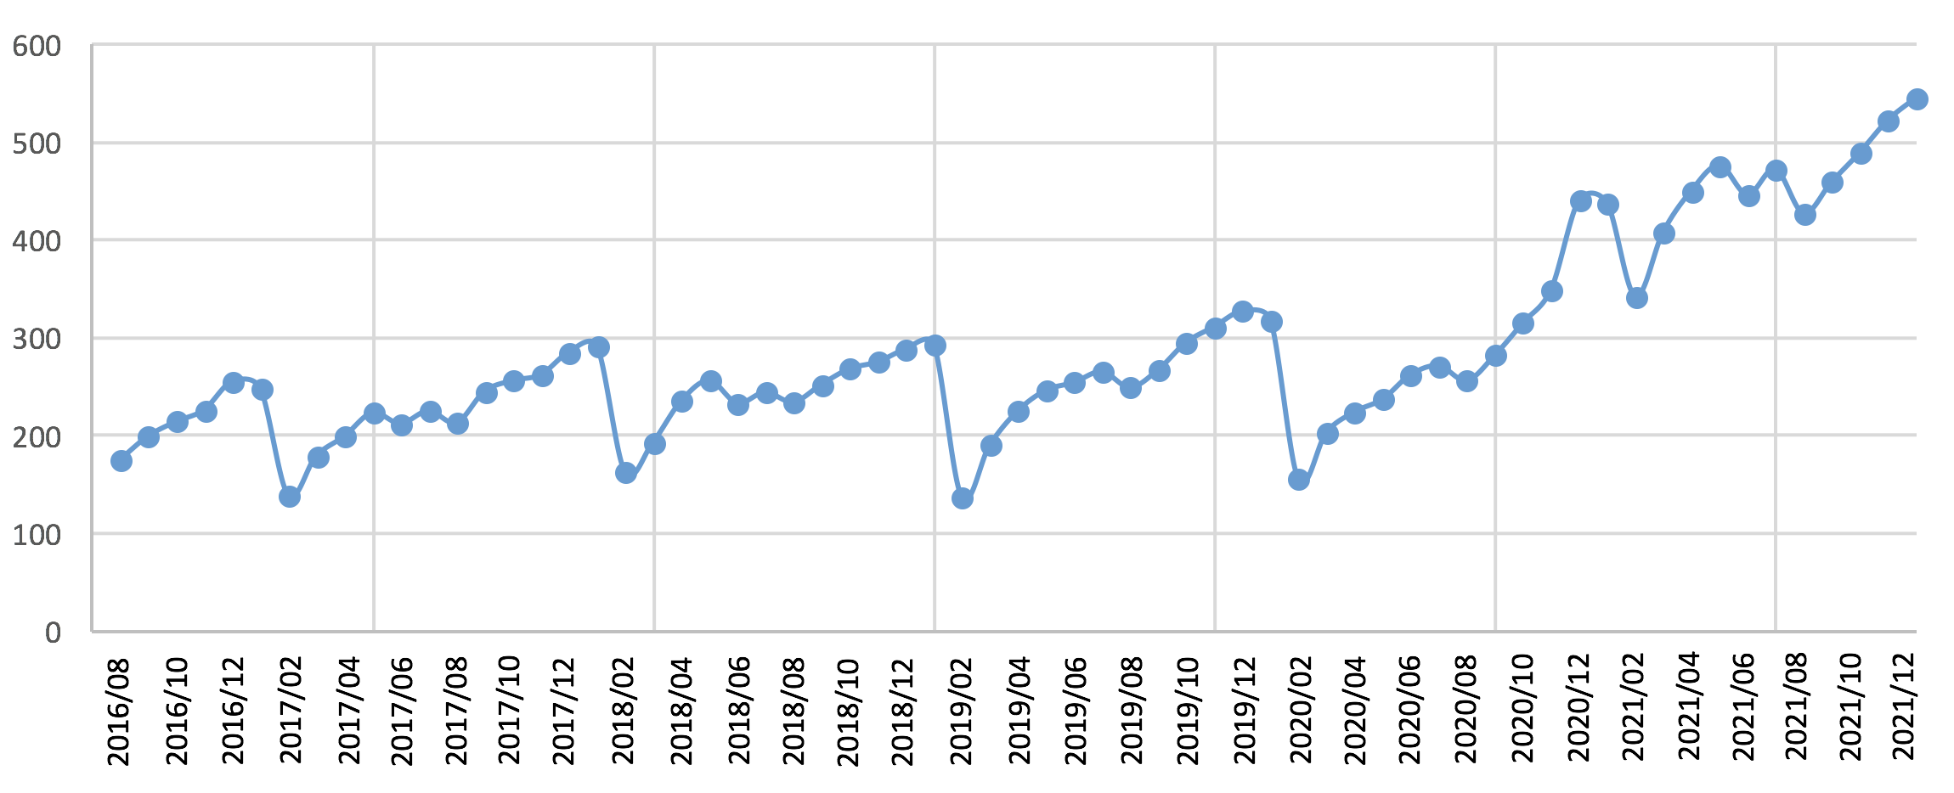
IEEE Membership statistics
+23.9% YoY
AESS Student members
545
440
HIGHEST
NUMBERS IN
THE LAST
6 YEARS
327
255
285
288
2016
2017
2018
2019
2020
2021
16

Slide 14
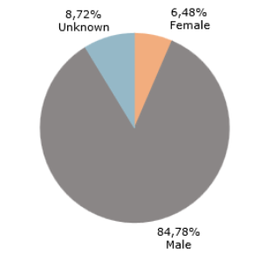
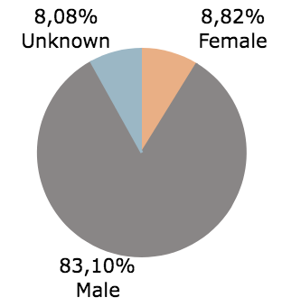
Increase membership diversity
IEEE Membership statistics
AESS membership count by gender
8,72% Unknown
6,48% Female
2019
2020
2021
84,78% Male
237 WIE
178 are student members
  (including graduate student members)
28

Slide 15

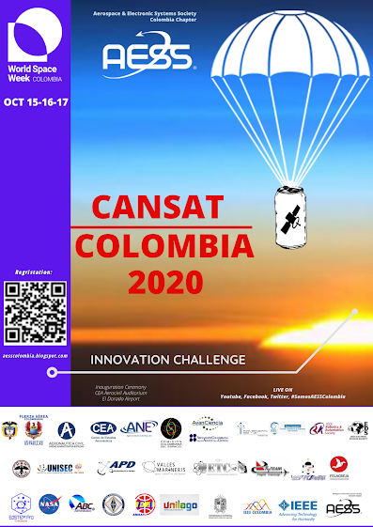


UPCOMING EVENTS
AESS COLOMBIA
Drones
Satellites
Space Robotics
May 2024
September 2024
November 2024
aesscolombia.blogspot.com

Slide 16

THANK YOU
GIOVANNA ESTEFANIA RAMIREZ R
Estefania.r@ieee.org
Colombia

