Slide 1
IEEE Aerospace Electronic Systems
WIE Committee Liaison
Kathleen A. Kramer
AESS Fall 2023 Board of Governors Meeting
10 and 11 November 2023
Sydney, Australia

Slide 2
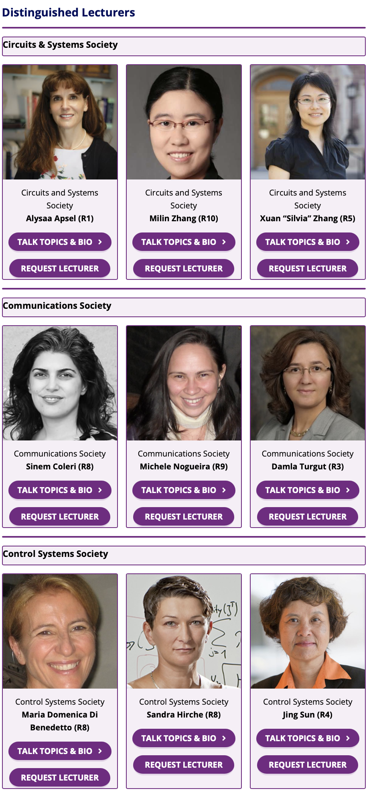

IEEE WIE DL Program (Society DLs)
Maria Sabrina Greco
Karen Haigh
Jiang Lin
Need to get ok from our DLs involved that they can also be listed on WIE’s site
https://wie.ieee.org/about/wie-committee/ieee-wie-distinguished-lecturers-program/

Slide 3
Kramer WIE Activities
American Controls Conference (ACC), 31 May 2023
IEEE International Microwave Symposium (IMS) WIE, 13 June 2023
IEEE UCSD EMBS Kick-Off, 9 October 2023
IEEE WIE Forum USA East, Pittsburgh, 28 October 2023
IEEE Future Networks World Forum, Baltimore, 14 November 2023
IEEE International Conference on Consumer Electronics, 7 January 2024

Slide 4
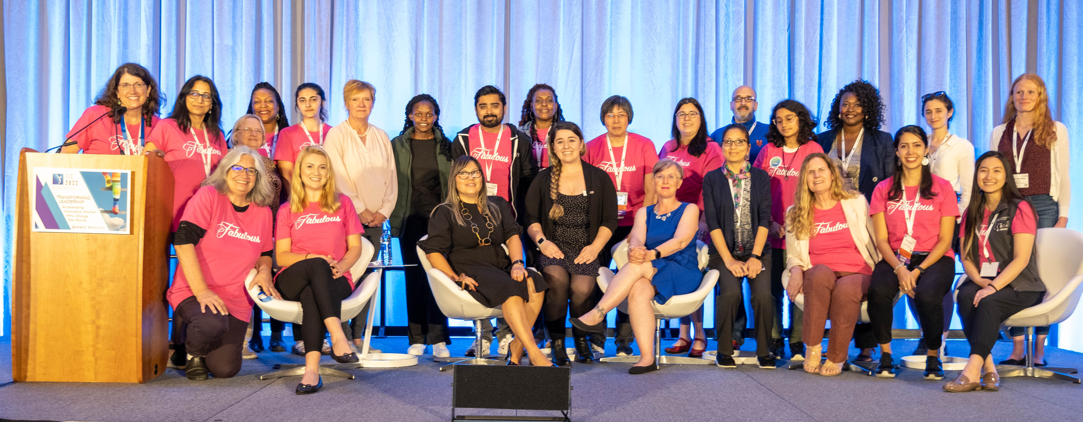
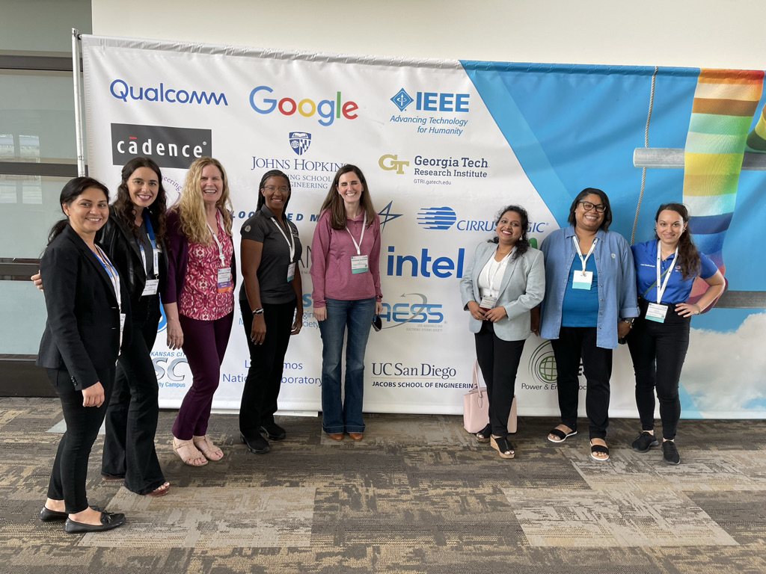
Best Practices Reminders
2022 and into 2023
AESS was as special registrant type created by WIE ILC 2022, providing registration for two WIE AESS and supporting conference. Please note for 2025 support.
Working with society VP Conferences to ensure flagship conferences individually organize special events that target underrepresented audiences, including WIE and that all events are inclusive (industry, YP, WIE) incorporate the spirit of the pledge in breadth of activities.…
Best Practices Report

