Slide 1
IEEE Aerospace Electronic Systems Young Professionals
Philipp Markiton
AESS Fall 2023 Board of Governors Meeting
10 and 11 November 2023
Sydney, Australia

Slide 2
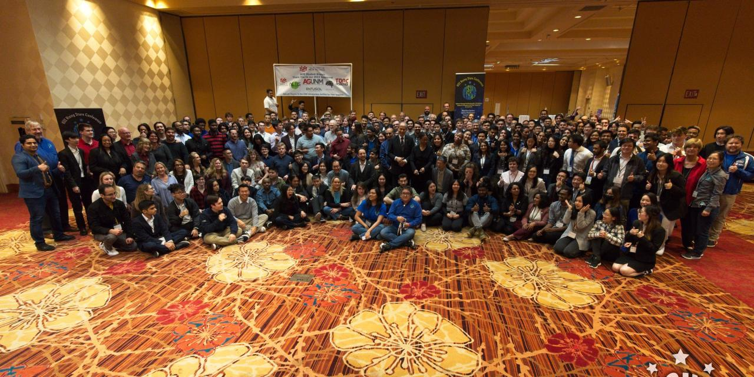
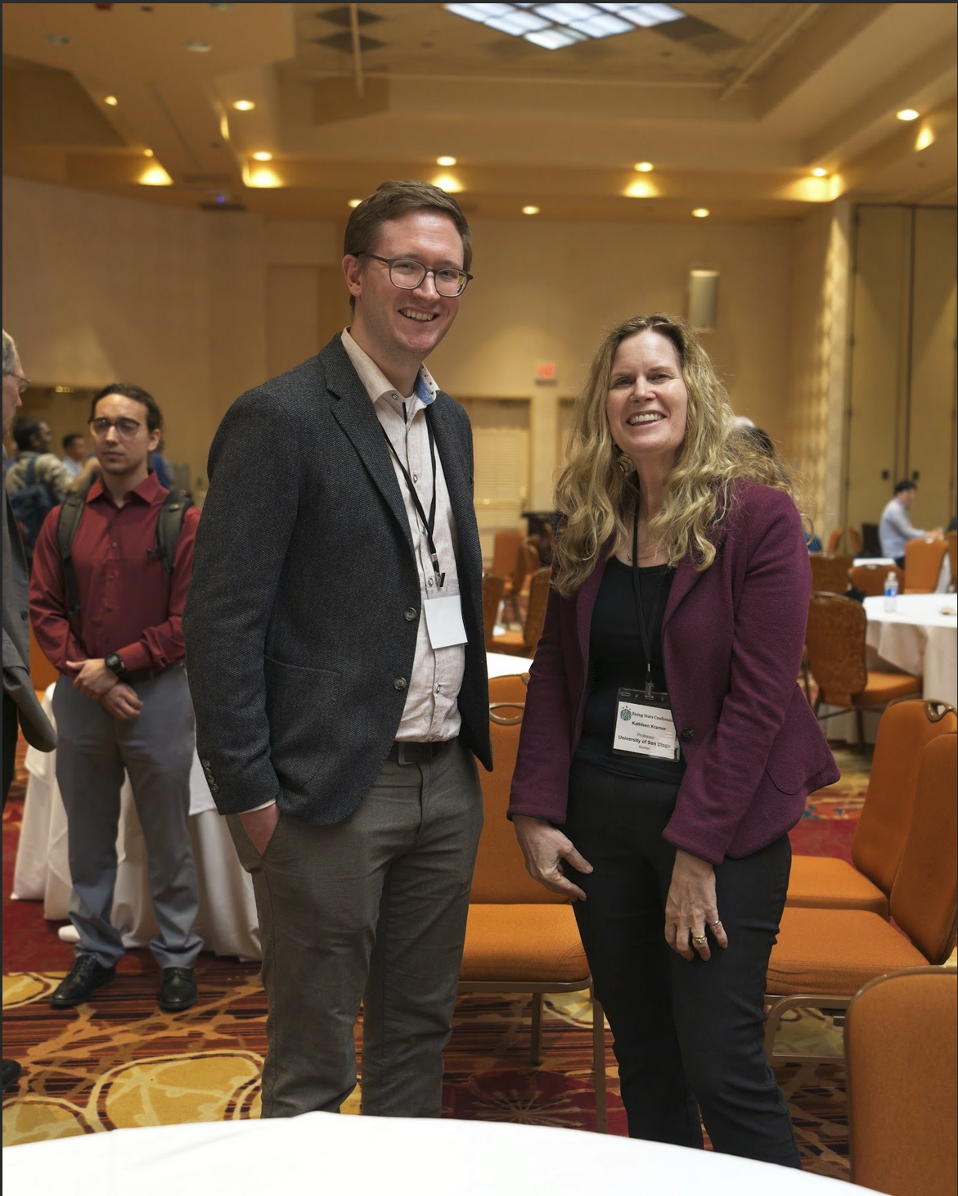
Year 2023
IEEE Rising Stars 2023:
January 3-5, Las Vegas, NV, USA.
YP event at IEEE Radarconf 2023 in San Antonio, TX, USA

Slide 3
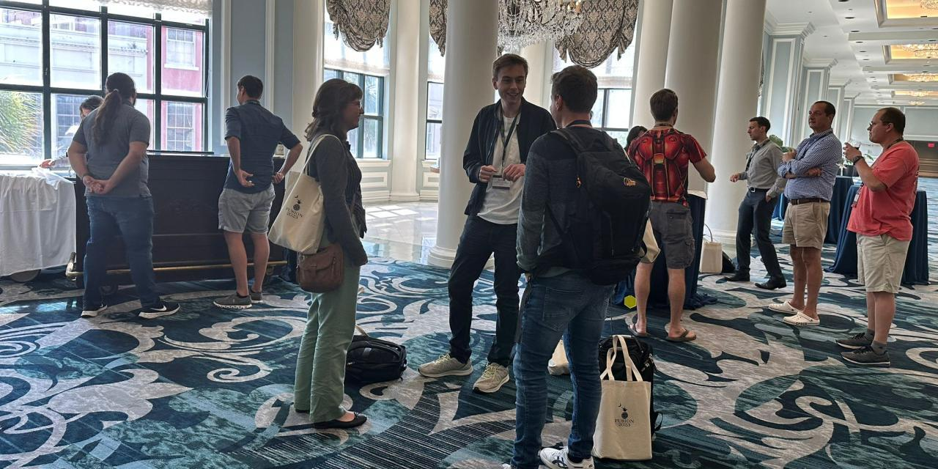
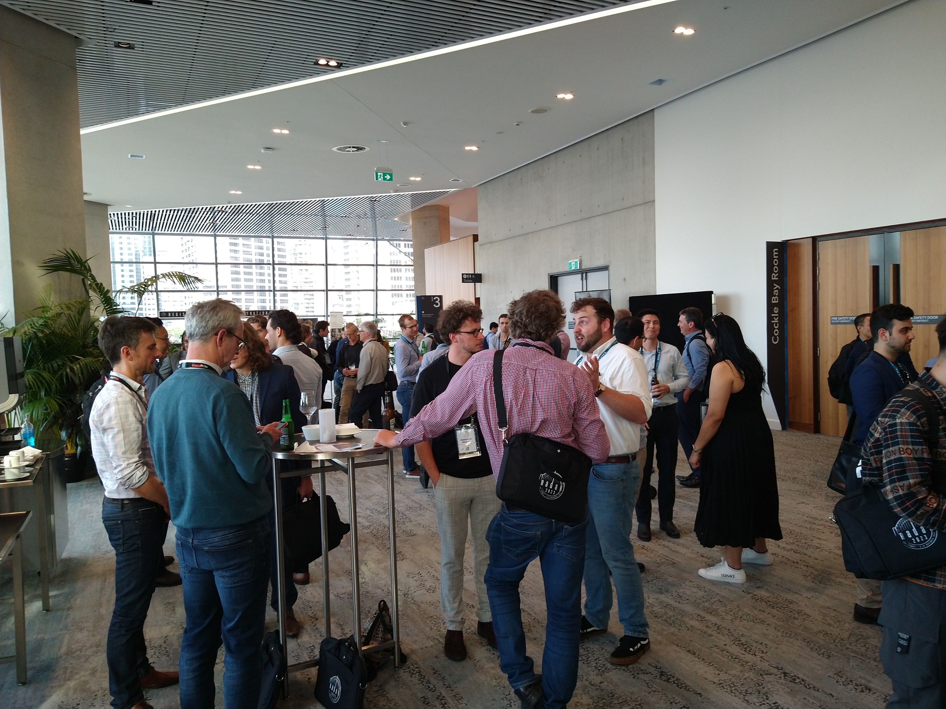
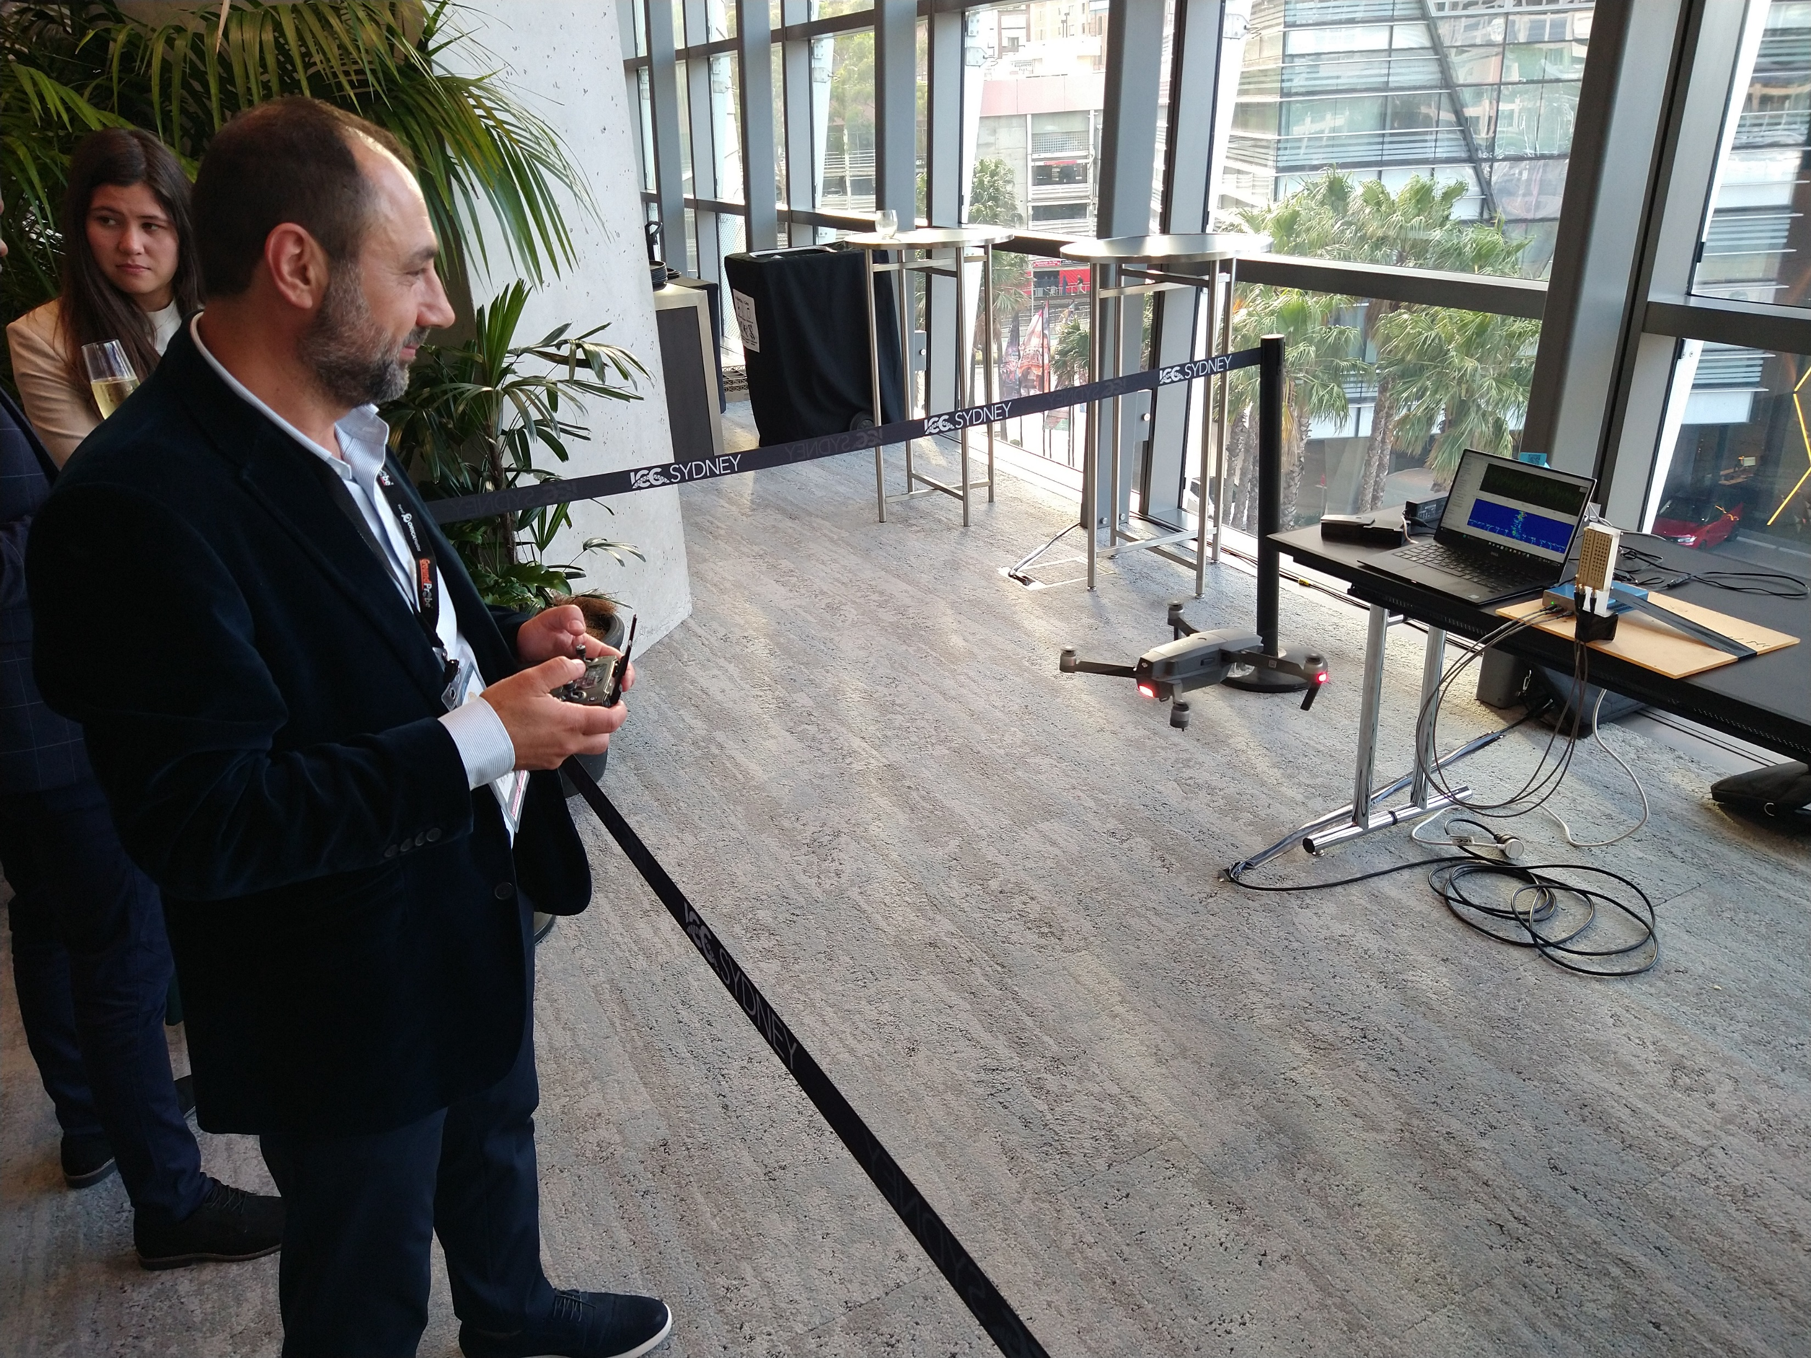
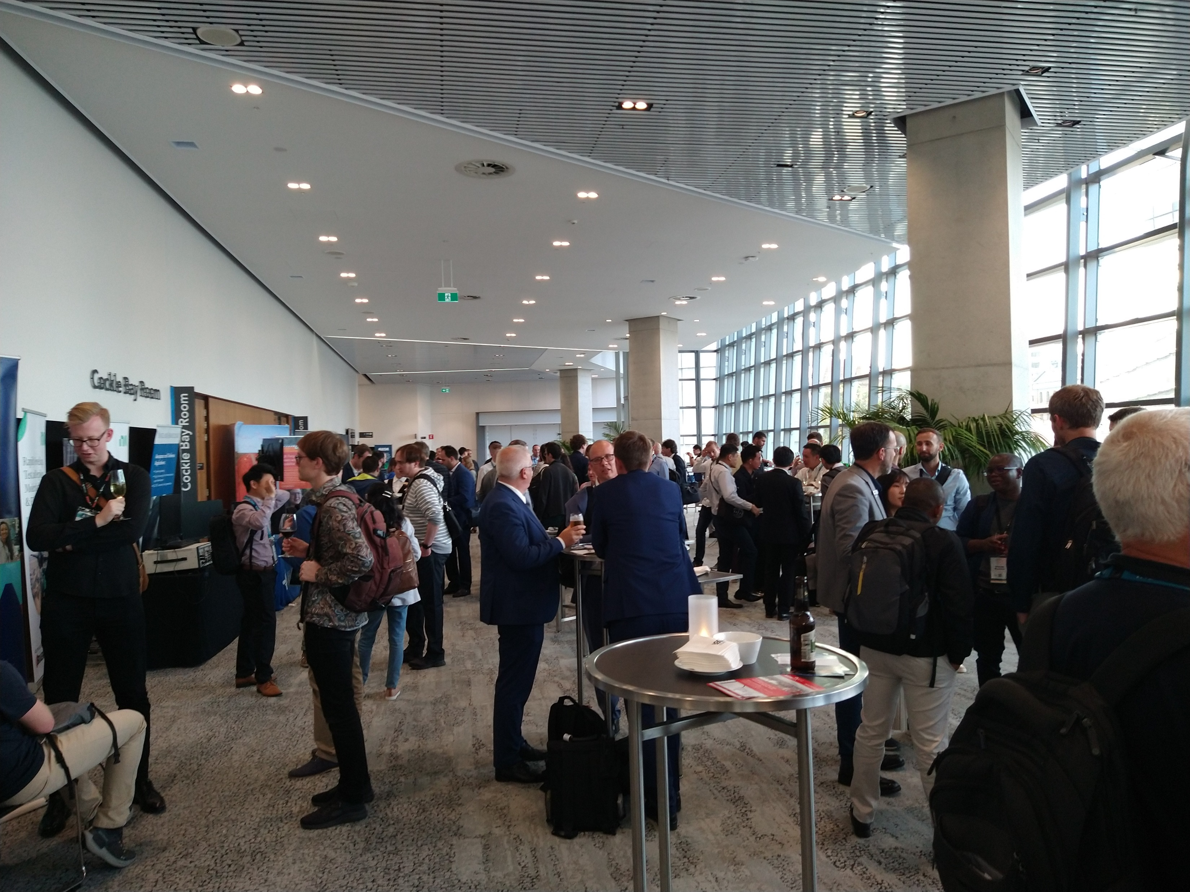
Year 2023
YP event at Fusion, Charleston, SC, USA
27 – 30 June 2023.
Little attendance –
Flight disruptions prior to the event / start of the conference?
Not enough advertisement?
YP event at Int. Radarconf, Sydney, Australia
06 – 10 November, 2023
Huge attendance!
Demo of drone detection .
Industry was involved.
Many thanks to Luke, Elias, and the organizing team!

Slide 4
Future Plans
Braham:
IEEE Middle East Student and Young Professionals Congress 2023
Tunisian Students & Young Professionals in Hammamet, Tunisia, 18-20 December 2023
IEEE YP Rising Stars 2024
YP events at IEEE Radarconf2024, Denver
Lessons learnt from YP events at IEEE Radarconf2023 / Fusion2023 and Int. Radarconf2023

