Slide 1
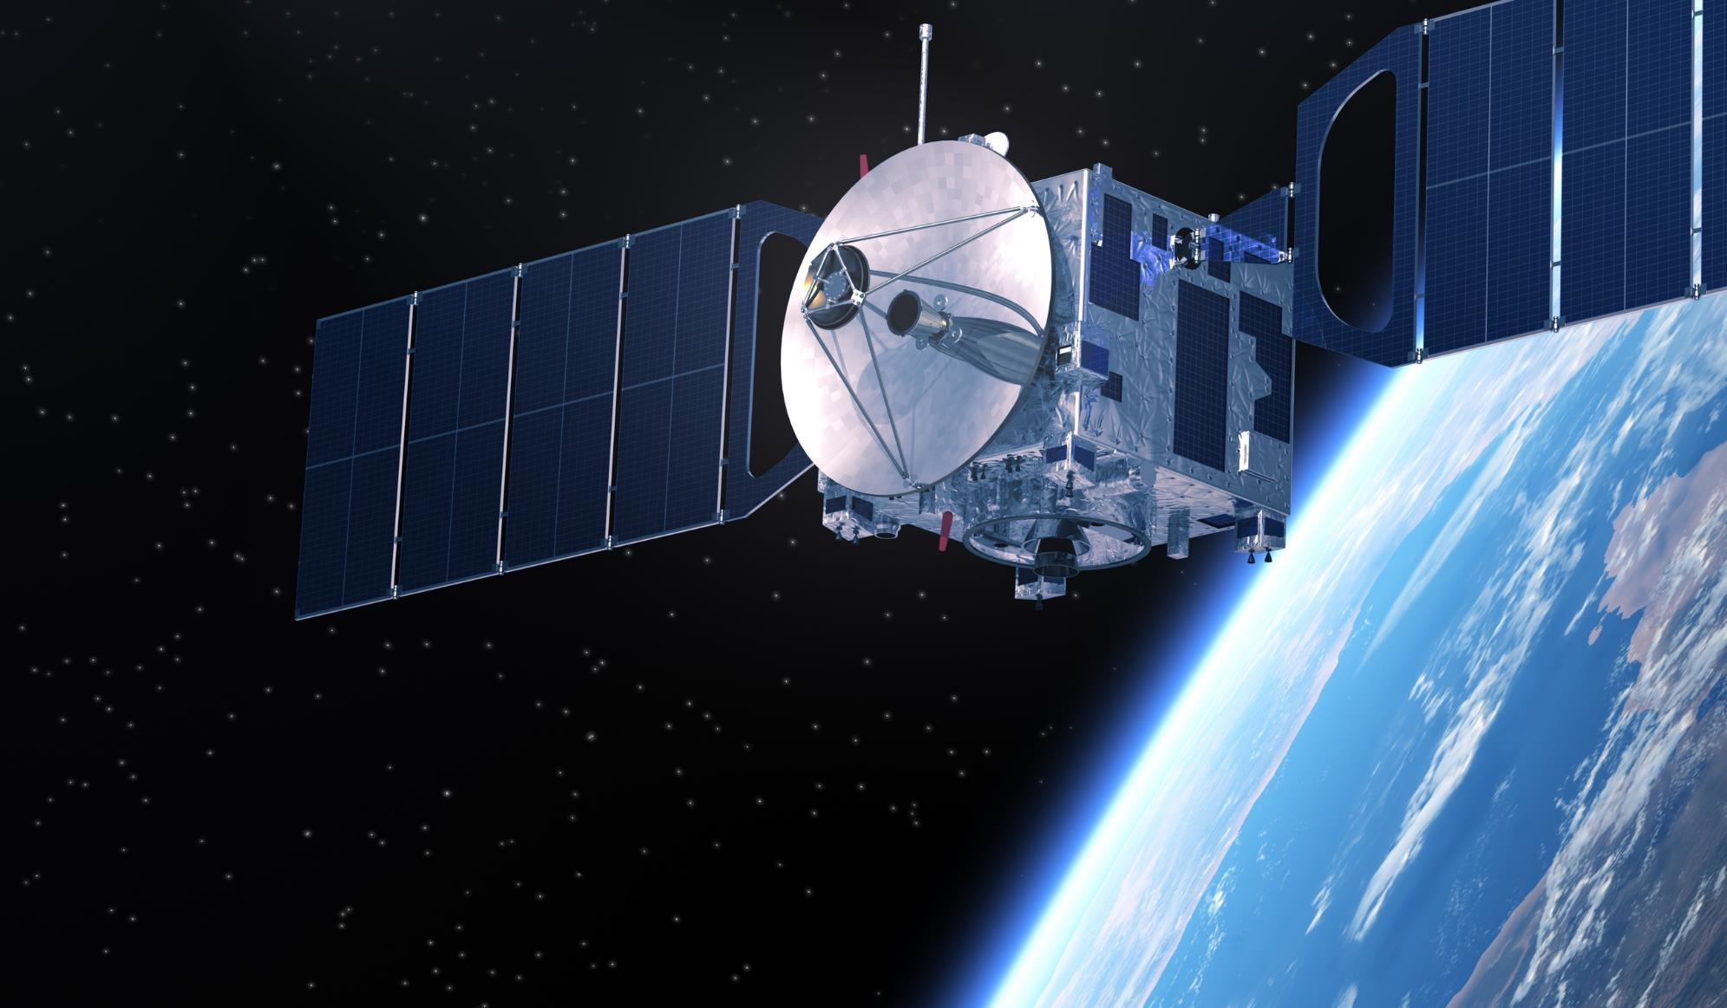
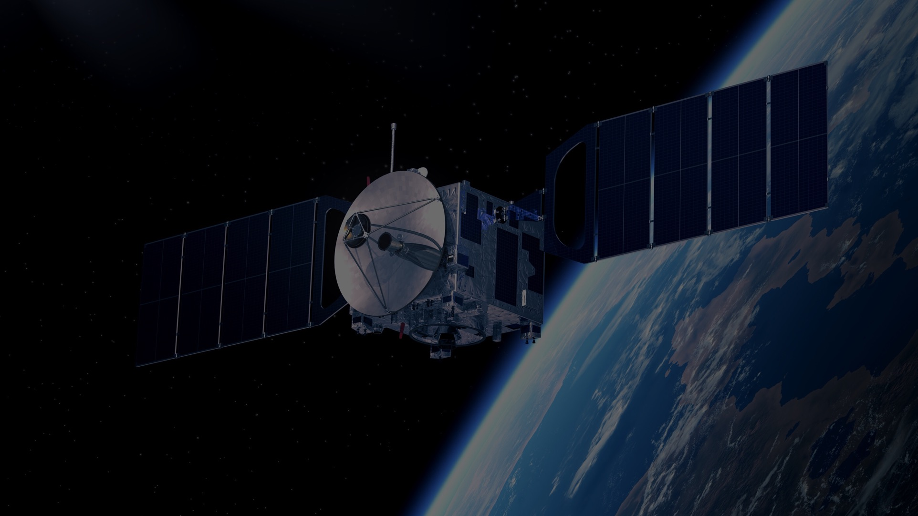

IEEE AEROSPACE AND ELECTRONIC SYSTEMS SOCIETY
ieee-aess.org

Slide 2




Field of Interest
The organization, systems engineering, design, development, integration, and operation of complex systems for space, air, ocean, or ground environments. These systems include but are not limited to navigation, avionics, mobile electric power and electronics, radar, sonar, telemetry, military, law-enforcement, automatic test, simulators, and command and control.

Slide 3









About AESS
Comprised of professionals who share your technical interests, joining AESS allows you to deepen ties to your technical community and take advantage of specialized opportunities. AESS has over 6,275 members and more than 140 chapters worldwide with programs like our Mentoring, Students, and Young Professionals to increase engagement and membership.
Conferences
Member Services
Publications
Education
Technical Panels
Awards
Notes:
Conferences: AESS financially and technically sponsors and co-sponsors over 30 conferences. Members are encouraged to submit papers, attend the conference, and network with your colleagues.
Publications: AESS sponsors and co-sponsors publications that provide differing levels of technology, invention and information to readers.
Technical Panels and Community: The creation of IEEE Standards, support of IEEE Conferences, and building a technical community are a primary responsibilities of the 6 AESS technical panels.
Member Services: AESS has over 5,000 members and more than 100 chapters worldwide with programs like our Mentoring, Students, and Young Professionals to increase engagement and membership.
Education: Provide technical content in-person and online to our members through the Distinguished Lecturers Program and Short Courses.
Awards: AESS has 17 awards recognizing our members for their contributions to publications, conferences, and technical achievements and two scholarships for undergraduate and graduate students.

Slide 4




Distinguished Lecturers Program
In-Person and Online Lecturers
100+
AESS Chapters and IEEE Sections are encouraged to take advantage of the AESS DL and Tutorial Program for their regular or special meetings, that allows them to select from an outstanding list of truly distinguished speakers who are experts in the technical fields of the society.
DL talk titles to choose from in a variety of technical fields
38
available DLs providing lectures online and in person at your next meeting, chapter event, and more
Education
Focused on providing technical content in-person and online to our members
Short Courses
While the desire is for short courses to be in-person and open to all members, they may be run virtually or exclusively to a specific company. To date, short courses have been run on four different continents, with a mixture of openly run in-person, virtual and exclusive offerings.
Online Library
130+ available recordings to watch on the IEEE Learning Network and growing!

Slide 5
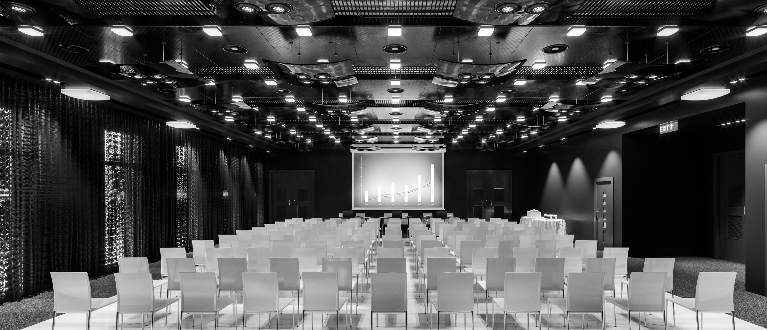


Conferences
As an AESS member, you receive a reduced registration rate, often the same amount as an IEEE Membership! A full listing of our conferences can be found on the AESS website.
AESS Financially and Technically Sponsors
AEROSPACE CONFERENCE
RADAR CONFERENCE
DIGITAL AVIONICS SYSTEMS CONFERENCE
AUTOTESTCON
Promotes interdisciplinary understanding of aerospace systems and applications for government and commercial .
Promotes radar engineering and hosts technical sessions, tutorials, and student challenges.
Brings together around 800 aerospace automatic test industry and gov/military attendees.
The preeminent R&D conference in the field of digital avionics offered.
Colorado, USA
Montana, USA
Maryland, USA
Barcelona, Spain
6-11 May 2024
2-9 March 2024
26-29 August 2024
29 Sept.-3 Oct. 2024

Slide 6





2024 Officers
President – M. Sabrina Greco
President Elect – Michael Braasch
Past President – Mark E. Davis
VP Conferences – Braham Himed
VP Publications – Luke Rosenberg
VP Education – Alexander Charlish
VP Finance – Peter Willett
VP Member Services – Lorenzo Lo Monte
VP Technical Operations – Rob Sabatini
VP Industry Relations – Stefano Coraluppi
Secretary – Walter D. Downing
Treasurer – Michael Noble
Contact Us
www.ieee-aess.org
admin@ieee-aess.org

Slide 7

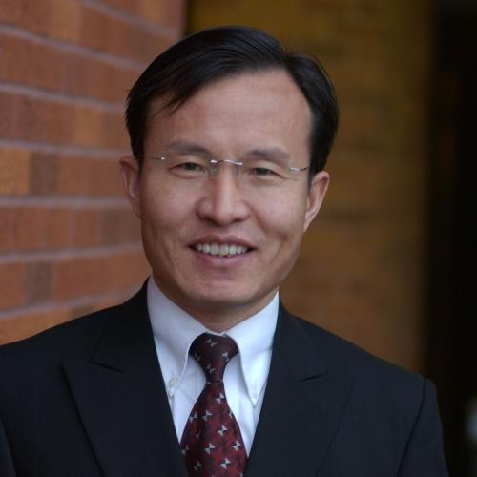


AESS Distinguished Lecturer
Ruhai Wang
Member The Texas State University System
Transport Protocols for Space Internet
July 9 , 2024
Watch on the IEEE Learning Network

Slide 8
Biography
Dr. Ruhai Wang
Professor in Phillip M. Drayer Department of Electrical and Computer Engineering at Lamar University, Texas.
Research interests include space networks, deep-space communications, computer networks, and cyber security
Published around 120 papers in international journals and conferences proceedings
Received the Ph.D. degree in electrical engineering from New Mexico State University in 2001
Senior Member, IEEE

Slide 9
Biography
Dr. Wang has been extensively involved with the IEEE AESS.
Currently an IEEE Distinguished Lecturer of AESS
Served an Associate Editor of the IEEE Aerospace & Electronics Systems Magazine (AES-M) for more than ten years
Served as an Associate Editor for the IEEE Transactions on Aerospace & Electronics Systems (TAES) from July 2018 to August 2020.
Dr. Wang also frequently served as a TPC chair/Co-Chair for international conferences/workshops
2007 IEEE International Conference on Communications
2008 International Workshop on Satellite and Space Communications (IWSSC 2008)

Slide 10
Transport Protocols for Space Internet
Abstract
A variety of protocols have been proposed or developed for reliable data transport in space Internet and similar network environments. This talk is intended to present a comprehensive and comparative summary of these protocols, focusing on the latest developments. The talk includes the following contents:
  (1) TCP/IP problems in space
  (2) Discussions and comments on the design and operation methods of the space Internet protocols
  (3) Comparisons and comments on their main techniques and performance
  (4) DTN for space Internet
  (5) Starlink of SpaceX and its protocols

Slide 11


Background
US government and the industry have considered extending the Internet into space environments using the Internet-type protocols such as Transmission Control Protocol/Internet Protocol (TCP/IP)
Space Internet or The Orbital Internet
No. 9 Best Inventions of 2008
7/7/2024
Space Internet

Slide 12
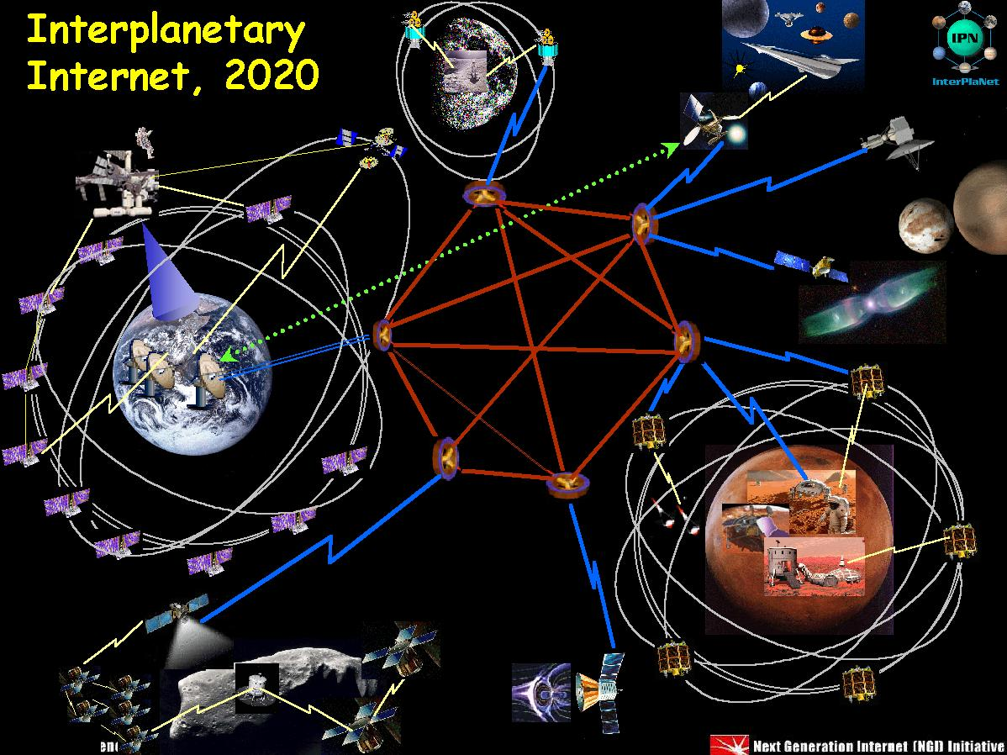
Background
NASA has been working towards space Internet to automate mission communications using networking protocols such as TCP/IP
  Near Earth (e.g., Starlink of SpaceX)
  Lunar
  Deep Space Network (Solar System Internet)
7/7/2024
Notes:
DTN for Deep-Space Communications
7/7/2024
12

Slide 13
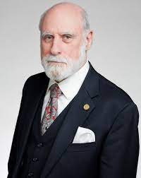
TCP Problems in Space
TCP/IP are the key technologies of the successful of the terrestrial Internet.
  Dr. Vint Cerf is recognized as the Father of the Internet because of his co-invention of TCP/IP protocols
Due to significant differences in communication environments, operation over space channels poses a number of problems to the Internet protocols in providing a reliable end-to-end data communication service.
7/7/2024

Slide 14
TCP Problems in Space
TCP’s major problems in space environment
  Long link-delays
  Frequent/lengthy link outage
  High channel/transmission errors
  Asymmetric channel-rates between spacecraft and ground
7/7/2024

Slide 15
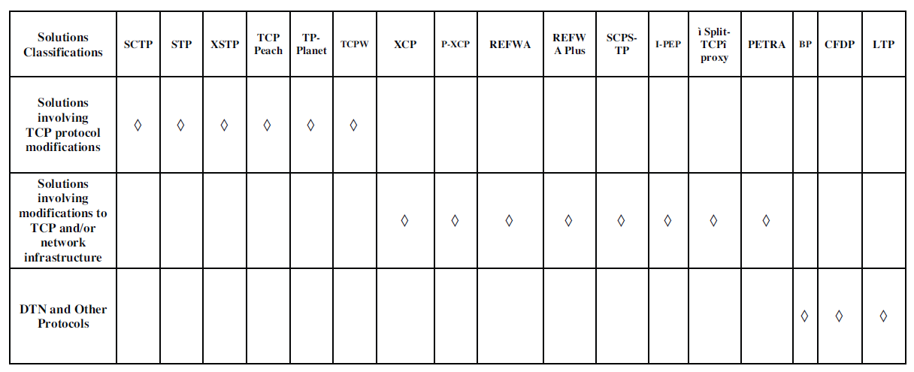
Data Transport Protocols for Space Internet
Source: R. Wang, T. Taleb, A. Jamalipour, and B. Sun, “Protocols for reliable data transport in space Internet,” IEEE Communications Surveys and Tutorials, vol. 11, No. 2, Second Quarter 2009, pp. 21-32. (Nominated for 2009 IEEE Communications Society Best Tutorial Paper)
7/7/2024

Slide 16
What Problems are Solved? (Part I)
7/7/2024

Slide 17
What Problems are Solved? (Part II)
7/7/2024

Slide 18
How Space-Internet Problems Solved? (Part I)
7/7/2024

Slide 19
How Space-Internet Problems Solved? (Part II)
7/7/2024

Slide 20
Performance of the Protocols (Part I)
7/7/2024

Slide 21
Performance of the Protocols (Part II)
7/7/2024

Slide 22
Concept of DTN
Delay Tolerant Networking (DTN) is a class of network techniques that use a store-and-forward mechanism to combat long link delays, frequent link disruptions, and asymmetric channel ratios.
Unlike TCP/IP, DTN employs a store-and-forward mechanism; DTN does not discard the data packets, even if the destination node is not found, but rather it stores them until a safe link to the next station is established
DTN uses Bundle Protocol (BP) as an application-layer protocol to construct the overlay network.
7/7/2024

Slide 23
TCP/IP vs DTN (Part I)
Source: J. Hu, R. Wang, etc., “Memory dynamics for DTN protocol in deep-space communications”, IEEE Aerospace and Electronic Systems Magazine, vol. 29, No. 2, February 2014, pp.22-30.

Slide 24
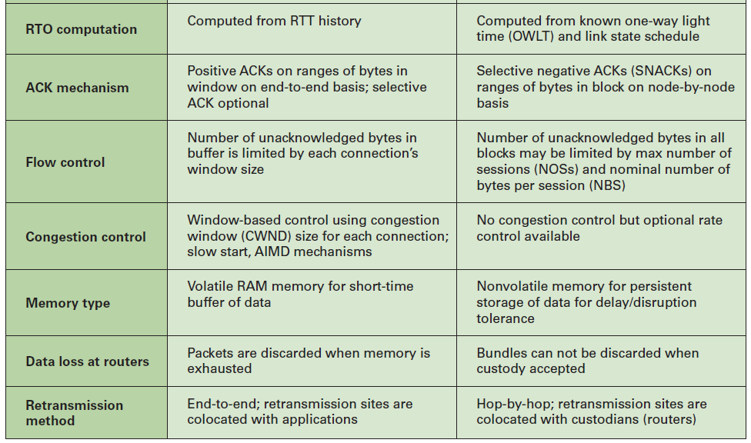
TCP/IP vs DTN (Part II)

Slide 25
DTN Protocol Stack
(for Heterogeneous Networks)
7/7/2024

Slide 26
DTN for Space
DTN offers a new solution in space communications involving long link delay and frequent link disruptions
DTN architecture has been proposed as the basis for the space Internet.
NASA considers DTN as the only candidate protocol suite that approaches the level of maturity required to handle the link break and delays inherent in space communications.
7/7/2024

Slide 27
Application of DTN in Flight Missions
Multiple implementations of DTN are now available, including the open-source Interplanetary Overlay Network (ION) code base developed and managed by NASA’s JPL and available for download at https://sourceforge.net/projects/ion-dtn/.
ION has been deployed in multiple space flight missions, including
  International Space Stations (ISS)-Earth networking system for reliable data delivery to Earth
  Deep space communications from Danuri, the Korea Pathfinder Lunar Orbiter (KPLO), which is now orbiting the moon.
7/7/2024

Slide 28
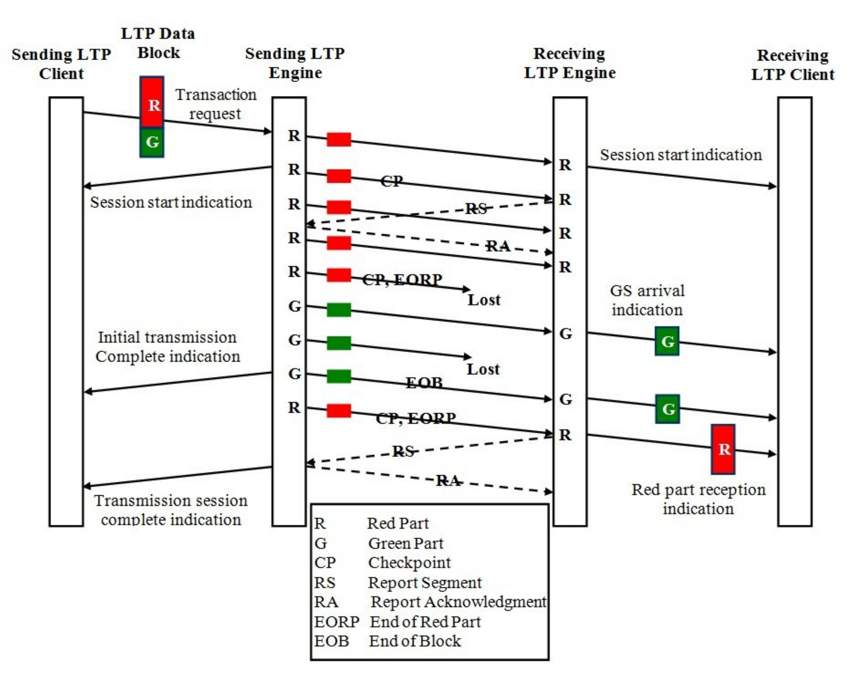
Operation of LTP
28
Source: CCSDS DTN for Space, 2010

Slide 29
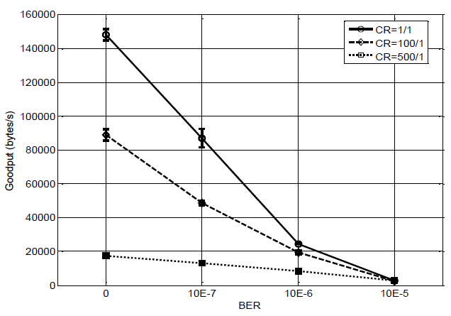
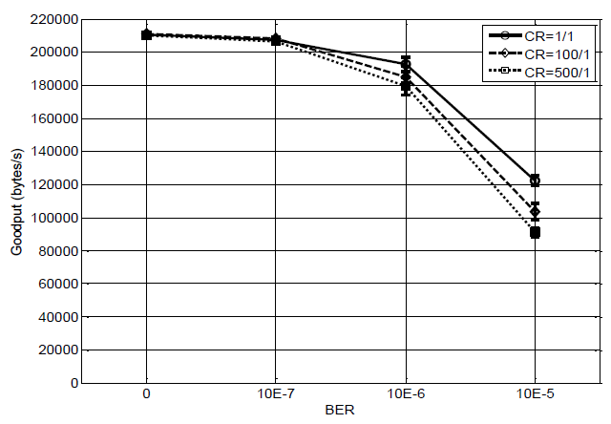
Performance of LTP vs TCP
TCP LTP
Goodput performance comparison between TCP and LTP in Cislunar Communications in presence of channel-rate highly asymmetry and high data loss

Slide 30

Starlink of SpaceX
Starlink is a satellite internet constellation system that aims to deliver global internet coverage.
The constellation will consist of thousands of mass-produced small satellites in low Earth orbit (LEO), working in combination with ground transceivers
7/7/2024

Slide 31
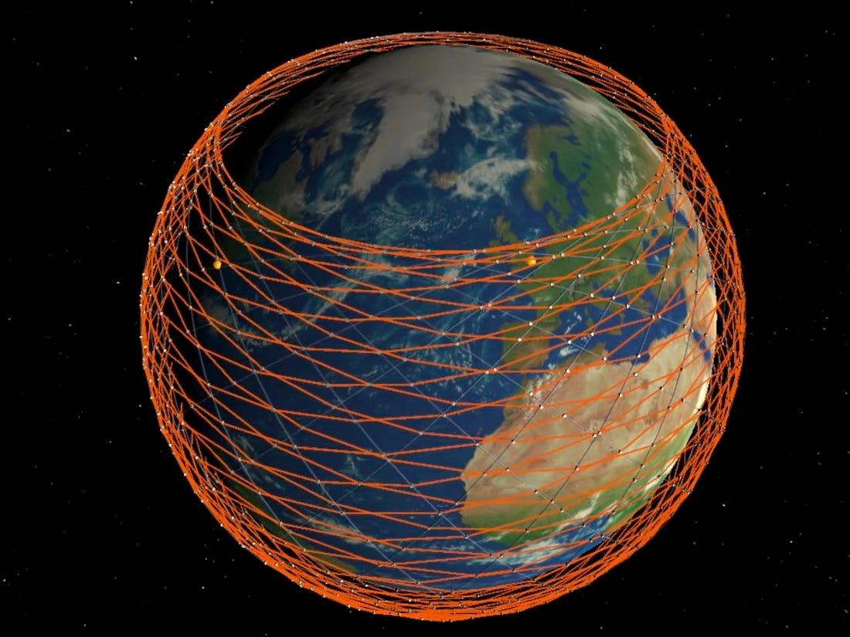
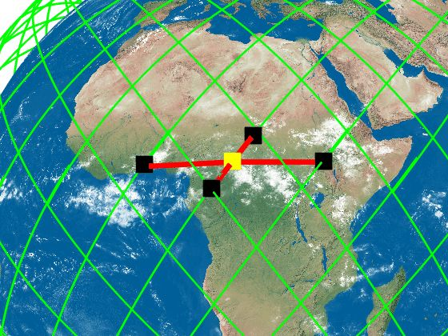
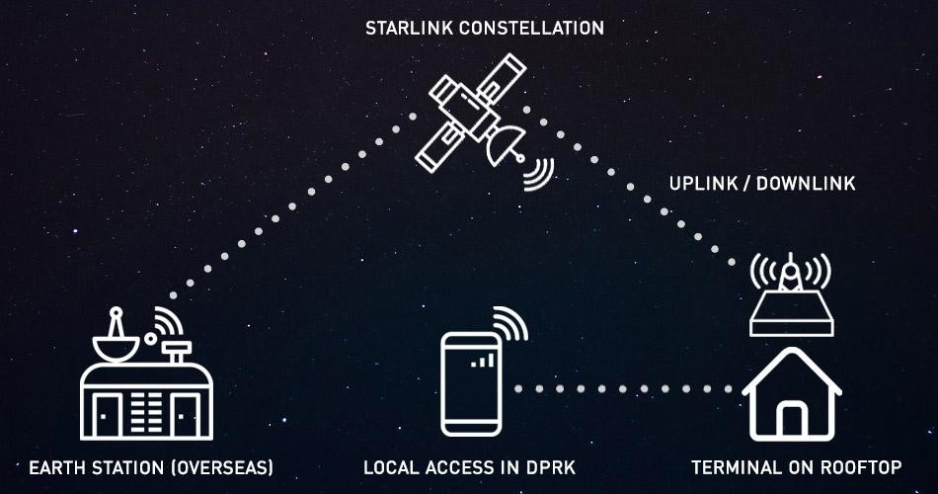
How Starlink Works?
Ground stations broadcast signals to satellites in orbits, which in turn relay the data back to the Starlink users on Earth.
7/7/2024

Slide 32
How Starlink Works?
The goal of Starlink is to build a constellation of almost 42,000 tablet-size satellites circling the globe in low orbit to meet this demand.
  The CubeSats -- miniature satellites commonly used in create a low latency network in space that facilitates edge computing on Earth
  LEO -- create tight network coverage, and their low Earth orbit produces low latency.
7/7/2024

Slide 33
How Starlink Works?
Starlink uses LEO satellites that circle the planet at only 300 miles above surface level. This shortened geostationary orbit improves internet speeds and reduces latency levels https://www.starlink.com/technology
Starlink looks like a giant Ethernet network. It’s a giant switch, and the switch fabric is below anything TCP sees.
7/7/2024

Slide 34
Transport Protocol of Starlink
Starlink uses its own protocol (simply, SpaceX Protocol or SPX) to communicate between its satellites and ground stations.
SPX is specifically designed to handle the unique challenges of satellite-to-satellite and satellite-to-ground communication, including high latency and data loss.
The exact details of how SPX works are proprietary to SpaceX and not publicly known, but it is believed to be based on existing TCP/IP or UDP/IP type of communication protocols used in satellite and wireless networks.
7/7/2024

Slide 35
Summary
Space Internet
TCP/IP Problems in Space
New Protocols for Data Transport in Space Internet
DTN and its Operation in Space
Starlink of SpaceX and Protocols
7/7/2024

Slide 36
Thank you! and
Questions? rwang@lamar.edu https://www.lamar.edu/engineering/electrical/faculty-and-staff/wang/index.html

