Slide 1
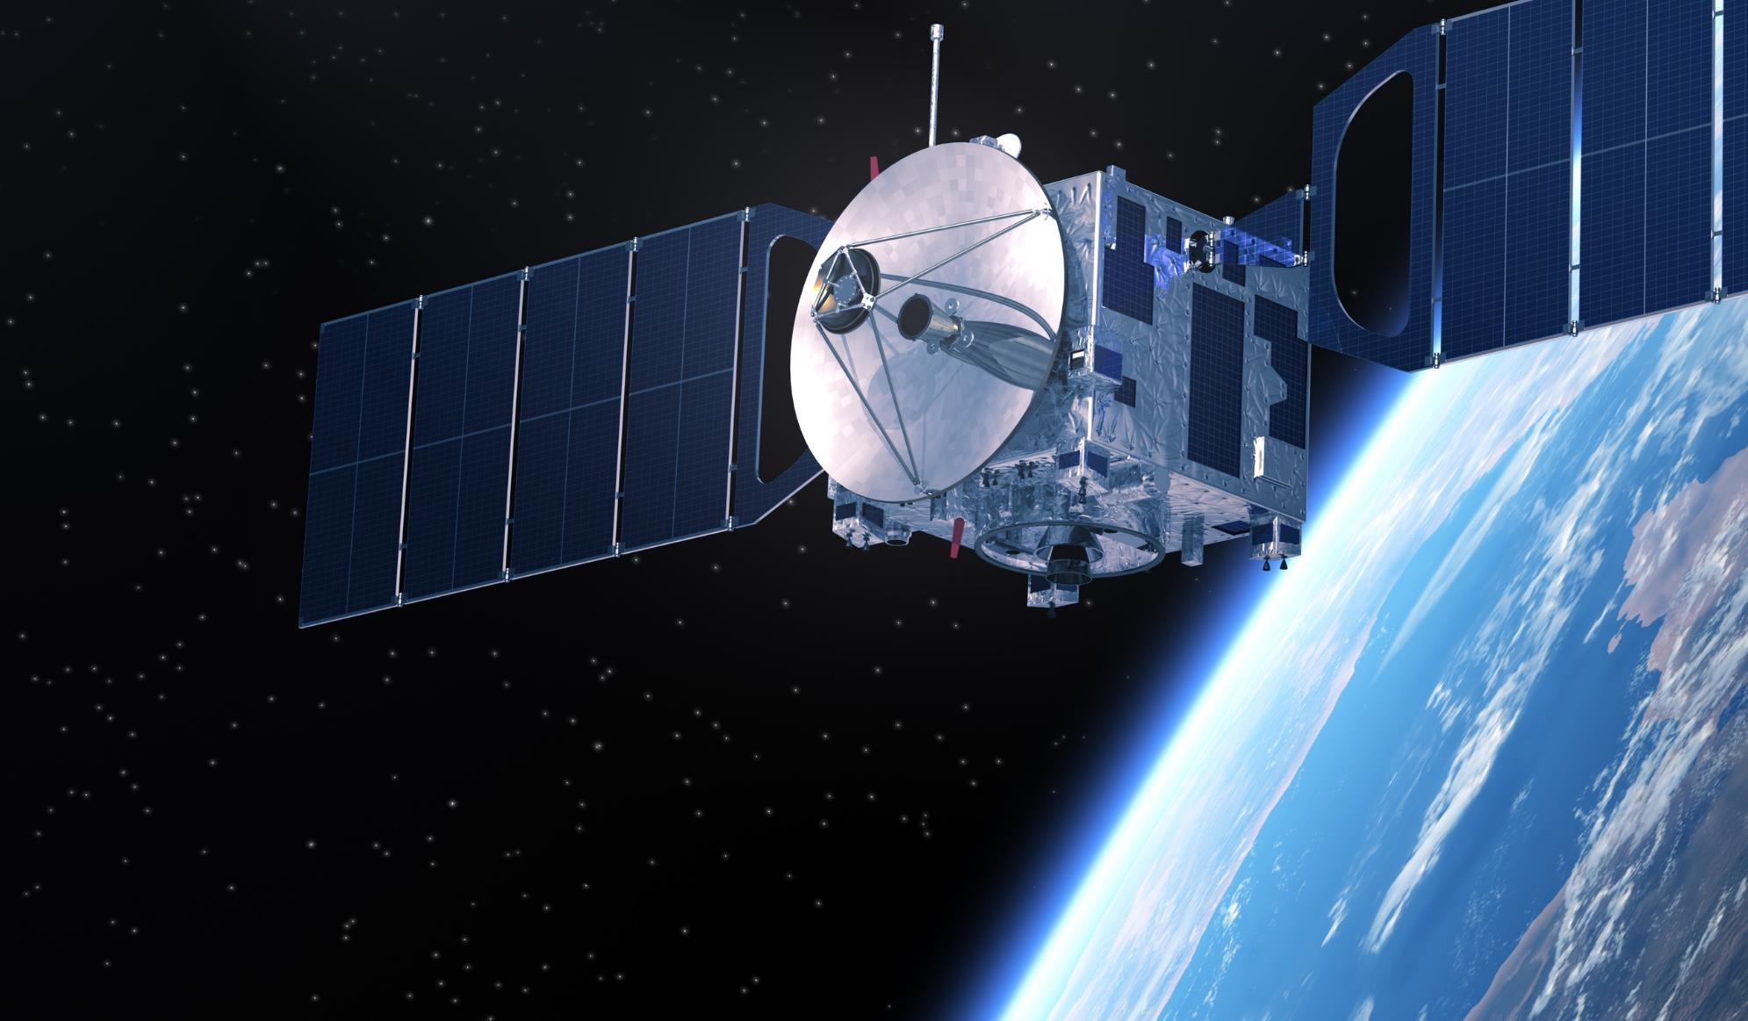
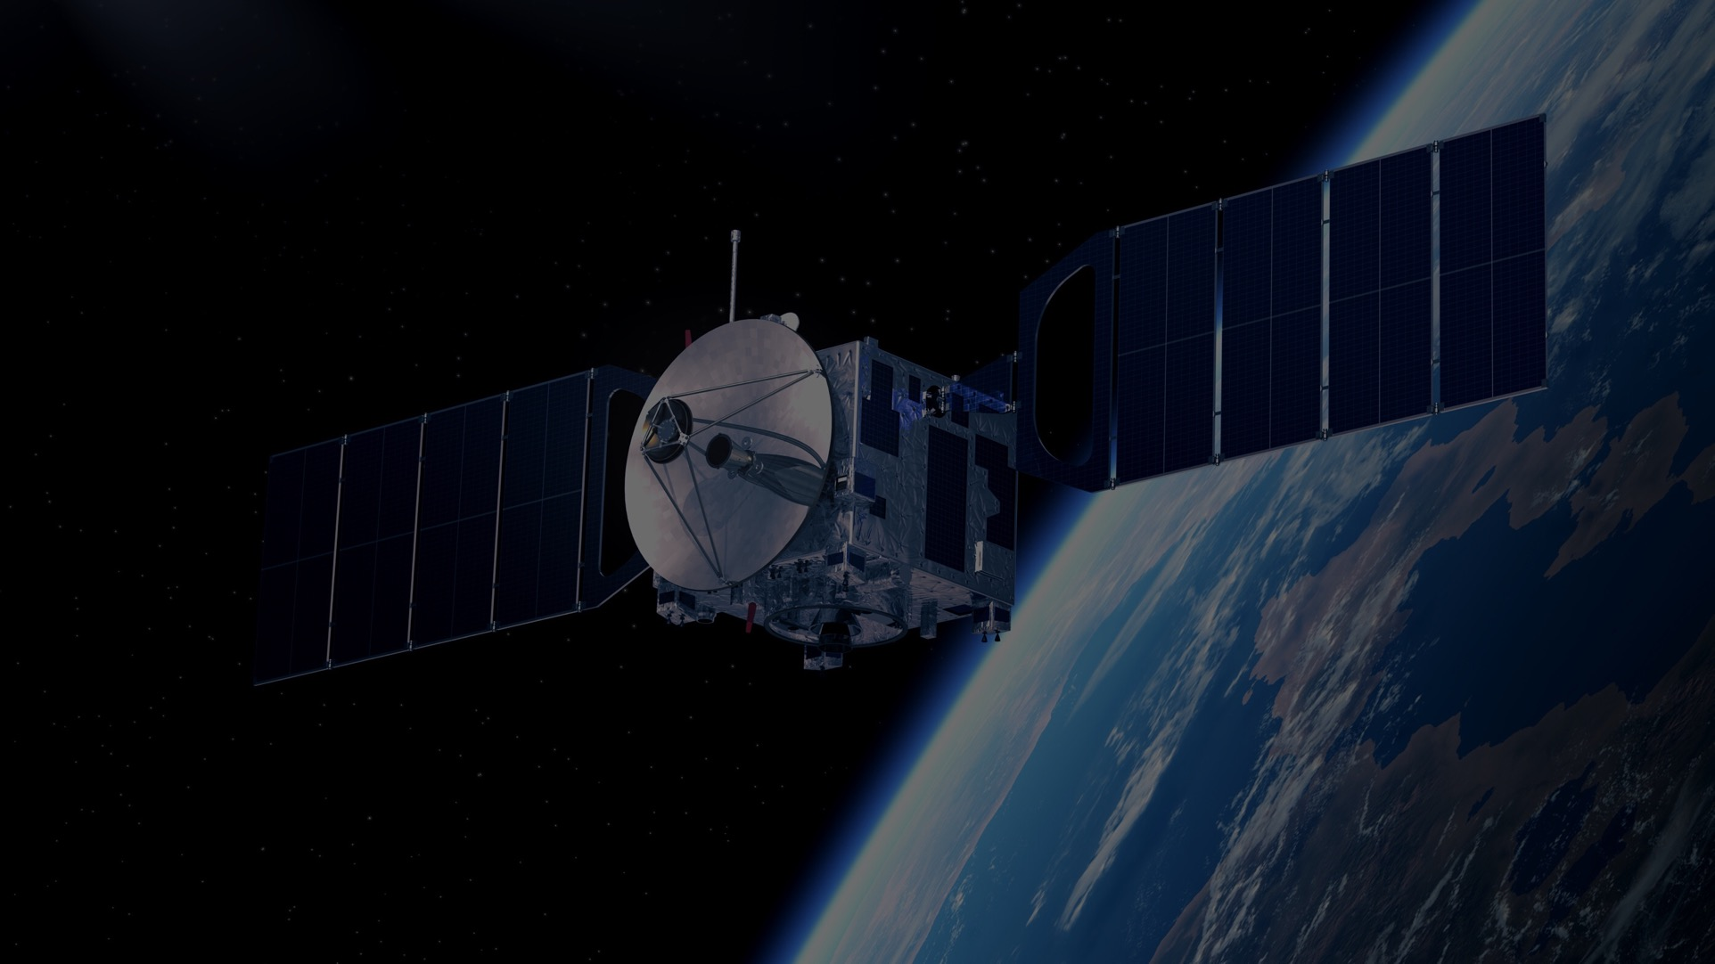

IEEE AEROSPACE AND ELECTRONIC SYSTEMS SOCIETY
ieee-aess.org

Slide 2




Field of Interest
The organization, systems engineering, design, development, integration, and operation of complex systems for space, air, ocean, or ground environments. These systems include but are not limited to navigation, avionics, mobile electric power and electronics, radar, sonar, telemetry, military, law-enforcement, automatic test, simulators, and command and control.

Slide 3









About AESS
Comprised of professionals who share your technical interests, joining AESS allows you to deepen ties to your technical community and take advantage of specialized opportunities. AESS has over 6,275 members and more than 170 chapters and student branch chapters worldwide with programs like our Mentoring, Students, and Young Professionals to increase engagement and membership.
Conferences
Member Services
Publications
Education
Technical Panels
Awards
Notes:
Conferences: AESS financially and technically sponsors and co-sponsors over 30 conferences. Members are encouraged to submit papers, attend the conference, and network with your colleagues.
Publications: AESS sponsors and co-sponsors publications that provide differing levels of technology, invention and information to readers.
Technical Panels and Community: The creation of IEEE Standards, support of IEEE Conferences, and building a technical community are a primary responsibilities of the 6 AESS technical panels.
Member Services: AESS has over 5,000 members and more than 100 chapters worldwide with programs like our Mentoring, Students, and Young Professionals to increase engagement and membership.
Education: Provide technical content in-person and online to our members through the Distinguished Lecturers Program and Short Courses.
Awards: AESS has 17 awards recognizing our members for their contributions to publications, conferences, and technical achievements and two scholarships for undergraduate and graduate students.

Slide 4

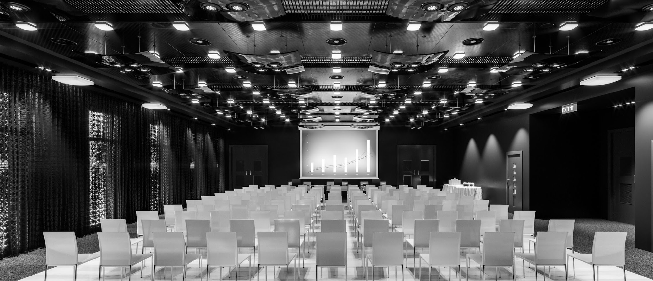






Conferences
AESS Financially and Technically Sponsors 30+ Conferences Annually
AESS Members receive discounts to sponsored conferences.
Visit the AESS website for a full listing of sponsored conferences.
Promotes radar engineering and hosts technical sessions, tutorials, and student challenges.
Promotes interdisciplinary understanding of aerospace systems and applications for gov/commercial.
Brings together around 800 aerospace automatic test industry and gov/military attendees.
The preeminent R&D conference in the field of digital avionics offered.
Krakow, Poland
Montana, USA
Maryland, USA
Montreal, Canada
4-10 October 2025
1-8 March 2025
15-18 Sept 2025
14-18 Sept. 2025

Slide 5




100+
Distinguished Lecturers Program
In-Person and Online Lecturers
DL talk titles to choose from in a variety of technical fields
AESS Chapters and IEEE Sections are encouraged to take advantage of the AESS Distinguished Lecturer and Tutorial Program for their regular or special meetings, that allows them to select from an outstanding list of truly distinguished speakers who are experts in the technical fields of the society.
40
available DLs providing lectures online and in person at your next meeting, chapter event, and more
Education
Focused on providing technical content in-person and online to our members
Short Courses
While the desire is for short courses to be in-person and open to all members, they may be run virtually or exclusively to a specific company. To date, short courses have been run on four different continents, with a mixture of openly run in-person, virtual and exclusive offerings.
Online Library
165+ available recordings to watch on the IEEE Learning Network and growing!

Slide 6




2025 Officers
President – M. Sabrina Greco
President Elect – Braham Himed
Past President – Mark E. Davis
VP Conferences – Lorenzo Lo Monte
VP Publications – Luke Rosenberg
VP Education – Puneet Kumar Mishra
VP Finance – Michael Noble
VP Member Services – Scott Goldstein
VP Technical Operations – Rob Sabatini
VP Industry Relations – Barry Tilton
Secretary – Walter D. Downing
Treasurer – Fulvio Gini
Contact Us
www.ieee-aess.org
admin@ieee-aess.org

Slide 7
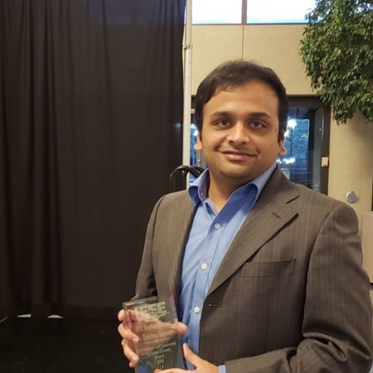
AESS Distinguished Lecturer
Sandeep Gogineni
Senior Scientist, ISL Inc.
High Fidelity RF Clutter Modeling and Simulation
S. Gogineni, J. R. Guerci, H. K. Nguyen, J. S. Bergin, D. R. Kirk, B. C. Watson, and M. Rangaswamy, “High fidelity RF clutter modeling and simulation,” IEEE Aerospace and Electronic Systems Magazine, Vol. 37, pp. 24-43, Nov 2022.

Slide 8
Biography
Dr. Sandeep Gogineni has over 18 years of experience working on radar and wireless communications systems. He worked for 6 years as an on-site contractor for Air Force Research Laboratory (AFRL), developing novel signal processing algorithms and performance analysis for passive radar systems. He received the 2018 IEEE Dayton Section Aerospace and Electronics Systems Society Award for these contributions to passive radar signal processing. Prior to his time at AFRL, during his graduate studies at Washington University in St. Louis, Dr. Gogineni developed optimal waveform design techniques for adaptive MIMO radar systems and demonstrated improved target detection and estimation performance. This work was recognized with the Best Student Paper Award at the 2012 International Waveform Diversity & Design Conference (WDD). At Information Systems Laboratories Inc., Dr. Gogineni has been working as a senior scientist on developing state-of-the-art high-fidelity RF modeling and simulation tools, channel estimation algorithms and optimal probing strategies for MIMO radar systems in the context of Cognitive Fully Adaptive Radar (CoFAR). He has also developed AI/ML based solutions for complex RF applications and implemented them on low C-SWaP neuromorphic hardware. Dr. Gogineni is currently serving as an IEEE AESS Distinguished Lecturer along with serving as an Associate Editor for IEEE Transactions on Aerospace and Electronic Systems. He is a recipient of the 2025 IEEE AESS Industrial Innovation Award. His expertise includes statistical signal processing, modeling and simulation, detection and estimation theory, machine learning, artificial intelligence, performance analysis, and optimization techniques with applications to active and passive radar systems.

Slide 9

Background
RF signals at the receiver are almost always corrupted by interfering signals (intentional and unintentional).
A major source of interference is reflections off ground clutter which are highly dependent on the terrain present in the illuminated scene.
Targets of interest can be obscured by these ground clutter reflections.
Therefore, the development of any new RF technique (including AI/ML) is heavily dependent on accurately modeling these ground clutter reflections.
Clutter returns can be modeled using two different techniques:
--Traditional Covariance based Statistical Modeling
-- Physics based Green’s Function Modeling

Slide 10
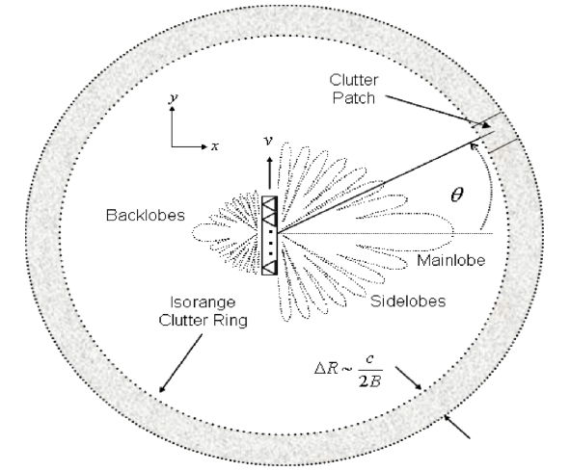
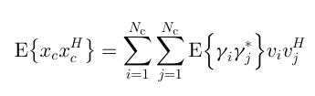

Covariance Based Modeling
Clutter response in a range bin of interest is expressed as a weighted combination of the space-time steering vectors corresponding to different clutter patches.
These weights (statistically modeled) denote the amplitudes of the clutter patches and are a function of the intrinsic clutter reflectivity and the transmit-receive antenna patterns.

Slide 11
Covariance Based Modeling
Disadvantages:
  Pure statistical modeling of the clutter returns is an approximation that does not capture the site-specific nature of clutter.
  The transmit DoFs have been collapsed into a complex scalar clutter reflectivity.

Slide 12
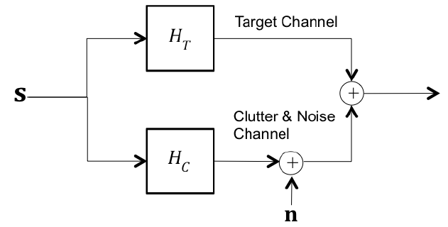
Stochastic Transfer Function Approach
This new approach to signal-dependent clutter modeling uses a “stochastic transfer function” to model each transmit-receive channel.
The transfer functions are computed from a fundamental physics scattering model using the Green’s functions.
Advantages:
The stochastic transfer function is transmit-signal independent even though the actual clutter returns are dependent on the transmit signal.
This approach facilitates an easy solution to the joint optimization of the transmit waveforms and receiver filters.

Slide 13
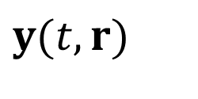
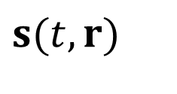
Stochastic Transfer Function Approach
Signal Dependent Components
Signal Independent Components
_{Target}
_{Channel}
$$y(t,r)$$
$$s(t,r)$$
Σ
Σ
Multidimensional
Spatio-Temporal
Transmit
Waveform
_{Clutter}
Rx noise

Slide 14
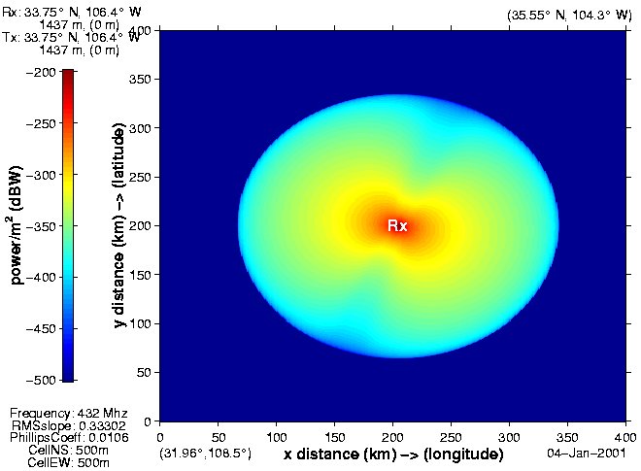
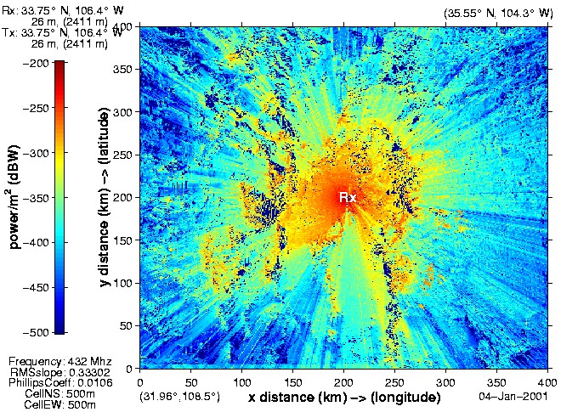
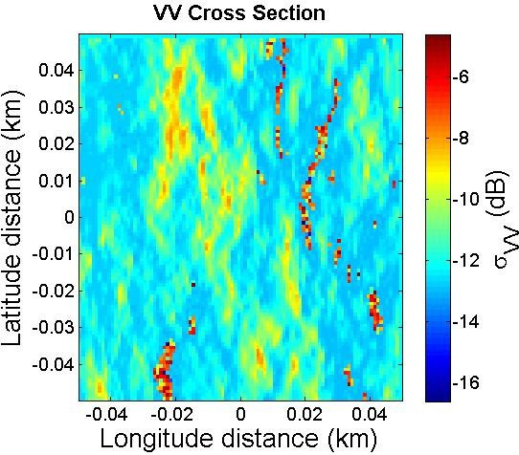
How Does One Generate the Transfer Functions?
Incorporate site-specific knowledge databases (terrain heights, land cover types, etc.) and solve Physics equations
All the examples presented in this article have been generated using high-fidelity RF modeling and simulation tool RFView
Traditional “Bald Earth”
Clutter Model
ISL’s Hi-Fi Real-World
Clutter Models
Ocean Scattering
Models
Eliminates need for approximate statistical representations!

Slide 15
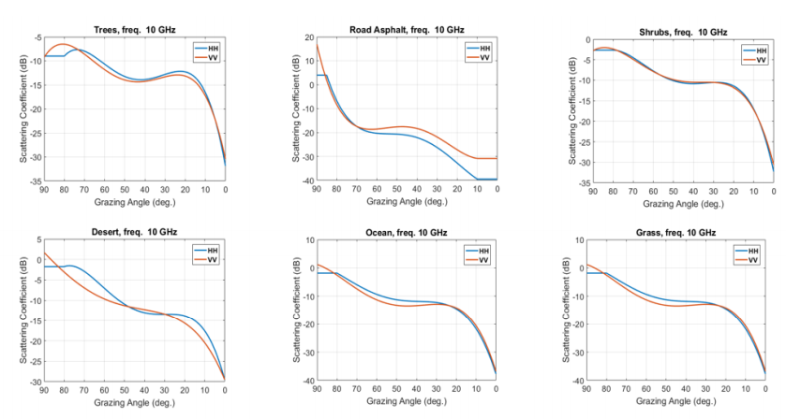
Landcover Types

Slide 16
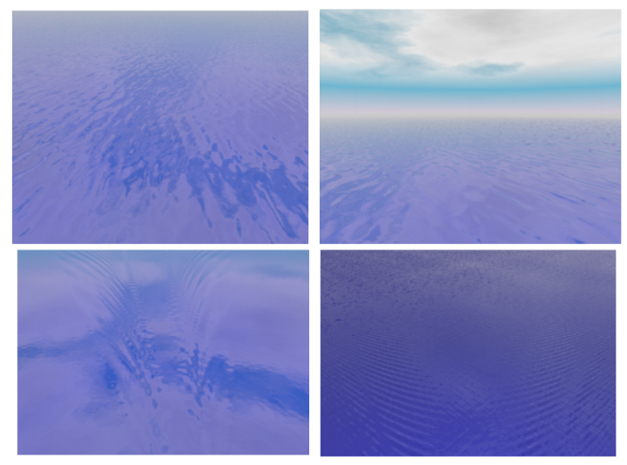
Ocean Surface Models

Slide 17
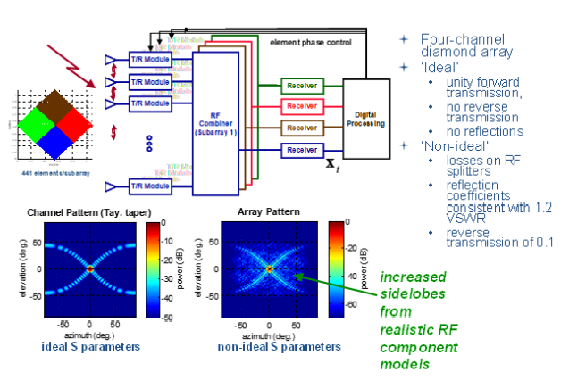
RF Component Modeling

Slide 18
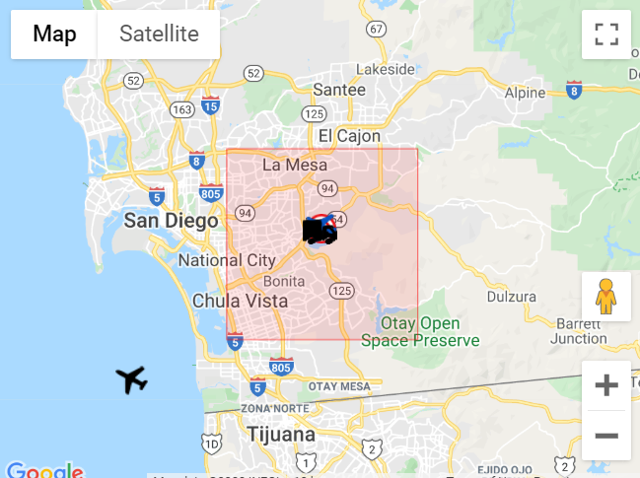
Examples: Scenario 1
Monostatic radar flying over the coast of Southern California

Slide 19
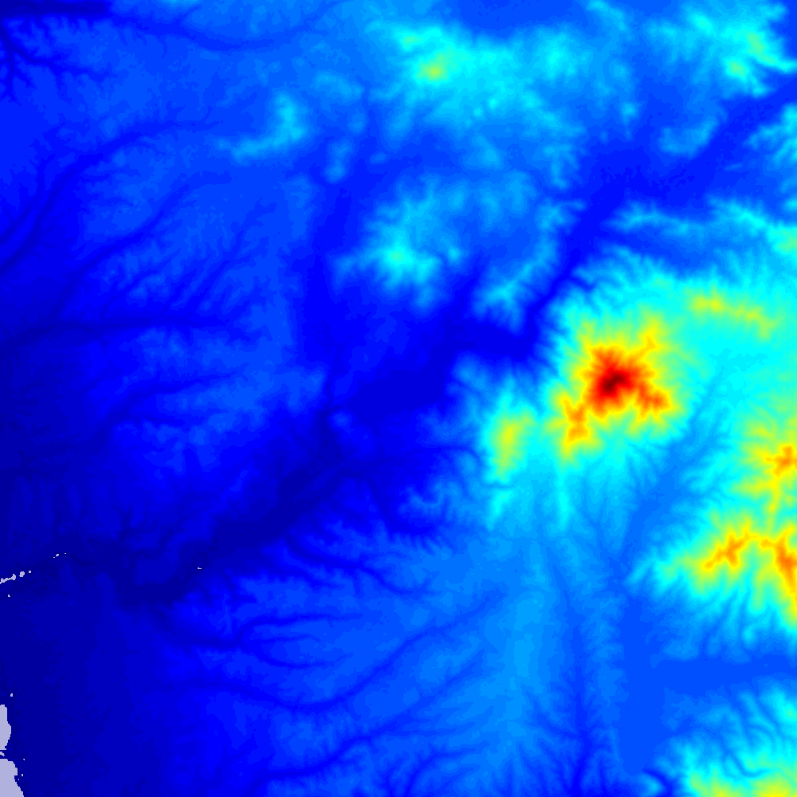

Scenario 1: Results
Terrain Map
LOS Map

Slide 20
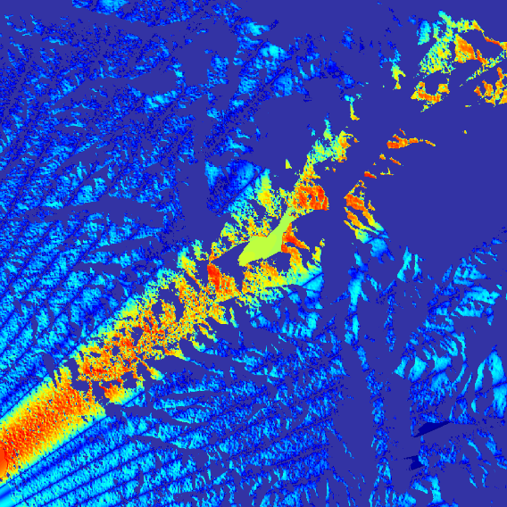
Scenario 1: Results
Clutter Map
with Beam Pattern

Slide 21
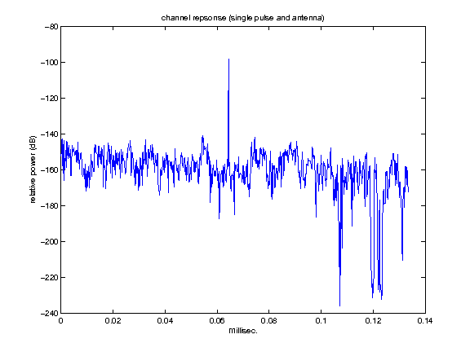
Scenario 1: Results
RFView computes both clutter
and target channels!!
Clutter + Target
channel impulse responses

Slide 22
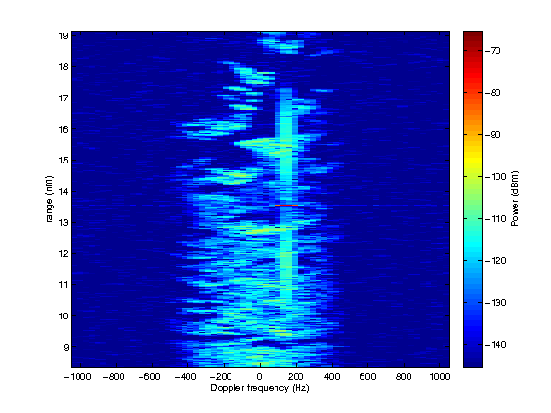
Scenario 1: Results
Range Doppler Plot
(Site Specific Results)

Slide 23
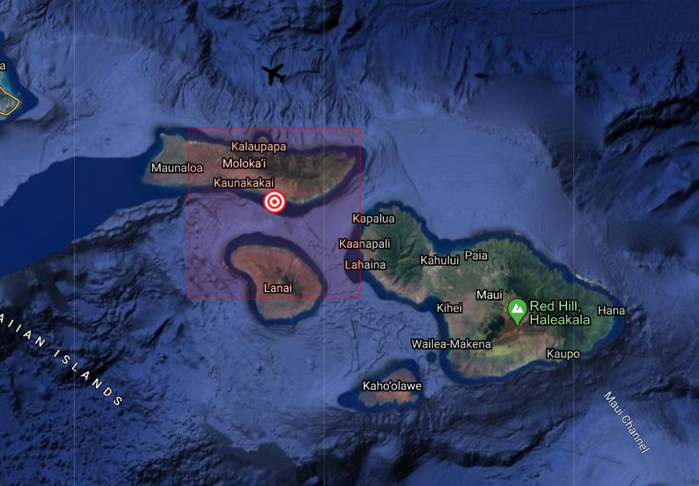
Examples: Scenario 2
Let’s fly further west all the way to Hawaii!!

Slide 24
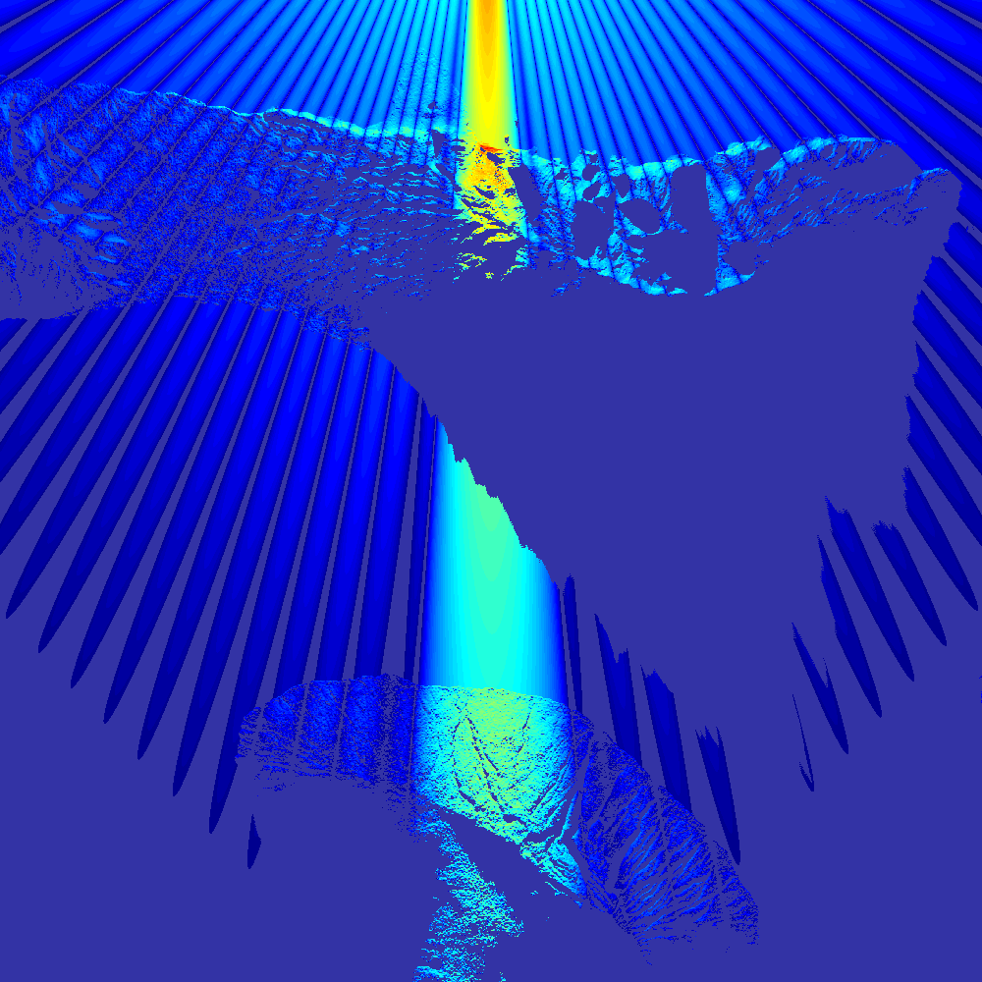
Scenario 2: Results
Clutter Map
with Beam Pattern
Huge peak on the first island hides part
of its coastline and the ocean from
the radar

Slide 25
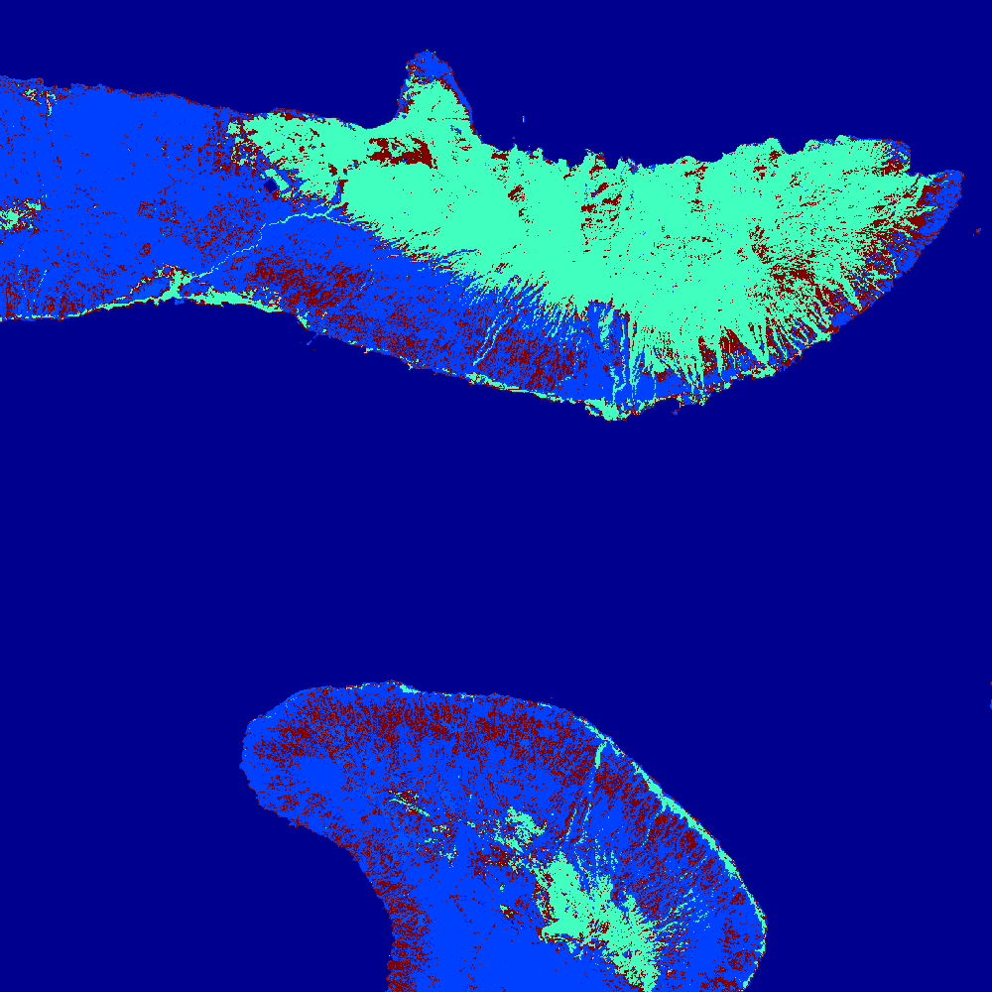
Scenario 2: Results
Cover map with the different terrain types

Slide 26
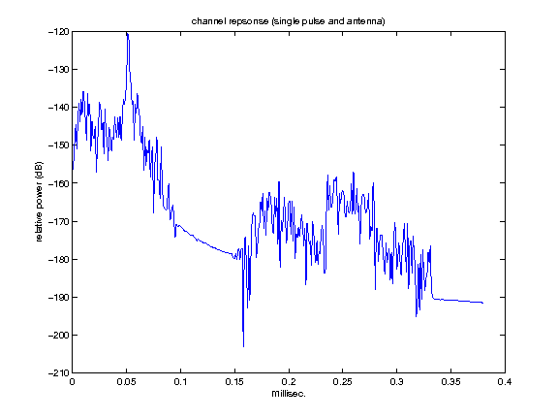
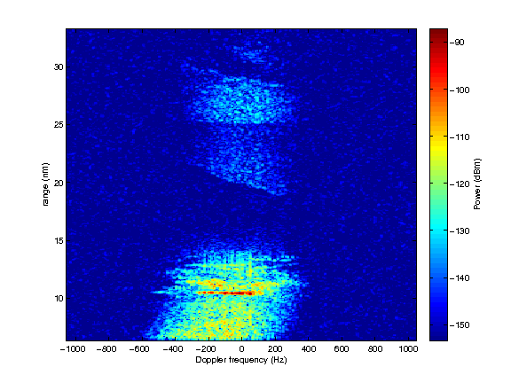
Scenario 2: Results
Channel Impulse Response
Range Doppler Plot

Slide 27
Validation with Measured Data
Traditional “Bald Earth”
Clutter Model
ISL’s Hi-Fi Real-World
Clutter Models
S. Gogineni, J. R. Guerci, H. K. Nguyen, J. S. Bergin, D. R. Kirk, B. C. Watson, and M. Rangaswamy, “High fidelity RF clutter modeling and simulation,” IEEE Aerospace and Electronic Systems Magazine, Vol. 37, pp. 24-43, Nov 2022.

Slide 28
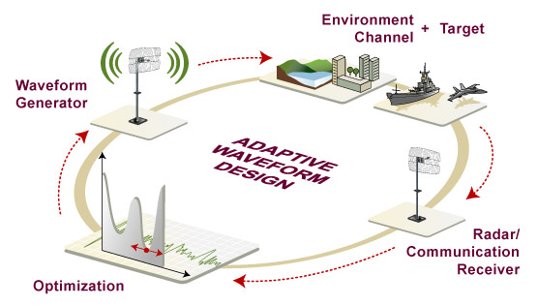
Cognitive Fully Adaptive Radar (CoFAR) Framework
SENSE – LEARN - ADAPT

Slide 29
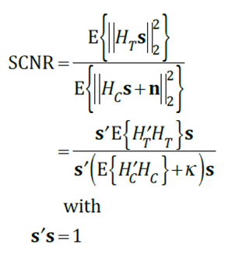


CoFAR Solution
The solution to the CoFAR optimization problem can be obtained by solving:
Optimization Reduces to Computing an Eigenvector!!

Slide 30
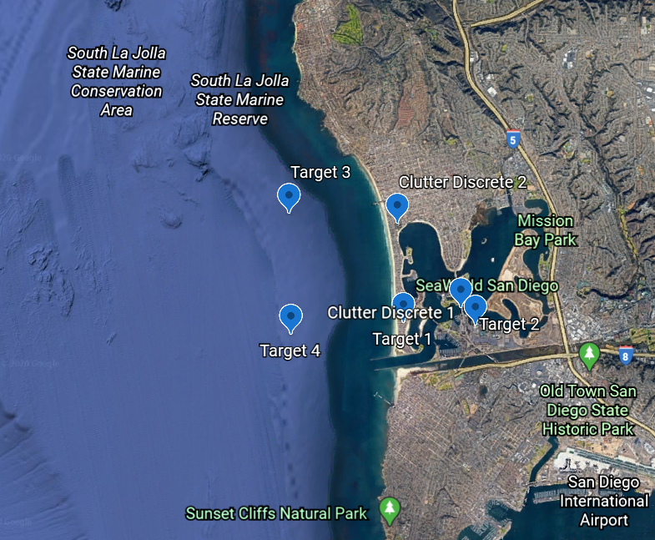
CoFAR Challenge Dataset
Scenario 1

Slide 31
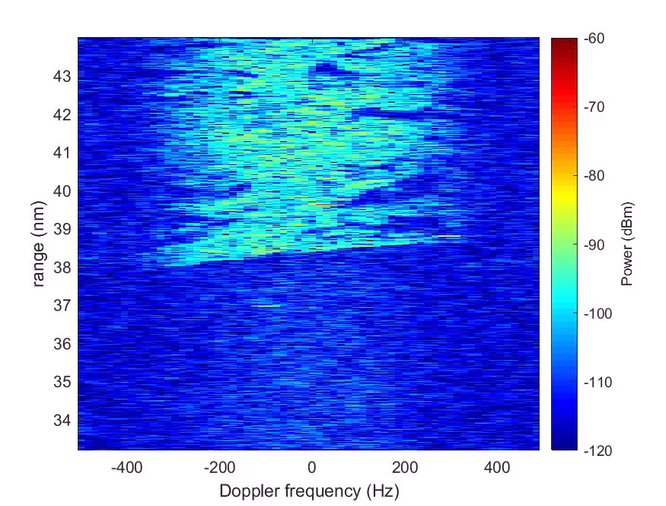
CoFAR Challenge Dataset
Scenario 1

Slide 32
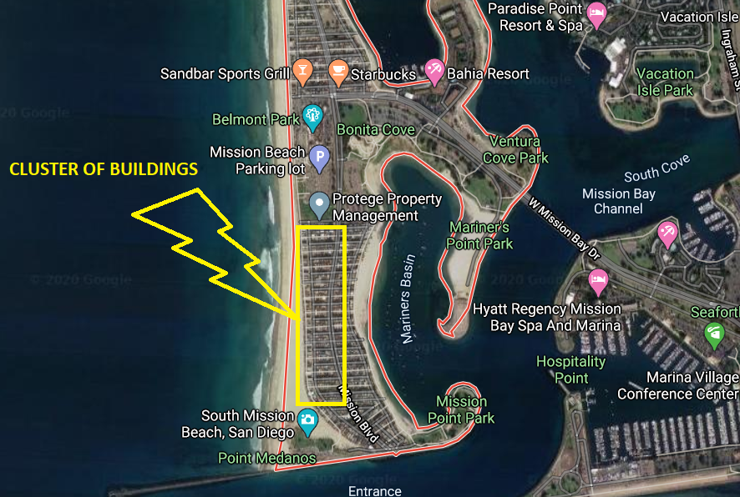
CoFAR Challenge Dataset
Scenario 2

Slide 33
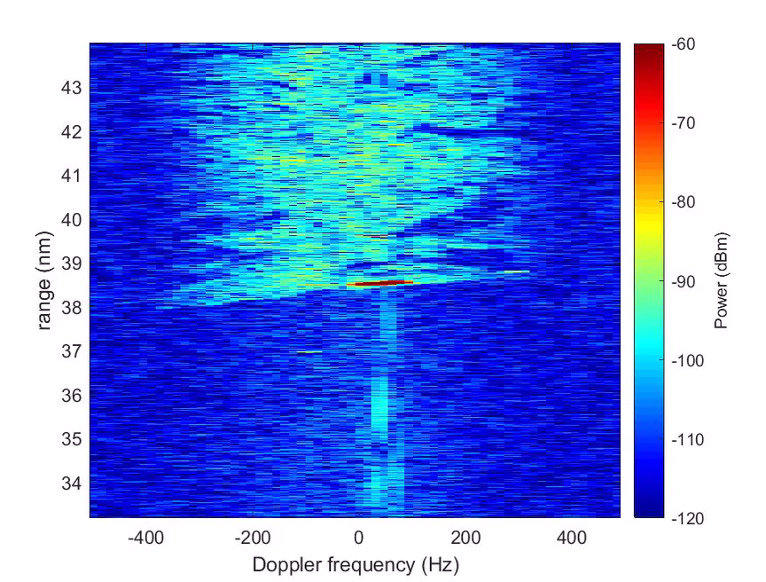
CoFAR Challenge Dataset
Scenario 2

Slide 34
Summary
Reviewed state-of-the-art approaches for high-fidelity site-specific physics-based RF clutter modeling and simulation.
Accurate models are essential to develop advanced signal processing algorithms as well as testing and evaluation.
Modern AI/ML techniques require large quantities of annotated training data which can be provided by high quality synthetic data generation capability.
Introduced cognitive radar challenge datasets
Airborne radar examples followed by a comparison of measured data with simulated data.

Slide 35
Thank You!!
Questions?

