Slide 1
Performance Prediction Modelling for Maritime Radar
Luke Rosenberg, FIEEE
Lockheed Martin Australia – Advanced Systems & Technology
Senior Research Engineer
Luke.Rosenberg@ieee.org

Slide 2
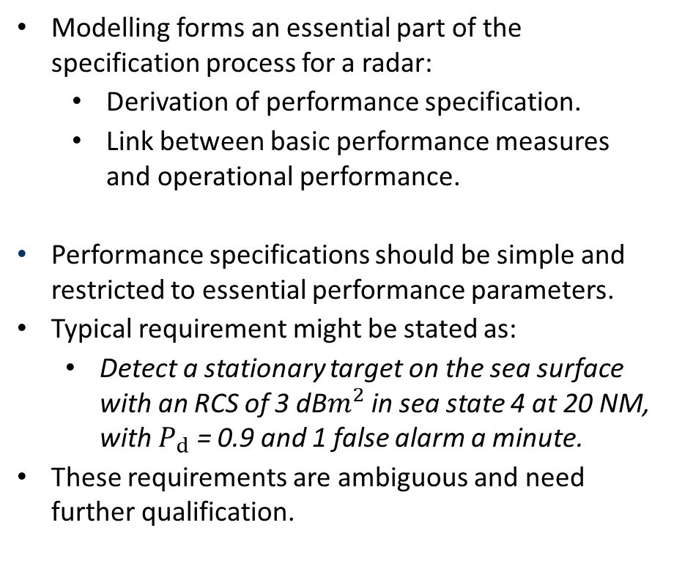
Performance prediction modelling
Modelling forms an essential part of the specification process for a radar:
  Derivation of performance specification.
  Link between basic performance measures and operational performance.
Performance specifications should be simple and restricted to essential performance parameters.
Typical requirement might be stated as:
  Detect a stationary target on the sea surface with an RCS of 3 dB$m^{2}$ in sea state 4 at 20 NM, with $P_{d}$ = 0.9 and 1 false alarm a minute.
These requirements are ambiguous and need further qualification.
Customer & Supplier
Customer
Supplier
Requirement definition
Modelling of potential performance
System and algorithm design
Performance assessment and acceptance trials
In-service tactics and training
In-service upgrades
Customer & Supplier
User
User, Customer & Supplier
Notes:
This diagram shows some of the key stages in the life-cycle of a radar. We will find that clutter models are used in various ways at each stage of such a life-cycle:
Requirements definition and specification
What the customer wants
Modelling of predicted performance
Possibly as part of a procurement competition
Design of radar waveforms and signal/data processing
Demonstration of performance and acceptance into service by a customer and/or user.
Training of personnel
In-service upgrades of equipment
New user requirements
Technology upgrades

Slide 3
Challenges with user requirements
False alarms
  Specification should acknowledge the possibility of spatial variations of alarm density, areas of low sensitivity etc.
  Low false alarm rates are very difficult to measure.
RCS (dBm²)
5
Minimum detectable radar cross section (RCS)
  What is the detection range for a 3 dBm² target?
  Intermediate-range detection limited by clutter.
  Long-range detection limited by noise.
  The simple measure of detection range has no real meaning.
4
3 dBm² target not detectable
3
2
1
0
5
10
15
20
25
Range (NM)
Notes:
This plot shows an example of the predicted minimum target radar cross-section (RCS) that can be detected with a detection probability (Pd) of 0.9, as a function of range in sea state 2. It can be seen that a 3 dB target RCS is detectable at short range and out to a maximum detection range of 21 km, but is not detected between about 2 NM and 8 NM. Thus the simple measure of detection range has no real meaning.
The availability of good models of clutter is essential to be able to understand the likely radar performance and to build a framework within which to specify and quantify performance (false alarms characteristics, detection ranges etc.).

Slide 4
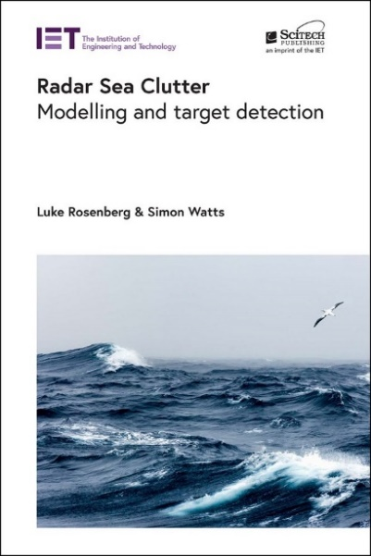
Seminar outline
Performance modelling and clutter statistics
Non-coherent performance prediction modelling
  Case study: Impact of model mismatch
  Case study: Detection performance for a fast-scanning radar
Coherent performance prediction
  Case study: Coherent or non-coherent detection?
Collaborator: Simon Watts
University College London, UK

Slide 5
Performance modelling
Assessing detection performance in clutter is initially determined using the radar range equation. Performance depends on:
Clutter characteristics (as a function of sea conditions, viewing geometry and radar parameters)
  Normalised radar cross-section, σ⁰
  Propagation conditions
  Amplitude statistics
  Doppler spectrum
  Spatial correlation
Processing mode:
  Non-coherent
    Can exploit pulse-to-pulse frequency agility which decorrelates the speckle and target.
    Integration of non-coherent pulses and scans
    Radar scans faster – better for pop-up targets like periscopes
  Coherent detection
    Can exploit Doppler and use pulse-to-pulse integration
    Radar needs to slow down to get more pulses on target
    Allows adaptive processing to suppress clutter
Notes:
Reliable prediction of radar performance over the sea depends upon accurate models of both the radar processing and of the sea clutter. At early stages of a radar design, the basic radar parameters (waveform design, antenna gain, transmitter power, receiver noise figure, signal and data processing algorithms) are defined. As the radar design develops and is refined, the radar performance needs to be continuously assessed in the context of this initial modelling.

Slide 6
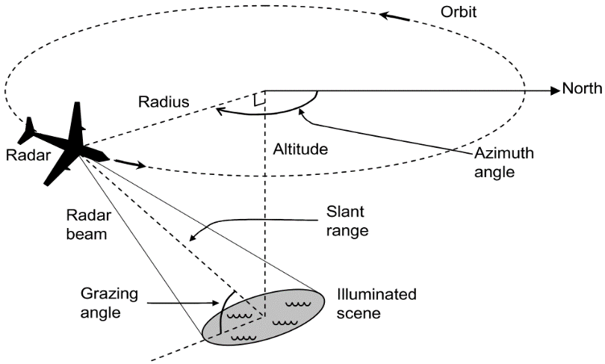
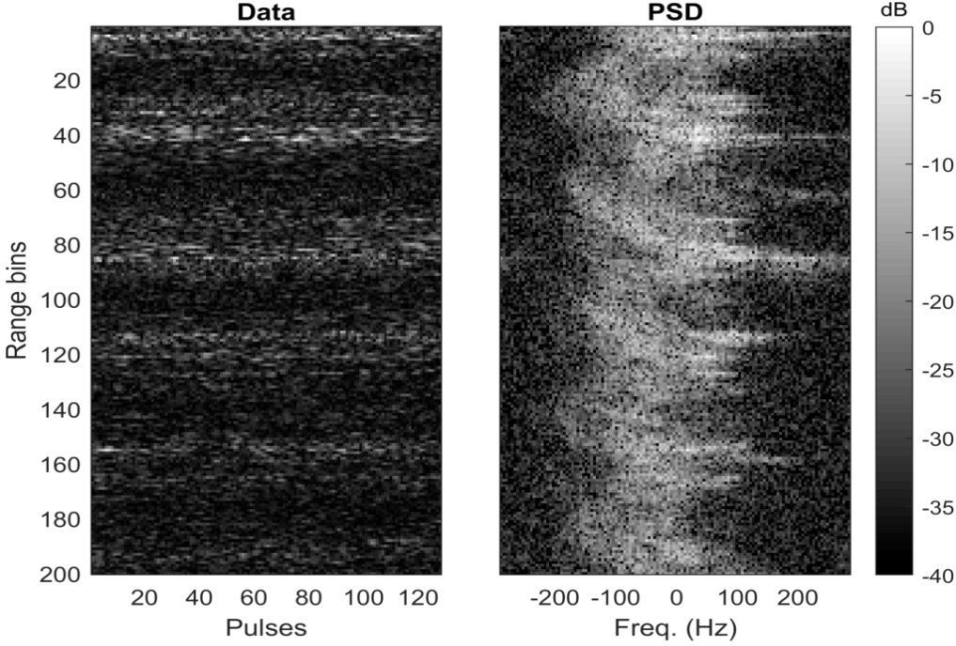
Sea clutter example
Example data – from the Ingara X-band sea clutter data set
  Size – 58,743 pulses x 1,006 fast-time samples.
  Wave structure changes with azimuth angle, upwind at 0°.
  Observation time: 208 s.
  Range time intensity
  Doppler spectrum

Slide 7
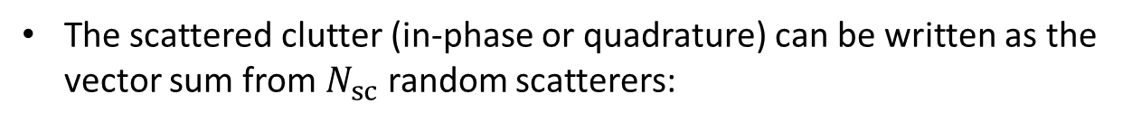

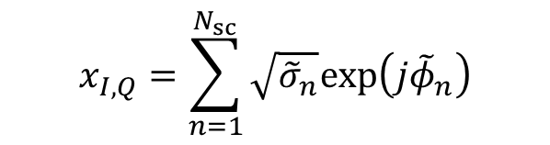
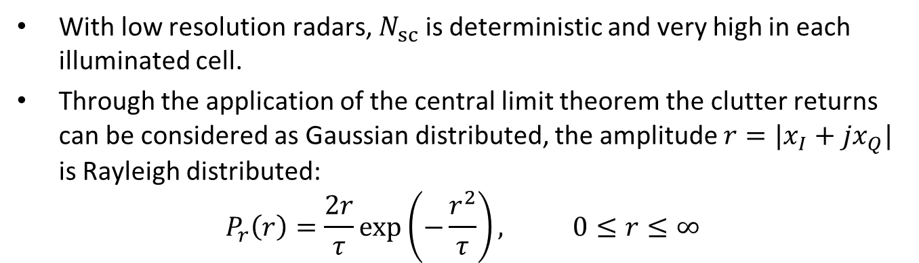
Clutter statistics
The scattered clutter (in-phase or quadrature) can be written as the vector sum from $N_{sc}$ random scatterers:
Vector sum of $N_{sc}$ scatterers
$$x_{I,Q}=\sum_{n=1}^{N_{sc}}{\sqrt{{\tilde{σ}}_{n}}exp\left(j{\tilde{φ}}_{n}\right)}$$
3
2
phase term
1
RCS of a single scatterer
-
1
1
2
3
With low resolution radars, $N_{sc}$ is deterministic and very high in each illuminated cell.
Through the application of the central limit theorem the clutter returns can be considered as Gaussian distributed, the amplitude $r=|x_{I}+jx_{Q}|$ is Rayleigh distributed:
$$P_{r}\left(r\right)=\frac{2r}{τ}\exp\left(−\frac{r^{2}}{τ}\right), 0≤r≤∞$$
-
1
-
2
-
3

Slide 8


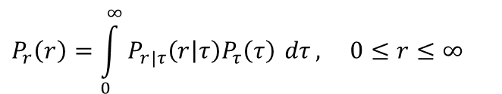

Compound Gaussian model
The compound-Gaussian model extends the Gaussian case by modelling the mean power, 𝜏 as a random variable.
Can be represented in amplitude or intensity:
$$P_{r|τ}\left(r|τ\right)=\frac{2r}{τ}\exp\left(−\frac{r^{2}}{τ}\right),$$
$$P_{r}\left(r\right)=\int_{0}^{∞}{P_{r|τ}\left(r | τ\right)P_{τ}\left(τ\right) dτ}, 0≤r≤∞$$
According to the model:
$$y=\sqrt{τ}x$$
$$x=x_{I}+jx_{Q}$$
Texture: non-negative random process, takes into account the local mean power
Speckle: complex Gaussian process, takes into account the local backscattering

Slide 9
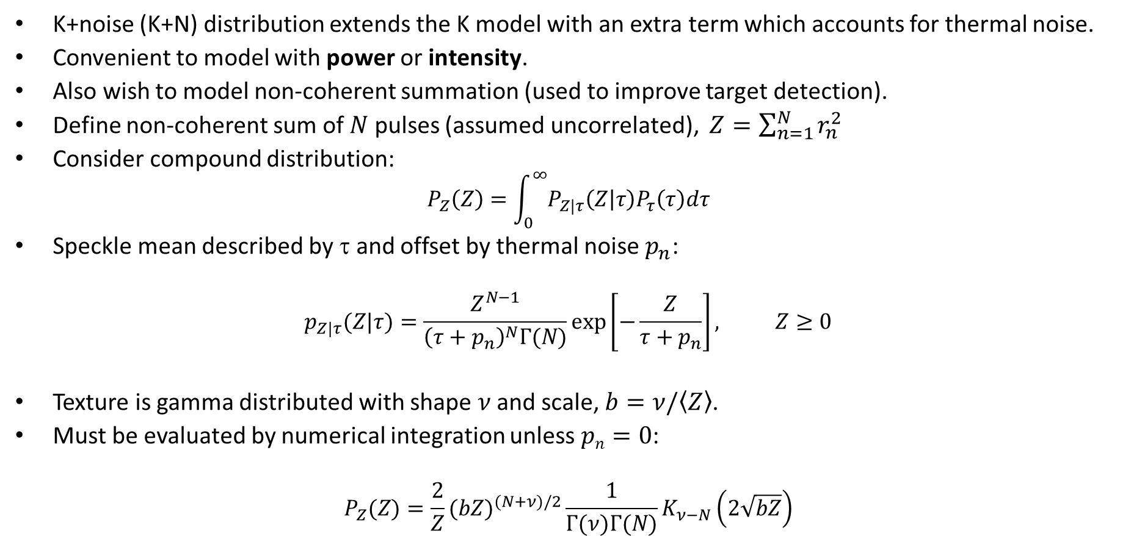
K+noise distribution
K+noise (K+N) distribution extends the K model with an extra term which accounts for thermal noise.
Convenient to model with power or intensity.
Also wish to model non-coherent summation (used to improve target detection).
Define non-coherent sum of $N$ pulses (assumed uncorrelated), $Z=\sum_{n=1}^{N}{r_{n}^{2}}$
Consider compound distribution:
$$P_{Z}\left(Z\right)=\int_{0}^{∞}{P_{Z|τ}\left(Z | τ\right)P_{τ}\left(τ\right)dτ}$$
Speckle mean described by $$ and offset by thermal noise $p_{n}$:
$$p_{Z|τ}(Z|τ)=\frac{Z^{N−1}}{{\left(τ+p_{n}\right)}^{N}Γ(N)}\exp\left[−\frac{Z}{τ+p_{n}}\right], Z≥0$$
Texture is gamma distributed with shape $ν$and scale, $b=ν/\left\langle Z\right\rangle$.
Must be evaluated by numerical integration unless $pn=0$:
$$P_{Z}(Z)=\frac{2}{Z}(bZ)^{(N+ν)/2}\frac{1}{Γ(ν)Γ(N)}K_{ν−N}\left(2\sqrt{bZ}\right)$$

Slide 10

KK+noise and Pareto+noise distributions
KK+noise (KK+N) and Pareto+noise (P+N) distributions shown to be a good model for spiky sea-clutter.
KK+N distribution has a texture which is the weighted sum of 2 gamma distributions:
$$P_{τ}(τ|⋅)=(1−k_{r})P_{τ}(τ|ν_{1},μ_{1})+k_{r}P_{τ}(τ|ν_{2},μ_{2})$$
Results in 2 independent K+N components – no physical justification.
Ratio of mean, $ρkk=μ2/μ1$determines the degree of separation in the tail.
𝑘_{𝑟} determines the level at which they start to diverge:
P+N distribution is much simpler than KK+N.
Uses an inverse gamma texture model with scale, $d=\left\langle Z\right\rangle \left(a−1\right)$ and shape, $a$:
$$P_{τ}(τ|a,d)=\frac{d^{a}}{Γ(a)}τ^{−a−1}\exp\left[−d/τ\right], τ≥0,a,d>1$$
Both distributions must be evaluated by numerical integration.
Notes:
[Ros10] L. Rosenberg, D. J. Crisp, and N. J. Stacy, "Analysis of the KK-Distribution with Medium Grazing Angle Sea-clutter," IET - Radar Sonar and Navigation, vol. 4, pp. 209-222, April 2010.
[Ros15] L. Rosenberg and S. Bocquet, "Application of the Pareto plus Noise Distribution to Medium Grazing Angle Sea-clutter," IEEE Journal of Selected Topics in Applied Earth Observations and Remote Sensing, vol. 8, pp. 255-261, Jan. 2015.

Slide 11
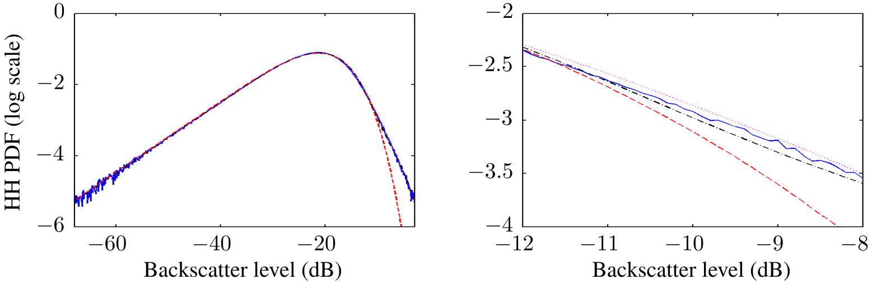
PDF model comparison
  Comparison of data fits: K+N, KK+N and P+N.
  Example data is from HH polarisation, upwind, 30º grazing.
  K+N under-estimates tail of distribution.
  Good fit for both KK+N and P+N.
Fit comparison for HH polarisation, (--) data, (--) K+N, (--) KK+N, (--) P+N
P+N
KK+N
K+N

Slide 12
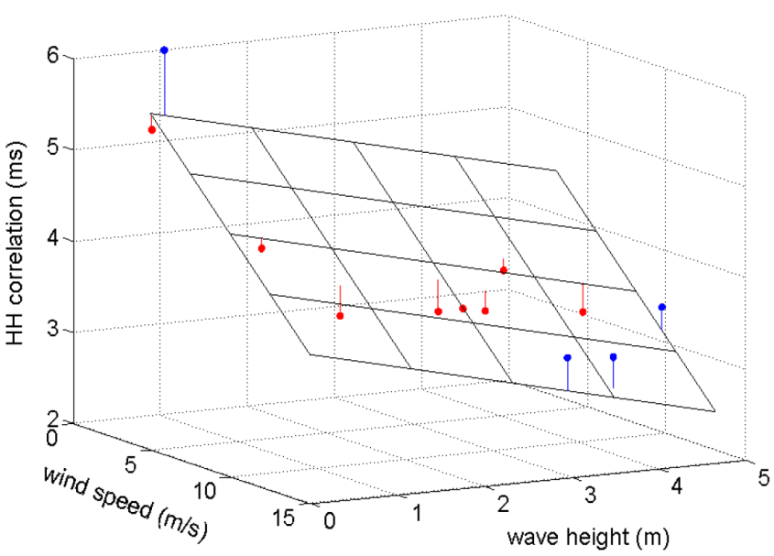
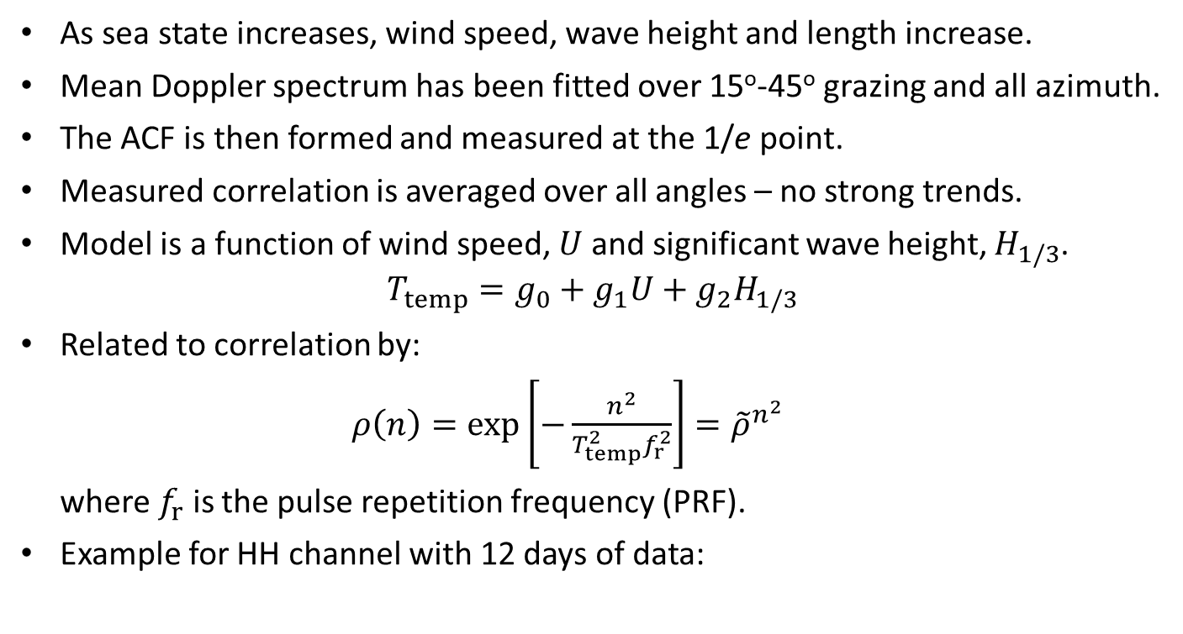
Temporal correlation model
As sea state increases, wind speed, wave height and length increase.
Mean Doppler spectrum has been fitted over 15º-45º grazing and all azimuth.
The ACF is then formed and measured at the 1/e point.
Measured correlation is averaged over all angles – no strong trends.
Model is a function of wind speed, $U$ and significant wave height, $H_{1/3}$.
$$T_{temp}=g_{0}+g_{1}U+g_{2}H_{1/3}$$
Related to correlation by:
$ρ\left(n\right)=\exp\left[−\frac{n^{2}}{T_{temp}^{2}f_{r}^{2}}\right]={\tilde{ρ}}^{n^{2}}$
where $f_{r}$ is the pulse repetition frequency (PRF).
Example for HH channel with 12 days of data:
Notes:
[Ros14] Rosenberg L., Characterisation of high grazing angle X-band sea-clutter Doppler spectra, IEEE Transactions on Aerospace and Electronic Systems, 2014, 50(1), pp. 406-417.

Slide 13
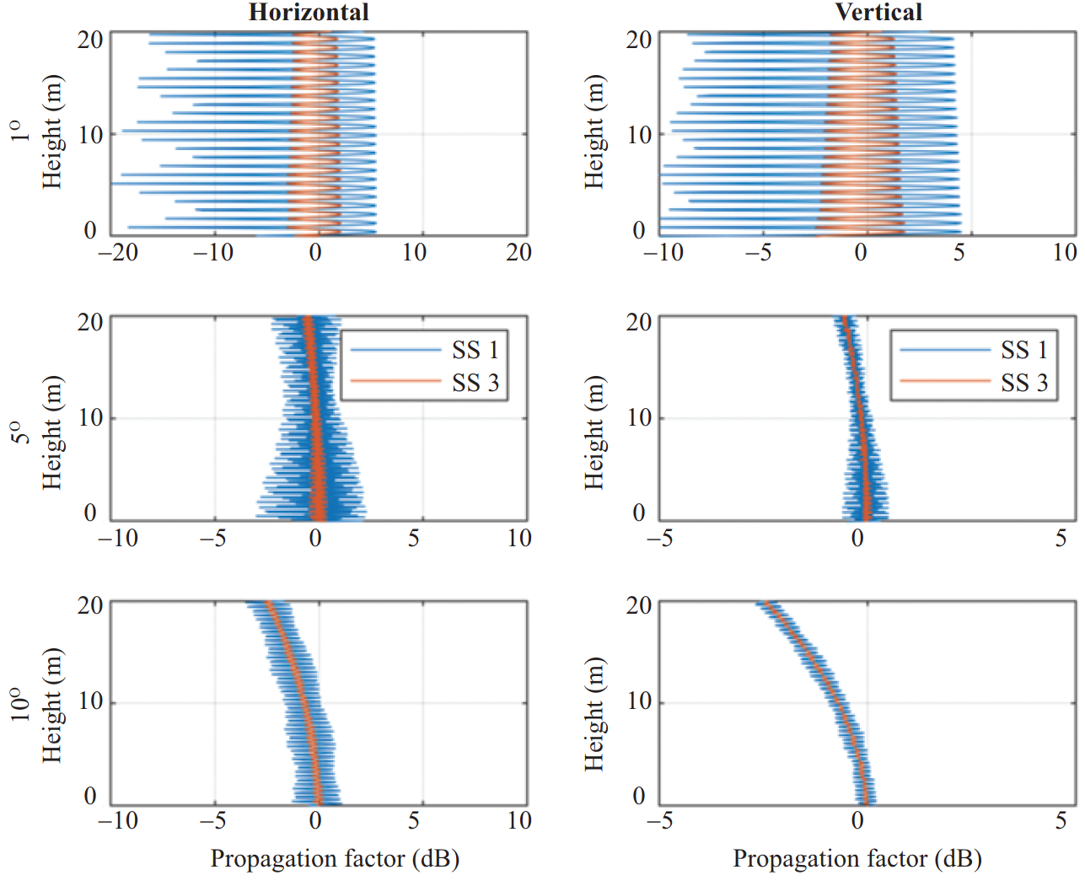
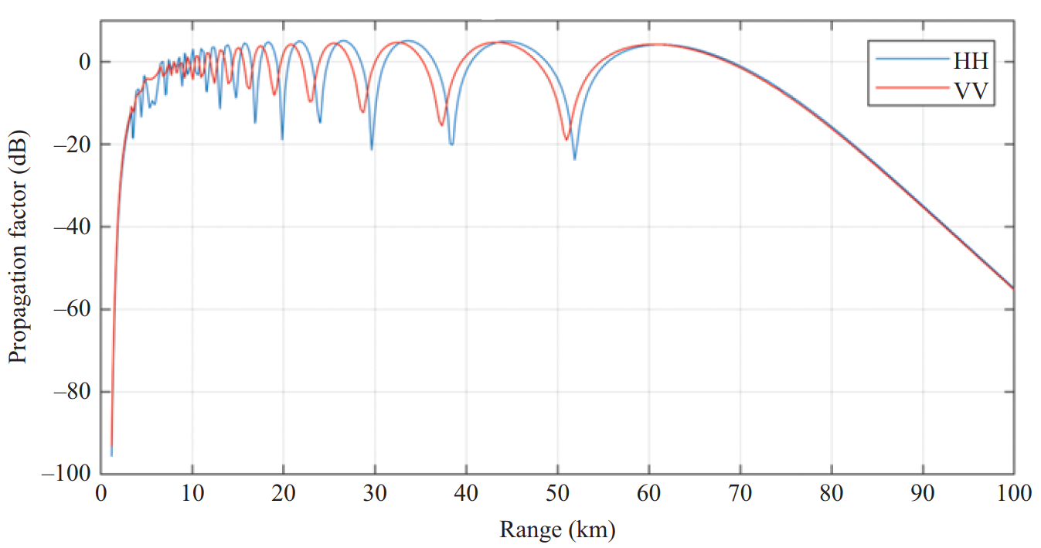
Propagation - multipath
Propagation modelling accounts for atmospheric loss and the impact of ducting and multipath.
Propagation factor is the difference in the received field strength relative to free-space.
Target representation is important in understanding the impact of multipath.
  Single scatterer targets can result in exaggerated variation of propagation factor.
  Distributed target models produce a smoothed RCS variation.
Impact of multipath is stronger at low grazing angles and sea states.

Slide 14
Seminar outline
Performance modelling and clutter statistics
Non-coherent performance prediction modelling
  Case study: Impact of model mismatch
  Case study: Detection performance for a fast-scanning radar
Coherent performance prediction
  Case study: Coherent or non-coherent detection?

Slide 15
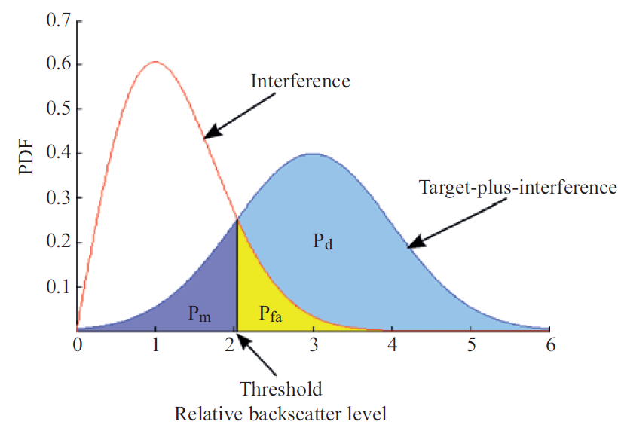
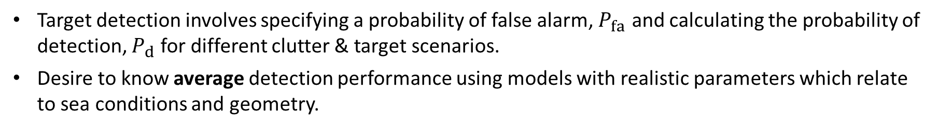
Non-coherent performance prediction modelling
Target detection involves specifying a probability of false alarm, $P_{fa}$ and calculating the probability of detection, $P_{d}$for different clutter & target scenarios.
Desire to know average detection performance using models with realistic parameters which relate to sea conditions and geometry.

Slide 16
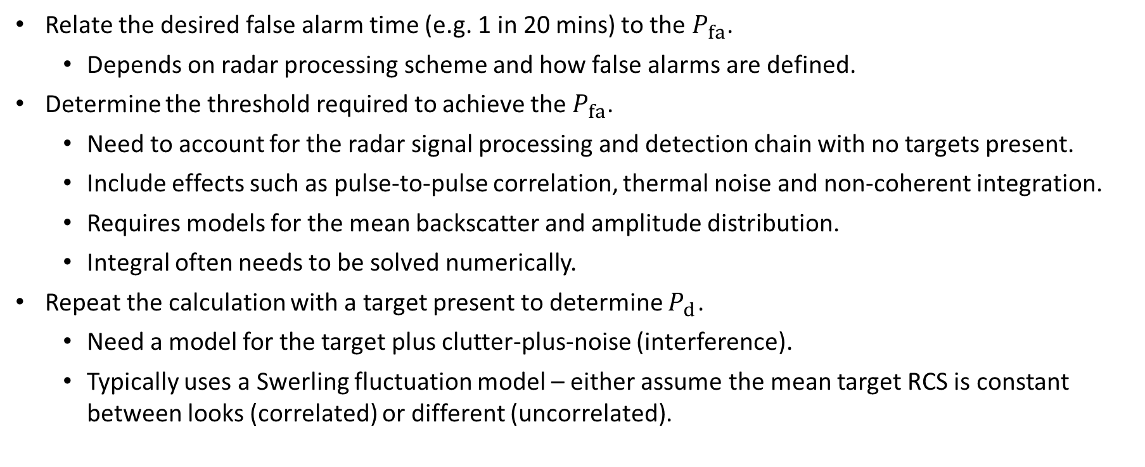
Calculation process
Relate the desired false alarm time (e.g. 1 in 20 mins) to the $P_{fa}$.
  Depends on radar processing scheme and how false alarms are defined.
Determine the threshold required to achieve the $P_{fa}$.
  Need to account for the radar signal processing and detection chain with no targets present.
  Include effects such as pulse-to-pulse correlation, thermal noise and non-coherent integration.
  Requires models for the mean backscatter and amplitude distribution.
  Integral often needs to be solved numerically.
Repeat the calculation with a target present to determine $P_{d}$.
  Need a model for the target plus clutter-plus-noise (interference).
  Typically uses a Swerling fluctuation model – either assume the mean target RCS is constant between looks (correlated) or different (uncorrelated).
Notes:
Model by Hau and Morinaga

Slide 17
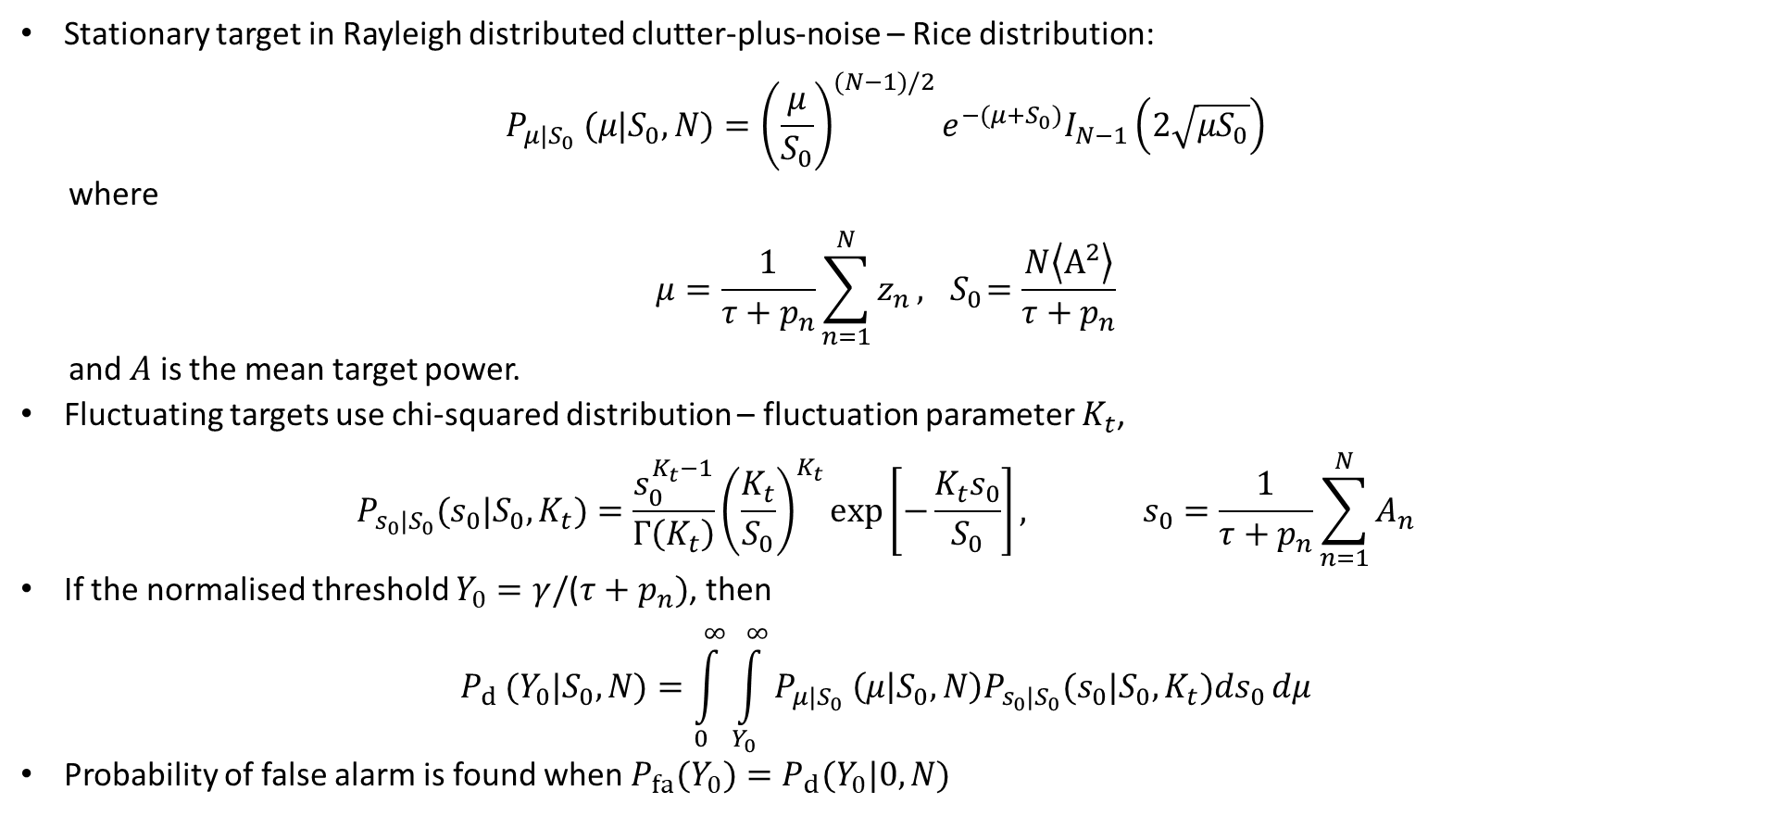
Target fluctuation model
Stationary target in Rayleigh distributed clutter-plus-noise – Rice distribution:
$$P_{μ|S_{0}} (μ|S_{0},N)={\left(\frac{μ}{S_{0}}\right)}^{(N−1)/2}e^{−(μ+S_{0})}I_{N−1}\left(2\sqrt{μS_{0}}\right)$$
where
$$μ=\frac{1}{τ+p_{n}}\sum_{n=1}^{N}{z_{n}}, { S}_{0}=\frac{N\left\langle A^{2}\right\rangle }{τ+p_{n}}$$
and $A$ is the mean target power.
Fluctuating targets use chi-squared distribution – fluctuation parameter $K_{t}$,
$$P_{s_{0}|S_{0}}(s_{0}|S_{0},K_{t})=\frac{s_{0}^{K_{t}−1}}{Γ\left(K_{t}\right)}{\left(\frac{K_{t}}{S_{0}}\right)}^{K_{t}}\exp\left[−\frac{K_{t}s_{0}}{S_{0}}\right], s_{0}=\frac{1}{τ+p_{n}}\sum_{n=1}^{N}{A_{n}}$$
If the normalised threshold $Y_{0}=γ/$($τ+p_{n})$, then
$$P_{d }(Y_{0}|S_{0},N)=\int_{0}^{∞}{\int_{Y_{0}}^{∞}{P_{μ|S_{0}} \left(μ | S_{0},N\right)P_{s_{0}|S_{0}}(s_{0}|S_{0},K_{t})ds_{0}}}dμ$$
Probability of false alarm is found when $P_{fa}(Y_{0})=P_{d}(Y_{0}|0,N)$
Notes:
It is generally not practical to model the detailed EM scattering properties of targets and so statistical methods are often employed. The most widely used statistical target models were introduced by Swerling, who along with Marcum, provided methods to calculate detection performance in noise. Later it became clear that the constant target model (often referred to as Swerling 0) and the four Swerling models (1 to 4) were not sufficient to describe the range of target behaviours observed in practice. Thus Swerling generalised his models to the ‘Generalised Chi-Squared’ or ‘Gamma’ distribution model..
We are interested in the detection of targets in K distributed clutter and noise. For the case where the speckle has identical correlation properties to the noise, this may be calculated from detection results in noise by adding the speckle to noise and integrating over the Gamma distribution for the clutter modulation.
The importance of separating the clutter power z into the two components (the speckle and the modulation) lies in their different correlation properties. Speckle de-correlates in a few milliseconds at I-band, samples separated spatially by more than the radar resolution are independent. The modulation carries all the correlation associated with the sea wave structure, and can therefore be correlated for over a second and over distances of many tens of metres. Furthermore, the speckle tends to be de-correlated by radar frequency agility whilst the modulation is unaffected. Thus for a scanning radar, with pulse to pulse frequency agility, the modulation x remains approximately constant over a beam dwell time while independent samples speckle of are obtained from pulse to pulse. If we assume that frequency agility provides independent samples of speckle, system noise may be added by offsetting x by the noise power.

Slide 18
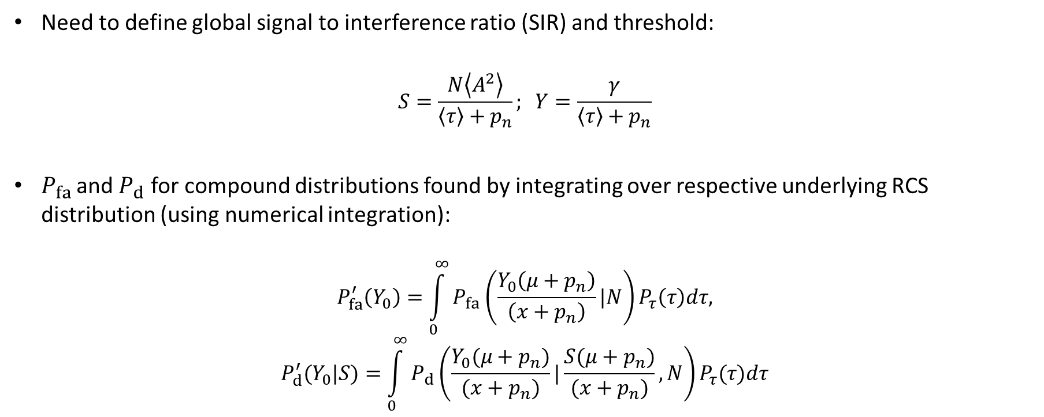
Compound distributions
Need to define global signal to interference ratio (SIR) and threshold:
$$S=\frac{N\left\langle A^{2}\right\rangle }{\left\langle τ\right\rangle +p_{n}}; Y=\frac{γ}{\left\langle τ\right\rangle +p_{n}}$$
$P_{fa}$ and $P_{d}$for compound distributions found by integrating over respective underlying RCS distribution (using numerical integration):
$$P_{fa}^{′}\left(Y_{0}\right)=\int_{0}^{∞}{P_{fa}\left(\frac{Y_{0}\left(μ+p_{n}\right)}{\left(x+p_{n}\right)}|N\right)}P_{τ}\left(τ\right)dτ,$$
$$P_{d}^{′}(Y_{0}|S)=\int_{0}^{∞}{P_{d}\left(\frac{Y_{0}(μ+p_{n})}{(x+p_{n})}|\frac{S(μ+p_{n})}{(x+p_{n})},N\right)}P_{τ}(τ)dτ$$

Slide 19
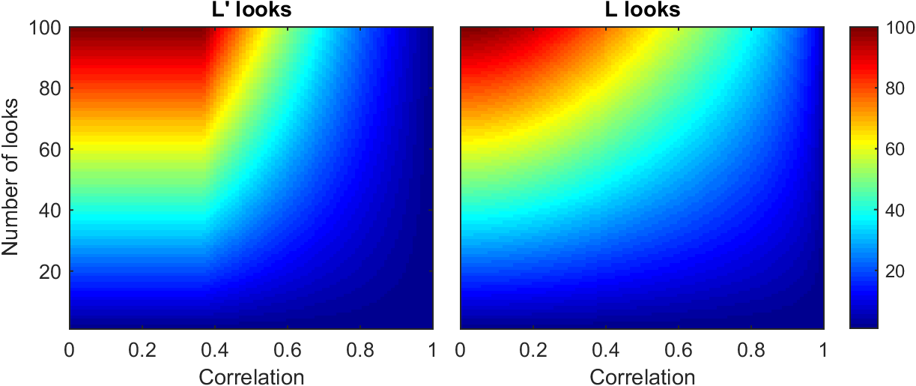
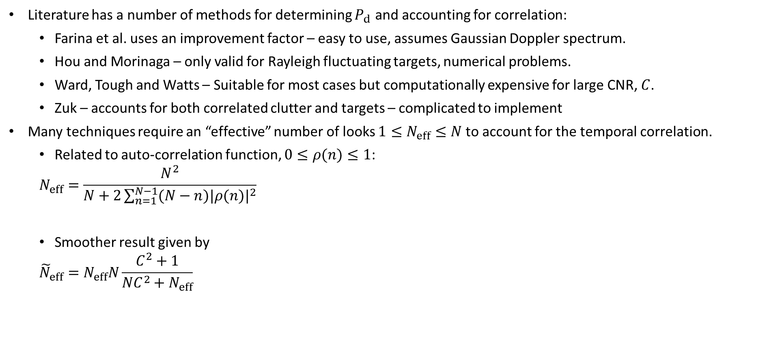


Parametric detection techniques with correlation
Literature has a number of methods for determining $P_{d}$ and accounting for correlation:
  Farina et al. uses an improvement factor – easy to use, assumes Gaussian Doppler spectrum.
  Hou and Morinaga – only valid for Rayleigh fluctuating targets, numerical problems.
  Ward, Tough and Watts – Suitable for most cases but computationally expensive for large CNR, $C$.
  Zuk – accounts for both correlated clutter and targets – complicated to implement
Many techniques require an “effective” number of looks $1≤N_{eff}≤N$ to account for the temporal correlation.
  Related to auto-correlation function, $0≤ρ(n)≤1$:
  $$N_{eff}=\frac{N^{2}}{N+2\sum_{n=1}^{N−1}{(N−n)|ρ(n)|^{2}}}$$
  Smoother result given by
  $${\tilde{N}}_{eff}=N_{eff}N\frac{C^{2}+1}{NC^{2}+N_{eff}}$$
$$N_{eff}$$
$${\tilde{N}}_{eff}$$
Notes:
Model by Hau and Morinaga

Slide 20
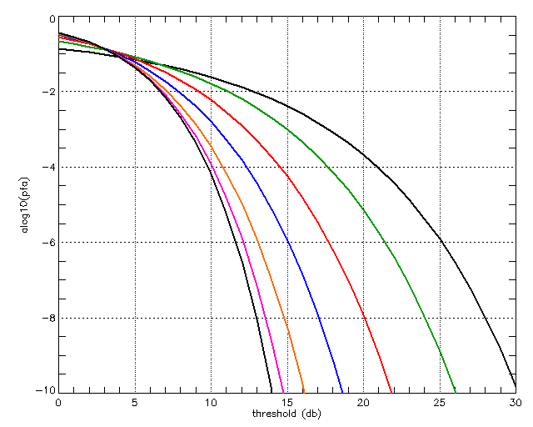
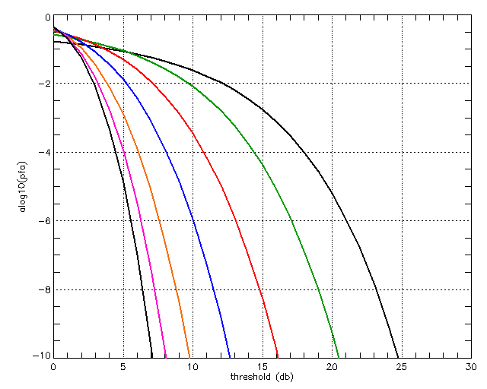
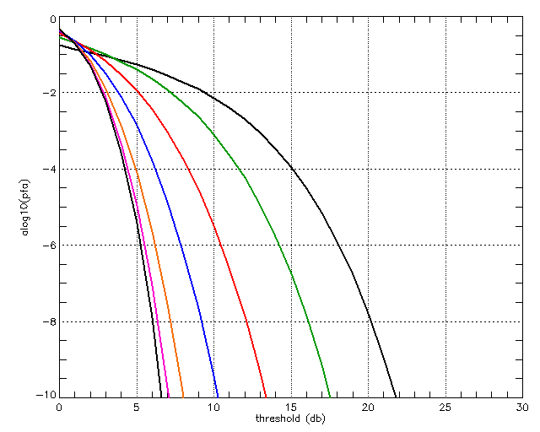
Detection calculations – probability of false alarm
Assuming K-distributed clutter
  Left - Single pulse probability of false alarm (no noise).
  Centre - 10 pulse probability of false alarm (no noise).
  Right - 10 pulse probability of false alarm (CNR = 0 dB).
ν = 100
ν = 0.1
ν = 100
ν = 0.1
ν = 100
ν = 0.1
Notes:
Probability of false alarm (log to the base 10) versus threshold (in dB relative to mean clutter power) for a single pulse of K distributed clutter. The lines correspond to difference values of shape parameter ν (black: 100, pink: 30, orange:10, blue: 3, red:1, green: 0.3, black:0.1)
The figures on this and subsequent pages show the probability of false alarm versus threshold, calculated using the equations above. As ν decreases, the threshold required for any particular PFA (below about 10⁻¹) increases. This means that the ‘spikier’ clutter tends to obscure targets and thus tends to reduce detection performance.

Slide 21
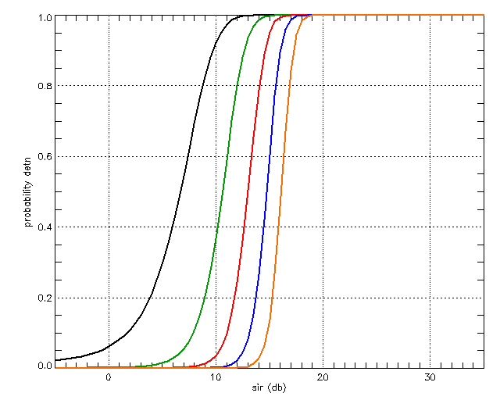
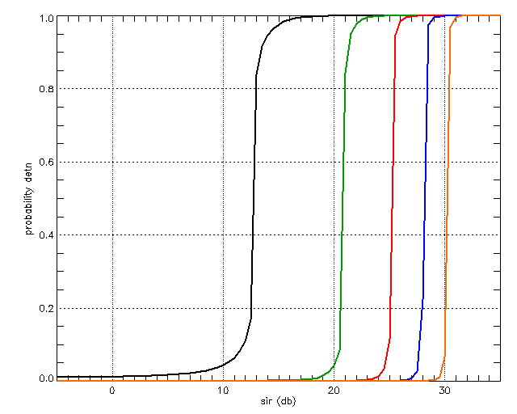
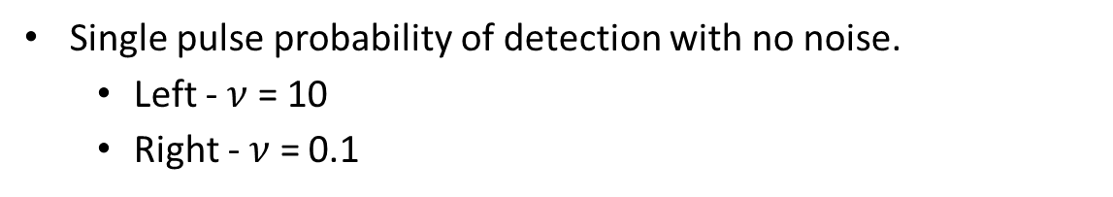
Detection calculations
Single pulse probability of detection with no noise.
  Left - $ν$ = 10
  Right - $ν$ = 0.1
P_{fa} = 10⁻²
P_{fa} = 10⁻¹⁰
P_{fa} = 10⁻²
P_{fa} = 10⁻¹⁰

Slide 22
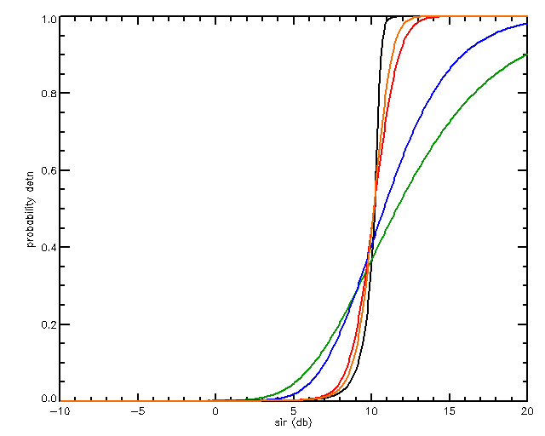
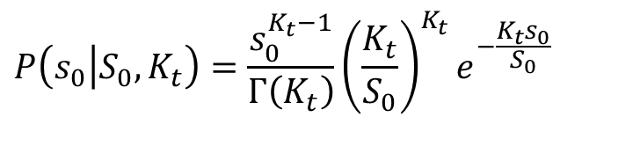
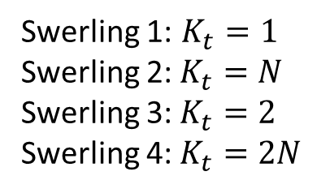
Detection calculations
16 pulse integration, probability of detection, $P_{fa}={10}^{−4}$
Clutter $=1$, Variation with target (Swerling) fluctuation model
4
2
Swerling targets
$$P\left(s_{0}\left|S_{0},K_{t}\right.\right)=\frac{s_{0}^{K_{t}−1}}{Γ\left(K_{t}\right)}{\left(\frac{K_{t}}{S_{0}}\right)}^{K_{t}}e^{−\frac{K_{t}s_{0}}{S_{0}}}$$
0
3
1
Swerling 1: $K_{t}=1$
Swerling 2: $K_{t}=N$
Swerling 3: $K_{t}=2$
Swerling 4: $K_{t}=2N$
Notes:
Probability of false alarm (log to the base 10) versus threshold (in dB relative to mean clutter power) for a single pulse of K distributed clutter. The lines correspond to difference values of shape parameter ν (black: 100, pink: 30, orange:10, blue: 3, red:1, green: 0.3, black:0.1)
The figures on this and subsequent pages show the probability of false alarm versus threshold, calculated using the equations above. This Figure is for a single pulse of K distributed clutter with no (radar system) noise. As ν decreases, the threshold required for any particular PFA (below about 10⁻¹) increases. This means that the ‘spikier’ clutter tends to obscure targets and thus tends to reduce detection performance.

Slide 23
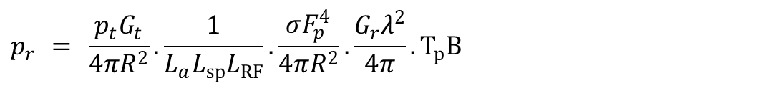
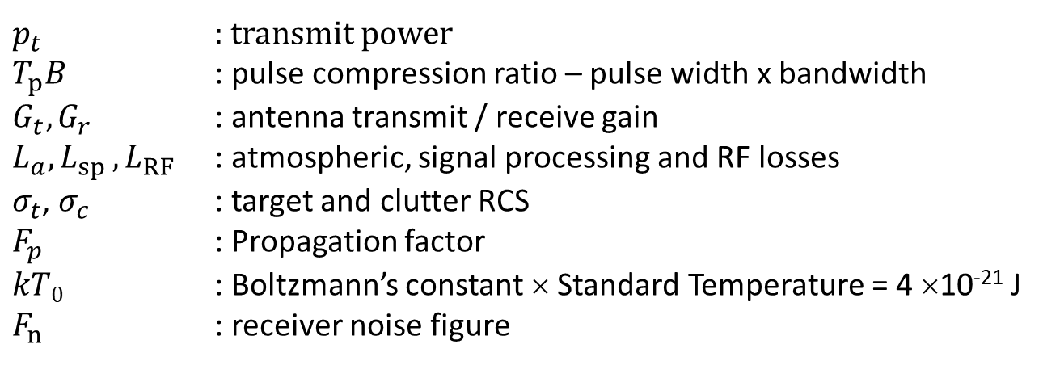

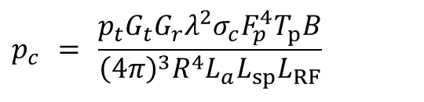
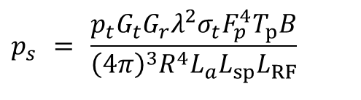
Radar equation and geometry
Radar range equation:
$$p_{r} = \frac{p_{t}G_{t}}{4πR^{2}}.\frac{1}{L_{a}L_{sp}L_{RF}}.\frac{σF_{p}^{4}}{4πR^{2}}.\frac{G_{r}λ^{2}}{4π}.T_{p}B$$
Signal, clutter and noise powers:
$$p_{s} = \frac{p_{t}G_{t}G_{r}λ^{2}σ_{t}F_{p}^{4}T_{p}B}{{\left(4π\right)}^{3}R^{4}L_{a}L_{sp}L_{RF}}$$
$$p_{c} = \frac{p_{t}G_{t}G_{r}λ^{2}σ_{c}F_{p}^{4}T_{p}B}{{\left(4π\right)}^{3}R^{4}L_{a}L_{sp}L_{RF}}$$
$$p_{n} = kT_{0}BF_{n}$$
$p_{t}$ : transmit power
$T_{p}B$ : pulse compression ratio – pulse width x bandwidth
$G_{t}, G_{r}$ : antenna transmit / receive gain
$L_{a}{,L}_{sp},L_{RF}$ : atmospheric, signal processing and RF losses
$σ_{t}$, $σ_{c}$ : target and clutter RCS
$F_{p}$ : Propagation factor
$kT0$ : Boltzmann’s constant × Standard Temperature = 4 ×10⁻²¹ J
$F_{n}$ : receiver noise figure
Notes:
Model by Hau and Morinaga

Slide 24
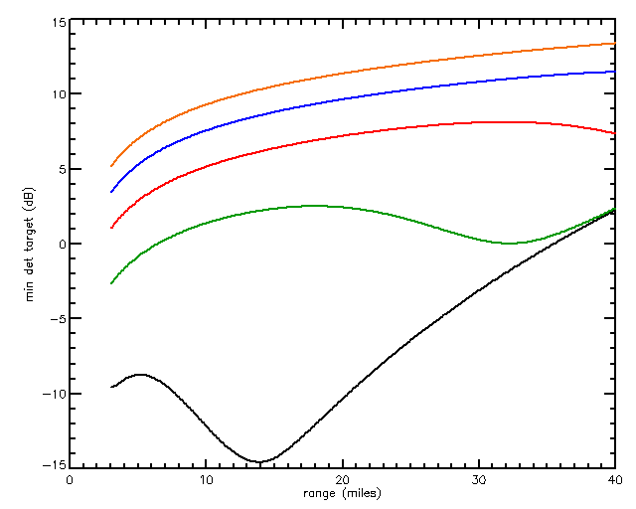

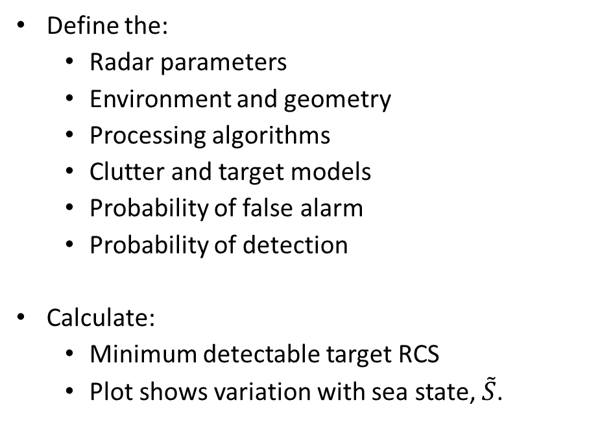




Overall non-coherent radar performance
Define the:
  Radar parameters
  Environment and geometry
  Processing algorithms
  Clutter and target models
  Probability of false alarm
  Probability of detection
Calculate:
  Minimum detectable target RCS
  Plot shows variation with sea state, $\tilde{S}$.
$$\tilde{S}=5$$
$$\tilde{S}=4$$
$$\tilde{S}=3$$
$$\tilde{S}=2$$
$$\tilde{S}=1$$
Notes:
The plot shows Minimum detectable target versus range for a radar with typical maritime surveillance parameters at 3000 feet altitude for sea states 1 to 5 (black=1, green=2, red=3, blue=4, orange=5). The plot uses the GIT σ⁰ clutter model and the compound K distribution.

Slide 25
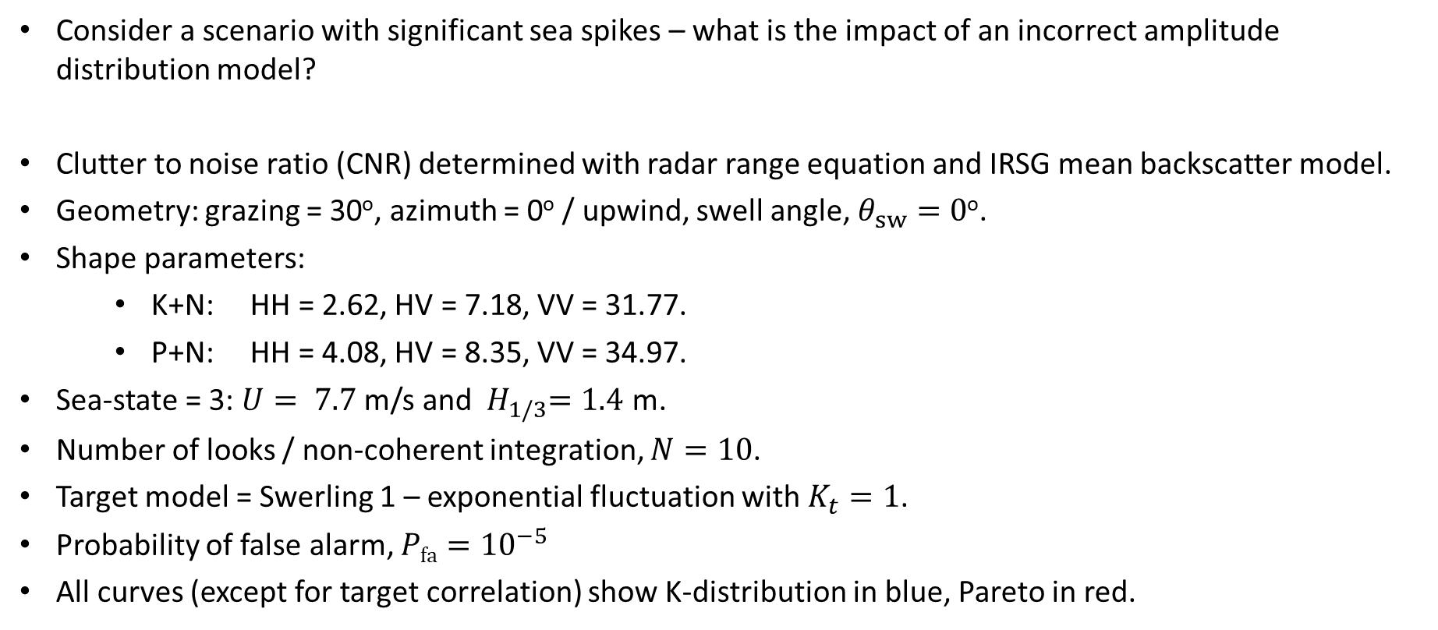
Case study 1: Impact of model mismatch
Consider a scenario with significant sea spikes – what is the impact of an incorrect amplitude distribution model?
Clutter to noise ratio (CNR) determined with radar range equation and IRSG mean backscatter model.
Geometry: grazing = 30º, azimuth = 0º / upwind, swell angle, $θ_{sw}=0\text{o}$.
Shape parameters:
  K+N: HH = 2.62, HV = 7.18, VV = 31.77.
  P+N: HH = 4.08, HV = 8.35, VV = 34.97.
Sea-state = 3: $U= 7.7$ m/s and ${ H}_{1/3}=1.4$ m.
Number of looks / non-coherent integration, $N=10$.
Target model = Swerling 1 – exponential fluctuation with $K_{t}=1$.
Probability of false alarm, $Pfa={10}^{−5}$
All curves (except for target correlation) show K-distribution in blue, Pareto in red.

Slide 26
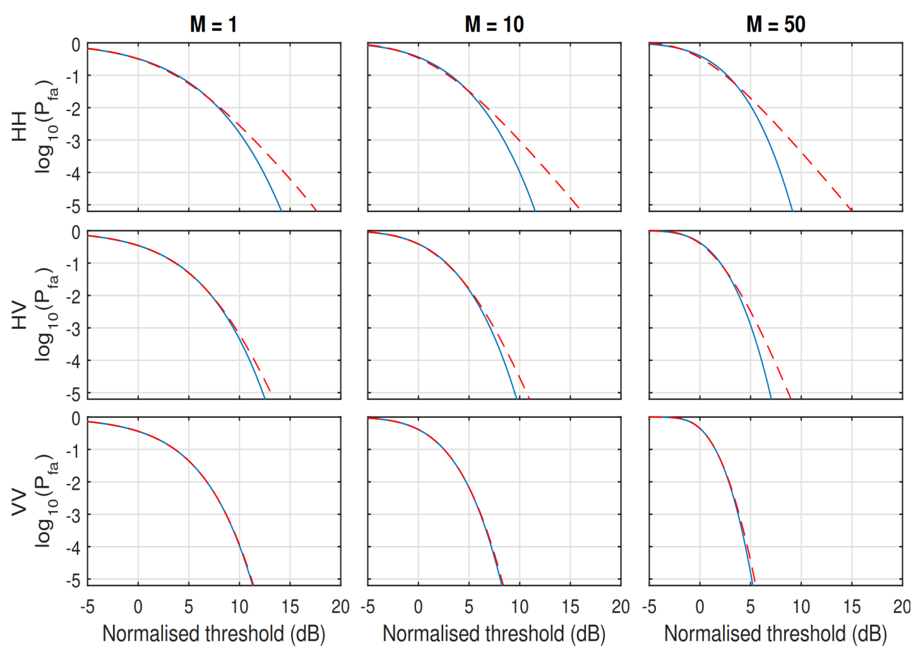
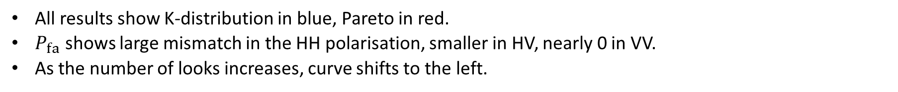



False alarm results
All results show K-distribution in blue, Pareto in red.
$P_{fa}$ shows large mismatch in the HH polarisation, smaller in HV, nearly 0 in VV.
As the number of looks increases, curve shifts to the left.
$$N=1$$
$$N=10$$
$N=$ 50

Slide 27
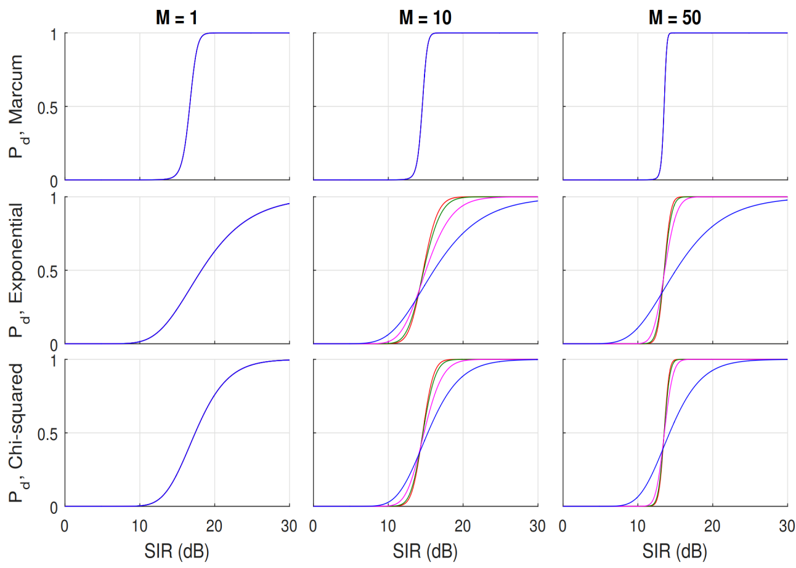
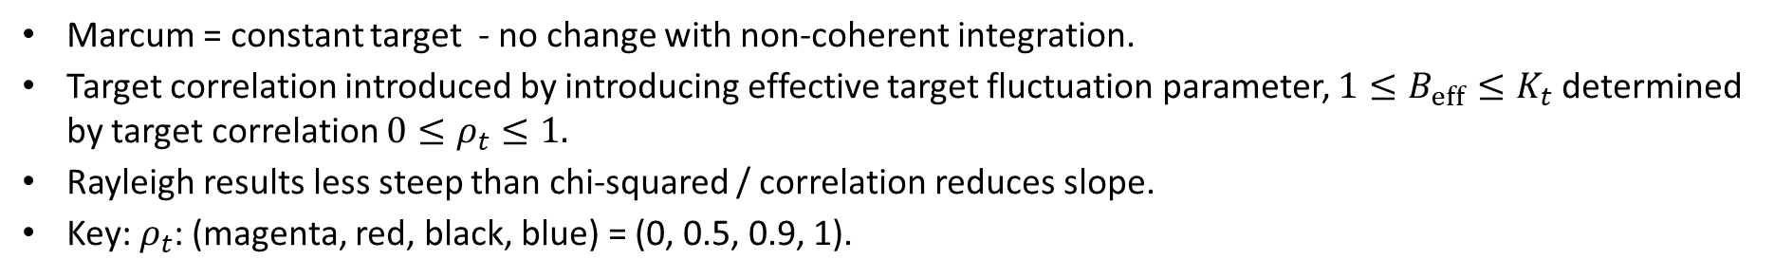



Variations in target model
Marcum = constant target - no change with non-coherent integration.
Target correlation introduced by introducing effective target fluctuation parameter, $1≤B_{eff}≤K_{t}$ determined by target correlation $0≤ρ_{t}≤1.$
Rayleigh results less steep than chi-squared / correlation reduces slope.
Key: $ρ_{t}$: (magenta, red, black, blue) = (0, 0.5, 0.9, 1).
$$N=1$$
$$N=10$$
$N=$50

Slide 28
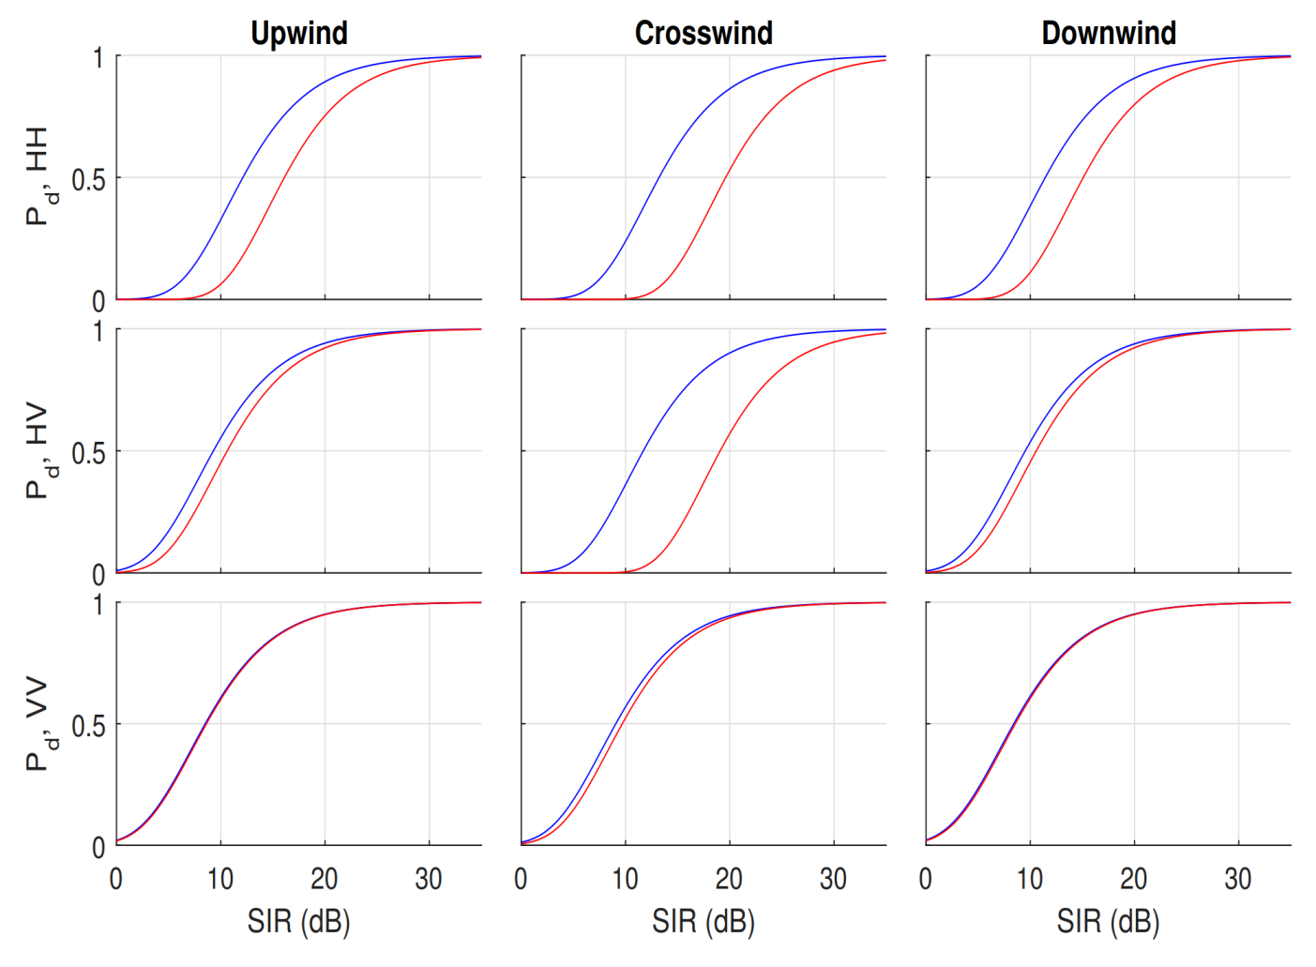
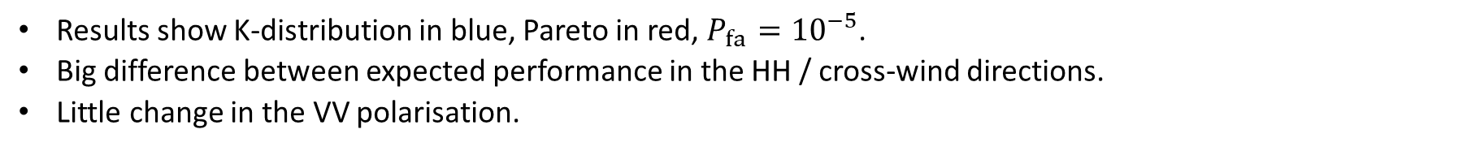
Variation in azimuth
Results show K-distribution in blue, Pareto in red, $P_{fa}{=10}^{−5}$.
Big difference between expected performance in the HH / cross-wind directions.
Little change in the VV polarisation.

Slide 29
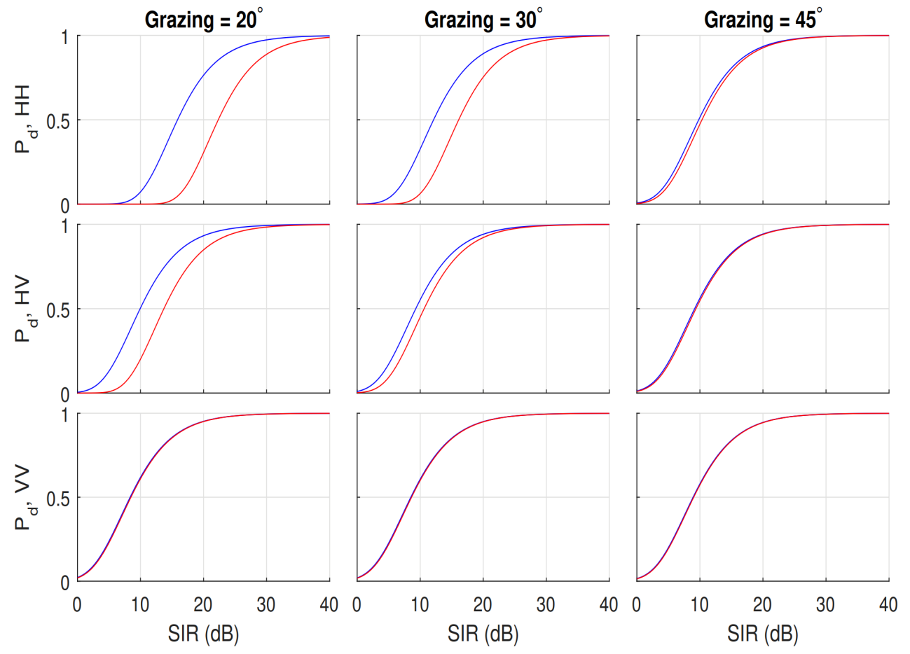
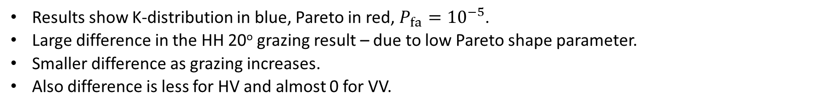
Variation in grazing
Results show K-distribution in blue, Pareto in red, $P_{fa}{=10}^{−5}$.
Large difference in the HH 20º grazing result – due to low Pareto shape parameter.
Smaller difference as grazing increases.
Also difference is less for HV and almost 0 for VV.

Slide 30
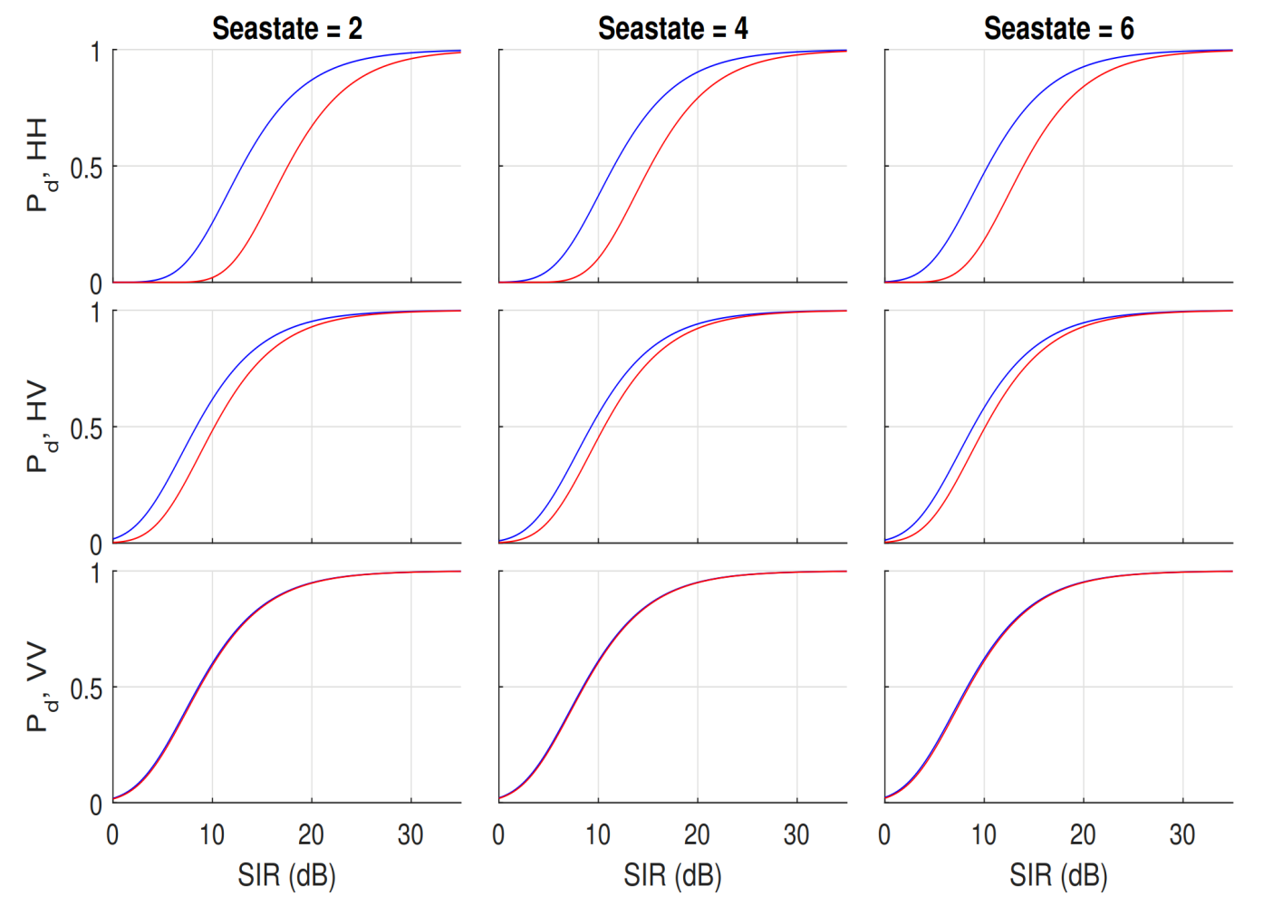
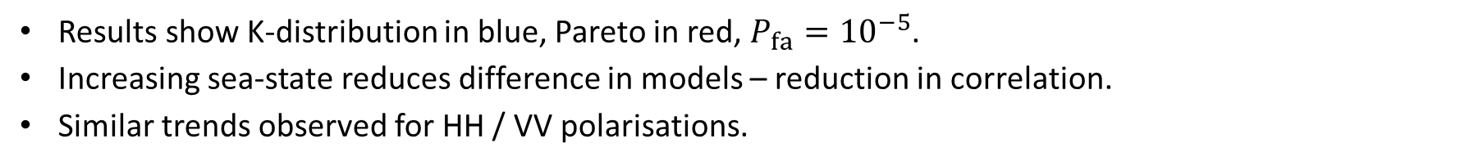
Variation in sea-state
Results show K-distribution in blue, Pareto in red, $P_{fa}{=10}^{−5}$.
Increasing sea-state reduces difference in models – reduction in correlation.
Similar trends observed for HH / VV polarisations.

Slide 31
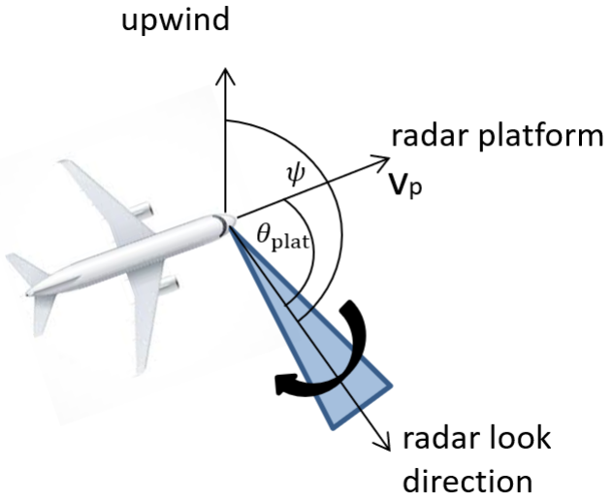
Case study 2: Detection performance for a scanning radar
OFFICIAL
What is the effect on the detection performance when changing:
  Geometry
  Sea state
  Propagation model
Results include:
  Power ratios
    Clutter-to-noise ratio (CNR)
    Signal-to-noise ratio (SNR)
    Signal-to-interference ratio (SIR)
  K-distribution shape reveals areas where clutter is spikiest in the radar return.
  Probability of detection for P_{fa} = 10⁻⁵
  Minimum detectable RCS for a P_{d} = 0.5

Slide 32
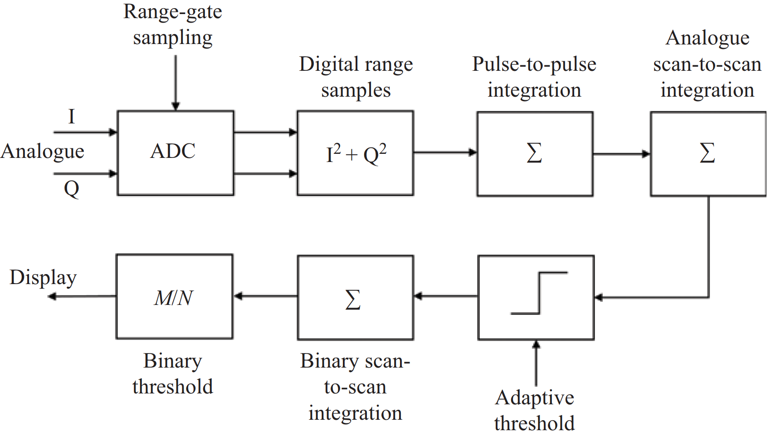

Detection scheme
OFFICIAL
Radar scans with a rate $ω_{scan}$ and point target will be in the beam for $T_{targ}=\frac{φ_{3dB}}{ω_{scan}}$ sec or $N_{targ}=floor\left(T_{targ}f_{r}\right)$ pulses,
  $f_{r}$ is the pulse repetition frequency (PRF)
  $φ_{3dB}$ is the 3dB azimuth beamwidth
Processing scheme includes:
  Pulse-to-pulse integration, $N$ pulses
  Scan-to-scan integration, $N_{s}$scans
  Binary thresholding

Slide 33

Scan to scan and binary integration
OFFICIAL
Scan to scan integration exploits consecutive scans to average clutter variations.
If the intensity input for a range / azimuth cell is $X_{k}$,
$$Y_{K}=\sum_{k=1}^{N_{s}}{X_{k}}$$
If memory is constrained, then use a feedback integrator:
$$Y_{k}=αX_{k}+\left(1−α\right)X_{k−1}, \\ Y_{1}=X_{1}$$
where $α$ is the scaling factor. These can be related by the relationship: $N_{s}≈\frac{2−α}{α}$.
Binary Integration or “M/N” processing combines multiple detections to form a single detection with a lower probability of false alarm.
i.e. a detection is called when at least M individual detections are declared.
This works to distinguish persistent from other short lived discrete scatterers and will reject any moving targets.
The final false alarm or detection probability, $P_{out}$can be related to the input, $P_{in}$ by
$$P_{out}=\sum_{n=M_{b}}^{N_{b}}{\left(\begin{matrix}N_{b} \\ n\end{matrix}\right)P_{in}^{n}{\left(1−P_{in}^{}\right)}^{N_{b}−n}}$$

Slide 34
Modelling scenario
OFFICIAL
Antenna
  Single channel, horizontal polarisation
  Radar beam pointing directly at target in azimuth, and maximum range in elevation (32 NM)
  Maximum power = 30 kW
  Antenna gain = 30 dB
  Az. / el. two-way 3dB beamwidth = 3º / 5º
Losses
  Radome loss = 0.75 dB
  Hardware losses (transmitter / receiver) = 3 dB
  Signal processing losses = 2 dB
  Noise figure = 4 dB
Waveform related losses
  Beamshape loss – variation in power levels over coherently integrated pulses
  Scanning loss – due to radar not pointing directly at target
Waveform
  Linear FM waveform
  Centre frequency = 10 GHz (X-band)
  Bandwidth = 500 MHz (0.3 m range resolution)
  Pulse width = 20 µs
Clutter models
  Continuous mean backscatter and K-distribution shape model
  Upwind, downwind, crosswind (default)
  Sea state 1, 3 (default) & 5
Target
  Height of 1 m
  Swerling 1 fluctuation
  RCS - 1 m²
Propagation models
  Point target
  Distributed target (default)

Slide 35


Radar performance results
OFFICIAL
All results use P_{fa} = 10⁻⁵
Min. RCS plots assume P_{d} = 0.5
Slow scanning mode:
Pulse repetition frequency = 1200 Hz
Scan rate = 10 rpm
Number of coherent pulses, N = 60
Number of scan-to-scan integrations, $N_{s}$ = 1
Binary thresholding, $M_{b}$/$N_{b}$= 3/5
First detection after 3*6 = 18 seconds
Scanning loss = 0.003 dB
Beamshape loss = 1.7 dB
Fast scanning mode:
Pulse repetition frequency = 2000 Hz
Scan rate = 100 rpm
Number of coherent pulses, N = 10
Number of scan-to-scan integrations, $N_{s}$ = 16, $α=0.12.$
Binary thresholding, $M_{b}$/$N_{b}$= 3/5
First detection after 3*0.6 = 1.8 seconds
Scanning loss = 0.12 dB
Beamshape loss = 2.0 dB

Slide 36


Performance results – wind direction @ 1000 ft
OFFICIAL

Slide 37




Performance results – wind direction @ 1000 ft
OFFICIAL

Slide 38


Performance results – sea state @ 1000 ft
OFFICIAL

Slide 39




Performance results – sea state @ 1000 ft
OFFICIAL
Notes:
Slightly better results for fast-scan

Slide 40


Performance results – propagation model @ 1000 ft
OFFICIAL

Slide 41




Performance results – propagation model @ 1000 ft
OFFICIAL

Slide 42
Results discussion – 1000 ft
OFFICIAL
Fast scan results are better in nearly all cases.
Best detection performance at downwind, worse at upwind.
Sea state has a huge impact on the performance results, sea state 1 shows amazing performance.
Point target propagation model fluctuates – may not be that realistic.
How do the power ratios change as the altitude increases?
Strong clutter mean backscatter as grazing angle gets higher.
Note – continuous clutter model only valid up to 45º grazing.

Slide 43


Performance at higher altitudes
OFFICIAL
Example shows min. detectable RCS for fast-scan mode and cross-wind
Performance degrades for near ranges as altitude / grazing increases.
For example, at 50,000 ft, clutter is very strong for ranges < 15 NM. Beyond this, detection may be possible.
Sea state has a big impact - unlikely to detect target in rough seas.
Notes:
Low height result is due to numerical problem

Slide 44
Seminar outline
Performance modelling and clutter statistics
Non-coherent performance prediction modelling
  Case study: Impact of model mismatch
  Case study: Detection performance for a fast-scanning radar
Coherent performance prediction
  Case study: Coherent or non-coherent detection?

Slide 45
Coherent performance prediction
Coherent detection involves processing bursts of data in successive range cells.
Threshold set by cell-averaging constant false alarm rate (CA-CFAR) or equivalent adaptive threshold running over range, independently in each Doppler bin.
With knowledge of CNR and amplitude statistics in each Doppler bin, detection performance as a function of frequency can be estimated in the same way as for non-coherent detectors.
Achieved using the evolved Doppler spectrum model.
Further adaptive signal processing to cancel clutter (whitening) requires the use of Monte Carlo modelling techniques.
Notes:
The methods discussed earlier can be used to predict the CNR and amplitude statistics in each Doppler bin. The single-pulse non-coherent detection calculations can be undertaken on the modulus of the output of each Doppler bin.

Slide 46


Evolving Doppler spectrum model
Gamma PDF correlated over time with mean intensity
$$P_{τ}\left(τ\right)=\frac{b^{ν}}{Γ\left(ν\right)}t^{ν−1}exp\left(−bτ\right), 0≤τ≤∞$$
Gaussian-shaped Doppler spectrum
$$G\left(f,τ,w\right)=\frac{τ}{\sqrt{2π}w }\exp\left(−\frac{{\left(f−m_{f}\left(τ\right)\right)}^{2}}{2w^{2}}\right)$$
$m_{f}\left(τ\right)=A+Bτ$ is the mean Doppler frequency,
$w$ is the spectrum width.
Normal PDF for the spectrum width, $w$:
$$P_{w}\left(w\right)=\frac{1}{\sqrt{2π}σ_{w}}\exp\left(−\frac{{\left(w−m_{w}\right)}^{2}}{{2σ}_{w}^{2}}\right), 0≤w≤∞$$
$m_{w}$ is the mean spectrum width,
$σ_{w}$ is the spectrum width.

Slide 47



Intensity moments of the model vs. Doppler frequency
The first and second moments of the clutter intensity can now be expressed as a function of Doppler frequency, $f$:
$$\left\langle τ′(f)\right\rangle =\int_{0}^{∞}{\int_{0}^{∞}{\int_{f−Δf/2}^{f+Δf/2}{P_{τ}\left(τ\right)P_{w}\left(w\right)G\left(f^{′},τ,w\right)dτdwdf′}}} \\ \left\langle τ′(f)^{2}\right\rangle =\int_{0}^{∞}{\int_{0}^{∞}{\int_{f−Δf/2}^{f+Δf/2}{P_{τ}\left(τ\right)P_{w}\left(w\right)G^{2}\left(f^{′},τ,w\right)dτdwdf′}}}$$
The shape parameter of the gamma distributed component of the clutter as a function of Doppler frequency is then given by:
$$ν′(f)={\left(\frac{\left\langle τ′(f)^{2}\right\rangle }{{\left\langle τ′(f)\right\rangle }^{2}}−1\right)}^{−1}$$
Noise power in each Doppler bin can be related to the overall clutter-to-noise ratio, $C$,
$$p_{n}^{′}=\left\langle τ\right\rangle /(CN)$$
The CNR in each Doppler bin with passband $Δf=f_{r}/N$ is
$$C′(f)=\left\langle τ^{′}\left(f\right)\right\rangle /p_{n}^{′}$$

Slide 48



Example
Radar wavelength, $λ =0.032$ m/s.
Wind velocity, $U=10$ m/s, looking upwind, low grazing angle
PRF, $f_{r}=2$ kHz
FFT length, $N=32$ (Doppler resolution 62.5 Hz)
$m_{f}\left(x\right)= 50+6x$
$m_{w}=62.5$ Hz, $σ_{w} = 1$ Hz.
CNR = 20 dB (time series data)
7
30
35
6
ν
= 5
ν
= 0.5
20
30
5
10
4
0
ν
= 5
25
3
-10
ν
= 1
ν
= 1
ν
= 0.5
20
2
ν
= 0.5
ν
= 1
-20
ν
= 5
1
-30
15
0
-
5
0
5
-40
-
5
0
5
10
Doppler bins
Doppler bins
-
5
0
5
K-distribution shape parameter, $ν’(f)$
Doppler bins
CNR (dB) as a function of Doppler frequency bin for overall CNR = 20 dB.
SIR required to achieve $Pd=0.5, Pfa{=10}^{−6}$, overall CNR = 20 dB.

Slide 49

Whitening filters
If the covariance matrix or average spectrum of the data over a burst in a given range cell can be predicted, the “optimum” detector can be devised.
Whitening filters assumed knowledge of the covariance matrix in the cell under test (CUT).
It is generally assumed that the covariance matrix of the CUT can be estimated from data in surrounding range cells.
The performance prediction for such detectors is often predicated on a spherically invariant random process (SIRP) model for sea clutter.
Consider data from N pulses in a coherent processing interval (CPI).
The radar signal model of size $N×1$ is:
$$h=As+c+ξ$$
where $A$ is the target (complex) amplitude and $s$ its steering vector
$$s=\frac{1}{\sqrt{N}}{\left[1 { e}^{j2πf} …e^{j2π\left(N−1\right)f}\right]}^{T}$$
with Doppler frequency, $f.$

Slide 50


Whitening filters
Post-Doppler whitening:
$${\left(\frac{H_{k}\left(n,l\right)}{{\hat{H}}_{k}\left(n,l\right)}\right)}/{\left(\frac{1}{N}\sum_{p=1}^{N}{\frac{H_{k}\left(p,l\right)}{{\hat{H}}_{k}\left(p,l\right)}}\right)} \begin{matrix}\begin{matrix}H_{0} \\ <\end{matrix} \\ \begin{matrix}> \\ H_{1}\end{matrix}\end{matrix} γ_{PD}(n,l)$$
where $H_{k}\left(n,l\right)$ is the Doppler spectrum for the $l$^{th} freq. bin, k^{th} range bin and centred at $f=nf_{r}/N$,
${\hat{H}}_{k}\left(n,l\right)$ is the estimated mean Doppler spectrum.
Adaptive matched filter (AMF):
where $\hat{R}$ is the estimated covariance matrix
Normalised adaptive matched filter (NAMF):
$$\frac{{\left|s^{H}{\hat{R}}^{−1}h\right|}^{2}}{\left(s^{H}{\hat{R}}^{−1}s\right)\left(h^{H}{\hat{R}}^{−1}h\right)} \begin{matrix}\begin{matrix}H_{0} \\ <\end{matrix} \\ \begin{matrix}> \\ H_{1}\end{matrix}\end{matrix} γ_{NAMF}$$
$$\frac{{\left|s^{H}{\hat{R}}^{−1}h\right|}^{2}}{s^{H}{\hat{R}}^{−1}s} \begin{matrix}\begin{matrix}H_{0} \\ <\end{matrix} \\ \begin{matrix}> \\ H_{1}\end{matrix}\end{matrix} γ_{AMF}$$

Slide 51

Covariance matrix estimation
Extensive literature on estimators of the normalised covariance matrix, most based on data being an SIRP.
Commonly assume there is a separate training data set with the same statistics, $z$
The SIRP model assumes that the sea clutter texture and speckle are independent:
$$R=\left\langle {zz}^{H}\right\rangle =\left\langle {xx}^{H}\right\rangle \left\langle τ\right\rangle$$
From this it follows that $R$ for a CUT might be estimated from $K$ adjacent range bins.
These estimators will have errors if they are based on averaging of surrounding data in non-stationary clutter.
Two common estimators include the sample covariance matrix (SCM) and the normalised sample covariance matrix (NSCM) – for balancing fluctuations in the texture.
$${\hat{R}}_{SCM} =\frac{1}{K}\sum_{k=1}^{K}{z_{k}z_{k}^{H}}$$
$${\hat{R}}_{NSCM} =\frac{1}{K}\sum_{k=1}^{K}{\frac{z_{k}z_{k}^{H}}{z_{k}^{H}z_{k}}}$$
Notes:
The time-varying and range-varying nature of the spectra has been described earlier and explain why the coherent returns from sea clutter cannot be described as SIRP.
See:
S.Watts, Modeling and simulation of coherent sea clutter, IEEE Trans AES Vol. 48, No.4, October 2012, pp. 3303-3317.
Greco, M., Stinco, P., Gini, F., and Rangaswamy, M.
Impact of sea clutter nonstationarity on disturbance
covariance matrix estimation and CFAR detector
performance, IEEE Transactions on Aerospace and Electronic Systems, 47, 3 (July 2010), 1502—1513.
Greco, M., Bordoni, F., and Gini, F., X-band sea clutter non-stationarity: The influence of long waves, IEEE Journal on Ocean Engineering, 29, 2 (Apr. 2004), 269—283.

Slide 52
Case study 3: Coherent or non-coherent?
When is it better to use coherent processing?
Non-coherent
  Can exploit pulse-to-pulse frequency agility which decorrelates the speckle and target.
  Integration of non-coherent pulses and scans
  Radar scans faster – better for pop-up targets like periscopes
Coherent detection
  Exploits pulse-to-pulse integration
  Radar needs to slow down to get more pulses on target
  Allows adaptive processing to suppress clutter.
Notes:
Frequency agility is not widely used in detecting slow moving targets
Frequency agility - carrier frequency changed from pulse to pulse
Clutter correlation between successive pulses reduces the integration gain

Slide 53




Scanning radar model
$N$
$N_{s}$
$N′=N×N_{s}$
Scanning radar with
  PRF = 2400 Hz
  3 dB azimuth beamwidth of 3º
Pulses on target in 10 secs duration
  N pulses in each scan
  N_{s} scans

Slide 54



Target and clutter models
Target model
  Coherent detection - Swerling 1 (SW1)
    Constant target reflections in a CPI but varies independently from scan-to-scan
  Non-coherent detection with frequency agility - Swerling 2 (SW2)
    Independent target returns pulse-to-pulse
Clutter model
  Compound K-distribution with temporal and spatial correlation
  Evolving Doppler spectrum model
Two-dimensional texture correlation
  $$ρ\left(r,t\right)=\exp\left(−\frac{r}{r_{d}}−\frac{t^{2}}{t_{d}^{2}}\right)\cos\left(\frac{2πt}{T_{s}}\right)$$
  Swell period, $T_{s}=12$s
  Temporal texture decorrelation time, $td$
Texture temporal correlation
$$td$$
$$td$$
$$td$$
Notes:
The spatial correlation was modelled using a negative exponential with a spatial decorrelation length, rd = 10 m for a range resolution, r
and the temporal correlation is modelled assuming a fully
developed sea with the swell period, tP = 12 seconds

Slide 55

Target detection
Coherent detector – Normalised Adaptive Matched Filter (NAMF)
  Covariance estimated using normalised sample covariance matrix
  Test statistic for n^{th} scan summed over $N_{s}$ scans
$$\sum_{n=1}^{N_{s}}{\frac{{\left|s^{H}{\hat{R}}_{n}^{−1}h_{n}\right|}^{2}}{\left(s^{H}{\hat{R}}_{n}^{−1}s\right)\left(h_{n}^{H}{\hat{R}}_{n}^{−1}h_{n}\right)}}\begin{matrix}\begin{matrix}H_{0} \\ <\end{matrix} \\ \begin{matrix}> \\ H_{1}\end{matrix}\end{matrix}γ_{C}$$
Non-coherent (NC) detector - Normalised square law
  Test statistic summed over $N_{s}$ scans
$$\sum_{n=1}^{N_{s}}{\frac{h_{n}^{H}h_{n}}{N_{ }{\hat{τ}}_{n}}}\begin{matrix}\begin{matrix}H_{0} \\ <\end{matrix} \\ \begin{matrix}> \\ H_{1}\end{matrix}\end{matrix}γ_{NC}$$
where
$${\hat{τ}}_{n}=\frac{1}{M}\left(\sum_{i=−M/2−G}^{i=−G−1}{z_{i,n}}+\sum_{i=G+1}^{i=M/2+G}{z_{i,n}}\right)$$

Slide 56


Single scan performance: SIR vs. Doppler frequency
Performance metric
  Minimum required SIR to achieve P_{d} = 0.8 and P_{fa} = 10⁻³
Pulses in a single CPI, N = 16
Non-coherent detector (dashed red)
  Performance is independent of Doppler
  Performs better where clutter is strong,
  $−50<f<170$Hz
NAMF detector (solid red)
  Performs better for higher values of Doppler
Cross over point of 170 Hz
  S-band (3 GHz), 16.5 knots (30 km/h)
  X-band (10 GHz) carrier, 5 knots (9.26 km/h)
f_{d} = 170 Hz
NAMF(SW1)
$$f$$
Notes:
In strong Doppler region, NC detector performs better. i.e., ~6dB gain

Slide 57



Single scan performance: SIR vs. CPI length
For a slow-moving target, f = 60 Hz
  Speckle correlation limits coherent integration gain
  NAMF detector is better for larger CPIs (slower scan rates)
NC detector is better for smaller CPIs (faster scan rates)
For a fast-moving target, f = 200 Hz
  Coherent detection offers best performance
NAMF(SW1)
$$f$$
NAMF(SW1)
NAMF(SW1)
NAMF(SW1)
$$f$$
$N$
Notes:
Required SIR reduces for all detectors with increasing Np
The poor performance of ALQ for smaller value of Np can be attributed to not having enough samples to whiten the correlated clutter.
the slope of the NC detector SIR curve is steeper for lower values of Np but becomes nearly constant as Np increases.

Slide 58






SIR vs. scan rate
Texture Correlation v = 1 (spiky clutter) v = 5 (less spiky clutter)
$$td$$
f = 60 Hz
NAMF(SW1),$f=60$
NAMF(SW1),$f=60$
$$td$$
NAMF(SW1),$f=200$
NAMF(SW1),$f=200$
$$td$$
f = 200 Hz
Non-coherent
Solid lines – $td$ = 5 s,
Dashed lines – $td$ = 1 s,
Dotted line – $td$ = 0.01 s

Slide 59
Case study summary
For slow moving targets
  Frequency agility considerably improves non-coherent target detection
  Performance improves with increasing scan rate
For fast moving targets
  Coherent detection is a better choice
  Best performance is achieved at lower scan rates (< 24 rpm)
Texture correlation limits the scan-to-scan integration gain

Slide 60
Final conclusions
Performance prediction modelling is an essential part of the specification process for a radar.
Performance strongly depends on:
  Selection of clutter models and how they vary with sea conditions, viewing geometry and radar parameters
  Choice of non-coherent vs. coherent processing
Detection is optimal with low sea states and downwind
Case studies showed that
  For slow moving targets, non-coherent detection with frequency agility offers good performance
  For fast moving targets, coherent detection is a better choice

Slide 61
Key References
Rosenberg, L. and Watts, S., Radar sea clutter: modelling and target detection, Institution of Engineering and Technology, 2022.
K. D. Ward, R. J. A. Tough, and S. Watts, Sea Clutter: Scattering, the K-Distribution and Radar Performance, second edition ed. The Institute of Engineering Technology, 2013
Rosenberg, L. and Bocquet, S., Non-coherent radar detection performance in medium grazing angle sea-clutter, IEEE Transactions of Aerospace and Electronic Systems, April 2017, 53(2), pp. 669-682
Mehboob, A., Rosenberg, L., Dogancay, K. and Ng, B., Waveform selection for a scanning radar in the maritime environment, IEEE Radar Conference 2021.

