Slide 1
IEEE Foundation Update
AESS BOARD OF GOVERNORS MEETING
Eileen Heltzer, Senior Development Officer
IEEE Foundation
10 May 2024

Slide 2
Notes:
As IEEE’s philanthropic partner – the IEEE Foundation is where technology and philanthropy intersect
The IEEE Foundation’s role in the relationship is to enable and manage donor investment in programs that IEEE units run.
Together with IEEE and our donors, we deliver opportunity, innovation and impact across the globe

Slide 3

Program Pillars
Illuminate the possibilities of technology by using it to address global challenges
Educate the next generation of innovators and engineers
Engage a wider audience in appreciating the value & importance of technology
Energize innovation by celebrating technological excellence
Future looks beyond our lifetime to shape the destiny of future generations
Notes:
Each year thousands of donors invest philanthropically with the IEEE Foundation. To organize the programs to whom they give, we categorize the IEEE programs into 5 pillars for financial reporting and marketing purposes. This is our take on I-E-E-E Foundation (note the first letter of each pillar spells out IEEEF – for IEEE Foundation)
Illuminate the possibilities of technology - programs include – Smart Village, MOVE, SIGHT, EPICS in IEEE
Educate the next generation – programs include – TryEngineering, REACH, PES Scholarship Plus, other scholarships, fellowships, travel grants and invited lectures
Engage all to appreciate technology - programs include – IEEE History Center, and Life members
Energize innovation with merit recognition - programs include – Awards at all levels of the IEEE and IEEE Eta Kapp NU (HKN), IEEE’s Honor Society,
Future looks beyond our lifetime – programs include - IEEE WIE and Foundation Fund

Slide 4




IEEE Foundation Core Services:
Benefitting IEEE’s Mission
Inspire Philanthropic Investment in IEEE
  Enabling donors to invest in IEEE Programs
  Matching donors to their favorite IEEE Programs
Manage Donations for IEEE
  Ensuring effective financial management & strong governance
  Stewarding donors and donations
Invest in IEEE Programs
  Turning donations into action and impact
  Providing philanthropic guidance
Notes:
Guided by our principles, the IEEE Foundation delivers three core services to advance IEEE’s mission through philanthropic giving.
We Inspire donations to IEEE – Bringing: Scale, Visibility, Focus, and Impact to the work of IEEE through philanthropy. During 2023, we raised more than $8.0 million in donations for IEEE programs.
We Manage Donations for IEEE – Our Board along with our highly competent staff ensure effective financial management and strong governance for the more than 250 donor designated funds that support a wide range of IEEE programs delivered by more than 60 different IEEE units. As of the end of 2023, the balance of the funds we manage for IEEE exceeded $74.2 million (watch for our audited financials in early May).
We Invest in IEEE Program, often augmenting what IEEE can do alone, turning the donations into action across our five programmatic focus areas that spell out I-E-E-E F using Illuminate, Educate, Engage, Energize and Future., During 2023, we invested $5.6 M in IEEE programs.

Slide 5


Funds as of 31 December 2023
260+ donor designed Funds for 60+ IEEE Program Partners supporting hundreds of awards, scholarships, and initiatives
$74.2 MM Fund Balance of which $14.5 MM is unrestricted; almost 60 million is restricted by donors
Notes:
ADD TEXT

Slide 6
Highlights of the AESS and IEEE Foundation Partnership

Slide 7
IEEE Foundation Manages
4 Donor Designated Funds and Sub-Funds for
IEEE Aerospace and Electronic Systems Society (AESS)
Total Fund Balance $175K as of 31 Dec 2023
Length of Use
  1 – Until Depleted
  3 – Fund Functioning as Endowment
Program Pillars
  2 – Educate
  2 - Energize
Notes:
Summary Slide about funds managed – IEEE Foundation manages 260 Funds with combined value of $7.4 million

Slide 8
AESS Funds - Detail
Fund Name | Length of Use | Purpose | Fund Balance 31 Dec 2023
Fred Nathanson Memorial Radar Education Fund | Until Depleted | Supports additive $1,000 Education Grant for the recipient of the Fred Nathanson Memorial Radar Award | $22,236
IEEE AESS Michael Wicks Fund | Fund Functioning as Endowment | Provides long-term support for the IEEE AESS Michael C. Wicks Radar Student Travel Grant program. AESS may spend up to 4% of the prior year fund balance to provide travel support graduate students. | $121,507
AESS Warren D. White Memorial Fund | Fund Functioning as Endowment | Supports the Warren D. White Award for Excellence in Radar Engineering (cash prize, plaque and travel expenses) | $5,845
Walter R. Fried Memorial Fund | Fund Functioning as Endowment | Supports The Walter R. Fried PLANS Best Paper Award in Navigation (cash prize & plaque). Awarded biennially in odd years during IEEE Position, Location and Navigation Symposium (PLANS) | $26,382
Notes:
Fund specifics

Slide 9
Support IEEE and AESS by Supporting the IEEE Foundation

Slide 10



Help Us Grow our Impact - Share your…
Share your treasure by making a philanthropic donation to the IEEE Foundation
Share your unique talents, knowledge, and experience to strengthen philanthropic support for IEEE Foundation
Share your time to spread the word about the IEEE Foundation
Notes:
IEEE depends on volunteer power – the sharing of time and unique talents – to advance technology for the benefit of humanity.
The IEEE philanthropic programs supported by our donors through the IEEE Foundation are no different. Each program has unique and special volunteering opportunities plus they depend on the third ‘T’ – Treasure – also known as charitable gifts –for all or a portion of their budgets.

Slide 11
Share success stories about donor supported programs
Lead by example by making a philanthropic gift to your favorite program– ieee.org/donate
Help Us
Help
IEEE AESS
Leverage your company’s matching gift program to double the value of your gift
Encourage your fellow IEEE members to donate
Work with the IEEE Foundation to thank donors, find new donors, and more!
Notes:
There are many ways you can help the IEEE Foundation Help IEEE – these are just some of the options. We would be delighted to explore others you may identify.

Slide 12
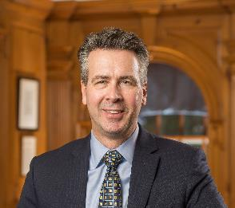
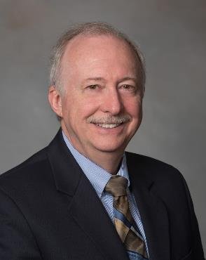
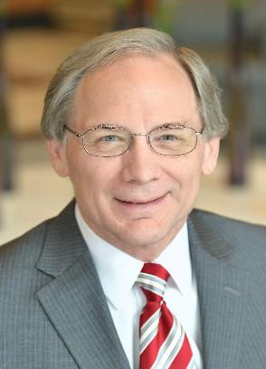
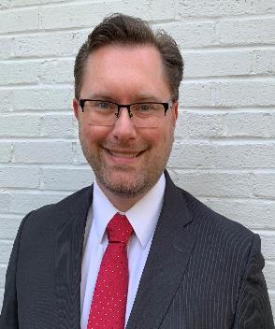
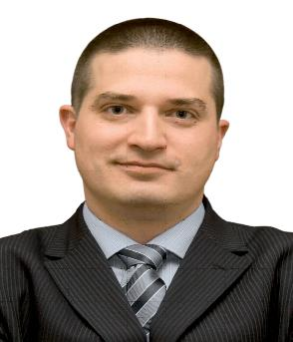
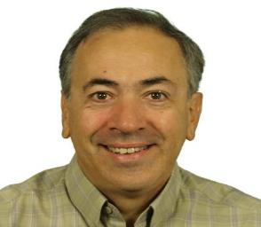
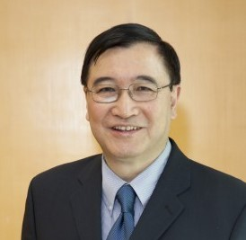
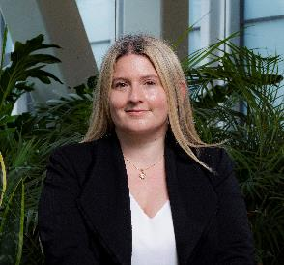
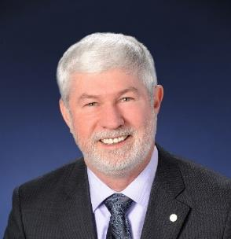
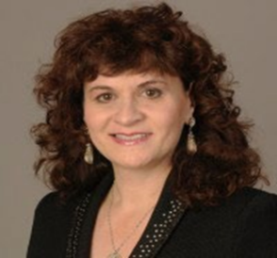
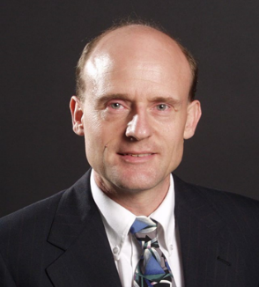
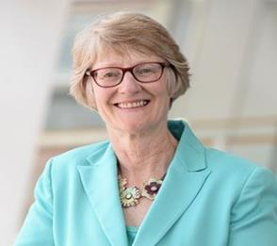
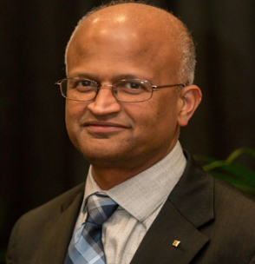
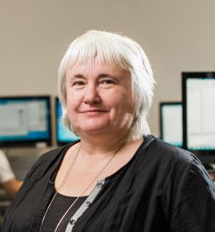
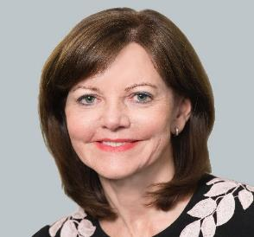
2024 IEEE Foundation Board of Directors
Ralph Ford
Jerry Hudgins
John McDonald
Christopher Geiger
Marko Delimar
Alex Acero
Nim Cheung
Lorena Garcia
Howard Michel
Karen Panetta
Steve Phillips
Sarah Rajala
Tomy Sebastian
Sarah Spurgeon
Mary Ellen Zellerbach
Notes:
The IEEE Foundation is fortunate to be led by a group of smart, dedicated and compassionate IEEE members who work diligently to translate the values of our donors into social impact. These 15 people dedicate significant time, talent and treasure every year to ensure IEEE’s philanthropic programs are robust and advancing technology for the benefit of society.

Slide 13


Slide 14




IEEE Foundation
445 Hoes Lane, Piscataway, NJ, 08854-4141
donate@ieee.org
www.ieeefoundation.org
Visit: www.ieeefoundation.org
Give: ieee.org/donate
Email: donate@ieee.org
Call: +1 732 562 3860

Slide 15
Appendix/Background Information

Slide 16



IEEE Foundation Origins
Incorporated in the State of New York on 16 Feb 1973
Purpose as defined in Certificate of Incorporation =
Further the scientific and educational purposes of IEEE
Qualified by the US Internal Revenue Services as a 501(c)(3) Public Charity
Notes:
IEEE Board of Directors approved the establishment of the IEEE Foundation during its 17 Jan 1973 meeting. Less than one month later, the IEEE Foundation was officially launched and has served the IEEE community for more the 5 decades with the core purpose of furthering the scientific and educational purposes of IEEE.
The IEEE Foundation is a qualified public charity in the United States under the IRS code 501c3. Donations to the IEEE Foundation are tax-deductible to the fullest extent allowed by law in the United States. For other countries, donors should check with your local tax adviser regarding tax deductions of charitable contributions

Slide 17
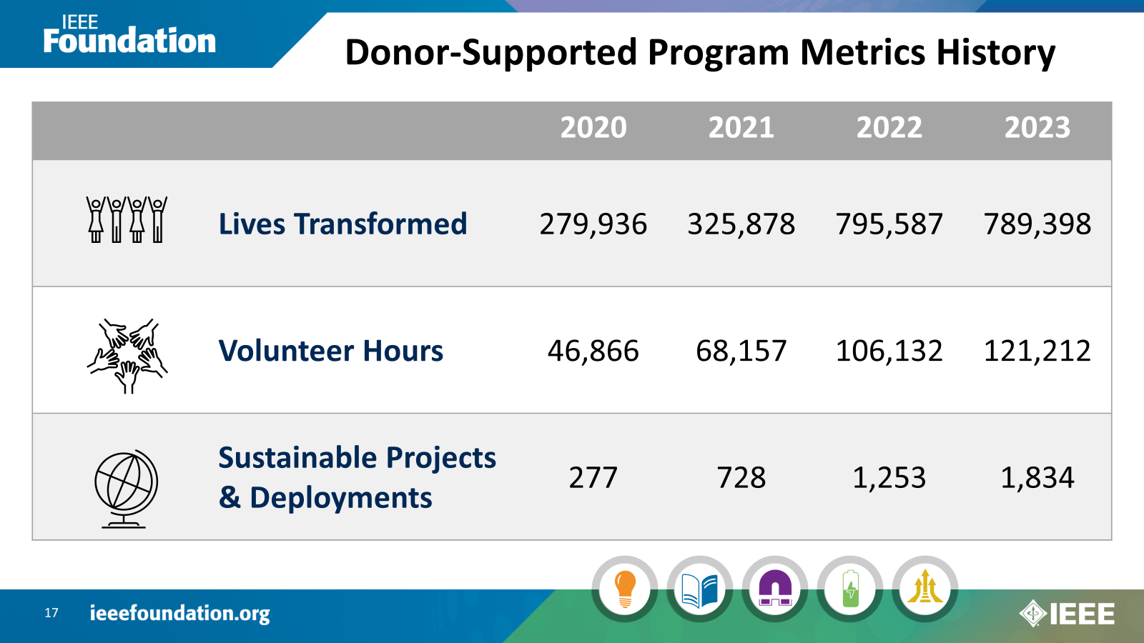



Donor-Supported Program Metrics History
 |  | 2020 | 2021 | 2022 | 2023
 | Lives Transformed | 279,936 | 325,878 | 794,947
 | Volunteer Hours | 46,866 | 68,157 | 106,132
 | Sustainable Projects & Deployments | 277 | 728 | 1,253
Notes:
Collectively and individually these IEEE programs are making a difference. They stats you see on the screen represent the impact made in each of these years.

Slide 18



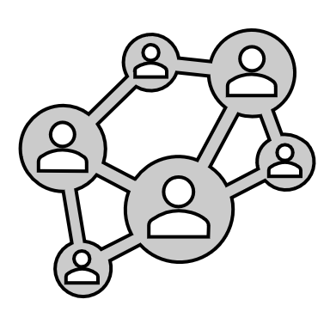

IEEE Foundation Role
What We Do
What We Don’t Do
Lend philanthropic guidance and expertise
Operate without Significant IEEE Partnership
Manage financial intake and reporting
Manage IEEE Programs
Connect donors with programs that match their interests and values
Invest in programs NOT affiliated with IEEE
Notes:
In thinking about the overarching role the IEEE Foundation serves in the IEEE eco-system – consider us to be similar in function to a university or hospital related foundation.
In fulfilling this role – we
Lend philanthropic guidance and expertise to IEEE run programs helping them grow their impact and augment their operations through philanthropy
Manage financial receipt and reporting of donations ensuring IEEE fulfills its fiduciary obligations to our donors
Connect donors to the IEEE programs that match their interests and values
What we don’t do is:
Operate without an IEEE program partner – we only hold funds or invest in programs that are operated by IEEE.
While we manage the donations for IEEE, we do not manage the programs. That is left to the IEEE OUs who hold funds with the Foundation. This includes, but is not limited to:
Managing the Program effectively and efficiently within budget,
Effectively measuring & reporting on program specific benchmarks and metrics
Any third-party seeking funding from the Foundation MUST have an IEEE OU partnership. We do not provide funding outside of the IEEE ecosystem.

Slide 19
Funding Available for Philanthropic
Programs or Projects
The Foundation is interested in supporting:
  New/existing projects and programs that improve access to technology, enhance technological literacy, and/or support technology education
  Fundraising dollar match opportunities
Proposed Programs/Projects:
  Expected to result in measurable and lasting impacts
  Operated by an IEEE units
Requests are accepted on a rolling basis all year.
For details, criteria, terms & conditions, and forms visit: https://www.ieeefoundation.org/funding-requests
Notes:
The Foundation has funding available to invest in IEEE in philanthropic programs/projects.
The Foundation is interested in supporting:
New/existing projects or programs that improve access to technology, enhance technological literacy, and/or support technology education
Workshops intended to bring together like minded individuals to work on societal issues that could benefit from technology and then disseminate the results to a larger audience
Fundraising dollar match opportunities for established IEEE programs who have a fund/funds with the Foundation to drive donor giving

Slide 20
Guiding Principles
Vision:
To be the heart of IEEE charitable giving and philanthropy.
Core Values:
Integrity - We act ethically and respectfully in every relationship and fulfill our obligations in a trustworthy, transparent, and fair manner.
Excellence - We challenge ourselves to deliver the very best in all we do, embrace the power of focus, and drive for meaningful outcomes.
Collaboration- We promote an inclusive and equitable culture and support global programs to enable the world’s citizens to invest in the application of technology that collectively benefits all humanity.
Stewardship - We act with courage to advance diversity in the technical profession, shape a more impactful future in the pursuit of transformational change and make decisions with focused purpose to safeguard the assets entrusted to us.
Mission:
To expand the IEEE charitable body of work by inspiring philanthropic engagement that ignites a donor’s innermost interest and values.
Notes:
As the philanthropic partner of IEEE, we connect IEEE member-led initiatives with financing, expertise and philanthropic guidance.
Our set of guiding principles – our Vision, Mission and Core Values provide the framework and focus to help us achieve this objective for the benefit of society.

Slide 21
Many Ways to Make a Gift of Treasure…
Online at www.ieee.org/donate
Mail a check to IEEE Foundation
Leverage company matching –
dollars & volunteer hours
Tribute Giving –
‘in honor or memory’
IRA Charitable Rollover
Donor Advised Funds
Appreciated Marketable Securities
Donate cash prizes and honoraria
Appreciated Cryptocurrency
Estate Giving – bequests & beneficiary designations
Notes:
The IEEE Foundation offers many different ways to share your treasurer – some make an impact today and others are setting the stage for tomorrow.
We welcome gifts of all sizes to the program that matches your values and passions.

Slide 22
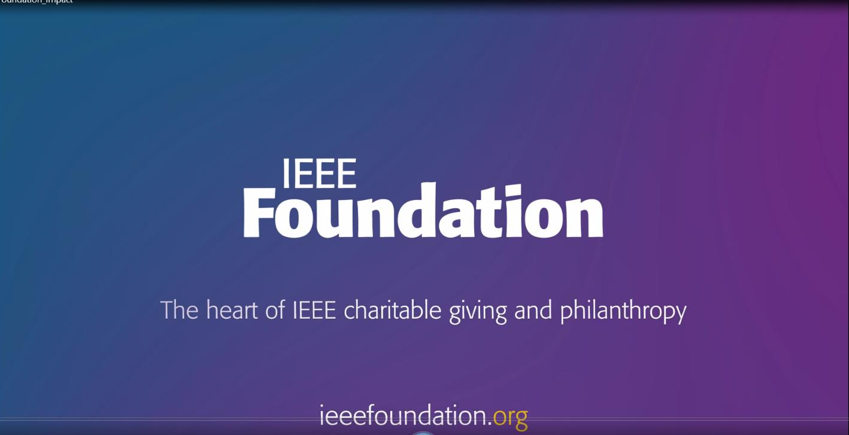
https://vimeo.com/904536191

Slide 23
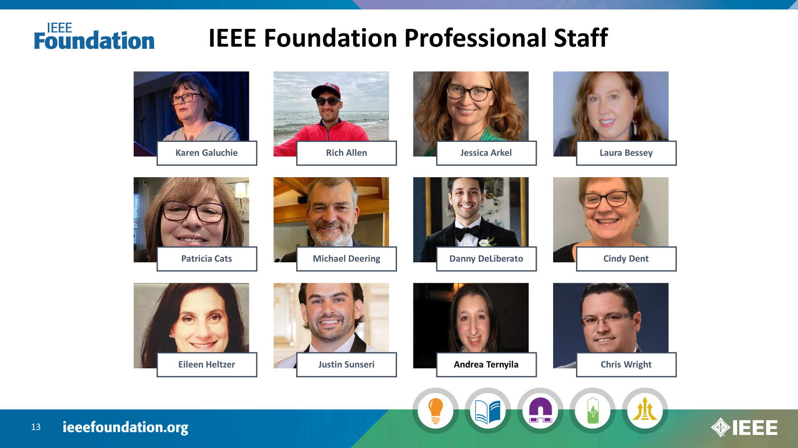
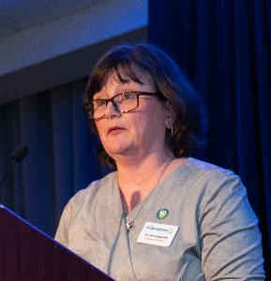
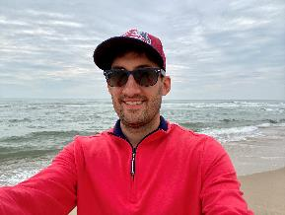
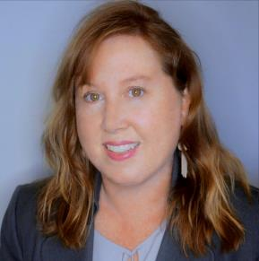

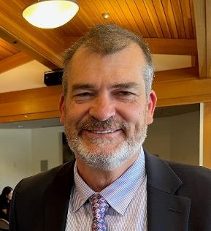
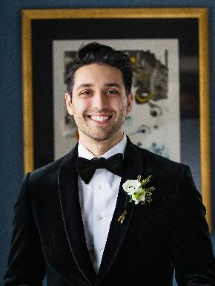
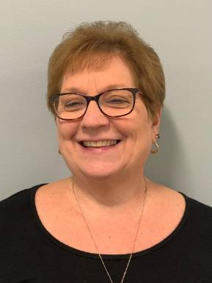
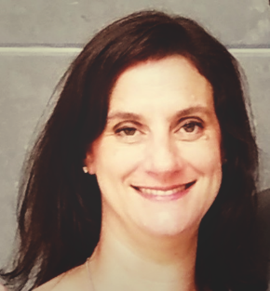
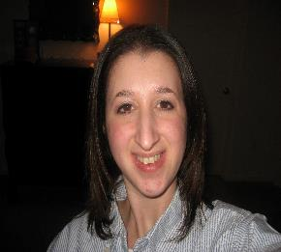
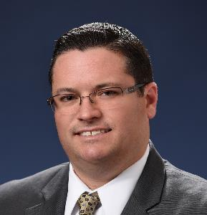
IEEE Foundation Professional Staff
Karen Galuchie
Rich Allen
Laura Bessey
Patricia Cats
Michael Deering
Danny DeLiberato
Cindy Dent
Eileen Heltzer
Andrea Ternyila
Chris Wright
Notes:
The work of the IEEE Foundation Board is complimented by a dedicated and compassionate team of professionals who work with our donors, IEEE program partners and IEEE Foundation Board to deliver opportunity, innovation and impact, and advance the IEEE mission across the globe

