Slide 1
IEEE Aerospace Electronic Systems
Financial Data Discussion
Steve Butler
2 February 2026
Cairo, Egypt

Slide 2
Objectives of Today’s Presentation
Strengths, Weaknesses, Opportunities, Threats (SWOT)
VP Finance Transition (from Mike Noble to Steve Butler)
Review Finances in 2025 (Plan, Budget, Actuals, and Closeout)
  Year 2025 (2025 Actuals) will not “closeout” until March 2026
  Actuals in this brief are pulled January 2026 but mostly based on October 2025 data
  Review Finances in 2026 (Plan, Estimated Budget, no Actuals)
Review changes occurring in 2025 and 2026
Review initiatives in place during this transition
BLUF - 2025 was a successful year for AESS and
we are entering 2026 healthy, with a good year ahead

Slide 3
1. SWOT
Strengths:
  Healthy surplus (based on December data)
  Good reserve account, good revenue in both conferences and publications
  Positive operational net
  Great major publications complemented by new ones
Weaknesses:
  New VP Finance
Opportunities:
  AESS well positioned to grow new initiatives and influence new technologies
Threats:
  Changes in IEEE Financial Management may impact AESS processes

Slide 4
2. Transition of VP Finance
The selection of Steve Butler for VP Finance was “out-of-cycle” on 12-10-2025
Mike Noble, Fulvio Gini, and Steve Butler met with Sandra Duran (IEEE Finance) on 12-17-2025
  Mike is locked out of the NextGen financial tool (and Peter)
  Steve attended the IEEE TAB-FM Financial Committee meeting on 1/5
  Steve and Mike presented the “Transition Plan” to AESS leadership on 1/9
  Steve gained access to the NextGen financial tool on 1/21
Society Treasurer training April 17

Slide 5
3. Year 2025 Execution Status (AI 1250)
Society Ops higher than budget and forecast due to Grand Challenge and Foundation contributions
Society membership on track to budget and forecast
Journals Transactions performing better than budget due to higher overlength revenue - overall performance may improve with final revenue distributions
Conference Events year end actuals on track with Oct forecast
* Preliminary 2025 actuals are pending final publication true-ups (packaged products, production costs, co-pub allocations)
Execution tracking is on pace to meet our latest forecast with projected net surplus
We’re financially very healthy

Slide 6
3. Budget for 2026
NOTE: larger surplus is due to removal of indirect corporate overhead in the budget
Corp overhead will be assessed at the end of the year
2024 saw roughly $1.1M in overhead charges spread across cost and product centers
Assuming 2025 overheads carry to 2026, the real net is ~$800k surplus (not $2M)
This figure is in family with previous years

Slide 7
3. Summary Budget – Revenue
Some changes are due to accounting process changes, not actual income, expenses changes
  e.g., technically sponsored papers have an overhead charge recouped by charging the author
- This put and take is eliminated in 2026
 |  | FY24 | FY25 | FY25 | FY26
 |  | Actual | Budget | Oct Fcst | Budget
 |  | Total Revenue | Total Revenue | Total Revenue | Total Revenue
PD_000000 - None | CC_21015 - Societies Operations | 0.4 |  | -
PD_000000 - None | CC_21020 - Meetings /Conference | 20.9 | 17.7 | 49.8 | -
PD_000000 - None | CC_21030 - Soc Publication Related Support | - | 0.2 | 0.1 | 0.1
PD_000000 - None | CC_21065 - Society Initiatives
PD_505002 - Society Education Products | CC_00000 - None | 0.1 |  | 0.1 | 0.0
PD_306001 - Society Membership | CC_00000 - None | 88.0 | 84.3 | 88.1 | 88.1
PD_140009 - Aerospace & Electronic Conferences Digital Library | CC_00000 - None
PD_120023 - Trans on Aerospace & Electronic Systems | CC_00000 - None | 1,821.1 | 1,370.7 | 2,278.0 | 2,507.6
PD_120111 - Journal of Lightwave Technology | CC_00000 - None | 58.9 | 55.7 | 60.1 | 61.9
PD_120152 - IEEE Journal of Miniaturization for Air & Space Systems | CC_00000 - None | 2.1 | 1.9 | 7.2 | 3.3
PD_120160 - Open Journal of Systems Engineering | CC_00000 - None | 2.8 | 6.8 | 2.4 | 1.3
PD_120166 - Transactions on Radar Systems | CC_00000 - None | 24.4 | 7.0 | 32.8 | 46.0
PD_110008 - Aerospace & Electronic Systems Magazine | CC_00000 - None | 152.8 | 149.8 | 156.8 | 149.0
PD_220006 - Conference Distributed Package Products | CC_00000 - None | 1,289.4 | 1,241.4 | 1,347.6 | 1,425.6
PD_210000 Conference Events | CC_00000 - None | 2,423.7 | 2,094.7 | 1,697.9 | 1,751.5
Operational Product | Operational Cost Center | 5,884.7 | 5,030.3 | 5,720.7 | 6,034.4
PD_000000 - None | CC_21075 - IEEE Reserve Allocation
All Product | All Cost Center | 5,884.7 | 5,030.3 | 5,720.7 | 6,034.4
Overhead will come when we close out the year - March
7

Slide 8
3. Summary Budget – Expense
Budgeted society ops cost center and publication expenses reflect decrease compared to prior years due to removal of IEEE and TA overheads
1
8
Tasks, Society Budget, Society Budget Summary

Slide 9
3. Summary Budget – Expense (External View)
 |  | FY24 | FY25 | FY25 | FY26
 |  | Actual | Budget | Oct Fcst | Budget
 |  | AC_500000 - Expense | AC_500000 - Expense | AC_500000 - Expense | AC_500000 - Expense
PD_000000 - None | CC_10130 - Education Committee | - | 1.0 | - | -
PD_000000 - None | CC_10135 - Membership Committee | 1.3 | 1.0 | 1.7 | 0.9
PD_000000 - None | CC_10140 - Awards Committee | - | 1.0 | - | -
PD_000000 - None | CC_10155 - Chapter Committee | 53.0 | 50.0 | 87.6 | 25.0
PD_000000 - None | CC_10160 - Other Committee | - | - | 9.9 | -
PD_000000 - None | CC_21010 - Executive Office | - |  | -
PD_000000 - None | CC_21015 - Societies Operations | 477.7 | 693.5 | 752.9 | 771.5
PD_000000 - None | CC_21020 - Meetings /Conference | 15.8 | 7.5 | 18.0 | 20.8
PD_000000 - None | CC_21030 - Soc Publication Related Support
PD_000000 - None | CC_21065 - Society Initiatives | 62.5 |  | -
PD_505002 - Society Education Products | CC_00000 - None | 0.0 | - | 0.0 | 0.0
PD_306001 - Society Membership | CC_00000 - None | 4.1 | 2.5 | 4.3 | 4.3
PD_120023 - Trans on Aerospace & Electronic Systems | CC_00000 - None | 106.9 | 75.9 | 124.1 | 137.6
PD_120111 - Journal of Lightwave Technology | CC_00000 - None |  |  |  | -
PD_110008 - Aerospace & Electronic Systems Magazine | CC_00000 - None | 181.9 | 128.1 | 192.2 | 186.8
PD_210000 Conference Events | CC_00000 - None | 2,108.0 | 1,619.2 | 1,467.9 | 1,497.4
External View (apples to apples view w/o overheads) or internal product costs
9
Tasks, Society Budget, Society Budget Summary

Slide 10
3. Summary Budget – Bottom Line
 |  | FY24 | FY24 | FY24 | FY25 | FY25 | FY25 | FY25 | FY25 | FY25 | FY26 | FY26 | FY26
 |  | Actual | Actual | Actual | Budget | Budget | Budget | Oct Fcst | Oct Fcst | Oct Fcst | Budget | Budget | Budget
 |  | Total Revenue | Total Expense | Net Profit | Total Revenue | Total Expense | Net Profit | Total Revenue | Total Expense | Net Profit | Total Revenue | Total Expense | Net Profit
Operational Product | Operational Cost Center | 5,884.7 | 5,047.0 | 837.7 | 5,030.3 | 4,542.5 | 487.8 | 5,720.7 | 5,104.8 | 615.8 | 6,034.4 | 3,994.3 | 2,040.1
PD_000000 - None | CC_21075 - IEEE Reserve Allocation |  | (1,200.0) | 1,200.0 |  |  |  |  | - | -
All Product | All Cost Center | 5,884.7 | 3,847.0 | 2,037.7 | 5,030.3 | 4,542.5 | 487.8 | 5,720.7 | 5,104.8 | 615.8 | 6,034.4 | 3,994.3 | 2,040.1
Migration of initiatives to ops (21065 --> 21015) completed in 2024
2026 changed budget and look completely – no overhead charges
IEEE board approved methodology for overhead – no longer budgeted or forecast
Apples to apples – external account view
BLAB: focus on external expenses which we can control
And … we are fundamentally not resource limited
10
Tasks, Society Budget, Society Budget Summary

Slide 11
4. Changes in IEEE Finance
Operations Spending Up 10%
Conference Returns Lower
New Processes in IEEE HQ Budget Products and Categories
US Tax Rules
Higher Over Limit Page Count (OLPC)
Global Conference Payment Process
Financial Health Ad Hoc committee revising the parameters by which Society Financial Health is calculated

Slide 12
4. Tax Exempt Status
The Institute of Electrical and Electronics Engineers (IEEE) and its Foundation are recognized as 501(c)(3) tax-exempt organizations under U.S. law, meaning they qualify for federal tax exemption and donations to them are generally tax-deductible for U.S. donors
They operate for public benefit through educational and scientific work, and the IEEE Foundation specifically manages donations to support these efforts
Benefits to individuals may create tax challenges
- e.g., AESS conference publications & TAES free for all AESS Society and
Student members
Raises private benefit concerns – e.g.,
  - Discounts on article processing fees, member recruiting initiatives and discounts
  - Member recruitment initiatives may now be insufficient for tax exemption

Slide 13
4. Over Limit Page Count (OPC) Tax Implications
Half of the publications charge OPCs – Society sets fees
Some societies offer member discounts and variable fees
Some funders disallow grant use for OPC charges
There is growing concern the member discounting practice, which can amount to more than the value of membership could jeopardize the IEEE’s tax status

Slide 14
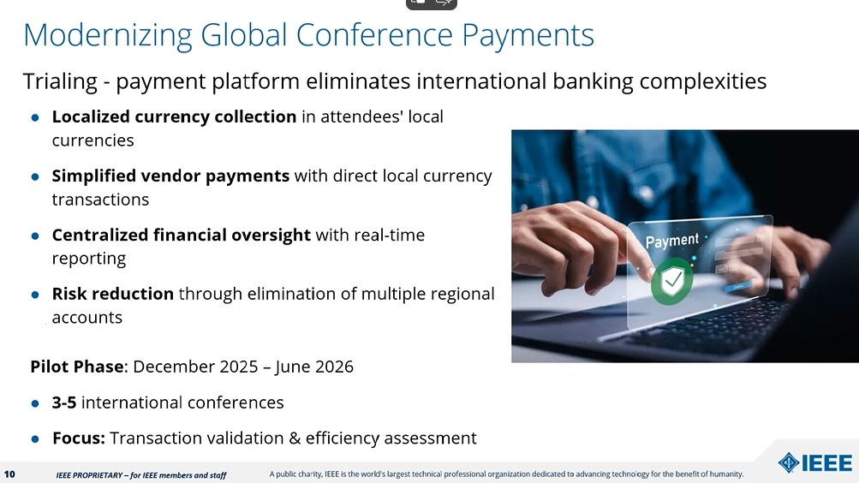
4. Global Conference Payment Process

Slide 15
5. Initiatives
Present financial data in an intuitive way such that the officer can quickly and fully understand their execution data
  - Group budget charts by VP area to improve value to VP budgeting
- Awards, Publications, Industry Relations, Technical Ops, Education,
Finance, Member Services, Young Professionals/Graduate/Undergrad

Slide 16
5. Words from Peter Willet (VP Finance 2024)
I was expecting the VPF position to be able to contribute three things:
  a perspective on and snapshot of the AESS budget and forecast
  a view of the larger financial landscape at IEEE
  a lever to control and improve the AESS budget
I found the VPF is only able to do 1 & 2
  NextGen is quite good (lots of data) but is not easy to work with
  Our IEEE budget contact (Sandra Duran) is very helpful and responsive to any question
  VPF needs to go to the annual (usually April) “Treasurer’s Workshop”
Up to 2024, almost all boxes in NextGen were “grayed out”.
  I tried to rationalize the budget so the VP’s would have instant Cost Center and spend-status access (through the NextGen contact: VPF, Treasurer, President) with account categories that help us understand what we have (e.g., “DL Travel”)
  The bottom line is that the VPF position is more informational, less executive
    That’s not to say the VPF position is not useful

Slide 17
Conclusion
AESS remains healthy and in position to prosper
- Financial Surplus Confirmed: Healthy surplus forecasted for
December 2025 despite operational spending up 10% since 2020
- Open Access Revenue Growth: Reached approximately $15.8 million in
2025, doubling contributions to Societies and Councils
Changes ahead (e.g., IEEE overhead charges, US Tax laws, Global contract)
Continue to grow on the work by Peter Willet and Mike Noble
We will have 2025 close-out and more detailed information on 2026 Plan, Budget, and Actuals before our Spring meeting

