Slide 1
IEEE Aerospace Electronic Systems
VP Member Services
Vince Socci
2026 AESS Officer Strategic Planning Meeting
2 - 3 February 2026
Cairo, Egypt

Slide 2
Outline
Recent Accomplishments
Current State of AESS Membership
Current Challenges & Issues
Short-Term Goals
Long-Term Goals

Slide 3
Recent Accomplishments
Since the Fall BoG Meeting – Current State Assessment
Completed Chapters Coordinator Handoff (Matt Ritchie is 2026 Chapters Coordinator)
Completed VP Member Services Transition handoff
Completed Kickoff Member Services Committee
Opened Chapter Activity Funding
Reviewed Chapter Handbook
Prepared 2026 plan

Slide 4
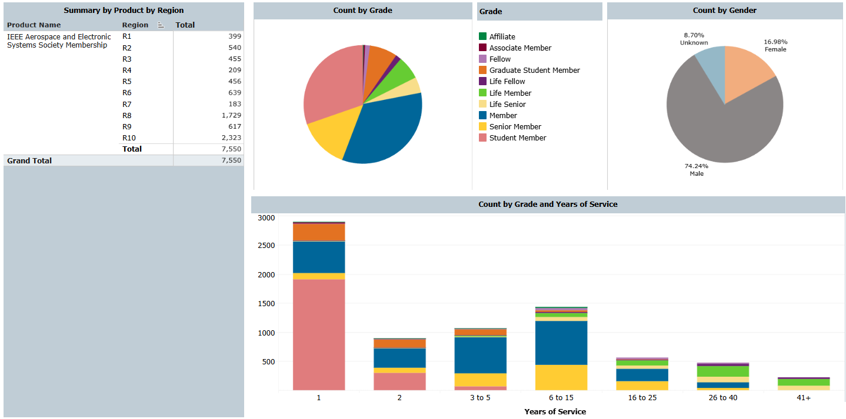
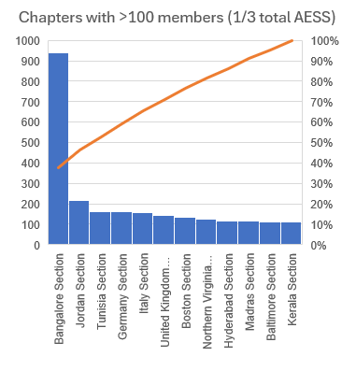
Our AESS Membership

Slide 5
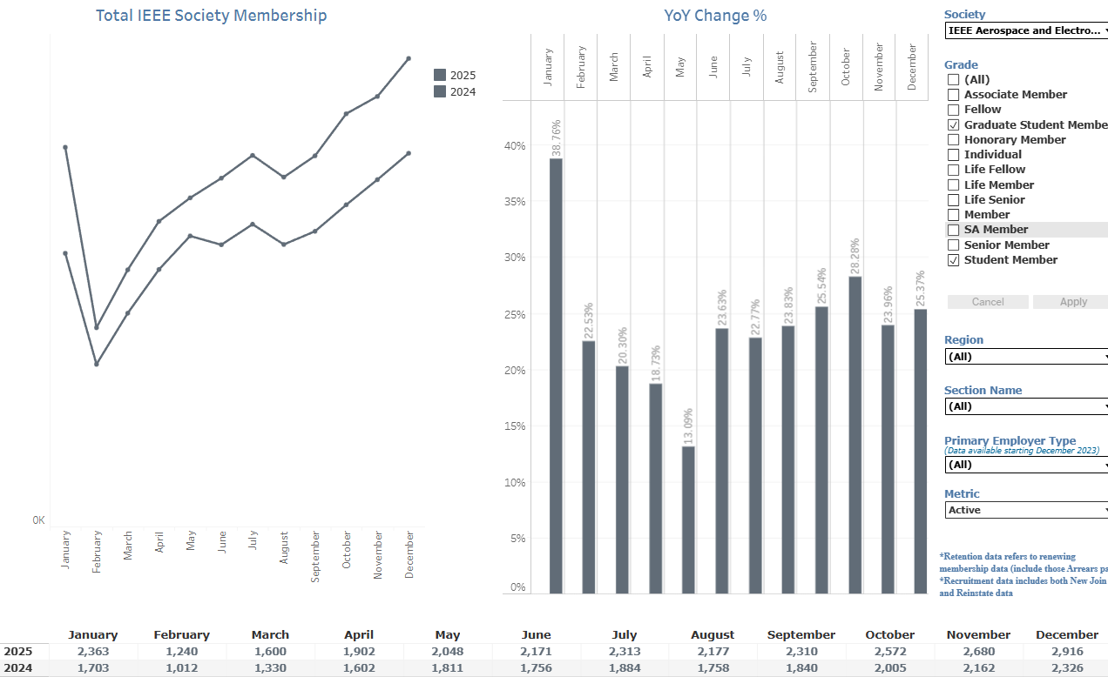
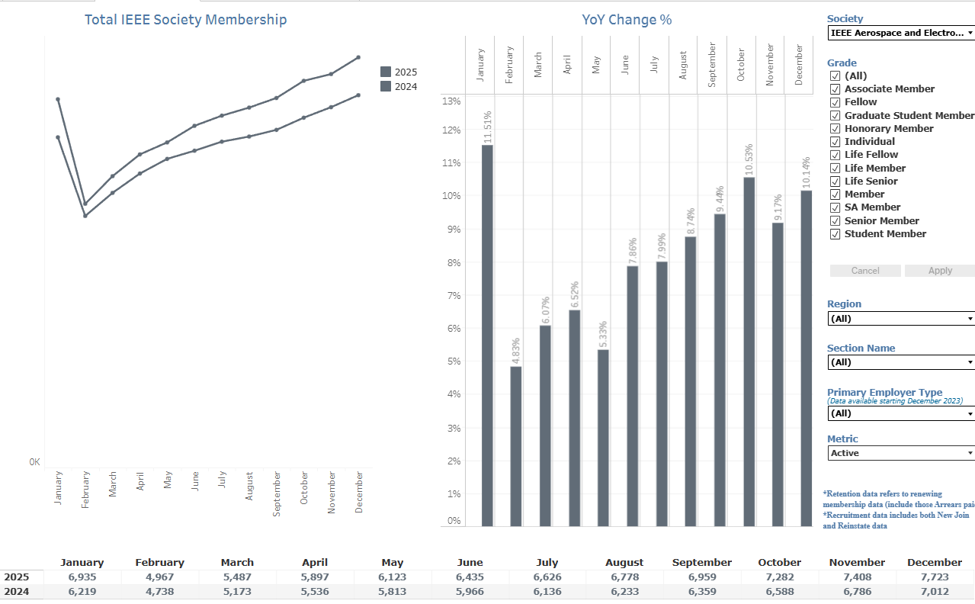
Year-over-year Membership Growth 2025/2024
R1 | R2 | R3 | R4 | R5 | R6 | R7 | R8 | R9 | R10 | Egy | Tun | Ken | UK
-1.72 | -0.36 | 1.09 | 9.14 | -3.37 | -1.19 | 17.18 | 17.21 | -2.60 | 23.40 | 500.0 | 15.23 | 30.00 | 2.78
Student Members (25.4% YoY Growth)
All Members (10.1% YoY Growth)

Slide 6
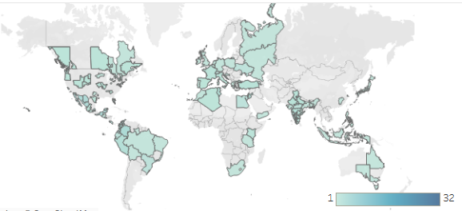
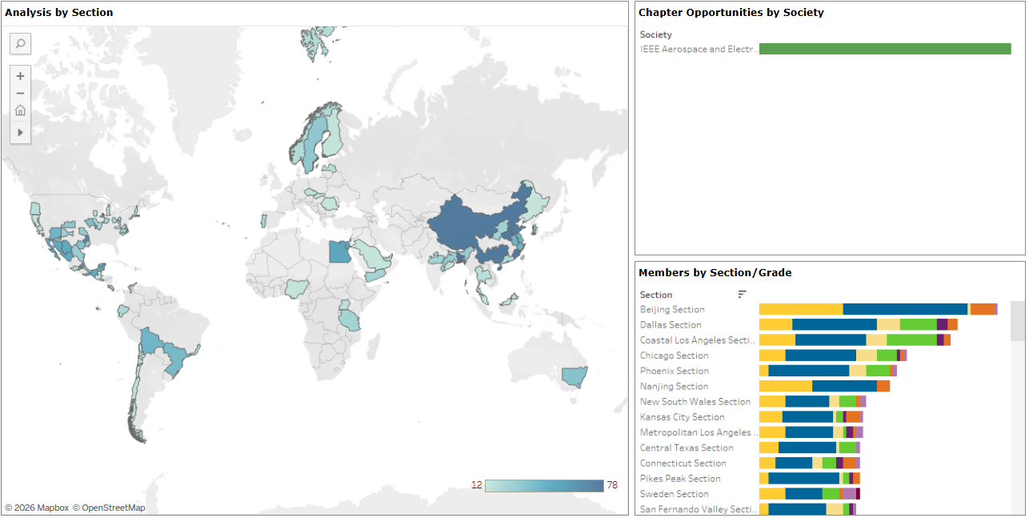
Geographical Distribution
Current Chapters
Some need revitalization
Hold chapter summits
Potential Chapters
Form where membership > 40 members
Top 5 prospects:
      Beijing Section (71 members)
      Dallas Section (59)
      Coastal Los Angeles Section (57)
      Chicago Section (44)
      Phoenix Section (41)

Slide 7
Leverage Chapter Activity Funding for Chapter Health
Help chapters use funding to create engagement and growth
Use chapter activity funding as seed funding for new chapters
2025 totals: 115 requests, 94 approvals, $86K funding

Slide 8
Current Challenges & Issues
Compliance: Some chapters have little engagement and low membership
Leadership: Chapter volunteers are necessary for all chapter revitalization and organization activities
Systems: Chapter Activity funding and Member Services Award criteria must be codified so we can remain consistent with expectations and decisions
Guidance: Chapter handbook is great (needs some minor updates) and can be used as curriculum for chapter summits
Metrics: Need a reliable way to measure member engagement and activities by each chapter
Retention: Understanding retention rates (not the same as member growth rates) – Are students staying on as professionals? Are professionals staying for their career? What is our member churn?
Notes:
AESS Requests and awards: https://docs.google.com/spreadsheets/d/15J_cwlM7dX3xJ_KwcGYYc_Ky8GEoV3x964OWyM9aVjo/edit?gid=456319551#gid=456319551

Slide 9
Short-Term Goals
Revitalize current chapters/SBCs – 4 chapter summits to promote effective operations
Organize members currently without chapters/SBCs – Formation of 5 new chapters
  Targets: Beijing, Dallas, Los Angeles, Chicago, Phoenix
Systematize member operations – Document our processes and decision criteria
Evangelize member resources – Promote educational, DL, chapter activities, panels, pubs
  Professional networking and mentoring, industry engagement (Arik Brown)
  Member engagement survey; PREMIER membership, WIE/YP engagement
Required AESS resources and support :
  Funding and admin support for Summits (estimate $600/attendee, funded through chapter activities)
  Member data for potential chapters
  Sustained Chapter Activity funding
  Member Services Committee continued support; International Directors support
Chapter Summit | Location | Event | Date | Regions
North America | Phoenix | BoG | May | R1-7
Asia | India | IEEE-SPACE | July | R10
South America | Peru | DSTEI | Sept | R9
Europe/Africa | UK | EuRAD | Oct | R8

Slide 10
Long-Term Goals
Once we get chapters on a solid foundation, shift focus to developing student branch chapters. Follow same ROSE format for student branch chapters
Promote opportunities for members without a local chapter to get engaged with the society
Promote new AESS membership across IEEE
Spend money to do good – Strategies for distributing funding to maximize member benefit
"The business of a for-profit is to make money; the business of a non-profit is to spend it.“ - Clara Barton (Founder of the American Red Cross)

