Slide 1
IEEE Aerospace Electronic Systems
President-Elect
Lorenzo Lo Monte
2026 AESS Officer Strategic Planning Meeting
2 - 3 February 2026
Cairo, Egypt

Slide 2

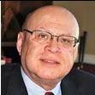

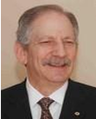
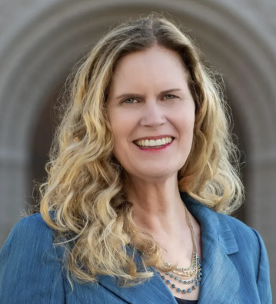
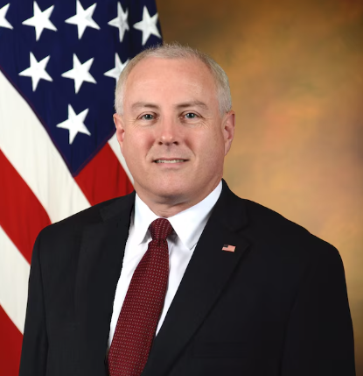
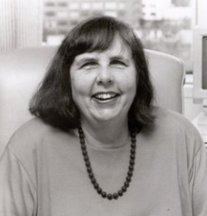
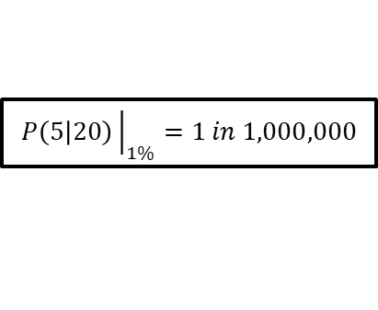
Recent Accomplishments
IEEE MEMBERS ~ 490k
AESS Members 1%
Ed
Palacio
Barry
Tilton
Peter
Eckstein
Kathleen
Kramer
Steve
Welby
Martha
Sloan
$$P\left(5 | 20\right){\left.​\right|}_{1\%}=1 in 1,000,000$$

Slide 3
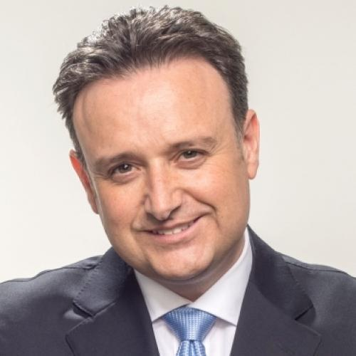
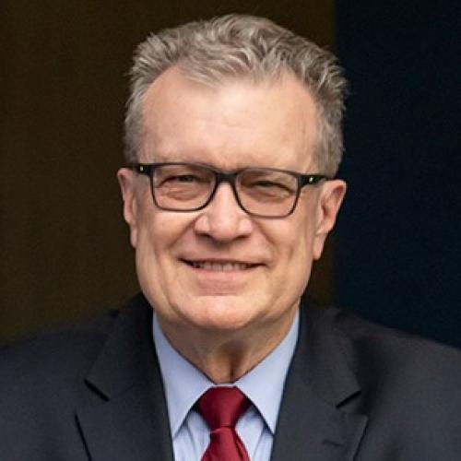
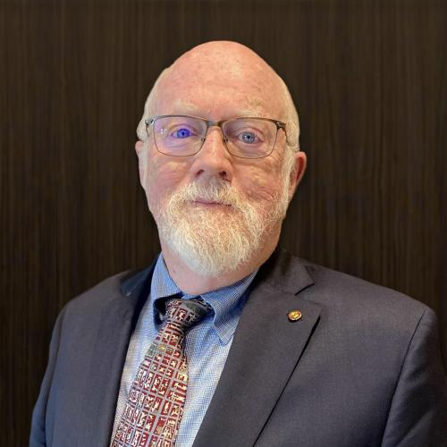

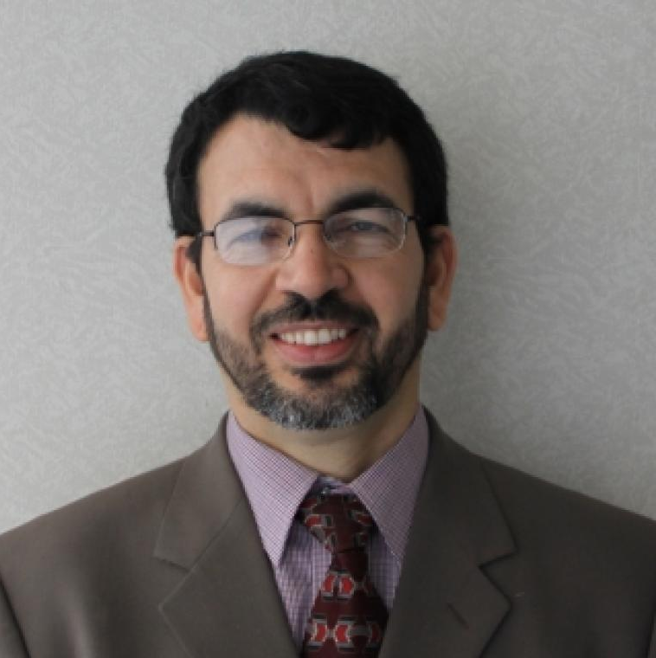
Vitality of AESS
Actuals
Projection
Society Vitality

Slide 4

Strategy Enables Operation
BoG drifts into operations when the strategy is unclear
At the SPM, our role is to set the frame:
  direction and priorities, guiding constraints,
  and the responsible allocation of resources.
  Within that frame, VPs and BoG do their best work by deciding how to execute.
“Trust, but Verify”: clear metrics,
periodic reviews, and
explicit definitions of success.
When strategy is clear, autonomy becomes a strength

Slide 5

Impact Happens Between Meetings
AESS does not create value in meetings: it creates value through execution between meetings.
Our greatest leverage is not adding more ideas but enabling progress.
Spend more time unblocking volunteers.
  Ask “What is slowing this down?”
  before asking “What else should we add?”
New initiatives often capture our imagination, but operational excellence are what members experience every day.
EXECUTION
IDEA
Ideas are how we grow, but execution is how we serve

Slide 6

Time Is Our Most Precious Resource
The scarcest resource in AESS is not funding, but the time and attention of committed volunteers.
Wise governance means spending that time where it creates the greatest benefit for our members.
  Not every issue deserves the same depth of attention; focus is what allows important work to move forward.
Before committing our time, we ask whether the effort is proportional to the value it creates for the Society.

Slide 7
Is This Initiative Worth Pursuing?
A Board-Level Discernment Guide
Member Value
  Who is clearly better off if we do this, and how will they actually experience that benefit?
Strategic Alignment
  Does this directly advance our stated priorities, or does it quietly dilute our focus?
Ownership & Capacity
  Who will own this work over time, and do they realistically have the capacity to sustain it?
System Impact
  What downstream effects will this have across the Society, intended or not?
Longevity & Stewardship
  Will this still make sense—and still be supported—three to five years from now?
Good governance is not about approving more ideas, but about choosing which ones deserve our collective energy

Slide 8

Build the Next Layer of Leadership
Our most lasting contribution is not what we approve, but who is prepared to lead next.
Each of us should regularly ask:
  Who am I mentoring?
  Who could step in tomorrow?
When leadership is continuously developed, the Society remains strong beyond any single term
Promote leadership as a Pipeline, not a Ladder

Slide 9
Recommendations for new VPs
You don’t need to have all the answers on day one
Revising your view is a sign of strength, not inconsistency
The best leadership is often invisible
BoG decisions shape real careers and communities
You are temporary custodians of a permanent institution.
Your job is to leave it stronger than you found it
Notes:
“When I first stepped into a leadership role like this, I assumed the challenge would be technical judgment—deciding what was right or wrong. What surprised me was how often the real work was listening, aligning, and helping good people move in the same direction.”

Slide 10
Thank You ☺

Slide 11

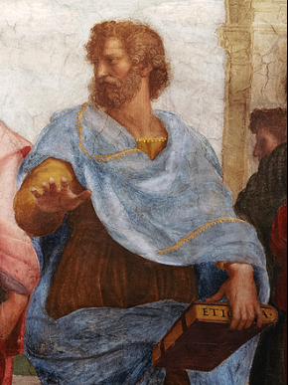
Levels of Thinking: A progression we recognize from experience
Thinking is shaped by expectations.
Dependent Thinking
Following the Rules
Thinking is guided by internally constructed principles
Self-Authoring Thinking
Holding my Beliefs
Thinking expands to include other minds
Mutual Thinking
Considering other Viewpoints
Thinking recognizes that meaning is context-dependent
Relativistic Thinking
Understanding all Perspectives
Thinking seeks coherence, not victory.
System Thinking
Seeing the Bigger Picture
Transformational Thinking
Good of the Whole
Thinking is oriented toward generativity and future impact.

