Slide 1
IEEE Aerospace Electronic Systems
Braham Himed
2026 AESS Officer Strategic Planning Meeting
2 - 3 February 2026
Cairo, Egypt

Slide 2
Congratulations to Mr. Abdelrahman “Tarek” Metwally, for establishing The AESS Egypt Section Chapter
Also, many thanks for supporting the 2026 AESS Strategic Planning Meeting (SPM)

Slide 3
Outline
Introduce New Board of Governors & Officers
  Roles
IEEE TAB Meetings
  Items of Interest
AESS Strategic Planning Meeting
  Accomplishments, Challenges, Short- and Long-Term Goals
Summary

Slide 4
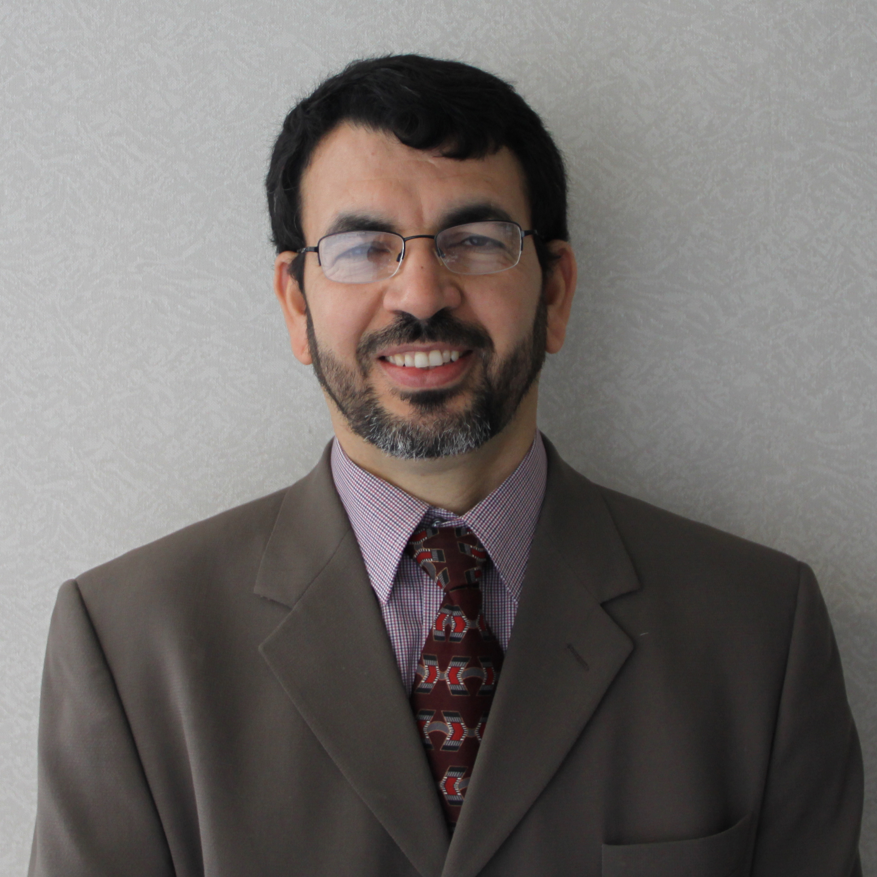
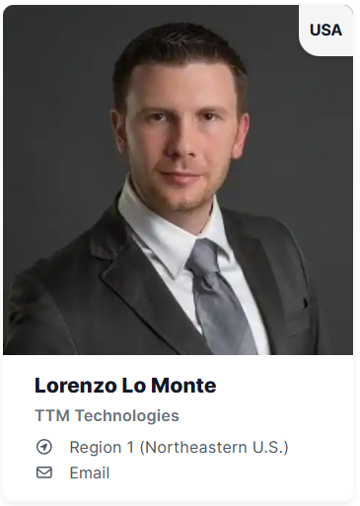
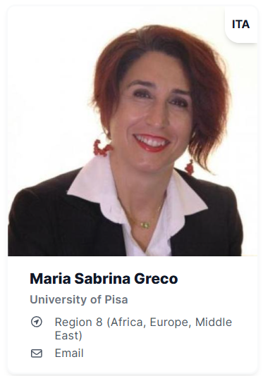
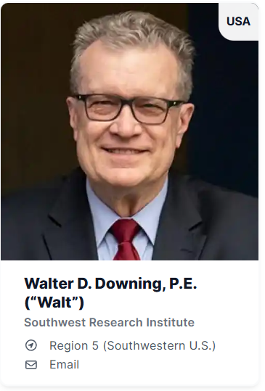
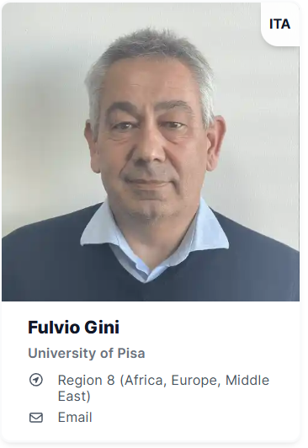
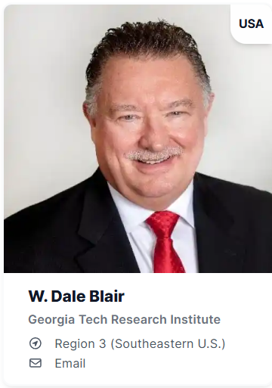
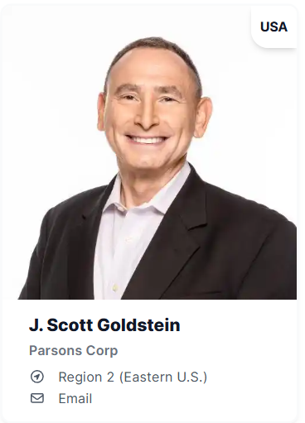
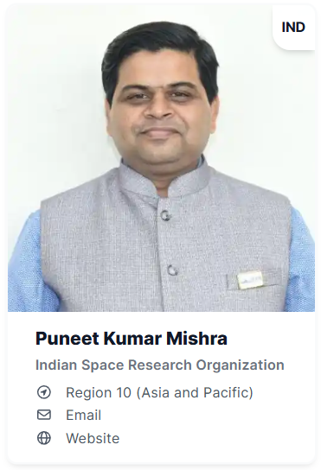
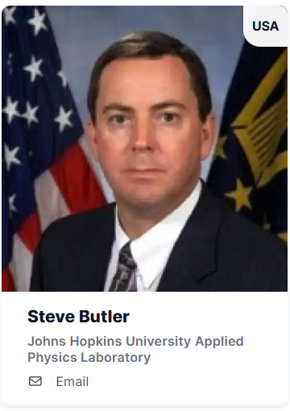
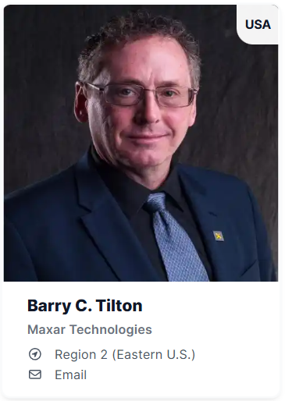
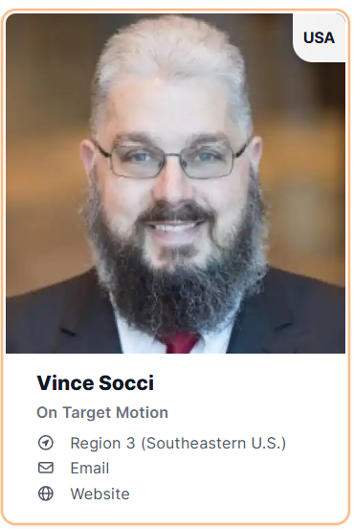
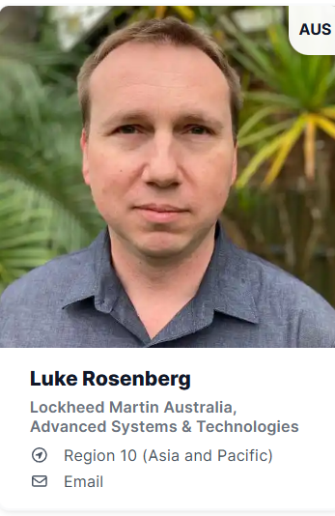
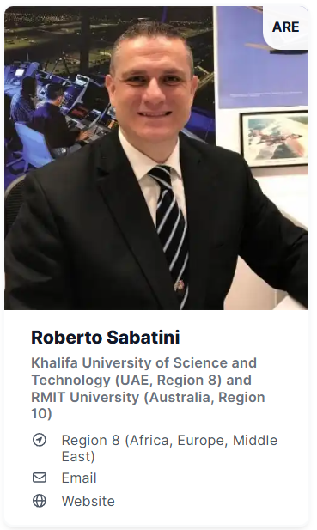
Officers (2026)
President-Elect
Past President
Secretary
Treasurer
President
Braham Himed
Vice President Awards
Vice President Conferences
Vice President Education
Vice President Finance
Vice President Industry Relations
Vice President Member Services
Vice President Publications
Vice President Technical Operations

Slide 5
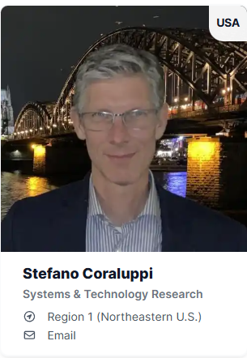
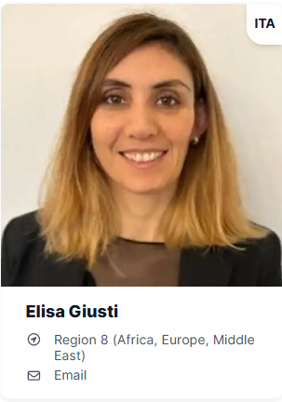
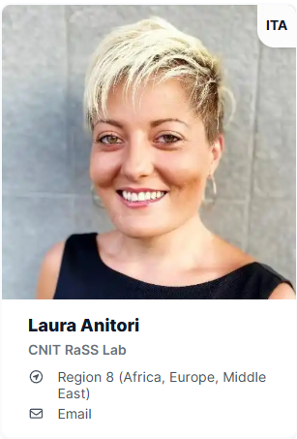
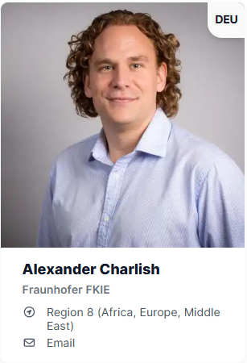
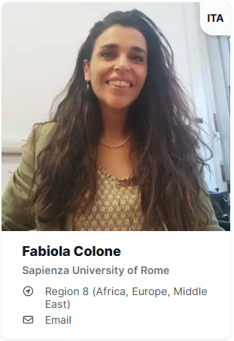
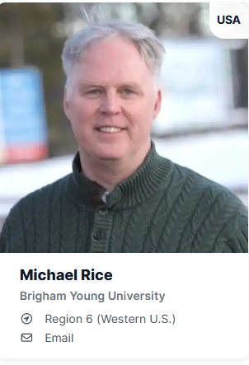
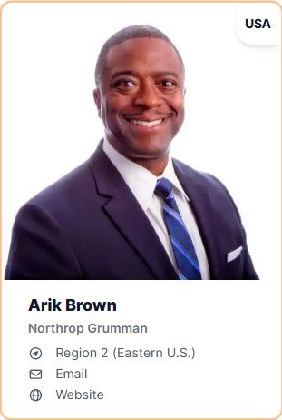
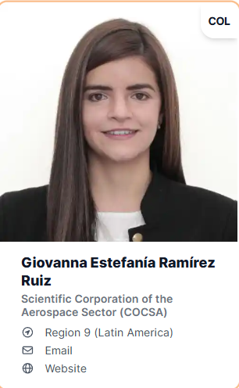
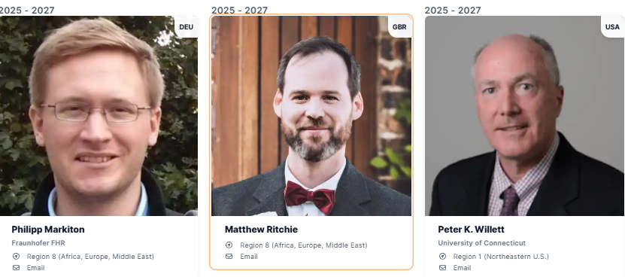

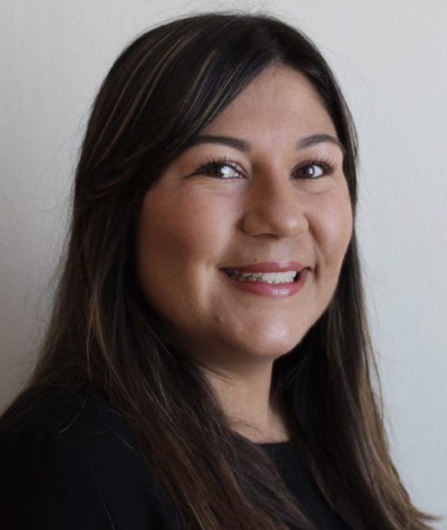
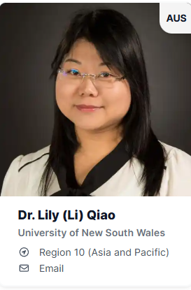

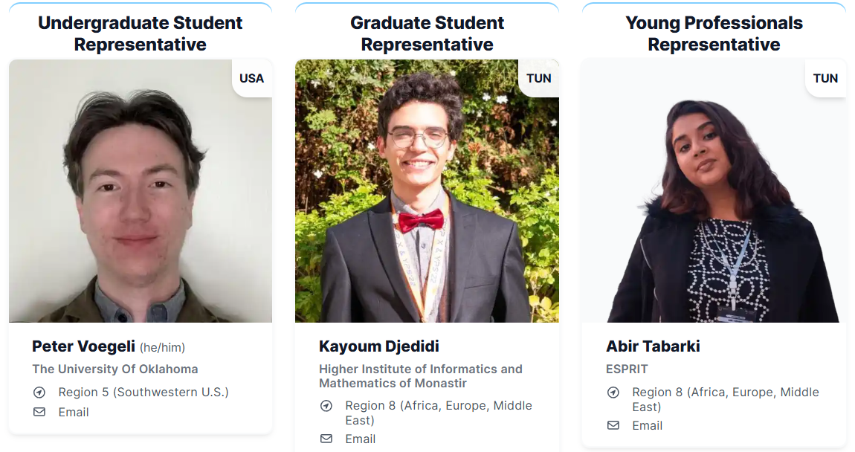
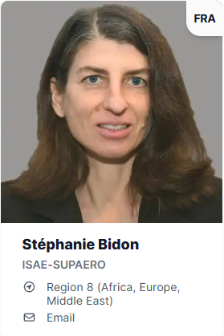

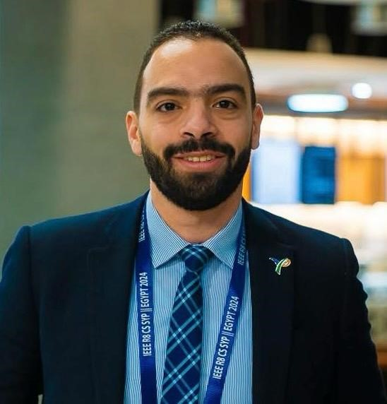
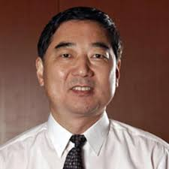


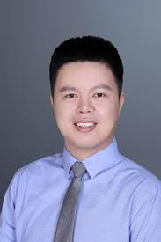
Members at Large (2026)
Presidential Appointments
International Directors
Julia Briggs, Operations Management

Slide 6
Objective as President
Grow AESS presence in under-represented regions
  Student enrolments (another 2,000+ growth in next 2 years)
  Increase chapter activities
  Hope to have at least one nominee from R8 (Africa + ME) in BoG
Strengthen AESS financial position
  Regroup form past losses
  Strengthen conferences and publications

Slide 7
IEEE TAB Objectives
IEEE TAB Presidents’ Forum – Focus Areas
  Advance AI-Augmented Hardware and Systems
    Hardware & system design global competition (Support IEEE priorities)
    Inter-society technology development and development
    Micro-foundry for chip prototyping and fabrication (for small companies)
    Lab in a box (for under-serviced areas)
    Online platform to support lab in a box and related activities
Inter-Society Collaboration
  Division IX – Sabrina Greco
  Division IV – Eric Mokole (former President of APS)

Slide 8
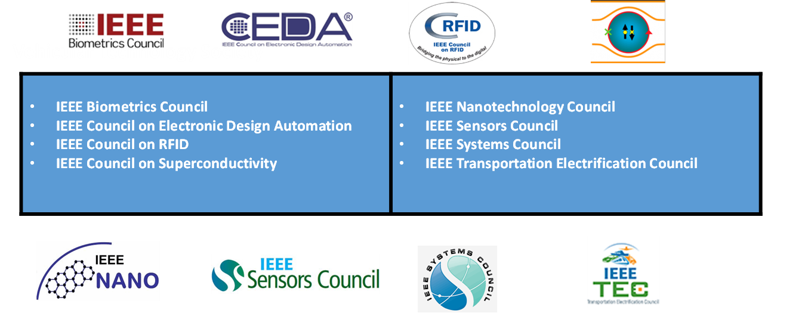
AESS Participation in Technical Councils

Slide 9
AESS Participation in Technical Communities
Blockchain Community
Brain Community
Digital Privacy Community
Digital Reality Community
Entrepreneurship Community
Future Networks Community
Technology for a Sustainable Climate Community
International Roadmap for Devices & Systems Community
Micro Electro Mechanical Systems Community
Public Safety Technology Community
Quantum Community
Pre-University STEM Community
Smart Cities Community
SusTech Community
TechEthics Community
Internet of Things Community

Slide 10






Programs, Incubation, Initiatives and Resources
Strategic Programs
IEEE Entrepreneurship
IEEE TechEthics
TAB Broadening Participation Committee
Coordination with MGA Affinity Groups:
  IEEE Young Professionals
  IEEE Women in Engineering
Future Directions Initiatives
Resources & Platforms
IEEE Resource Centers – education
IEEE DataPort – platform for data and project ideas
Notes:
Program Mission: coordination, amplification, and aggregation as well as programmatic gap analysis across all of TA.

Slide 11














2026 Future Directions Initiatives & Collaborations

Slide 12
AESS Strategic Planning Meeting
Accomplishments
Challenges
  Identify sources
  Proposed actions
  Timeline
Short-Term Goals
Long-Term Goals

Slide 13
Summary
Many thanks to those who made the trip to Cairo, Egypt
  Enjoy your time!
Very strong AESS BoG
  Great contributions
  Major activities
  Overall growth

