Slide 1
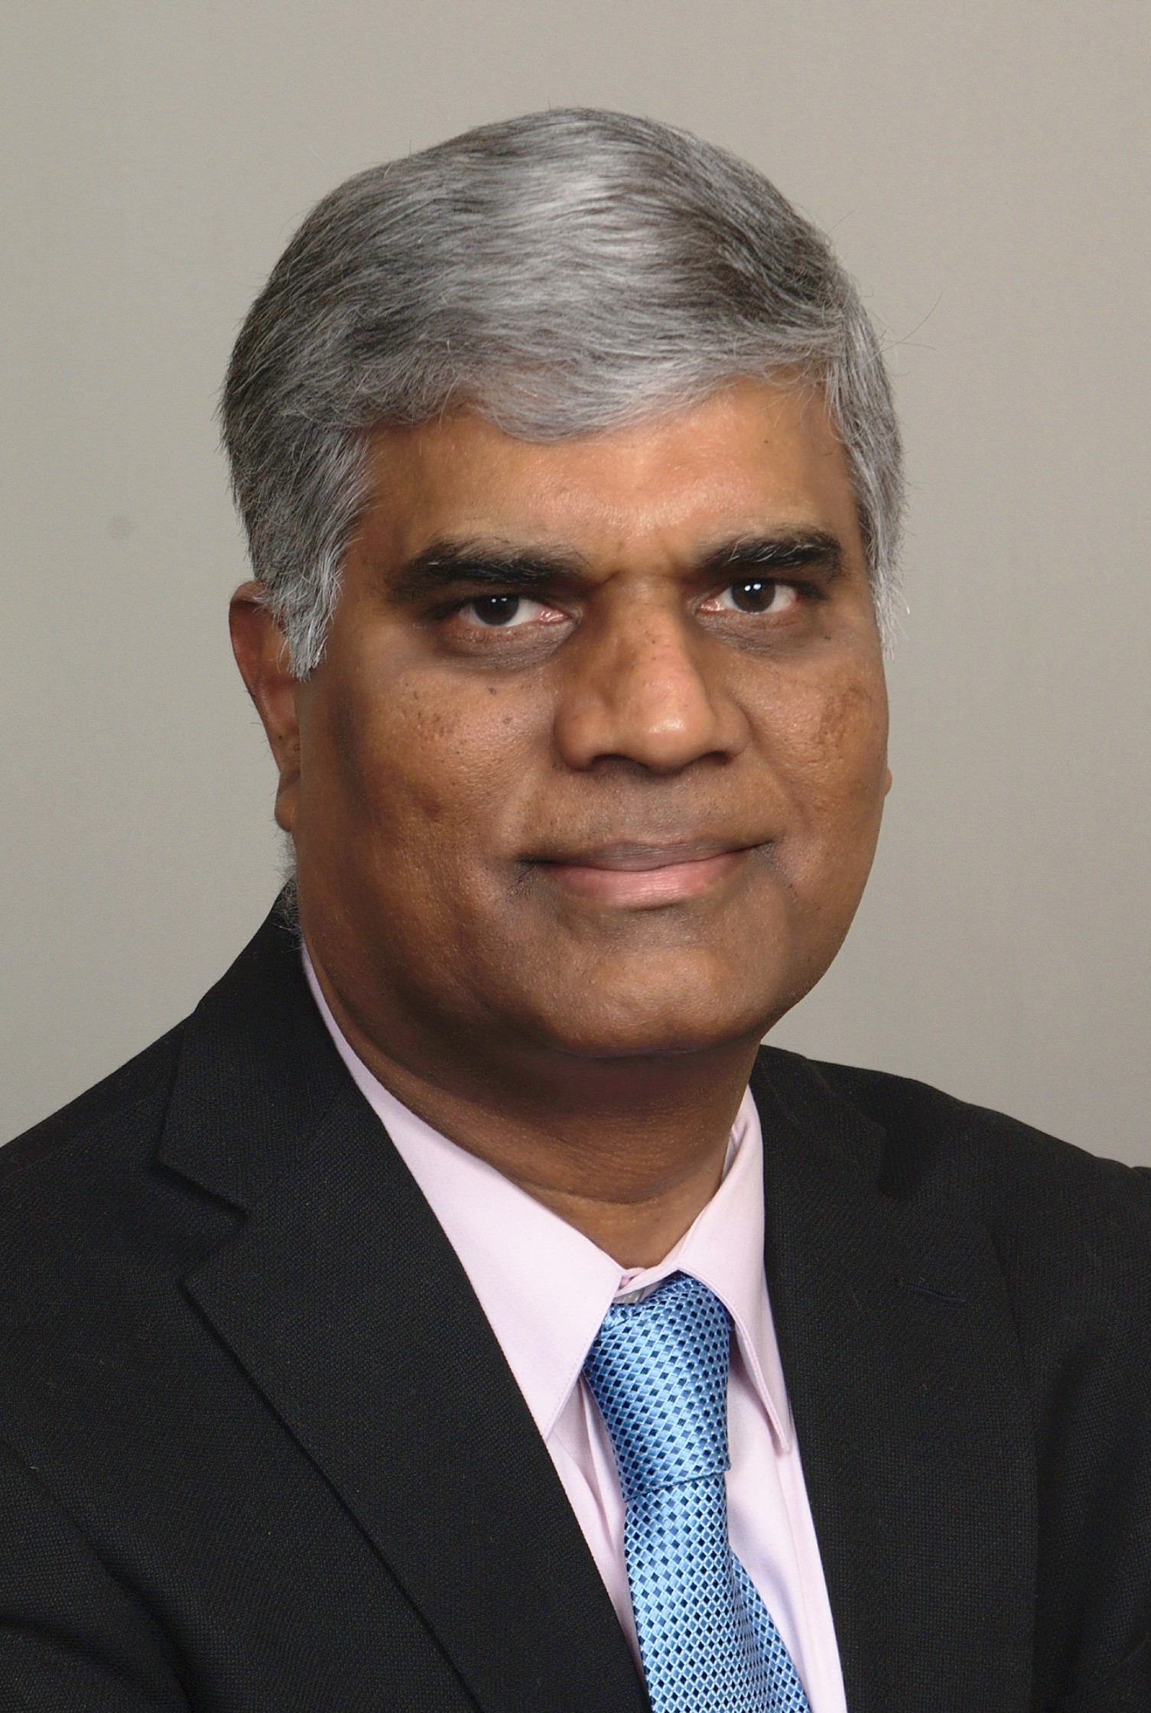

IEEE Antennas and Propagation Society
Dr. C. J. Reddy, Fellow IEEE
2026 IEEE AP-S President
Siemens Fellow
Siemens Digital Industry Software
cjreddy@ieee.org
May 2026

Slide 2

IEEE Antennas and Propagation Society
Mission
AP-S’s core purpose is to foster antennas, propagation and electromagnetics theory, technology, applications innovation and excellence for the benefit of humanity.

Slide 3
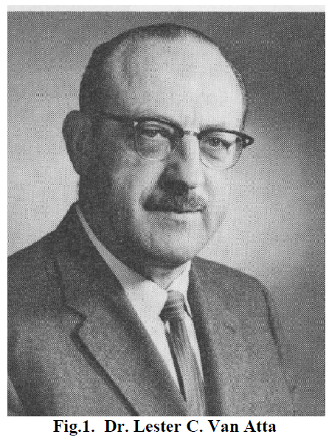
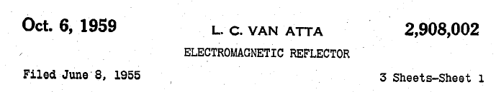
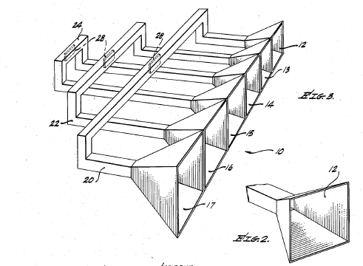
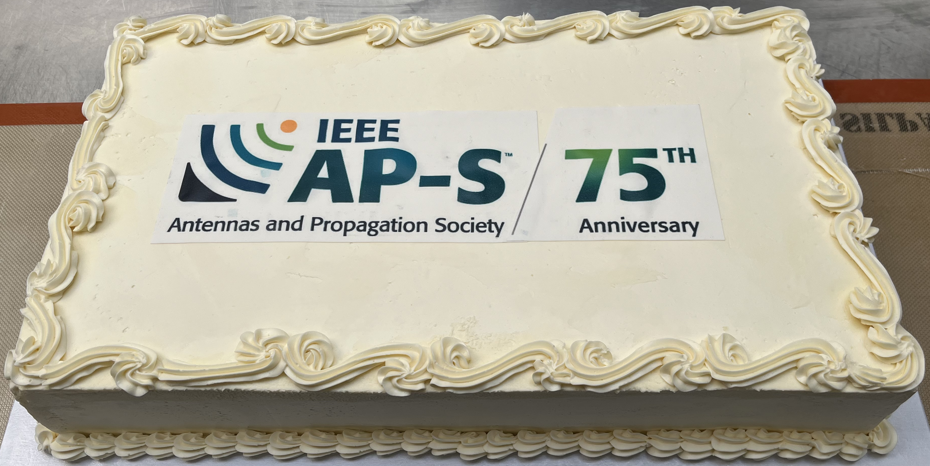
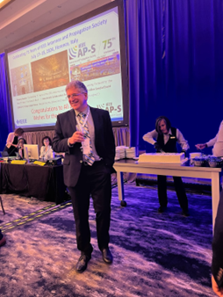
75th Anniversary (1949-2024)
1949 – Lester C. Van Atta
Founded the Professional Group on Antennas and
Propagation in the Institute of Radio Engineers (IRE)
Lester C. Van Atta
PGAP Chair 1949-50
Lester Clare Van Atta (April 18. 1905 – March 16. 1994) was the inventor of the retroreflector. https://ethw.org/Lester_C._Van_Atta
Prof. Branislav M. Notaros
2024 IEEE AP-S President

Slide 4
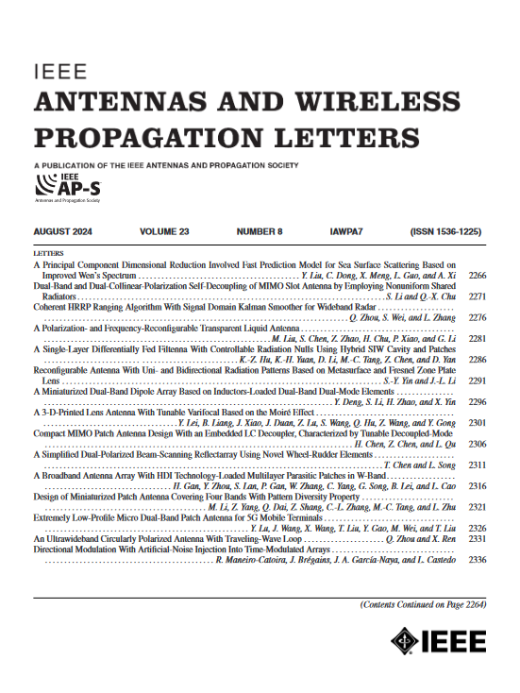

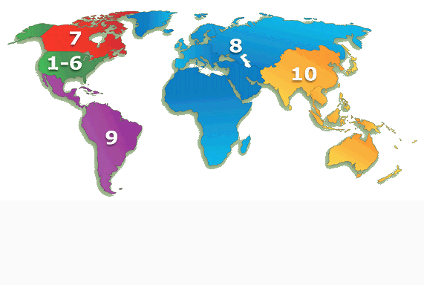
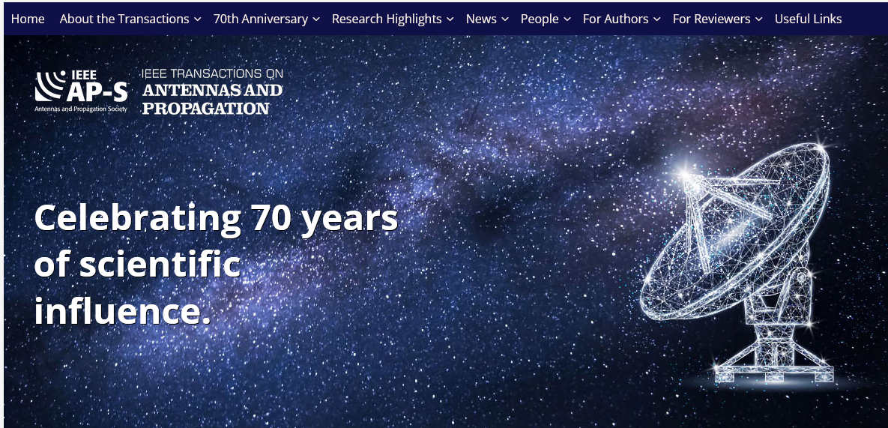
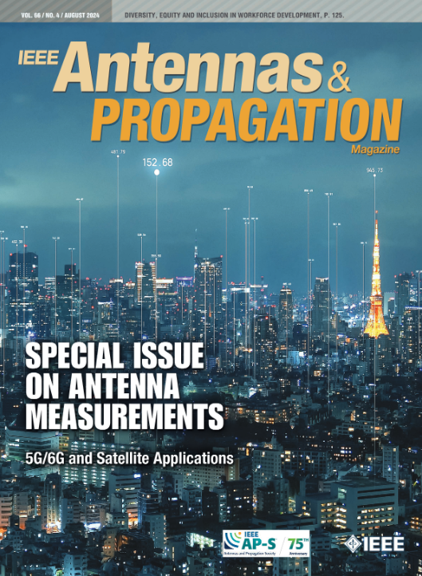


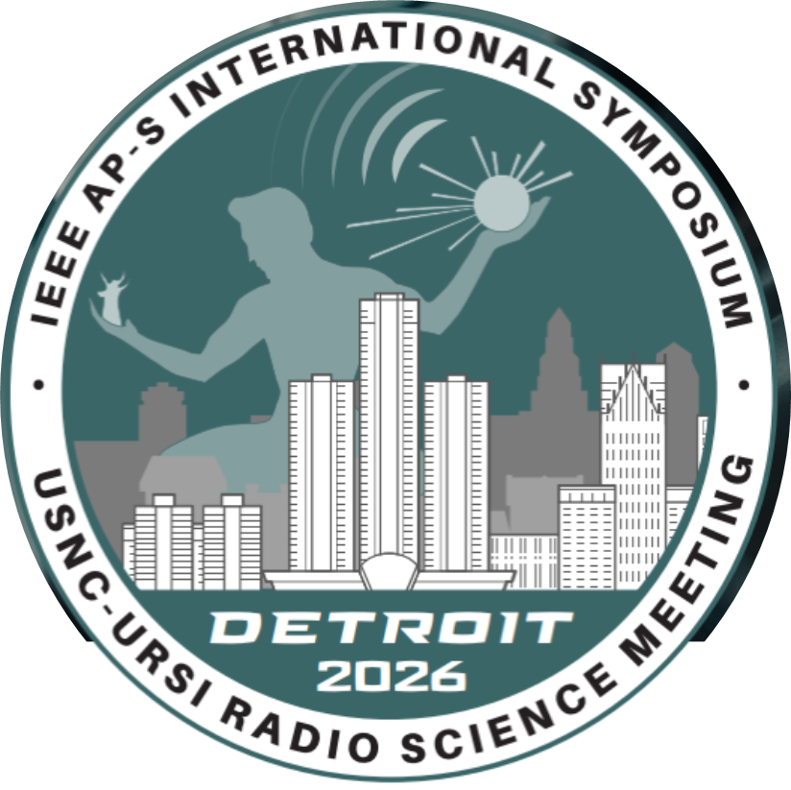



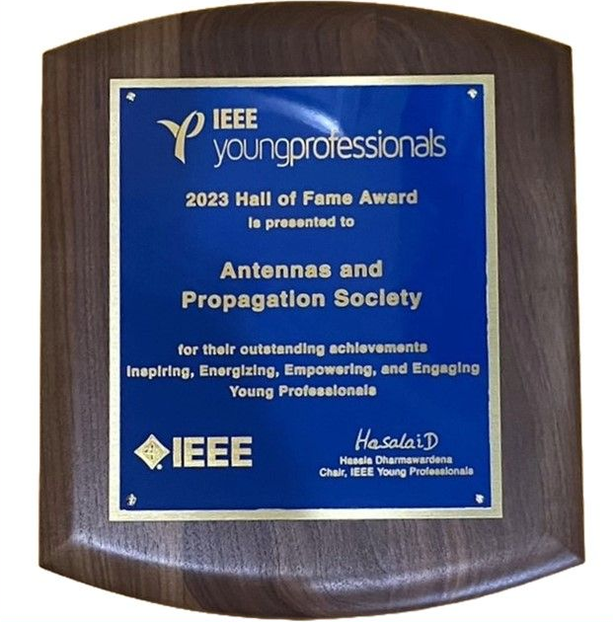

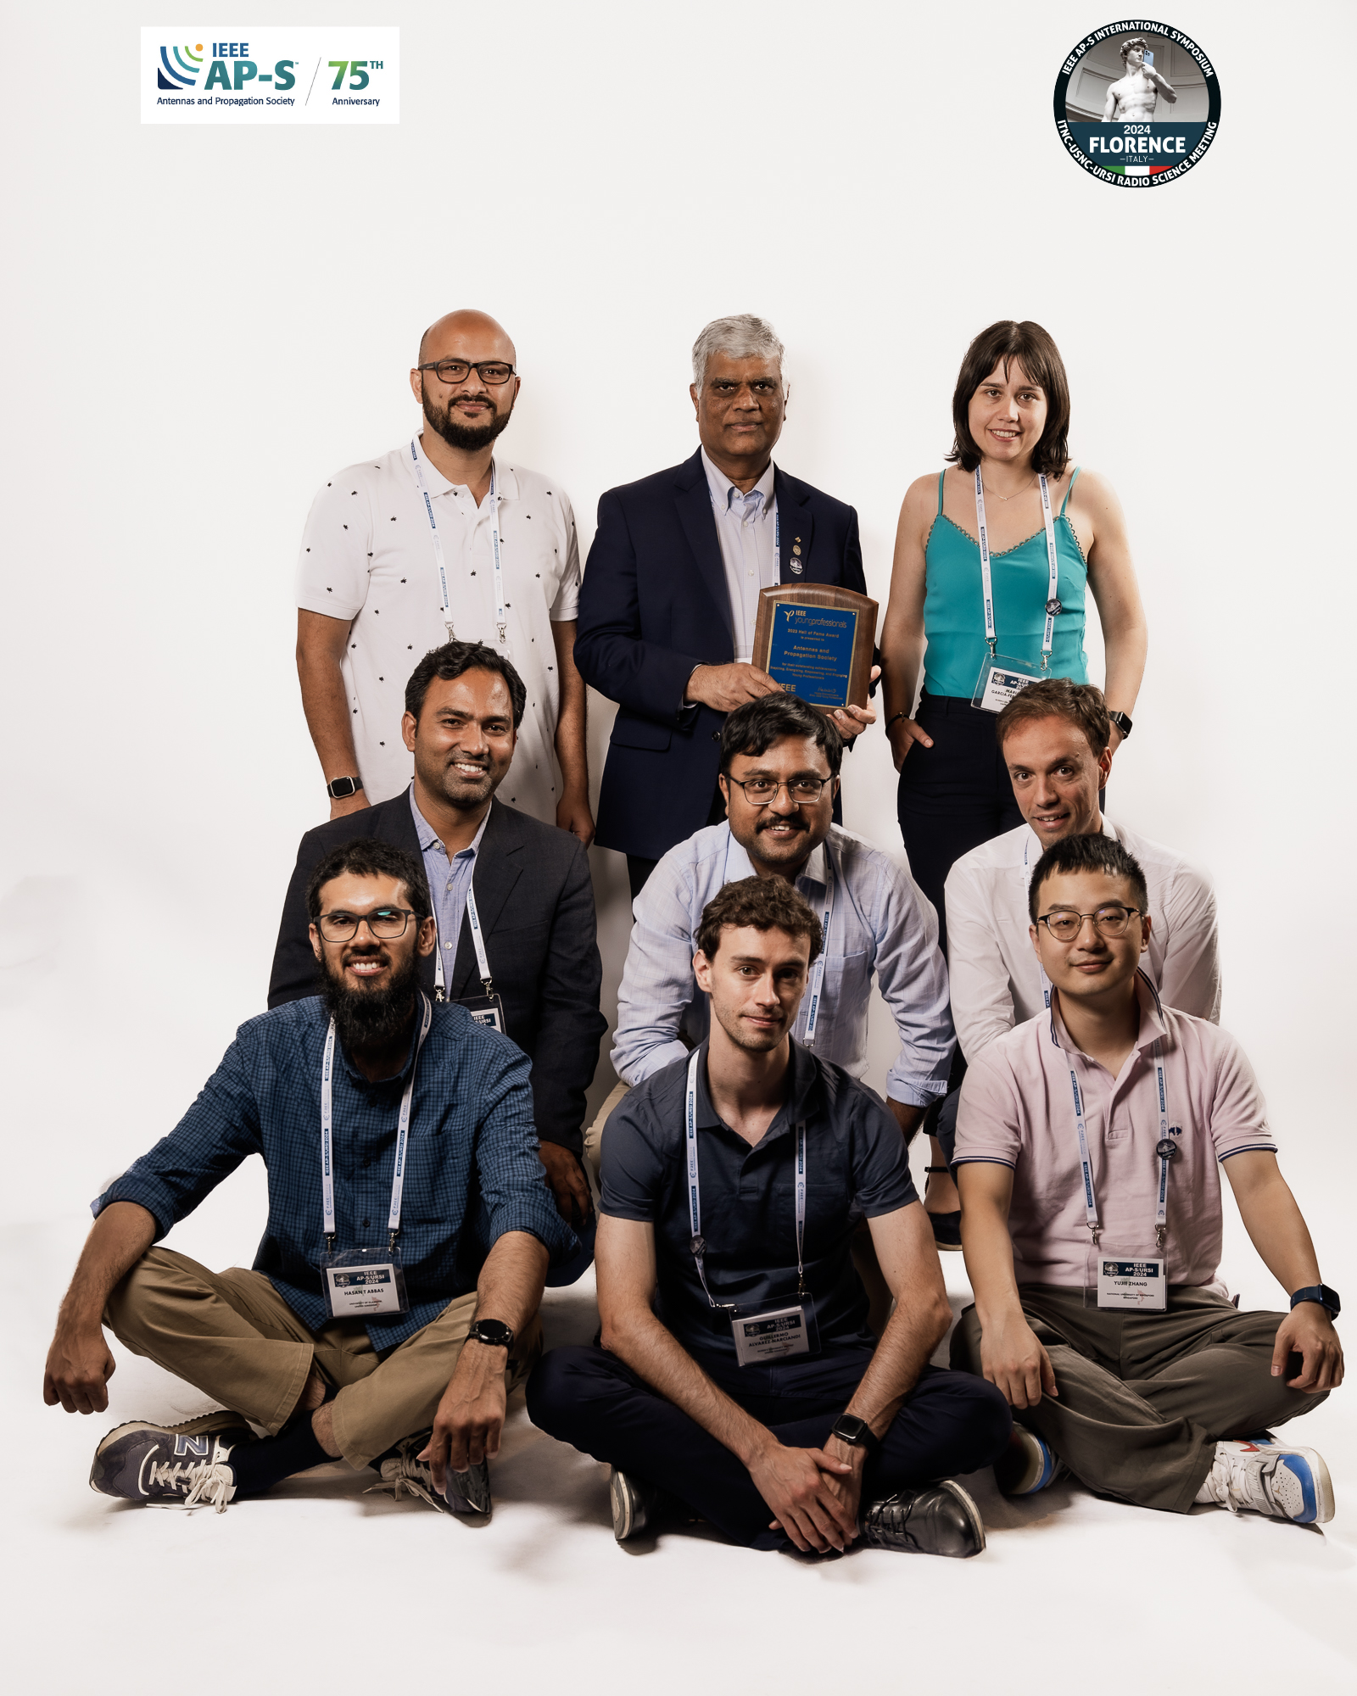
AP Society Today
12 Journals
40+ Conferences
17,000+ Members
300+ Chapters
Recognitions:
40+ Field/Paper Awards
350 Fellowships/Grant Awards

Slide 5
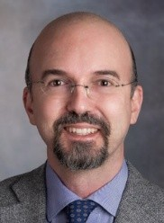
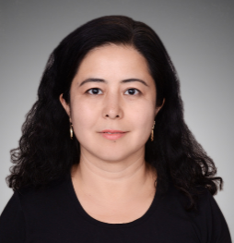
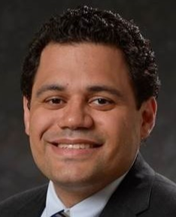
2026 IEEE AP-S Officers
President
President-Elect
C.J. Reddy
Siemens, USA
Francesco P. Andriulli
Politecnico di Torino, Italy
Secretary
Treasurer
Reyhan Baktur
Utah State University, USA
Néstor D. López
BAE Systems, Inc.,USA

Slide 6
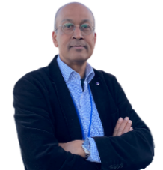
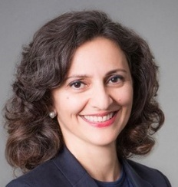
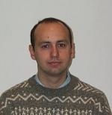
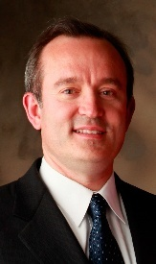
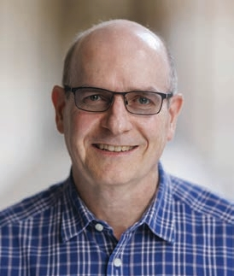
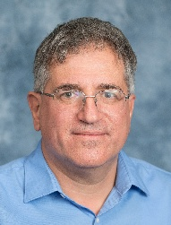
AP-S Officers
Vice President – Professional Activities
Vikass Monebhurrun
University Paris-Saclay, France
Vice President – Technical Activities
Mahta Moghaddam
University of Southern California, USA
Vice President – Operations and Finance
Guido Lombardi
Politecnico di Torino, Italy
Vice President – Conferences
Danilo Erricolo
University of Illinois at Chicago, USA
Vice President – Publications
Christophe Fumeaux
The University of Queensland, Australia
Director of Intersociety Collaboration (DISC)
Branislav M. Notaros
Colorado State University, USA

Slide 7
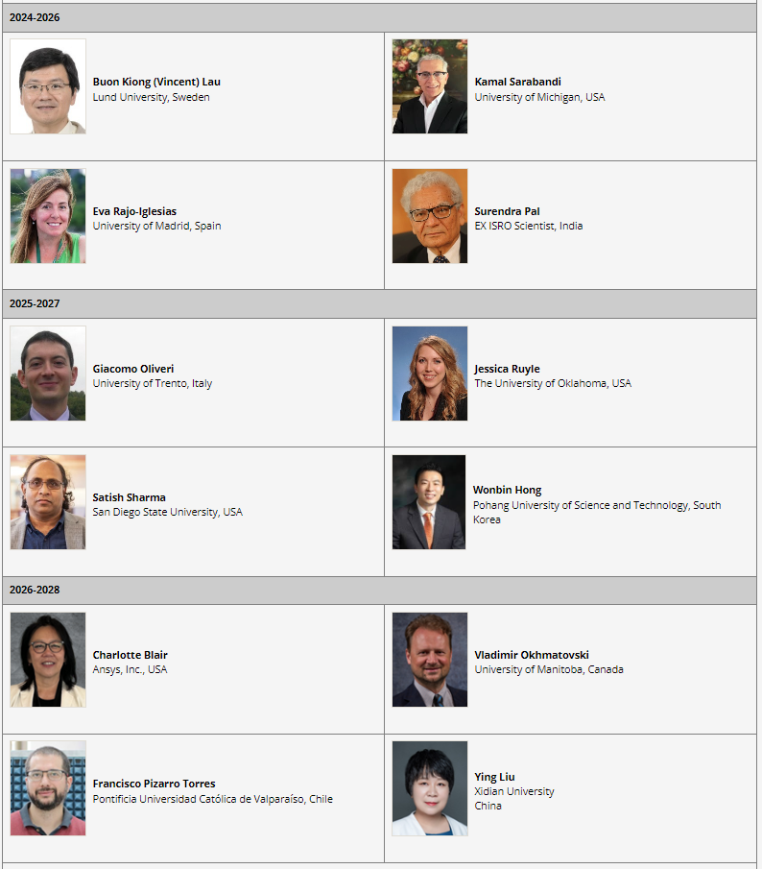
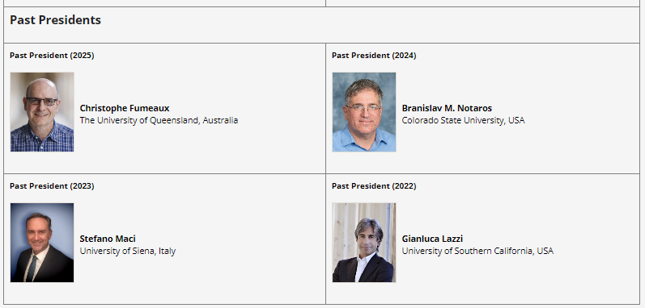
AP-S AdCom
With Voting Rights
President and President-Elect
12 Elected AdCom Members
4 Immediate Past Presidents
AdCom – Ex-officio Members
Chairs – Standing Committees (~25)
Editor-In-Chiefs of AP-S owned Journals

Slide 8
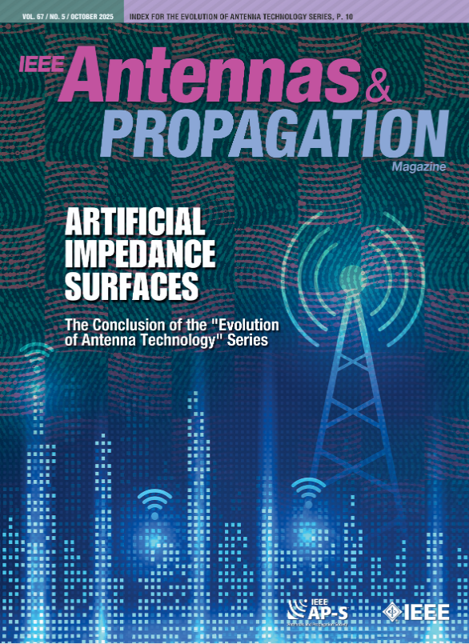
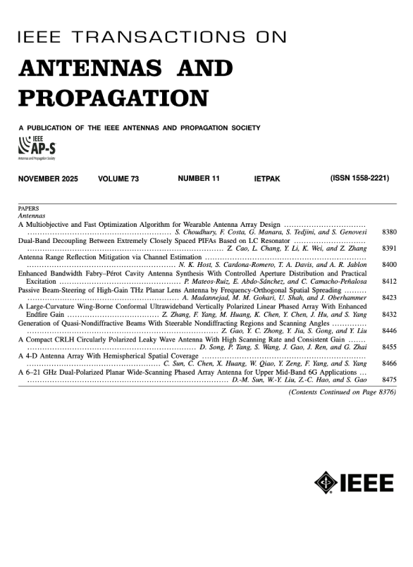
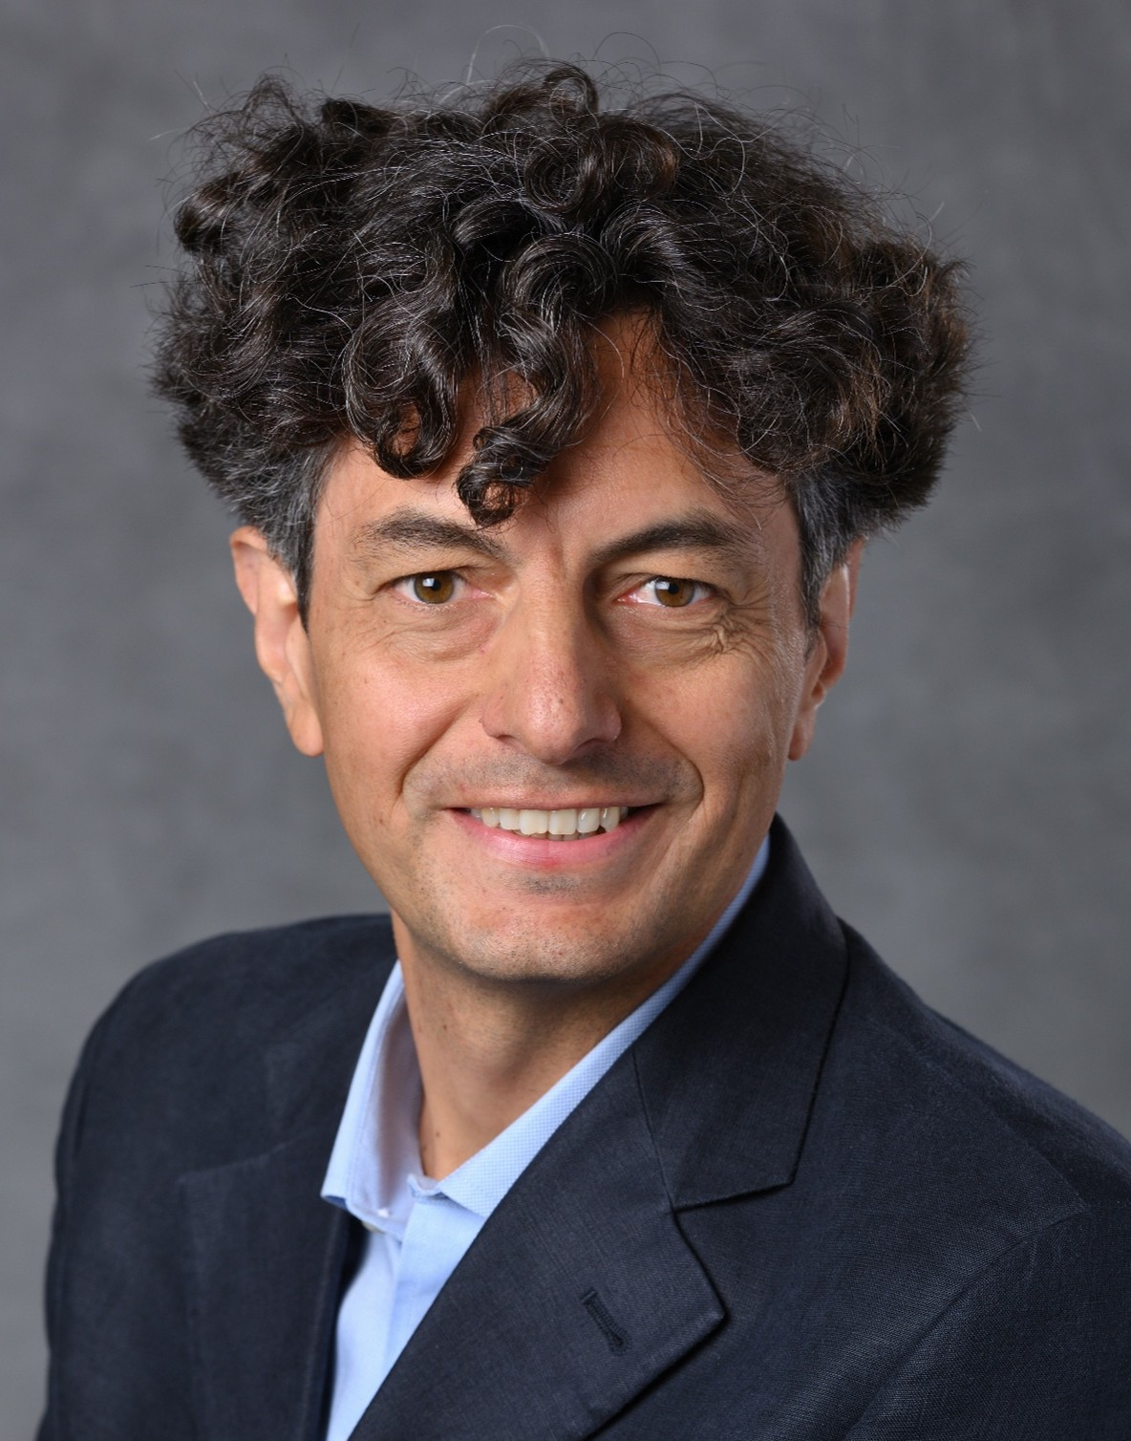
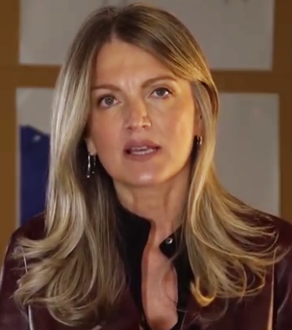
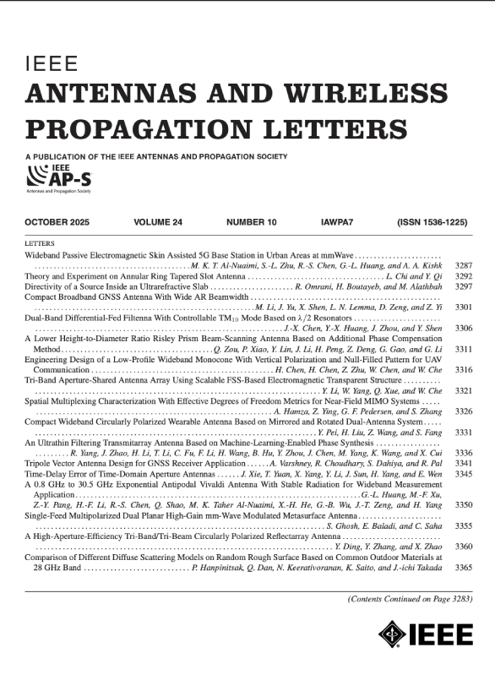
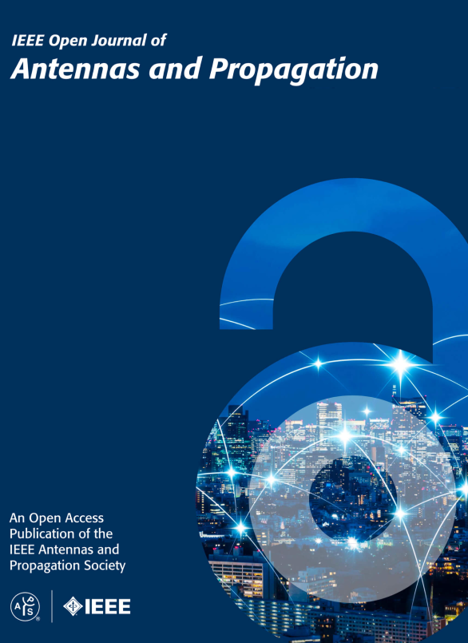
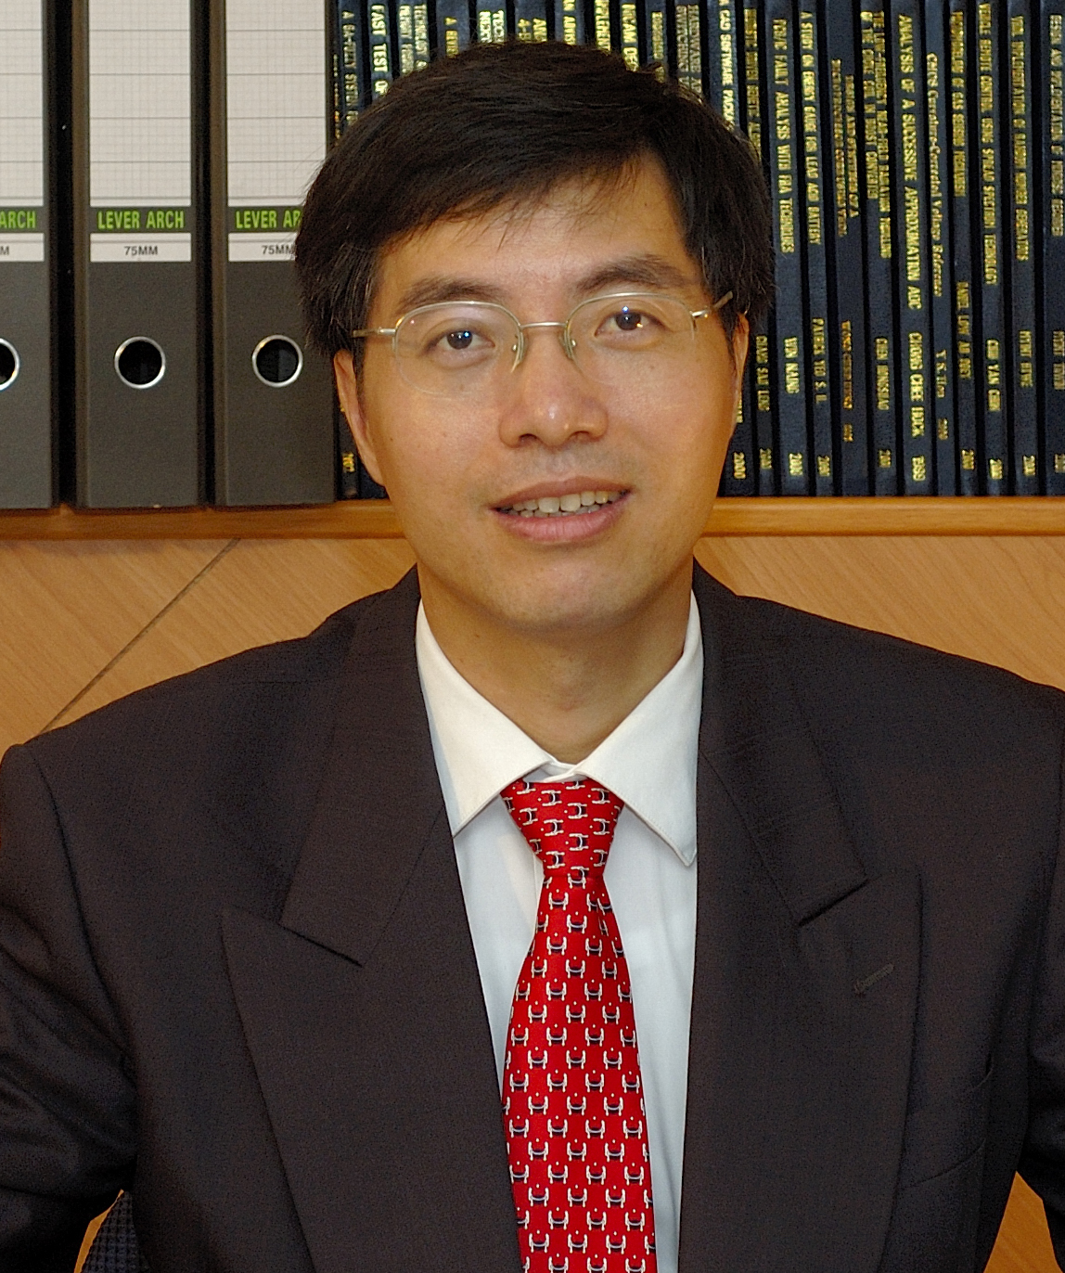
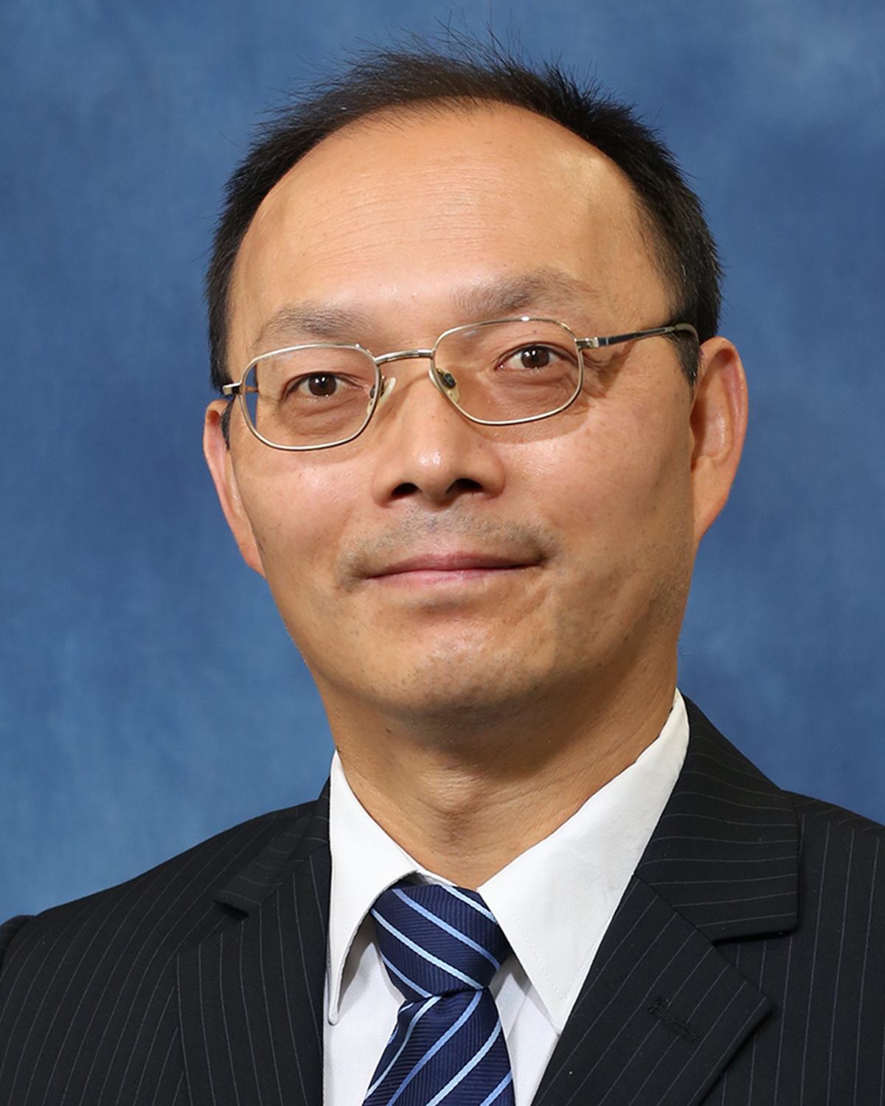
AP-S Journals
EIC: Mauro Ettorre
Impact Factor: 5.9
EIC: Konstantina S. Nikita
Impact Factor: 5.8
EIC: Zhongxiang Shen
Impact Factor: 3.6
EIC: Steven Gao
Impact Factor: 4.8

Slide 9
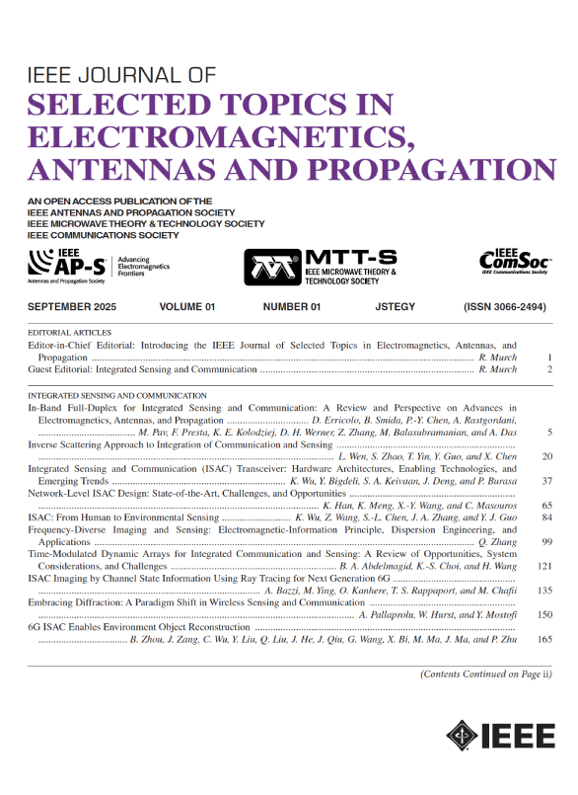
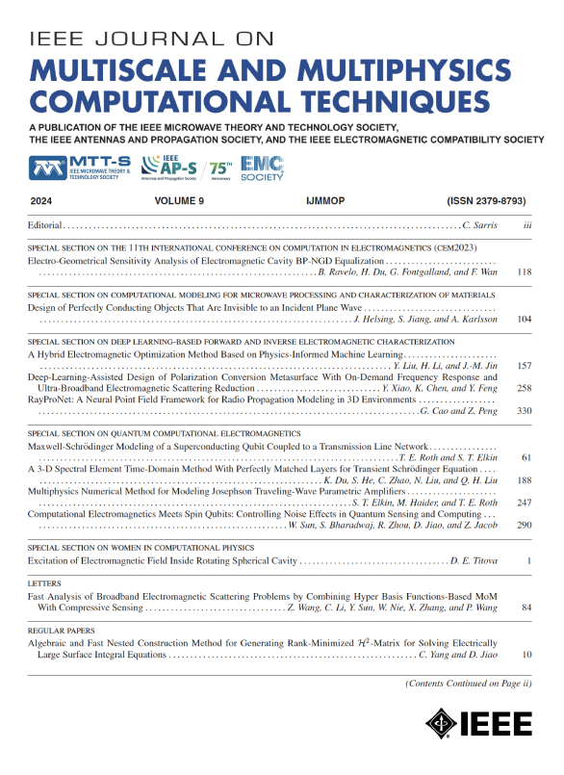
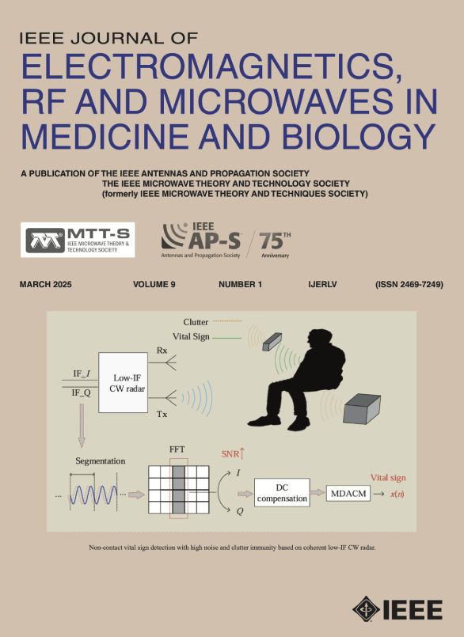
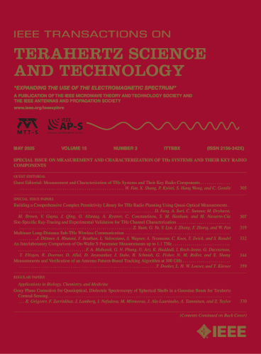
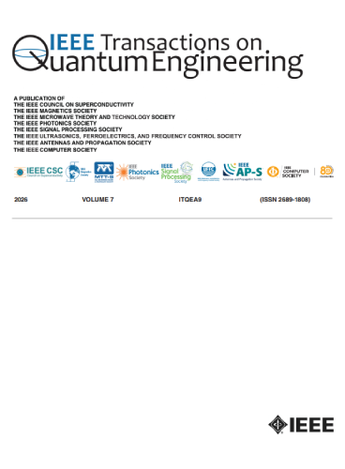
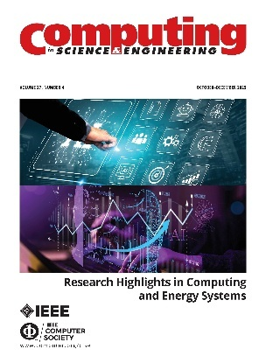

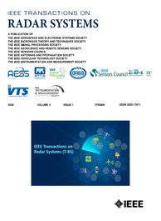
AP-S Co-Sponsored Journals

Slide 10
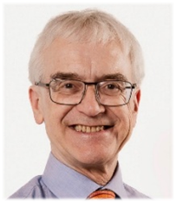
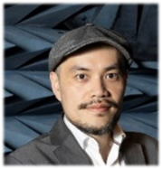
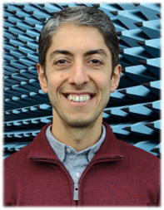
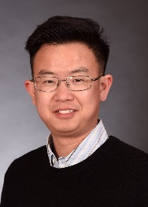
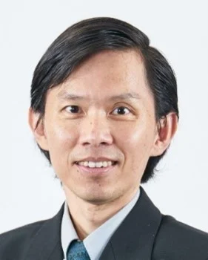
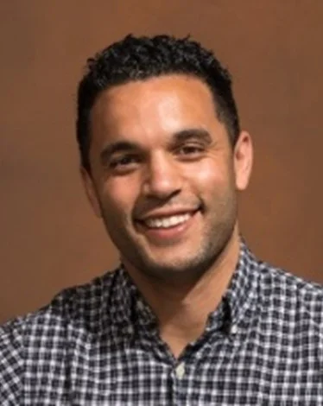
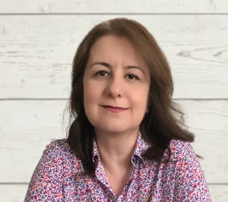
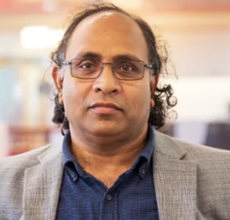
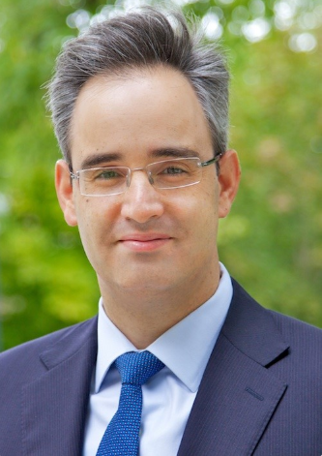
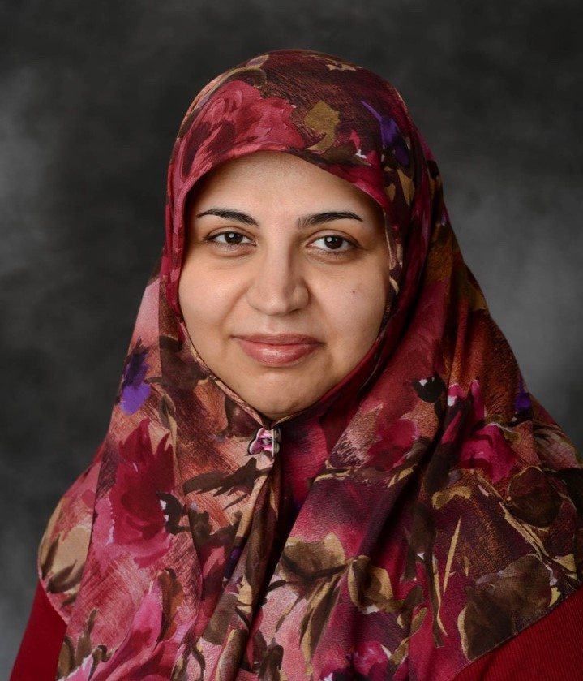
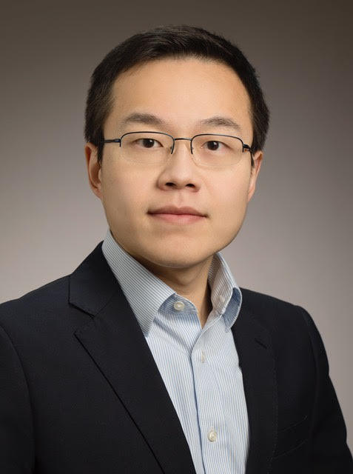


AP-S Distinguished Lecturers
Richard W. Ziolkowski
Pai-Yen Chen
Okan Yurduseven
Bing Zhang
Eng Leong Tan
Nacer Chahat
Özlem Özgün
Satish Sharma
CostasSarris
Sima Noghanian
Zhen Peng
Qammer H. Abbasi
Chow-Yen-Desmond Sim
https://ieeeaps.org/dl-program/distinguished-lecturer-program

Slide 11










2026 IEEE AP-S Young Professional Ambassadors
Kamil Yavuz Kapusuz
Belgium
Anikó Német
United Kingdom
Apala Banerjee
Saudi Arabia
Kentaro Murata
Japan
Hadeel Elayan
United States
Shu-Lin Chen
Australia
Mohammed Farouk Nakmouche
Canada
David O. Rodriguez-Duarte
Italy
Hadi Mousavi
Australia
Arup Ray
India
https://ieeeaps.org/committees/2026ypa

Slide 12
AP-S Awards
TECHNICAL ACHIEVEMENT/CONTRIBUTIONS TO
FIELD OF SOCIETY/TECHNICAL COMMITTEE//SERVICE TO PROFESSION
IEEE Distinguished Achievement Award
IEEE Honorary Life Member of AdCom
IEEE Outstanding Service Award
IEEE John Kraus Antenna Award
IEEE Lot Shafai Mid-Career Distinguished Achievement Award
IEEE Harrington-Mitra Award in Computational Electromagnetics
IEEE Ulrich L. Rohde Humanitarian Technical Field Project Award
IEEE Antennas and Propagation Society Mojgan Daneshmand Grant for Women
IEEE Antennas and Propagation Society Young Professional of the Year
IEEE Antennas and Propagation Society Distinguished Industry Leader Award
IEEE Antennas and Propagation Society Industrial Innovation Award
IEEE Antennas and Propagation Society Standards Development Award
IEEE Honorary Life Member of AdCom
IEEE Antennas and Propagation Society Service Award

Slide 13
AP-S Awards
PAPER Awards
IEEE Sergei A. Schelkunoff Transactions Prize Paper Award
IEEE Harold A. Wheeler Applications Prize Paper Award
IEEE R.W.P. King Award
EEE John Kraus Antenna Award
IEEE Piergiorgio L.E. Uslenghi Prize Paper Award
IEEE Antennas and Propagation Edward E. Altshuler Prize Paper Award
IEEE Open Journal of Antennas and Propagation Best Paper Award
IEEE Antennas and Propagation Society Acharya Jagadish Chandra Bose Paper Award
CONFERENCE PAPER/SESSION/SERVICE/COMPETITION
IEEE Ulrich L. Rohde Innovative Conference Paper Awards on Antenna Measurements and Applications
IEEE Ulrich L. Rohde Innovative Conference Paper Awards on Computational Techniques in
Electromagnetics
IEEE AP-S Tapan K. Sarkar Best Conference on Antennas Measurements and Applications (CAMA)
Student Paper Award
IEEE Best Industry Paper Award at IEEE International Symposium on Antennas and Propagation

Slide 14
AP-S Awards
EDUCATION - FELLOWSHIP/SCHOLARSHIP
IEEE Raj Mittra Travel Grant
IEEE Chen-To Tai Distinguished Educator Award
IEEE Donald G. Dudley, Jr. Undergraduate Teaching Award
IEEE AP-S Eugene F. Knott Memorial Pre-Doctoral Research Grants
IEEE Leopold B. Felsen Research Grant for Electromagnetics
IEEE AP-S Doctoral Research Grants
IEEE Antennas and Propagation Society Fellowship
IEEE Antennas and Propagation Society Undergraduate Summer Research Scholarships
STUDENT (Awards, Grants, Competitions/Contests)
IEEE Best Student Paper Award
IEEE AP-S Student Design Contest
IEEE AP-S C.J. Reddy Travel Grant for Graduate Students
IEEE AP-S John Volakis Travel Grant for Graduate Students
IEEE AP-S Student Travel Grants
CHAPTER
AP-S IEEE AP-S Chapter Award

Slide 15



AP-S Talent Development Fund
IEEE will match donations dollar for dollar, per IEEE Financial Operations guidelines, enabling AP-S to double its impact
The AP-S Talent Development Fund promises to generate Waves of Support to empower tomorrow’s innovators today, amplifying opportunities for tomorrow’s pioneers in the field, and paving the way for new and exciting exploration.
https://ieeeaps.org/philanthropy/ieee-ap-s-talent-development-fund

Slide 16




Impact of AP-S Talent Development Fund
IEEE AP-S Leopold B. Felsen Research Grant in Electromagnetics
IEEE AP-S John Volakis Travel Grant for Graduate Students
IEEE AP-S C. J. Reddy Travel Grant for Graduate Students
IEEE AP-S Acharya Jagadish Chandra Bose Paper Award
Instituted through a donation from the Felsen Family to keep alive the memory and scientific legacy of Professor Leopold. B. Felsen (1924-2005),
Instituted through a donation from Prof. John Volakis and his past graduate students to honor Dr. John Volakis for his distinguished contributions to the fields of antennas and propagation as
well as his exemplary mentorship.
Instituted through a donation from Dr. C. J. Reddy in 2019 via IEEE Foundation and now part of the AP-S TDF. With matched funds, number of travel grants increased from 6 to 10 !!
Instituted through a donation from Dr. C. J. Reddy to honor Acharya Jagadish Chandra Bose who was the first to conduct millimeter wave experiments in 1894 in India.

Slide 17

AP-S Conferences – 2026 IEEE AP-S/URSI
https://2026.apsursi.org/

Slide 18



Follow IEEE AP-S on LinkedIn
https://www.linkedin.com/company/ieeeaps/
https://ieeeaps.org/

Slide 19




