Slide 1
IEEE Aerospace Electronic Systems
VP Conferences
Scott Goldstein
AESS Board of Governors Meeting – Spring 2026
15-16 May 2026
Phoenix, AZ, USA
IEEE Confidential

Slide 2
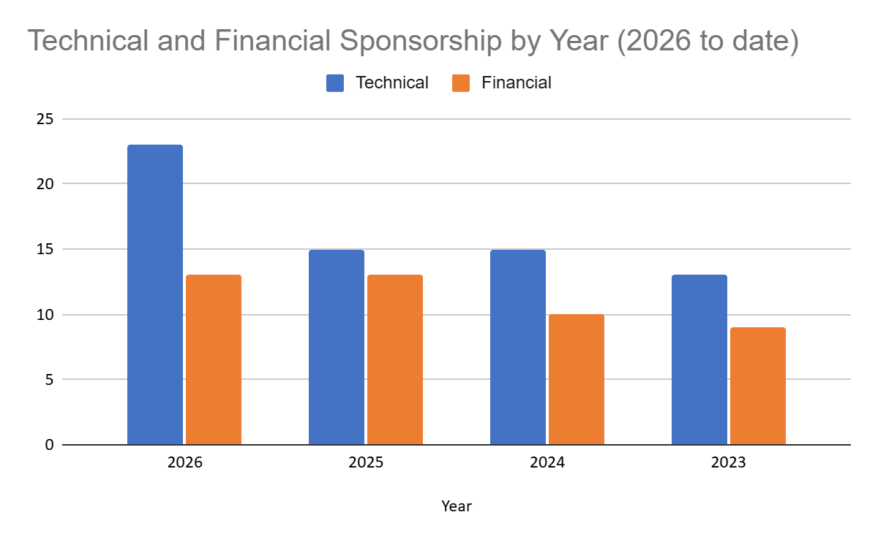
2025 Accomplishments: Sponsorship trends
2026 to date:
23 Technical
13 Financial
36 total
2025
15 Technical
13 Financial
IEEE Confidential

Slide 3
2025 Accomplishments
Primary activity has been working with conferences on technical and financial sponsorship
Increased overall number of sponsorships year-over-year
  Reached out to try to turn technical sponsorships to financial sponsorships
  Many times, too late for current year but have positive consideration for next year
  Already matched the number of financial sponsorships in ’25 and still receiving requests and discussions for ’26 and ’27
Learning how to use and engage committee
IEEE Confidential

Slide 4
2026 Objectives
Increase overall sponsorships
Increase financial sponsorships / turn tech to financial
Examine geographical distribution to see how to proactively grow
Examine conferences that have no AESS sponsorship but that are within AESS sphere of interest to gauge interest in adding AESS sponsorship proactively
Engage committee productively
IEEE Confidential

