Slide 1
IEEE Aerospace Electronic Systems
VP Finance
Peter Willet
- presenting for Steve Butler
May 15, 2026

Slide 2
Topics
Where we fit in the IEEE budget
AESS budget
Recent activities
  Conference closeouts
  Subscription pricing
  Membership pricing
Authority levels for Initiatives
Summary

Slide 3
AESS as a part of the IEEE Budget (k$)
Shows the relative size of the AESS budget - We are not the biggest, but we are big

Slide 4
IEEE Technical Activities Trends
TA & S/C Excluding Market Fluctuation
$
Revenues saturating, expenses climbing
The shape of the revenue vs expenses curve concerning
Society travel! – not the primary contributor but bears watching

Slide 5
AESS Budget Over 5 Years
AESS 5-Year View
Notes on Net
  FY22 had COVID influences
  FY25 moved overhead budget
    “Overhead expense accounts were not budgeted for and will not appear in the forecast”

Slide 6
AESS Budget (2025 – 2026) by Cost Centers

Slide 7
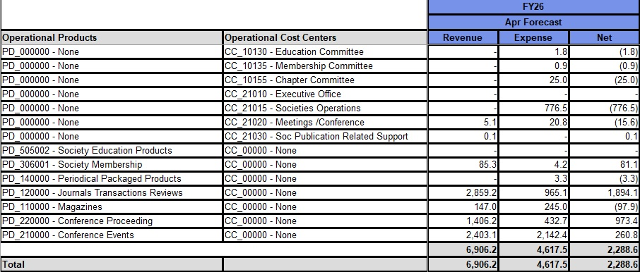
AESS Budget 2026 by Products and Cost Centers (k$)
2026 Budget by Products and Cost Centers (k$)

Slide 8
2025 Conference Closeouts
Green = Closed
Yellow = Due
No Highlight = On Track to Close

Slide 9
2026 Conferences

Slide 10
Revenue Sources: 2000 vs 2025 (IEEE)
Subscriptions
# Periodicals
106
240
Nonmember
Individual Pub Title Subcription Rev.
$16.5 mil
$3.2 mil
Periodical Package Distribution to S/Cs
$23.5 mil
$55.8 mil
Technical Activities’ Open Access Rev.
$0
$15.6 mil
What prompted most of this change?
  Movement of IEEE’s customers through the product pipeline (from smaller to larger package purchases)
  Adoption of a flexible strategy regarding Open Access -- creation of 35 fully OA titles and introduction of an OA option within every subscription-based journal
10/15

Slide 11
Subscription Prices

Slide 12
2027 Society Memberships

Slide 13
Innovation Spending Authority - Strategic Initiatives & Public Imperative Activities (PIA)
$ Amounts *
Approval Required
Under $100k | OU leadership (AESS President)
$100k to $250k | IEEE Innovation Committee
$250k to $1M | IEEE Finance Committee
Over $1M | IEEE Board of Directors
* Approximate $ thresholds; identified risks may result in additional approvals

Slide 14
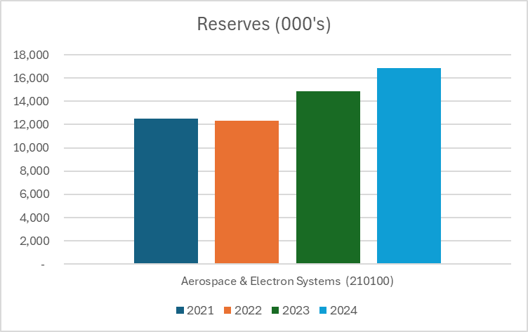
Summary
AESS on track to execute on budget in 2026
  Financial execution tracking closely to budget with projected net surplus ~5% over budget
2025 Conferences closing out on schedule
Subscription and member prices updated
We remain financially healthy

Slide 15
Questions

