Slide 1
IEEE Aerospace Electronic Systems
Prof. Networking and Mentoring Chair
Arik Brown
AESS Board of Governors Meeting – Spring 2026
15-16 May 2026
Phoenix, AZ, USA
IEEE Confidential

Slide 2

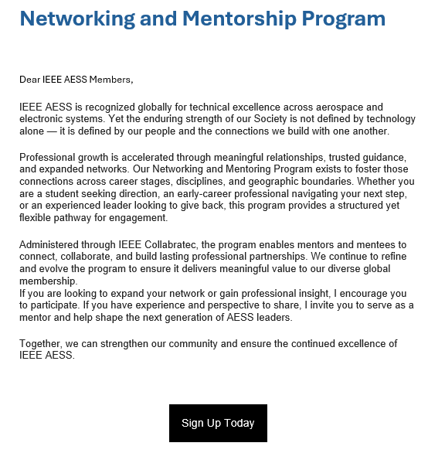
2025/2026 Accomplishments
IEEE AESS QEB Article Published
  Article submitted to and published in the IEEE AESS Quarterly Engineering Brief (QEB) Q1 2026 highlighting the program’s mission, structure, and value to the AESS community
AESS Letter Distributed to Full AESS Membership
  Email sent to the full AESS membership encouraging participation in the Networking and Mentoring Program as either a mentor or mentee
Collaboration with Broadening Participation Panel
  Met with Broadening Participation panel to discuss joint efforts for establishing mentor/mentee relationships and co-hosting advertised social events for potential mentors and mentees to meet
IEEE Confidential

Slide 3
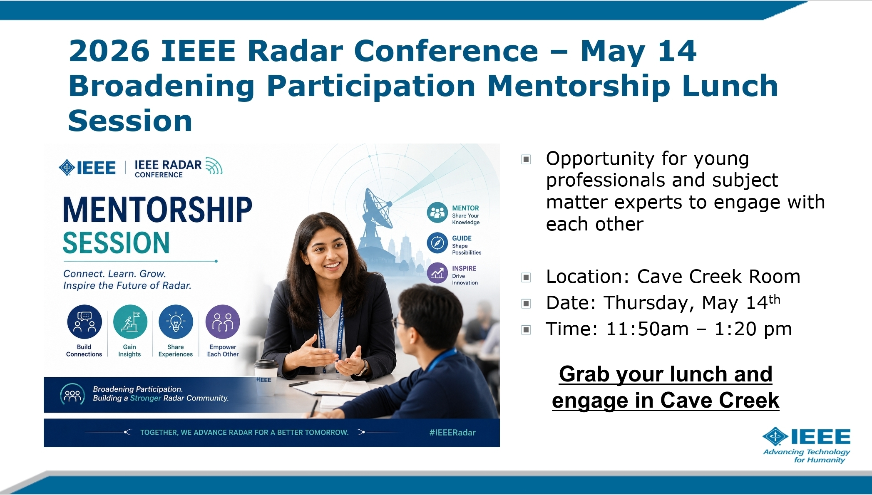
Broadening Participation Panel Collaboration
Meeting Summary
  Met with the IEEE AESS Broadening Participation panel and others to explore collaborative opportunities between our two committees
    Sevgi Gurbuz, Justin Metcalf, Jacqueline Fairley, and Peter John-Baptiste
Key Discussion Items
  Partnering to establish structured mentor/mentee relationships serving both programs’ participant communities
  Co-hosting an advertised social event at conferences where potential mentors and mentees can meet informally
Outcome
  Agreed to leverage the May 14 Radar Conference session to immediately identify interested mentors and capture contact information (see next slide)
IEEE Confidential

Slide 4
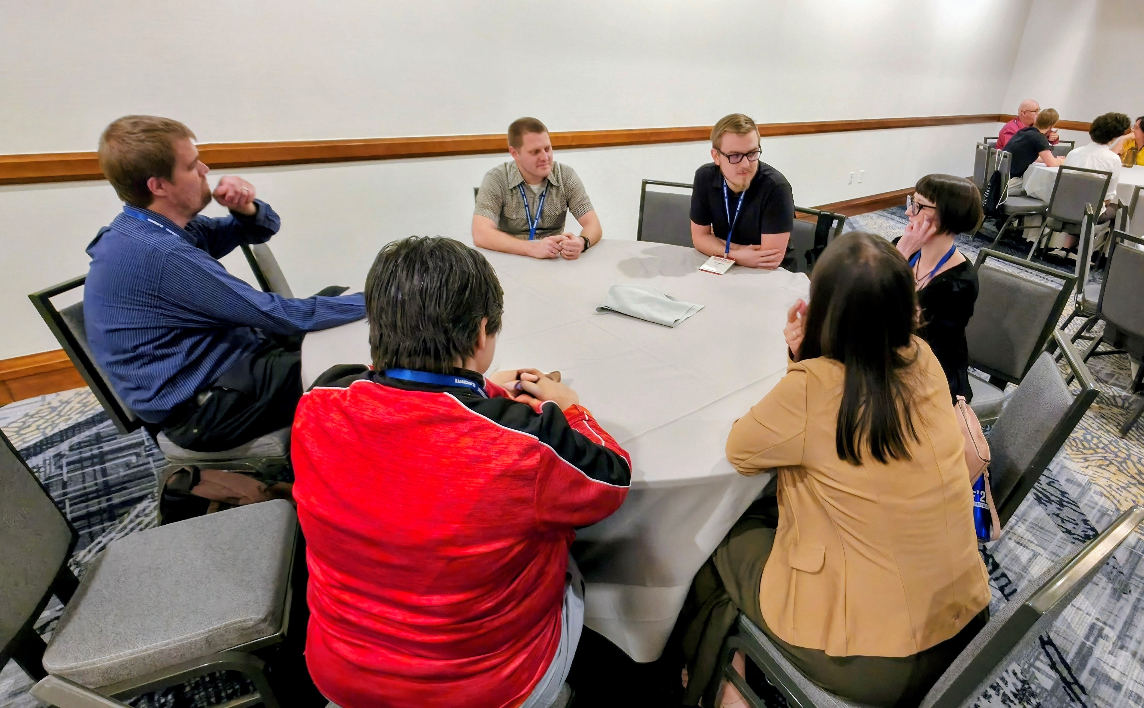
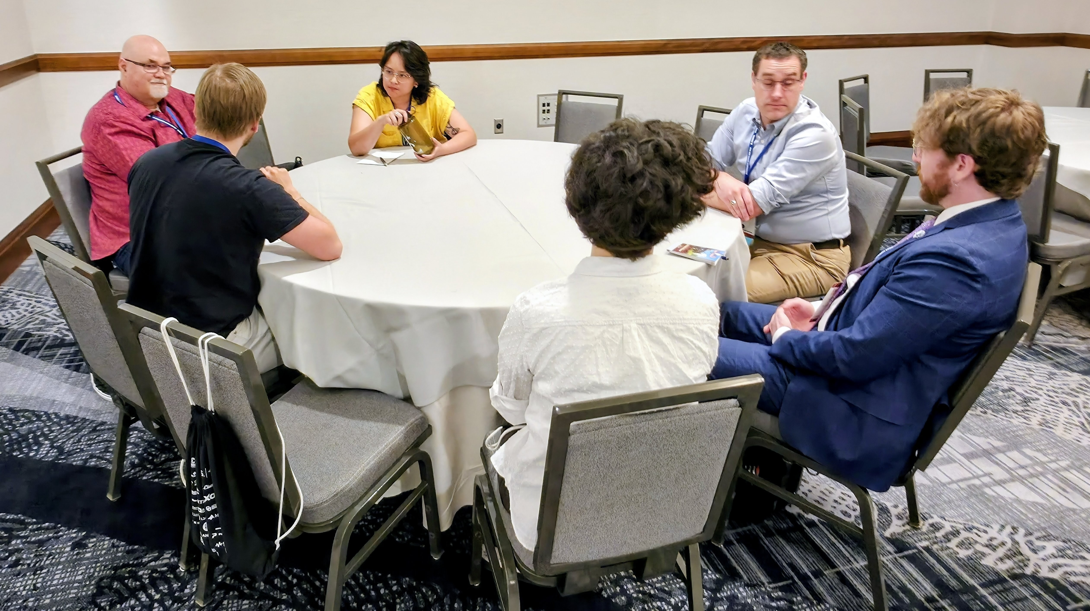
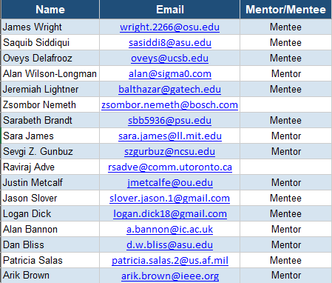
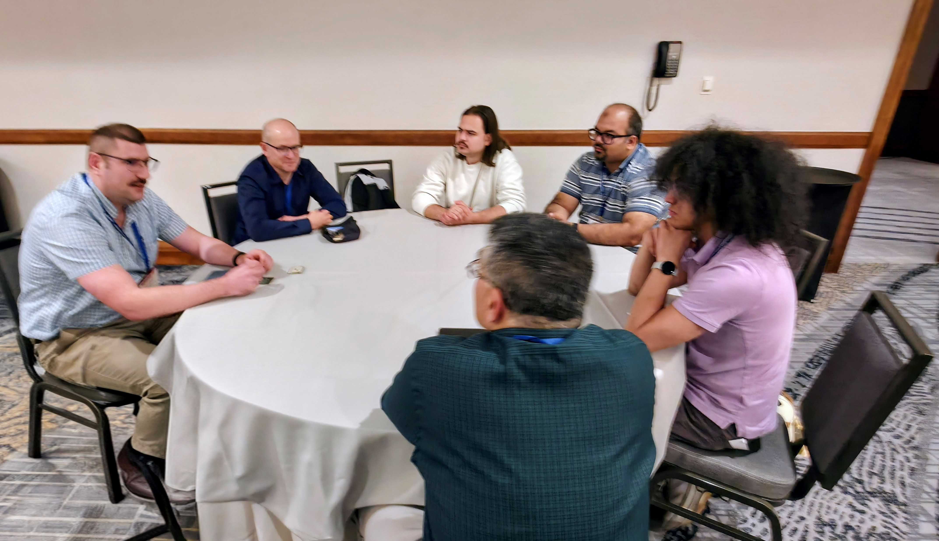
Thursday Mentorship Session – Focused Action Plan
Context
  Following productive discussion with the Broadening Participation panel, we aligned on a concrete near-term action leveraging the 2026 IEEE Radar Conference
Revised Session Focus – May 14 Mentorship Lunch (Cave Creek Room, 12:30 AM – 1:30 PM)
  Primary objective: identify interested mentors in the room and collect their contact information
  This will seed a mentor pool that can be matched with mentees
Follow-on Actions
  Use captured mentor contacts to facilitate matches and pursue co-hosted social event with Broadening Participation at future conferences
IEEE Confidential

Slide 5
2026 Objectives
Co-host advertised mentor/mentee social event with Broadening Participation panel at next major conference
Execute a virtual mentor panel
Publish one mentor/mentee spotlight
IEEE Confidential

Slide 6
Issues / Show-stoppers
None currently
IEEE Confidential

Slide 7
Corporate Participation: Research Alignment Forum
Challenge: Conferences as Recruiting Venues Have Limited Return for Companies
  Clearance constraints and the increasingly international attendee composition limit recruiting effectiveness at events like the IEEE International Radar Conference
Proposal: Establish a “Research Alignment Forum” Embedded Within the Conference
  Broadcast Northrop Grumman priority technology areas (advanced arrays, on-array processing, adaptive sensing, autonomy-enabled RF systems)
  Academic researchers and partners present work aligned to NG focus areas; NG technical leaders evaluate and identify high-value research for follow-on collaboration
Validated Model: NG/UCLA Collaboration
  NG/UCLA partnership initiated through Undergraduate Research Program led to novel algorithm development that directly contributed to a DARPA SOAP (Scalable On-Array Processing) program academia/industry partnership
  2026 Special Session: On-Array Processing for Multifunction Radar Systems
Intended Outcomes
  Strengthen university partnerships aligned to corporate needs and provide technology scouting
  Create a repeatable pathway: Academic Research → Corporate programs → Mission/financial impact
IEEE Confidential

Slide 8
Backup Slides
IEEE Confidential

