Slide 1
IEEE Aerospace Electronic Systems
Dr. Braham Himed, AESS President
AESS Board of Governors Meeting – Spring 2026
15-16 May 2026
Phoenix, Arizona, USA

Slide 2
Welcome
Welcome all AESS BoG members
Welcome to our guests from sister societies
  Antennas and Propagation (AP-S) – MOU in progress
  Geo-Science and Remote Sensing (GRS-S) – MOU in place
  Microwave Theory and Technology (MTT-S) – MOU in progress

Slide 3
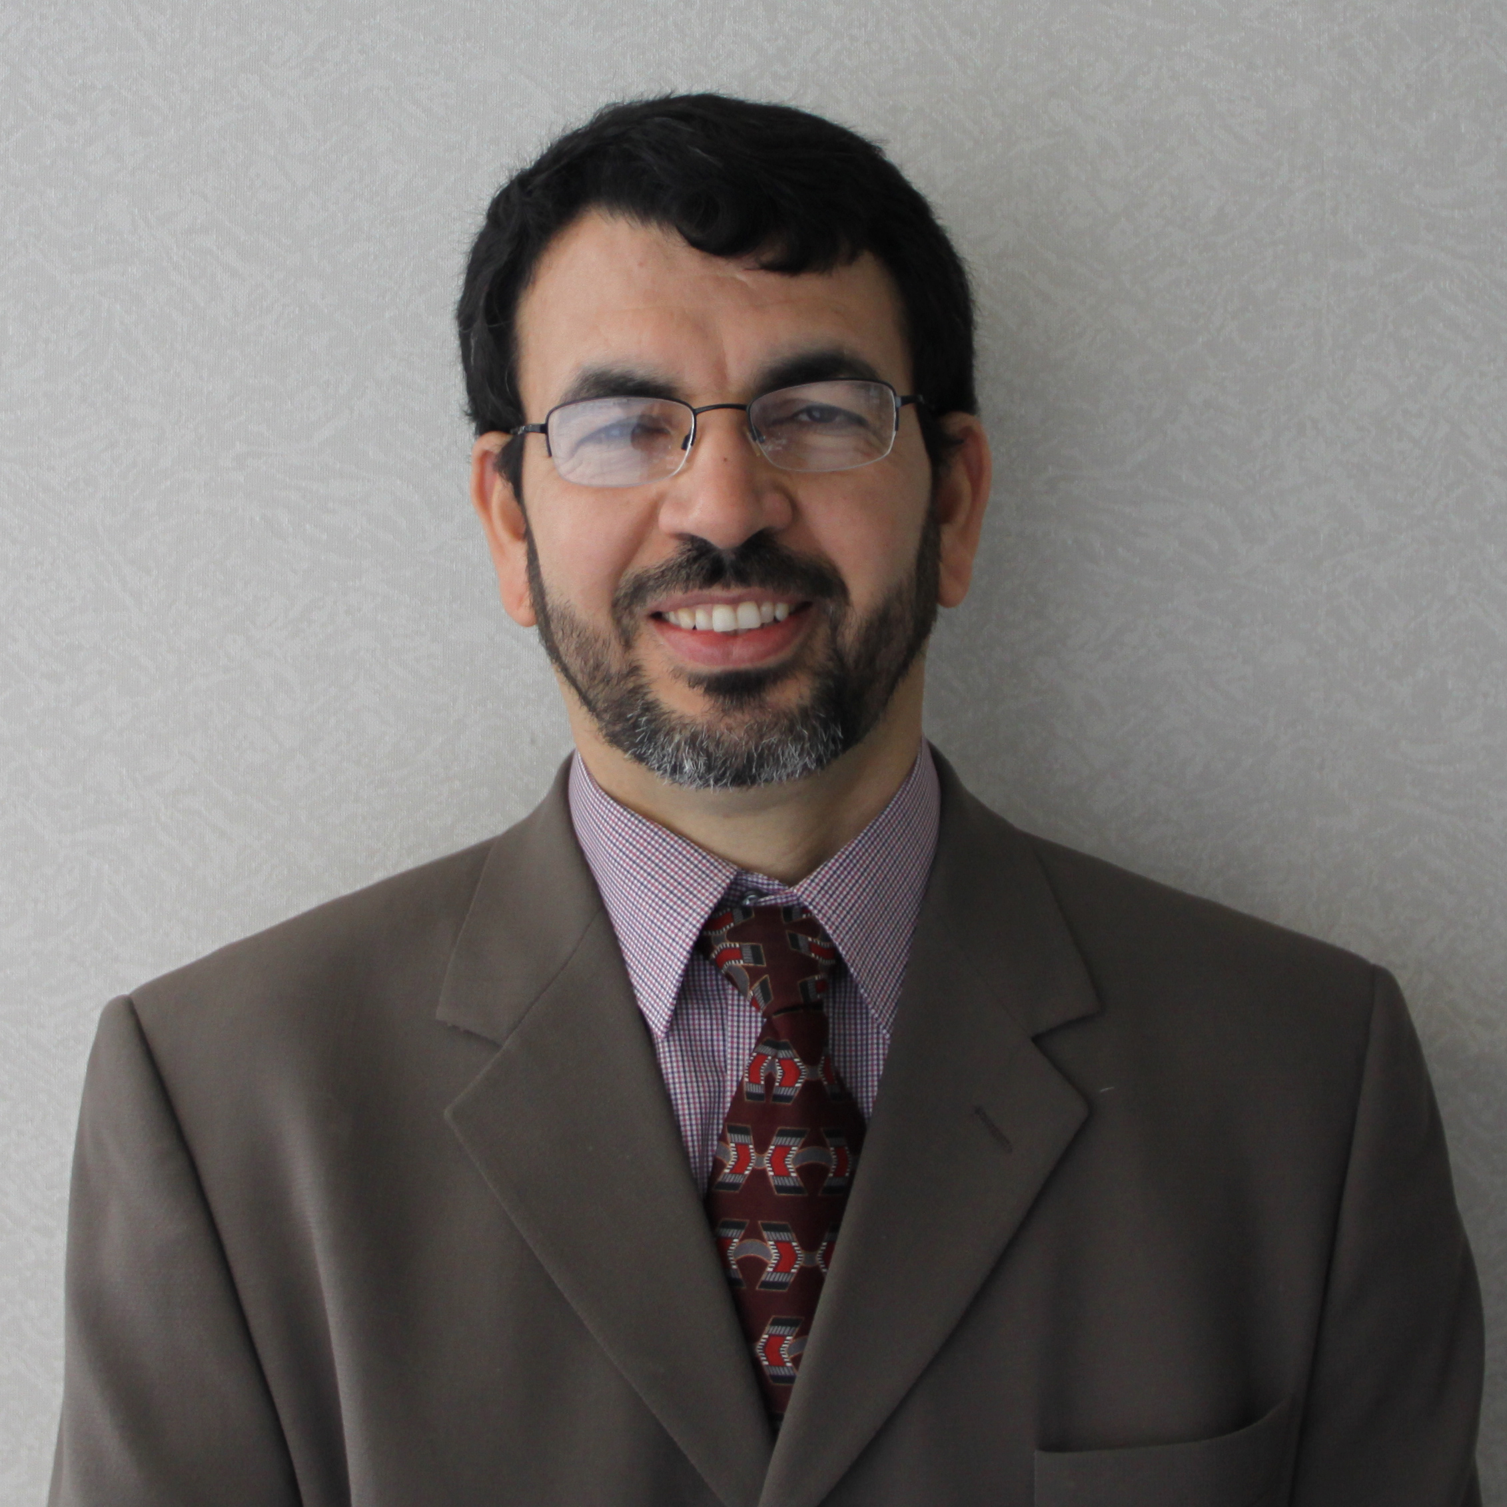
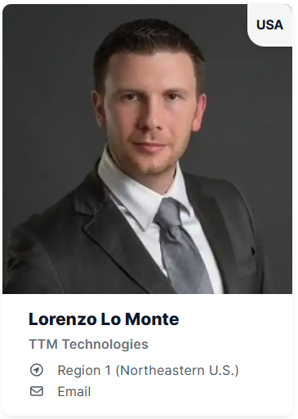
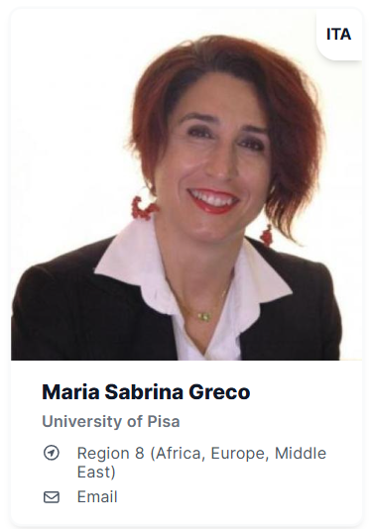
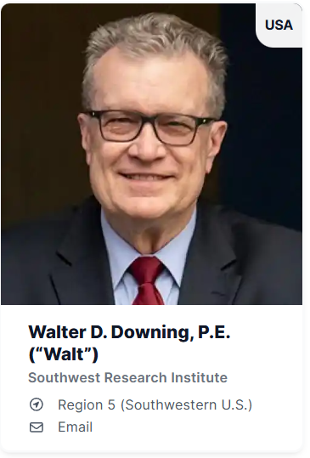
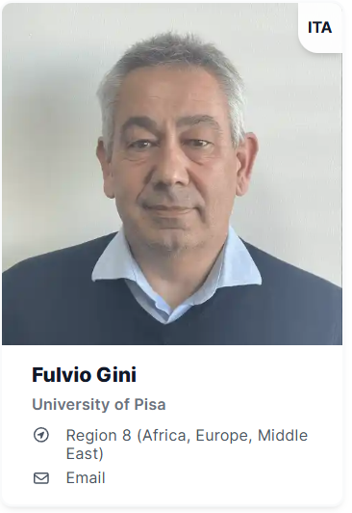
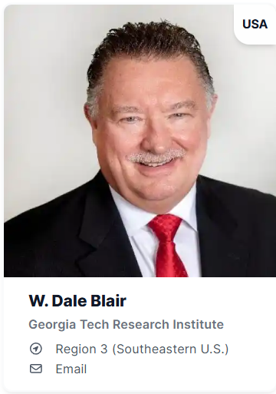
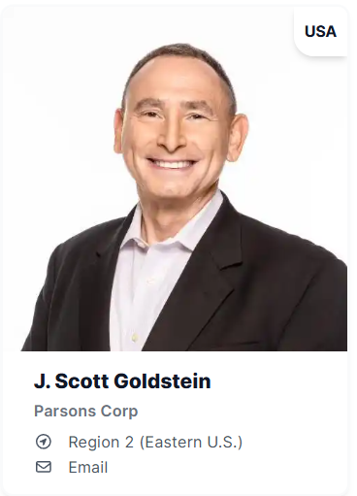
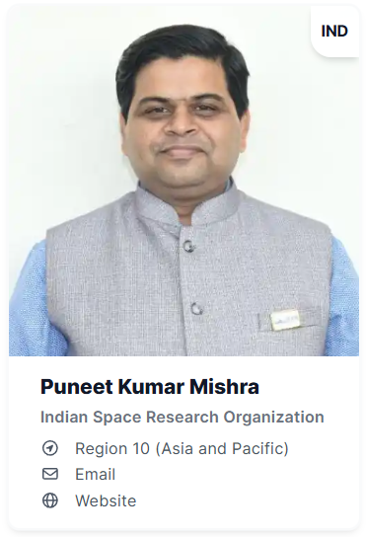
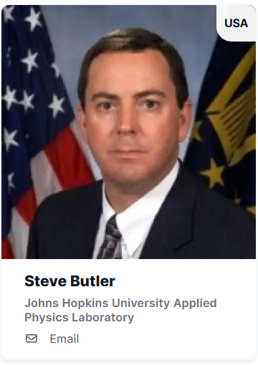
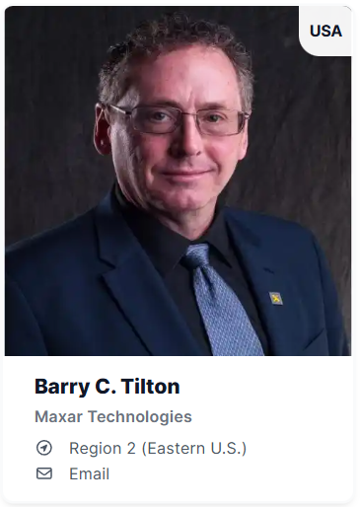
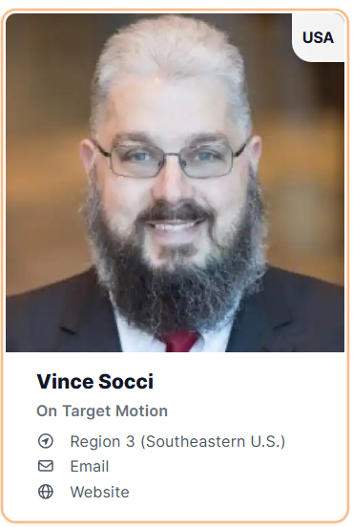
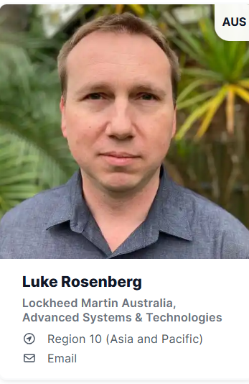
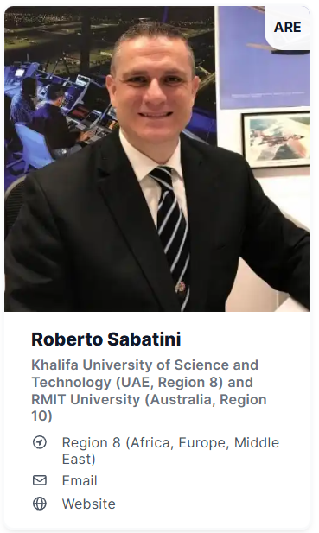
Officers (2026)
President-Elect
Past President
Secretary
Treasurer
President
Braham Himed
Vice President Awards
Vice President Conferences
Vice President Education
Vice President Finance
Vice President Industry Relations
Vice President Member Services
Vice President Publications
Vice President Technical Operations

Slide 4
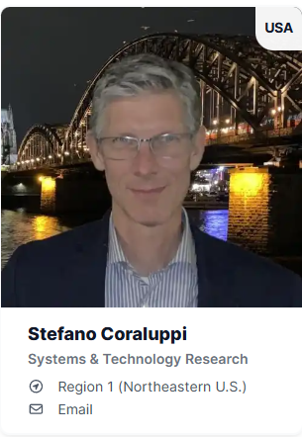
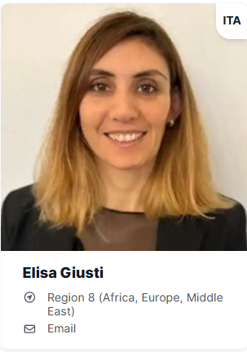
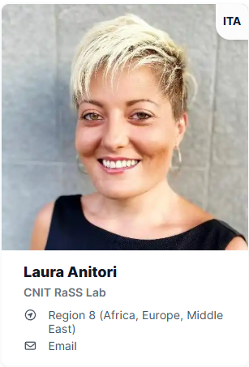
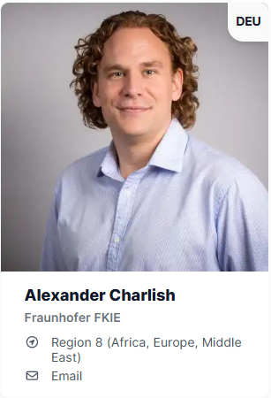
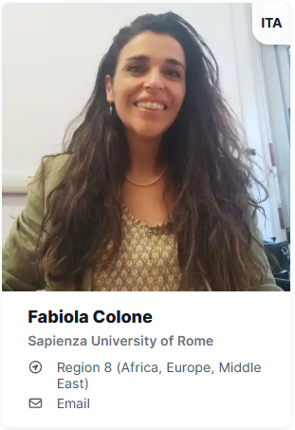
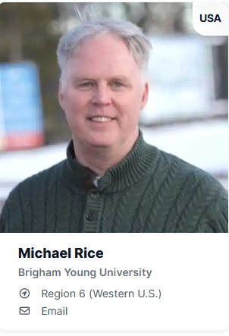
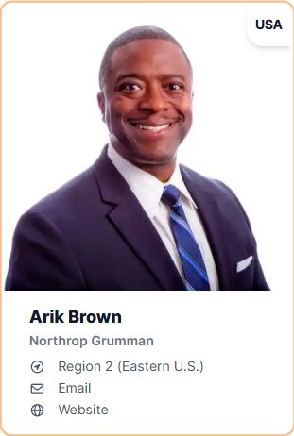
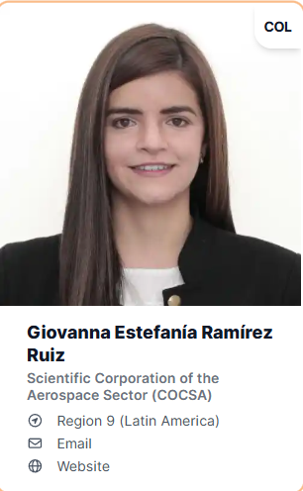
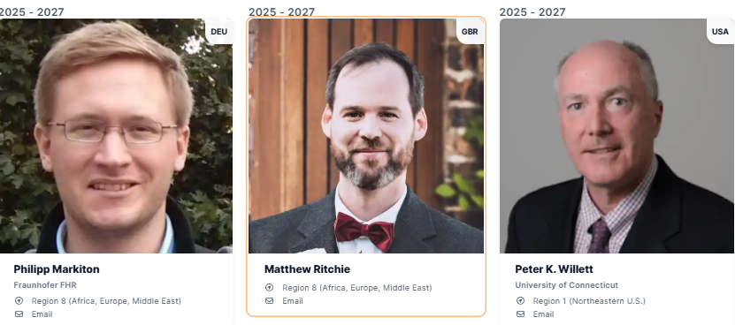

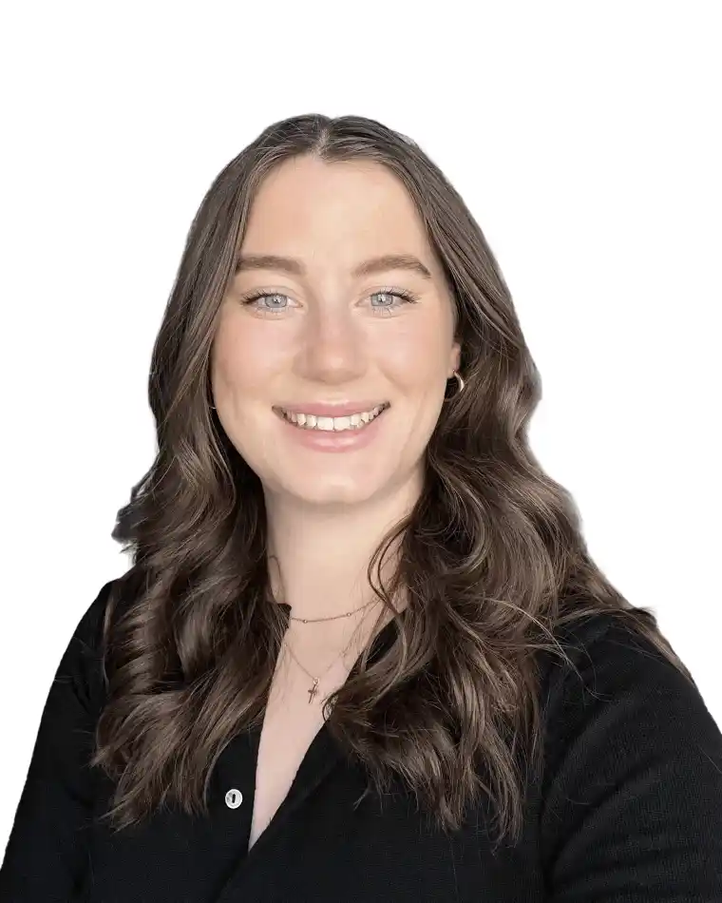
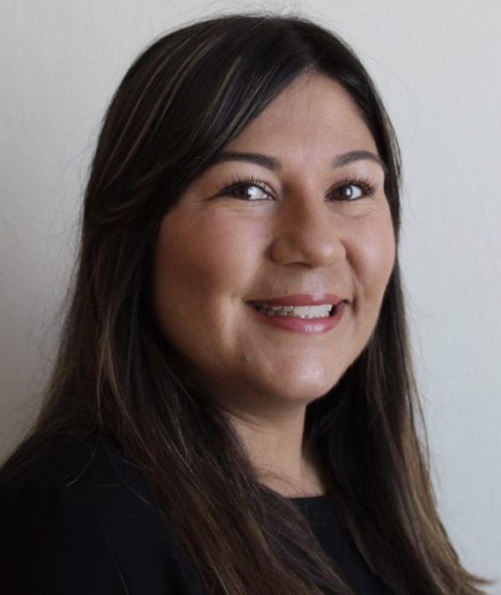
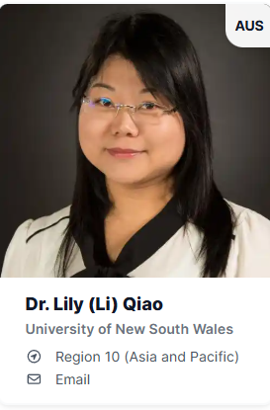
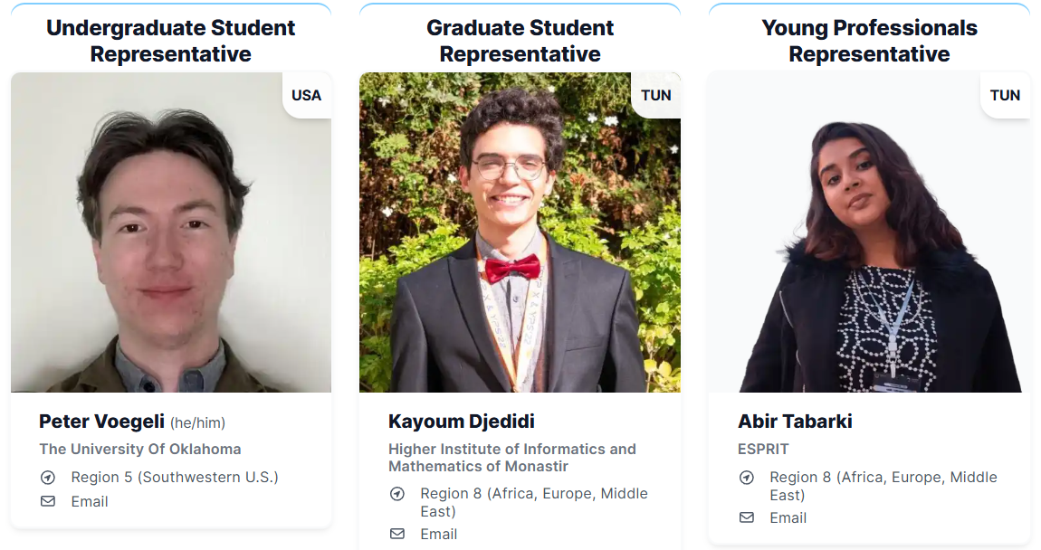
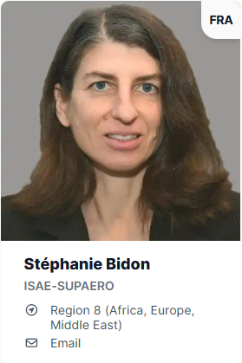
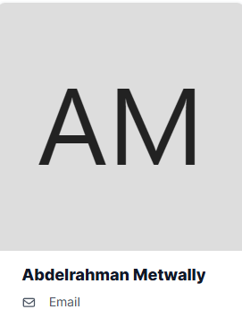
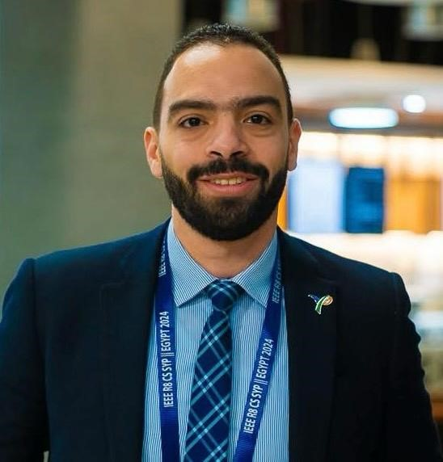
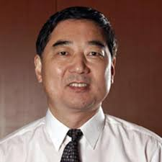
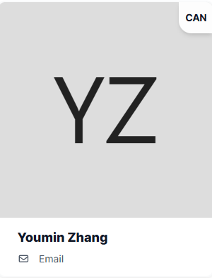

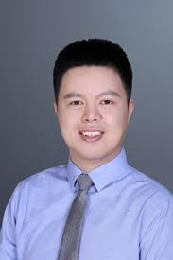
Members at Large (2026)
Presidential Appointments
International Directors
Julia Briggs
Executive Admin

Slide 5
Objective as President
Grow AESS presence in under-represented regions
  Student enrolments (another 2,000+ growth in next 2 years)
    10 SBC petitions so far
    2 sections chapters
  Increase chapter activities
  Desire to have one BoG member from R8 (Africa + ME)
Strengthen AESS financial position
  Regroup form past losses
  Strengthen conferences and publications

Slide 6
IEEE TAB Objectives
IEEE TAB Presidents’ Forum – Focus Areas
  Advance AI-Augmented Hardware and Systems
    Hardware & system design global competition (Support IEEE priorities)
    Inter-society technology development and development
    Micro-foundry for chip prototyping and fabrication (for small companies)
    Lab in a box (for under-serviced areas)
    Online platform to support lab in a box and related activities
Inter-Society Collaboration
  Division IX – Sabrina Greco
  Division IV – Eric Mokole

Slide 7
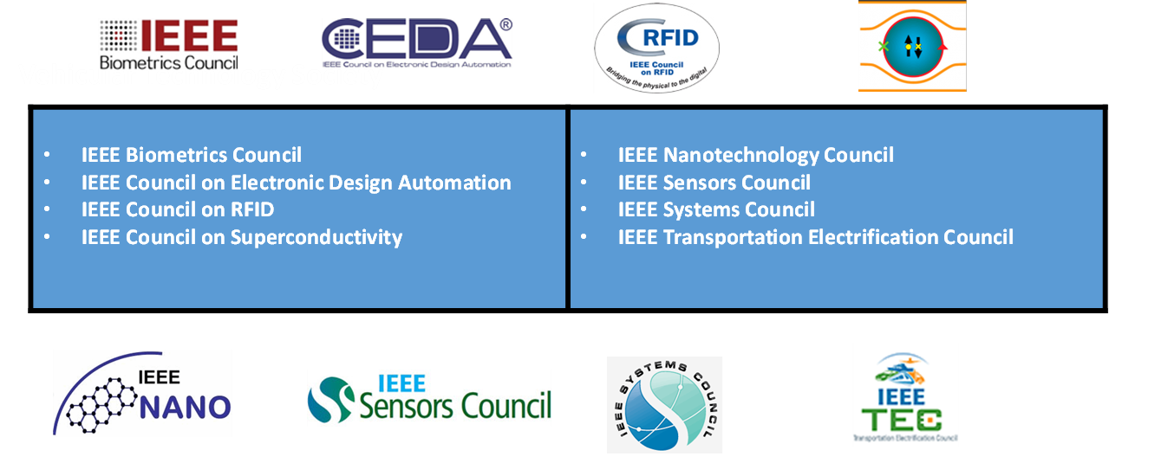
AESS Participation in Technical Councils

Slide 8
AESS Participation in Technical Communities
Blockchain Community
Brain Community
Digital Privacy Community
Digital Reality Community
Entrepreneurship Community
Future Networks Community
Technology for a Sustainable Climate Community
International Roadmap for Devices & Systems Community
Micro Electro Mechanical Systems Community
Public Safety Technology Community
Quantum Community
Pre-University STEM Community
Smart Cities Community
SusTech Community
TechEthics Community
Internet of Things Community

Slide 9






Programs, Incubation, Initiatives and Resources
Strategic Programs
IEEE Entrepreneurship
IEEE TechEthics
TAB Broadening Participation Committee
Coordination with MGA Affinity Groups:
  IEEE Young Professionals
  IEEE Women in Engineering
Future Directions Initiatives
Resources & Platforms
IEEE Resource Centers – education
IEEE DataPort – platform for data and project ideas

Slide 10
2026 Spring BoG Meeting
Accomplishments
  Summarize committees' main activities
    Point out areas and activities that address the SWOT (Strategy, Weaknesses, Opportunities, and Threats)
    Define areas that Cross-Committees can strengthen the Opportunities and reduce the Threats
2026 Objectives
  Please limit to no more than 3 slides
Identify Issues / Show-stoppers
  Identify any issues that’s preventing from doing your job properly

Slide 11
Meeting Rules
Be involved in the discussion
Wait to be recognized before speaking
Share time and avoid interrupting others
Treat others with respect
Stay mentally present
Try to avoid tending to non-meeting business
Do your best to show up on time and come prepared
Everyone’s participation is important

Slide 12
Organization (Saturday’s Discussion)
Secretary
President
President Elect
Admin
Treasurer
Past President
Vice-Presidents
Awards
Conferences
Education
Finance
Industry Relations
Member Services
Publications
Technical Operations
Publicity & Marketing
2026-2028
8
Members at Large
2025-2027
7 (1)
2024-2026
7 (1)
Presidential Nominations
Young Professionals
DL Coordinator
Undergraduate
Graduate
Regions | 2 - 6 | 7 | 8 | 9 | 10 | 11
Int Directors (s) | 1 | 1 | 2 | 1 | 1 | 1

Slide 13
Distinguished Lecturer (DL) Program
Move current DL program into webinar program starting in 2027
  Virtual only
  Available to society chapters, student branch chapters, others
Rebrand Distinguished Lecturer (DL) program in 2027
  5 Distinguished Lecturers for a year
  Keep active previous 2 years
  Available only to society chapters and student branch chapters

Slide 14
Distinguished Industry Speaker (DIS) Program
Initiate new Distinguished Industry Speaker (DIS) program in 2027
  Recognized experts with a background in industrial applications
  Educate and interact with Society members about topics that are of primary importance to industry and AESS community at large
  Speakers will focus their presentations on industrial applications of interest to practicing engineers and stress practical issues
  5 Distinguished Lecturers for a year
  Keep active previous 2 years
  Available only to society chapters and student branch chapters

