Slide 1
IEEE Aerospace Electronic Systems
VP Publications
Luke Rosenberg
AESS Board of Governors Meeting – Spring 2026
15-16 May 2026
Phoenix, AZ, USA
IEEE Confidential

Slide 2
TAES Update
TAES is currently within the top 10 “Grand Journals” of IEEE in terms of publications per quarter. IF: 5.7
  In 2025, TAES had 6100 paper submissions (original + revisions)
  In 2026, TAES is on track for 8500 paper submissions (original + revisions)
2025/2026 Updates:
  New technical Area “ISAC” co-sponsored by the “Radar, SP and EW” and “Communication and Sensor Fusion” thematic areas
  Reviewer evaluation time reduced from 45 days to 30 days
  Journal now has a single volume so articles get published as they are typeset
  Barry Carlton Award Process further streamlined thanks to the guidance and feedback from Dale Blair
  2025 AE Recognition Awards - 13 AEs were recognized out of 209.
2026 Goals:
  Ad-hoc committee looking at how to ensure the success of TAES:
    Should we split out another journal?
    Impact of new IEEE tools to help pre-screening / reviewer selection (global campus / prophy)
    Will there be a reduction in the number of radar papers due to TRS getting an impact factor?
  Complete operations manual
  Continued push for special sections based on conferences.
IEEE Confidential
Notes:
Please summarize your committees main activities (i.e. conferences, publications, education, member activities, etc.)
Please point out areas and activities that address the SWOT (Strategy, Weaknesses, Opportunities, and Threats)
Define areas that Cross-Committees can strengthen the Opportunities and reduce the Threats.
Accomplishment 1
Accomplishment 2
Accomplishment 3
No more than 3 slides (all others in backup)

Slide 3
MAES Update
  2025/2026 Update
  The paper back log is in good shape and there are more submissions. IF: 3.8
  Roster has 1 AEIC and 26 AEs
  301 papers handled in 2025, 51% rejection
  New paper format that is written jointly by best paper student awardees, see example in the link.
  The AESS Cybersecurity panel proposed a special issue, currently open.
  Pau / Alesso will be more involved in the cover image selection.
2026 Goals:
  Complete guidelines to ensure standardised interviews in the magazine.
  Revamp the student highlights and interview columns following new guidelines.
  Extend the best student paper to NAVICON and other interested AESS conferences.
Month | Original | Revised | Total
January 2025 | 18 | 31 | 49
February 2025 | 13 | 19 | 32
March 2025 | 17 | 11 | 28
April 2025 | 15 | 12 | 27
May 2025 | 11 | 5 | 16
June 2025 | 17 | 1 | 18
July 2025 | 13 | 11 | 24
August 2025 | 12 | 8 | 20
September 2025 | 14 | 9 | 23
October 2025 | 13 | 7 | 20
November 2025 | 11 | 8 | 19
December 2025 | 18 | 7 | 25
Total | 172 | 129 | 301
IEEE Confidential
Notes:
Please summarize your committees main activities (i.e. conferences, publications, education, member activities, etc.)
Please point out areas and activities that address the SWOT (Strategy, Weaknesses, Opportunities, and Threats)
Define areas that Cross-Committees can strengthen the Opportunities and reduce the Threats.
Accomplishment 1
Accomplishment 2
Accomplishment 3
No more than 3 slides (all others in backup)

Slide 4
Other Updates
Quarterly Email Blast
  Transition to a new EiC in 2026
JLT
  2699 papers handled, 44% acceptance. IF: 4.8
  10.5% open access uptake
  1 EIC, 5 Deputy Editors, 49 AEs
  Special issues for 2026:
    Optical figure Sensing
    Optical Switching for AI data centers
    Microwave Photonics
  New/emerging areas:
    Multi mode fibres for imaging
    Software controlled PICs
    Integrated communication and sensing
OJSE
  Needs to achieve > 20 publications to start building up to an impact factor.
  Systems Council wants to rejuvenate the journal -> AESS to follow their lead and support as necessary
IEEE Confidential
Notes:
Please summarize your committees main activities (i.e. conferences, publications, education, member activities, etc.)
Please point out areas and activities that address the SWOT (Strategy, Weaknesses, Opportunities, and Threats)
Define areas that Cross-Committees can strengthen the Opportunities and reduce the Threats.
Accomplishment 1
Accomplishment 2
Accomplishment 3
No more than 3 slides (all others in backup)

Slide 5
Other Updates
TRS
2025/2026 Update
  516 papers handled in 2025, 35% acceptance
  New dedicated Editorial Assistant: Kara McArthur (under contract)
  Editorial Board grown to 5 Assoc. EiCs and 19 AEs
  Prepare for expected significant uptick in submissions as TRS qualifies for initial Impact Factor (June 2026)
  New standalone website to be redirected from each sponsoring Society’s website (Conference Catalyst under contract).
2026 Goals
  Best paper award
    Recognition for reviewers and editorial board members
    New special sections
JMASS
  Expect 20% increase in submissions due to first impact factor IF: 2.1
  Achieved first CAS division which is Q3 (the same to IEEE GRSL) -> more PhD students will publish with J-MASS.
  In 2026, J-MASS has three new special editions and 39 new submissions.
    Miniaturized Radar and SAR Systems: Advanced Signal Processing for Resource-Constrained Airborne and Spaceborne Platforms
    Advanced Sensing and Data Processing for UAV and Small Satellite Platforms
    Artificial Intelligence Meets UAVs
IEEE Confidential
Notes:
Please summarize your committees main activities (i.e. conferences, publications, education, member activities, etc.)
Please point out areas and activities that address the SWOT (Strategy, Weaknesses, Opportunities, and Threats)
Define areas that Cross-Committees can strengthen the Opportunities and reduce the Threats.
Accomplishment 1
Accomplishment 2
Accomplishment 3
No more than 3 slides (all others in backup)

Slide 6
Issues / Show-stoppers
Scholarone is limiting
  New tools being trialed to help with issues of AI use, reviewer selection, identifying plagiarised papers
TAES is still growing and causing high workloads for editors
  Urgently need new tools to help with pre-screening
  More AEs required to keep paper count manageable.
OJSE needs help to attract papers
  Work with Systems Council to help with rejuvenation.
IEEE Confidential

Slide 7
Backup Slides
IEEE Confidential

Slide 8
IEEE Transactions on Aerospace and Electronic Systems Update
Dr. Gokhan Inalhan
Editor-in-Chief, IEEE TAES
02.05.2026

Slide 9
TAES Update : New Journal Structure
Passed 2025 IEEE PRAC with very positive comments
  “This appears to be a well-run and successful journal. The team is commended for their excellent work in making the journal so successful.”
In June 2025, we had the major structural change within TAES introducing three thematic areas and three thematic EiCs (TEiCs) and one journal level AEiC:
  GNC and Intelligent Systems : Prof. Inseok Hwang (US, Purdue University)
    Embeds 8 closely related technical areas
    Covers 40-45% of all submissions
  Radar, SP and EW : Prof. Igal Bilik (IL, Ben Gurion University of the Negev )
    Embeds 4 closely related techical areas
    Fundamental building block of TAES covering 40% of all submissions
  Communication and Sensor Fusion : Prof. Lyudmila Mihaylova (GB, University of Sheffield)
    Embeds the remaining 5 somewhat related technical areas
    Covers 15-20% of all submissions
  Journal level AEiC : Prof. Andrea L’Afflitto (US, Virginia Tech)

Slide 10
TAES Update : New Journal Structure
This structural change is focused on
  Better addressing the increasing volume of submissions that TAES is receiving
    Higher quality processes including an additional layer of checks
    Better distribute the workload across (including training, supervision and guidance tasks as well) the EiC and AEiCs and increase system robustness against editorial losses
    Allow usage of AEs across the technical areas to better distribute the expertise and workload
  TAES is currently within the top 10 “Grand Journals” of IEEE in terms of publications per quarter.
In April 2026, TAES introduced a new technical Area “ISAC” co-sponsored by the “Radar, SP and EW” and “Communication and Sensor Fusion” thematic areas
  Special Section to locomote the new technical area
  Further links to ISAC Conferences

Slide 11
TAES Update : Editoral Process and Roster Upgrade
In November 2025, we held the TAES Executive Advisory Board Meeting
  Focus on best approaches to address editorial stress and strain
In April 2026, to further locomote the flux of editorial processes, TAES further reduced the reviewer evaluation times from 45 days to 30 days, in addition reduced the editorial process times in half to only 15 days covering :
  TEiC, SE, AE, Reviewer Assignment
  AE, SE, TEiC, EiC Decision-Making after review completion
As of May 2026, TAES has
  4 AEiCs (3 TEiCs, 1 journal level AEiC)
  3 Thematic Areas, 17 Technical Areas
  23 Senior Editors leading/co-leading technical areas
  209 Active AEs in comparison to 105 AEs in 2023!
    Increasing gender diversity (Female 1 TEiC, 1 SE, 26 AE from 6,82% from 2020)
    Better reflection of AESS membership regional percentiles to TAES AE regional percentiles (Increased Region 10 participation)

Slide 12
TAES Update : TAES in numbers…
In 2023 TAES had 2863 paper submissions (original + revisions)
In 2025 TAES had +6100 paper submissions (original + revisions)
In 2026 TAES is on the pace to achieve +8500 paper submissions (original + revisions)
As of May 2026, on a daily basis
  20-25 papers are assigned to reviewers
  20-25 paper decisions are submitted to the authors

Slide 13
TAES Update : Further issues
Barry Carlton Award Process further streamlined thanks to the guidance and feedback from Dale Blair
  3 year standing award committee co-chaired by TEiCs and overseen by EiC
  Further refinement of selection criteria for future years
2022 Barry Carlton Award Winner
  M. Neinavaie, J. Khalife and Z. M. Kassas, "Acquisition, Doppler Tracking, and Positioning With Starlink LEO Satellites: First Results," in IEEE Transactions on Aerospace and Electronic Systems, vol. 58, no. 3, pp. 2606-2610, June 2022, doi: 10.1109/TAES.2021.3127488
2025 AE Recognition Awards
  13 AEs were recognized
  Very competitive award for only the best of the best performing AEs
As of 2026 TAES has a single volume
  Get accepted = get published immediately
  We have informed our request to categorize publications under thematic areas (to be completed…) under the single volume

Slide 14

Progress Update on
IEEE Transactions on Radar Systems
IEEE Transactions on Radar Systems
April, 2026
Fabiola Colone
Editor-in-Chief

Slide 15
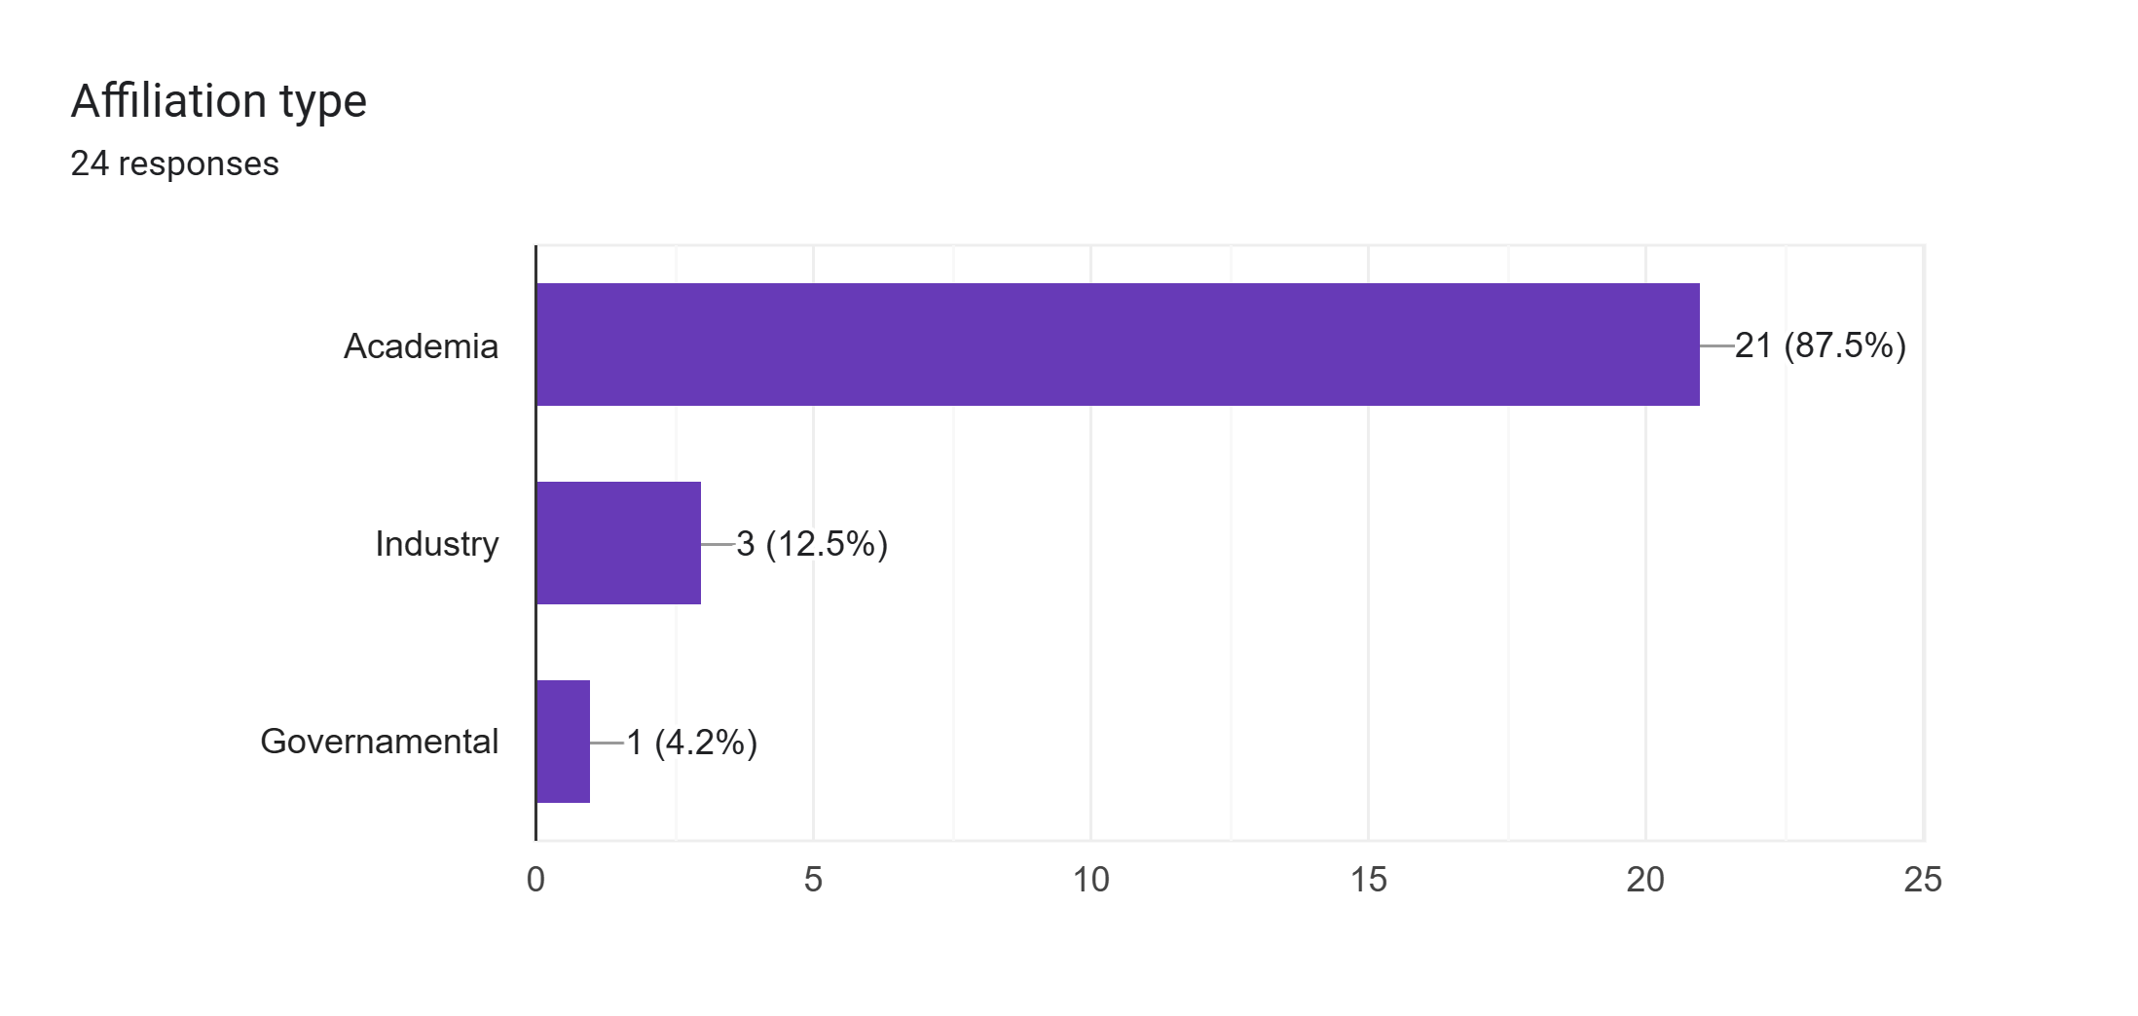
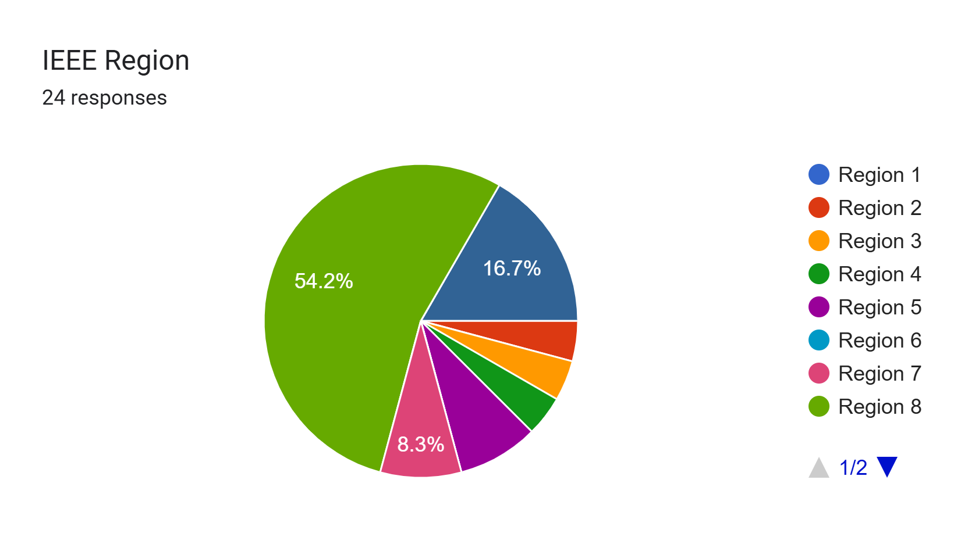
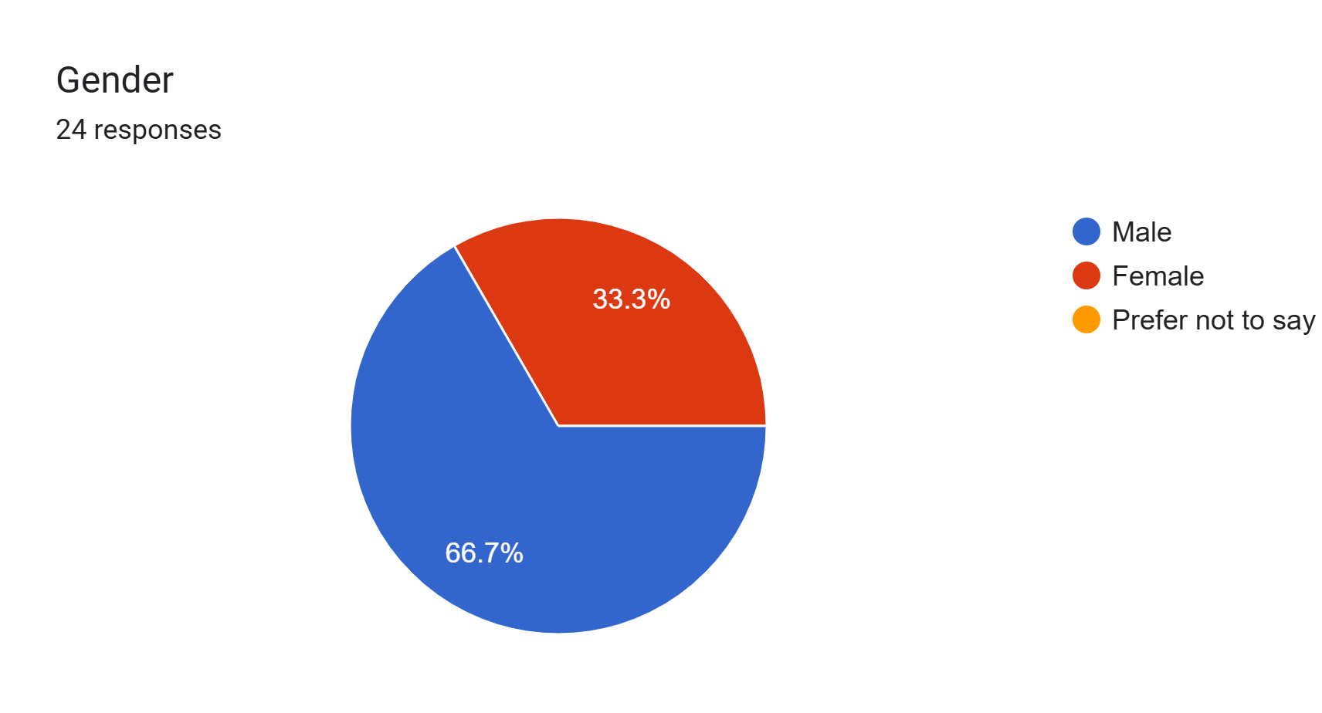
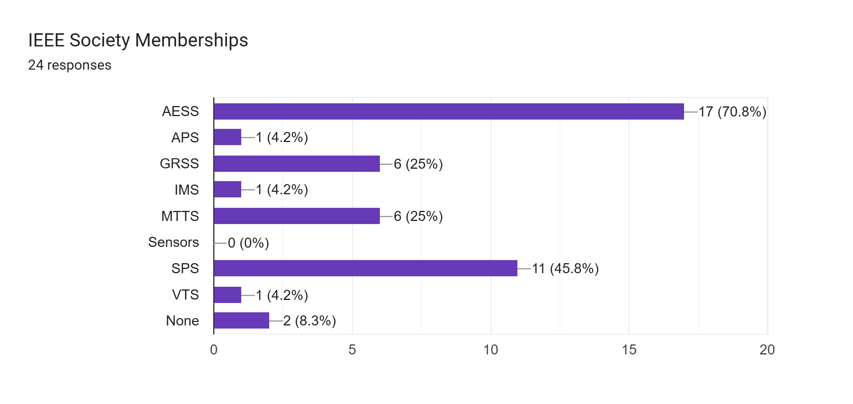
Editorial Board
New dedicated Editorial Assistant: Kara McArthur (under contract)
Editorial Board now comprises 5 Assoc. EiCs and 19 AEs

Slide 16
1st Quarter Stats
Publishing Metrics | 1st Quarter 2026 | 1st Quarter 2025 | 2025 FULL YEAR
Submissions | 161 (105 original, 56 revised) | 99 (59 original, 40 revised) | 516 (334 original, 192 revised)
Decision Ratio | A: 37.3%, R: 16.9%, IR: 45.7% | A: 42.9%, R: 38.8%, IR: 18.4% | A: 34.9%, R: 33.2%, IR: 31.9%
Sub-to-first decision | 26.9 d | 42.8 d | 40.0 d
Sub-to-posting | 79.7 d | 131.4 d | 135.7 d
IEEE journals performance | N/A | Q1 for average weeks submitted to 1st decision & average weeks submitted to online post. | Q1 for CUMULATIVE average weeks submitted to 1st decision & CUMULATIVE average weeks submitted to online post.
Submissions/acceptance ratio by Country | China (66/16.7%), Germany (19/50.0%), USA (19/54.5%), Netherlands (9/50.0%), India (9/40%) | China (20/14.3%), Germany (8/42.9%), India (8/33.3%), USA (6/28.6%), … | China (112/37.2%), USA (52/34.7%), India (47/17%), Germany (25/50%), …
Published papers | 47 | 45 | 121 (99 in 2024)
Downloads | 30635 | 21590 | 94526

Slide 17
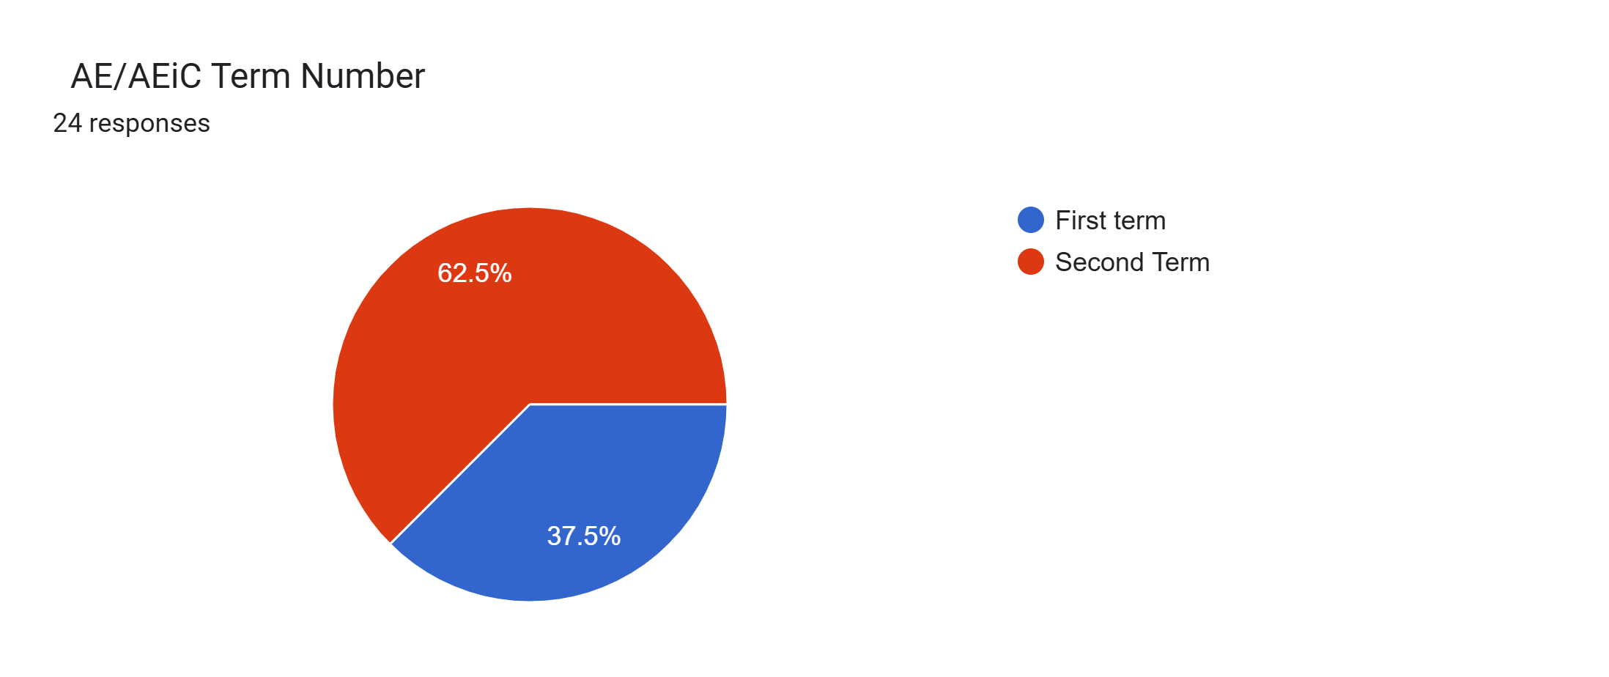
Plans to grow
  Prepare for expected significant uptick in submissions as TRS qualifies for initial Impact Factor (June 2026 release)
  New AEs → Targeted characteristics: Internationally recognized experts, able to attract new reviewers, previous experience in editorial activities, responsive, tech areas: AI/ML, signal processing, imaging and remote sensing.
  New WEB pages → Started developing a standalone website to be redirected from each sponsoring Society’s website (Conference Catalyst under contract).
  Future plans:
  Best paper award
  Recognition for Reviewers and Editorial Board members
  New special section

