Slide 1
IEEE Aerospace Electronic Systems
VP Technical Operations
Roberto Sabatini
AESS Board of Governors Meeting – Spring 2026
15-16 May 2026
Phoenix, AZ, USA
IEEE Confidential

Slide 2
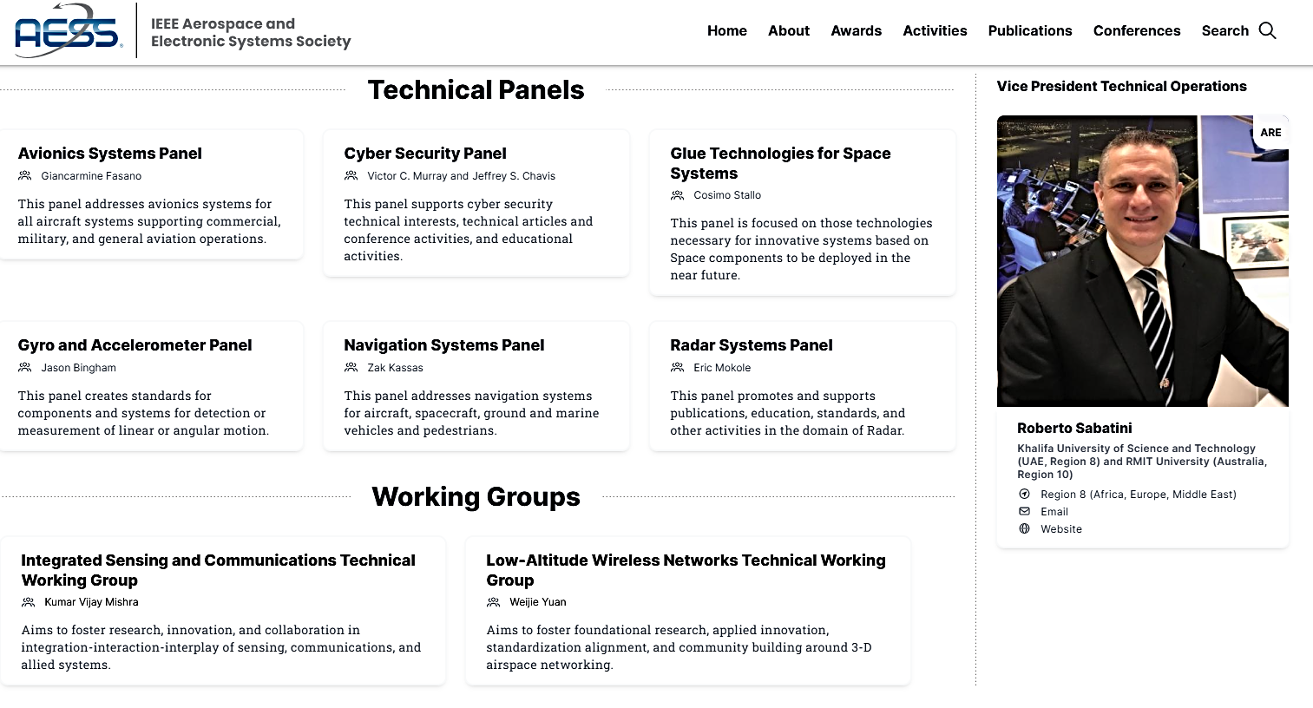
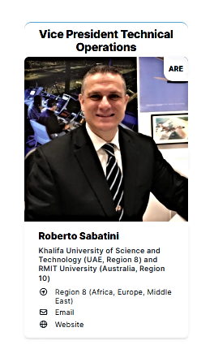
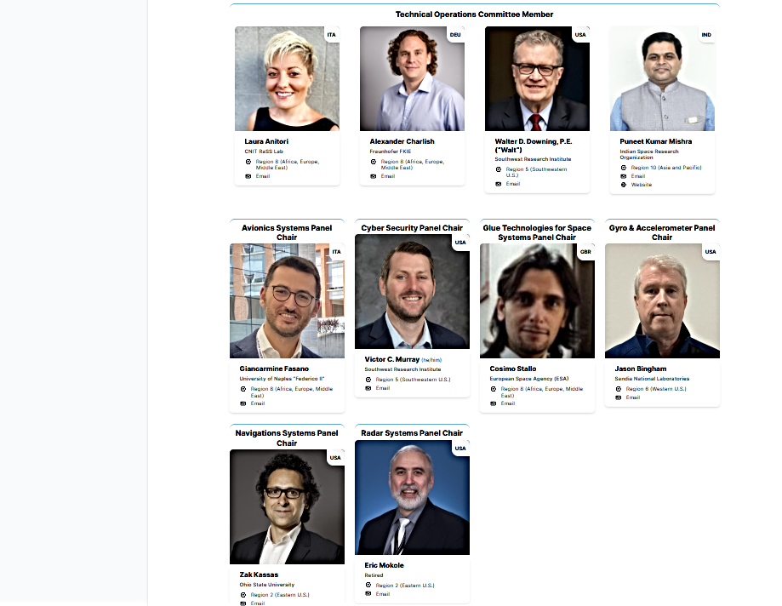
AESS Technical Operations
IEEE Confidential

Slide 3
2025 Accomplishments
Summary of TechOps Activities in 2025
Conferences & Publications:
  Substantive contributions to AESS-sponsored events. Organizing committees, leading tracks and competitions.
  Navigation TP and Avionics TP co-developed and launched IEEE NAVICON (scheduled for Dec 2026).
  Impactful contributions to editorial activities (SE, AE, and SIE) for TAES and AESM publications.
Education Initiatives:
  Summer Schools and Workshops organized, including “Frontier Technologies for Space 2.0 Communications” and “Post Quantum Cryptography for Embedded Devices.”
  Increasing number of TP-led tutorials/lectures at AESS-sponsored conferences and several AESS Distinguished Lectures delivered on core TechOps topics, including avionics, radar, navigation, space systems, LAWN, and ISAC.
Member Activities and Standardization:
  Established the ISAC Technical Working Group (TWG) and LAWN TWG.
  AESS Challenge Problem II, “Cybersecure and Resilient Avionics Operations” (RFP published. Updated deadline for proposal submission is Friday, May 22nd, 2026).
  Hosted Inaugural TechOps Summit to drive standardizations and collaboration across TechOps.
  Significant drive to enhance geographic and demographic diversity within TP/TWG (industry contributions).
IEEE Confidential

Slide 4
2025 Accomplishments
SWOT Overview:
Strengths:
  Strong accomplishments in education, research, and technical standardization.
  Effective inter-panel collaboration (especially Navigation, Avionics, and Cyber Panels) on initiatives such as Challenge Problem II.
Weaknesses:
  Varied structures, objectives, and membership criteria across TPs.
  Resource allocation and limited retention strategies.
Opportunities:
  Expand regional and demographic diversity while fostering industry and government involvement.
  Address sustainability, trusted autonomy, and cybersecurity through joint initiatives (AESS and inter-society).
Threats:
  Coordination challenges with other IEEE and non-IEEE professional societies hindering collaborative initiatives.
  Strong external competitors in several TP/TWG focus areas (other IEEE and non-IEEE societies).
IEEE Confidential

Slide 5
2026 Objectives
Key Objectives for 2026
Standardization Across TPs
  Finalize and implement the "AESS TechOps Policies, Procedures, and Best Practices" guide.
  Align TP operations with consistent reporting practices and membership criteria.
Promote Research and Education
  Launch the FALCON Research & Training Initiative to drive cross-disciplinary R&I projects and training programs/lecture series on sustainable and autonomous aerospace systems.
Strengthen Stakeholder Diversity and Engagement
  Promote regional inclusion and diversity across under-represented groups/demographics.
  Expand industry and government involvement within TPs and TWGs.
IEEE Confidential

Slide 6
2026 Objectives
Interdisciplinary and Transdisciplinary Collaboration
Ongoing Joint Activities:
  Inaugural Tri-Society IEEE ISAC Conference (November 2026, Lisbon).
  Inaugural AESS-sponsored IEEE Navigation Conference (December 2026, Munich).
  Foster interdisciplinary collaboration to address aerospace challenges in autonomy, cyber-physical security, and sustainability.
  Complete Delphi Survey (Stage 2 questionnaire finalized – To be deployed soon) and analyze results to sharpen alignment with member and industry needs.
IEEE Confidential

Slide 7
2026 Objectives
Key Deliverables in 2026
Finalize Phases 2 and 3 of the Delphi Survey and publish findings to guide strategic foresight and ecosystem evolutions.
Improve interdisciplinary collaboration across TPs and TWGs, including joint R&I and training initiatives (FALCON Program).
Establish structured processes for TP and TWG governance and development, ensuring continuity, effectiveness, and sustainability (TechOps Guide).
IEEE Confidential

Slide 8
Issues / Show-stoppers
Challenges Preventing Effective Operation
TP Structure and Performance Challenges
  Inconsistent structures, operations, and objectives across TPs.
  No standardized process for selection, retention, and engagement of panel members.
Inadequate Representation
  Low industry and government participation limiting cross-sector collaboration.
  Lack of diversity in membership, particularly from under-represented regions and demographics.
Administrative and Financial Constraints
  Limited administrative resources (e.g., dedicated support for TechOps Summit).
  No funding mechanisms for TWGs (i.e., need to partner with TPs).
IEEE Confidential

Slide 9
TechOps Action Items Progress
Identified Solutions
Developed targeted R&I, training, and outreach initiatives leveraging Delphi Survey insights, also addressing key global challenges aligned with the AESS mission, as well as regional and demographic diversity gaps (AESS FALCON Innovation Program).
Defined and implement standard procedures for TWG and TP establishment, membership selection, and reporting.
Defined minimum expectations and KPIs for TWGs to evolve into TPs (if desired).
Defined clear and consistent criteria for TP and TWG discontinuation.
Proposed a dedicated funding allocation mechanism for TWGs (ensuring independence from TPs).
Ensured support for TechOps Summit administrative and logistical needs.
TechOps Guide
IEEE Confidential

Slide 10

TechOps Action Items Progress
AESS FALCON Innovation Program Status Update
The FALCON Innovation Program promotes technological innovation and fosters collaboration within AESS TPs and TWGs (Supertopic Evolutions: Trusted Autonomy and Sustainability).
Focus areas include multidisciplinary research, professional development, student competitions, and industry challenges in Sustainable Aviation and Spaceflight Systems.
Research & Innovation Initiatives: Major industry-focused initiatives advancing Aerospace Electronic Systems (AES) technologies.
Education & Training Programs: Dedicated professional training in the form of Lecture Series, Short Courses, Workshops, and Tutorials.
Student Competitions: International student competitions, driving innovation and engagement within the AESS student community.
Conference Contributions: Presenting to AESS-sponsored conferences, enhancing visibility and promoting cross-disciplinary collaboration.
IEEE Confidential

Slide 11
TechOps Action Items
AESS FALCON Innovation Program Future Plans
Launch of a Virtual Technology Accelerator Hub:
  Innovation Scaleup: Facilitates the development of new ideas, focusing on advancing them to the stage of working prototypes (TRL 4-5) and aiming to test them in the intended flight operational environment (TRL 6-7).
  Collaboration Spaces: Provides a virtual environment where researchers, industry professionals, and academia can collaborate seamlessly.
  Technical Resources and Tools: Coordinates access to specialized equipment, simulation platforms, or software crucial for technological development.
  Funding and Grants: Helps secure seed funding and connects innovators with potential investors to support projects.
  Mentorship and Advisory Support: Offers expert guidance to refine technologies and enhance solutions.
  Industry Partnerships: Creates connections with industry leaders to support technology transfer and real-world implementation.
  Skill Development: Conducts training and workshops to prepare participants with skills relevant to advanced Aerospace Electronic Systems (AES) technologies.
  Key Challenges:
  Securing Budget Allocations: Ensuring financial support to scale the program effectively.
  Strengthening Global Outreach: Expanding efforts to attract and engage a diverse range of participants worldwide.
IEEE Confidential

Slide 12
TechOps Action Items
AESS FALCON Innovation Program
KUST Available AAM/UAS Flight Prototypes (Testbeds)
IEEE Confidential

Slide 13
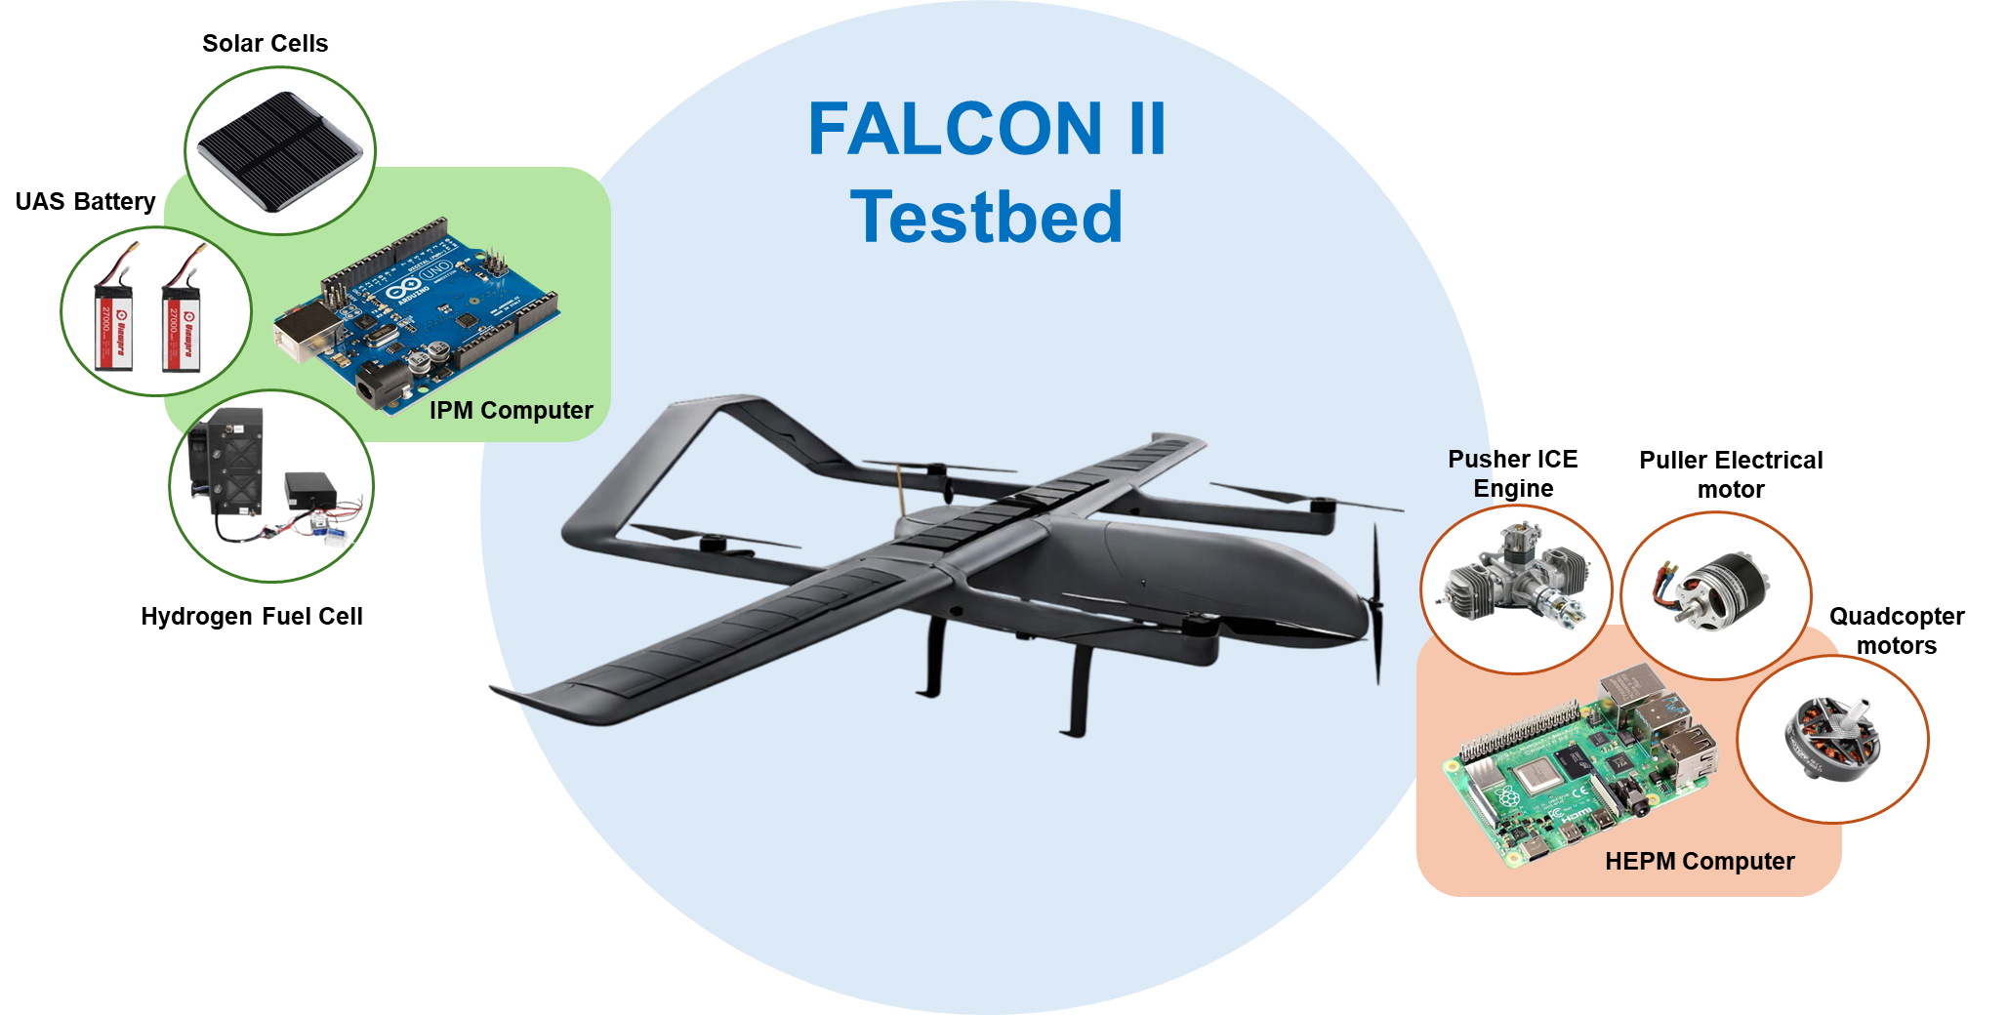
TechOps Action Items
AESS FALCON Innovation Program
Pilot Project (Example) – Hybrid-Electric VTOL Drone for Advanced Air Mobility
IEEE Confidential

Slide 14
TechOps Action Items Register
AI 1304 | Roberto Sabatini to send the draft of the Technical Panels Document to Lorenzo Lo Monte by next BoG meeting. CLOSED – TechOps Guide sent to Lorenzo, Braham, and Julia (Included as supplementary material to the BoG Spring meeting documentation)
AI 1303 | Roberto Sabatini to meet and discuss the FALCON Research and Training Program with Industry Relations, Conferences, and Education by Spring BoG Meeting. IN PROGRESS – Updated due date is August 2026
AI 1302 | Roberto Sabatini to send Julia Briggs information to create a standardized nomination form and timeline for all Technical Panels during a certain time of the year by Spring BoG meeting. CLOSED – The procedure is included in the TechOps Guide.
AI 1301 | Roberto Sabatini to determine the requirements for TWG to be elevated to Technical Panels by Spring BoG meeting. CLOSED - The requirements are included in the TechOps Guide.
AI 1300 | Roberto Sabatini to send Julia Briggs the requested support for the TechOps Summit by July1 2026. IN PROGRESS – Detailed requirements will be shared by the set due date of July 1, 2026.
AI 1242 | Roberto Sabatini to partner with Julia Briggs to update the Delphi survey to be distributed to all AESS members by December 2025. CLOSED and Text of Phase 2 Survey already in Julia’s possession (AESS Admin will deploy the Phase 2 survey by May 31, 2026).
IEEE Confidential

Slide 15
TechOps Motion 1
The TechOps Committee moves to allocate up to USD 15,000 to establish the FALCON Innovation Program, supporting its initial development, organization, and execution.
Pros:
  Promotes Global Collaboration Across Disciplines: The FALCON program will foster synergy among international researchers, industry professionals, and academic institutions, enabling impactful partnerships and knowledge-sharing.
  Advances Research and Training Initiatives: The program will serve as a platform for strategizing and implementing cutting-edge research projects and innovative training opportunities, directly contributing to AESS goals.
  Encourages Diversity and Accessibility: Financial support will enable the program to engage participants from underrepresented regions, demographics, and disciplines, increasing global participation and visibility.
  Provides Foundational and Administrative Support: Allocating financial resources will ensure the successful establishment of the program, allowing for efficient setup, outreach, and initial operational execution.
  Cons: None identified.
Financial Implications:
Up to USD 15,000 will be allocated in the first year to support the establishment and initial activities of the FALCON Innovation Program. This funding will cover program development, marketing and outreach, pilot projects, administrative setup, and other operational costs as required.
IEEE Confidential

Slide 16
TechOps Motion 1
Proposed Allocation of Initial Seed Budget (USD 15,000)
Networking and Partnership Building
  Host a networking session to connect university students and faculty with aerospace professionals, industry leaders, and potential investors.
  Explore partnerships with local and global aerospace firms for future collaborations.
  Estimated Cost: $3,000
Marketing and Outreach
  Create branding materials: logo design (first draft already developed), templates, and initial digital presence (website, social media accounts, email campaigns).
  Host an official launch event (online or hybrid) to increase visibility.
  Estimated Cost: $3,000
Workshops and Training Programs
  Conduct 1-2 technical workshops focused on areas relevant to Aerospace Electronic Systems (AES) technologies, including key hardware and software design concepts, standards, and Technology Readiness Levels (TRLs)
  Engage faculty members or industry experts for mentorship and skills training.
  Estimated Cost: $4,000
Platform Development and Tools
  Fund 1–2 small pilot projects or mini-research initiatives to demonstrate the efficacy of the accelerator.
  Offer grants of $2,000 per team for completing proof-of-concept work (TRL 3–4).
  Estimated Cost: $5,000
IEEE Confidential

Slide 17
TechOps Motion 2
The TechOps Committee moves to allocate up to USD 15,000 per calendar year to fund the TechOps Summit organization and execution (after each Fall BoG meeting).
Pros:
  Enhances Collaboration Across Technical Panels (TPs): The TechOps Summit has proven to be essential in fostering synergy among TPs and identifying opportunities for joint initiatives. Financial support will ensure the event's continuity and effectiveness.
  Serves as a Platform to Drive Strategic Planning and Innovation: The Summit allows TPs to exchange ideas, align priorities, and strategize efforts, driving impactful contributions to AESS goals.
  Encourages Industry and Global Participation: Formal funding will enable the Summit to attract more diverse participation, including industry and international delegates (also beyond the existing TP/TWG membership), thereby increasing visibility and influence.
  Provides Logistical and Administrative Support: Securing financial backing will enable smooth execution of the Summit, enhancing outcomes and reducing reliance on volunteer resources.
  Cons: None identified.
Financial Implications:
Up to USD 25,000 per calendar year, specifically allocated for the organization, venue logistics, technology platforms, guest speakers, and other operational costs for the TechOps Summit. TP/TWG Chairs will be funded separately through the standard Presidential Travel Approval Form.
IEEE Confidential

Slide 18
TechOps Motion 3
The TechOps Committee moves to allocate up to USD 5,000 per calendar year to fund the activities of each Technical Working Group (TWGs), aligned with AESS strategic objectives. Similar to Technical Panels (TPs), the funding requests will be submitted to the VP TechOps for initial screening and voted upon by the members of the TechOps Committee (majority vote required).
Pros:
  Supports Strategic Objectives: Financial support for TWGs will enable them to undertake meaningful projects and activities that directly align with and advance AESS’s strategic goals.
  Promotes Innovation: TWGs are vital for fostering innovation in emerging topics and cutting-edge technologies. Adequate funding ensures that these initiatives can achieve impactful outcomes.
  Parallels Existing TP Processes: By following a similar model to TPs, the funding allocation process will ensure transparency, accountability, and alignment across all initiatives within TechOps.
  Encourages Interdisciplinary Collaboration: Providing funds to TWGs will empower cross-disciplinary efforts that bring together diverse expertise from multiple TPs and external stakeholders.
  Enables Global and Industry Participation: Adequate funding can assist TWGs in hosting events, workshops, and studies that involve international and industry experts, further enhancing AESS’s global reach and influence.
Cons: None identified.
Financial Implications:
Up to USD 10,000 per calendar year for the current two active TWGs. Each TWG may request up to USD 5,000 annually, subject to approval by the VP TechOps and a majority vote by the TechOps Committee.
IEEE Confidential

Slide 19
Contributions from Technical Panels and Technical Working Groups
NOTE: The full slide packs from the TP/TWG Chairs (Semi-Annual Reports) are included in the BoG Documentation as Supplementary Material
IEEE Confidential

Slide 20
Avionics Systems
Technical Operations Panel
Semi-Annual Updates
Giancarmine Fasano
Chair, Avionics Systems Panel
AESS Board of Governors Meeting – Spring 2026
15-16 May 2025
Phoenix, AZ, USA

Slide 21

Avionics Systems Panel
The Avionics Systems Panel (ASP) is composed of IEEE Associate or higher-level members who are representatives of industry, government laboratories, educational institutions and professional societies, and who are active in the domain of Avionics. Its main objectives are:
  Promote and support collaborative research initiatives in the domain of Avionics
  Develop and disseminate high-quality IEEE publications in the domain of Avionics
  Promote and support educational activities in the domain of Avionics
  Sustain and oversee the programs of the IEEE/AIAA Digital Avionics Systems Conference (DASC) and the Integrated CNS Conference; and contribute to other conferences and dissemination initiatives
  Manage the nomination and selection of candidates for IEEE Awards in the domain of Avionics
  Encourage submission of nominations for IEEE Fellows and Senior Members in the domain of Avionics
  Recommend and support new IEEE avionics standards or revisions of existing standards

Slide 22
ASP Committees
The ASP relies on a diverse community of experts (currently from US, EU, UK and Asia), contributing to the work of five different committees. The panel holds regular monthly meetings addressing the following topics, managed by separate committees:
  Research and Innovation (R&I). Participation to NASA UTM and AAM activities; connections/collaborations with NextGen in the US and SESAR in the EU; other national and international Avionics/ATM/UAS programs; Collaborations with JARUS, ICAO, IFATCA, and others
  Publications. Editorial Board and reviewer contributions to the Transactions on Aerospace and Electronic Systems and AESS Systems Magazine; Special Issues on Avionics, UTM/UAM and Space Systems; joint journal publication initiatives (e.g., Avionics Systems for Trusted Autonomy, Multi-Domain Traffic Management, Avionics Education)
  Conferences. IEEE/AIAA Digital Avionics Systems Conference (DASC); IEEE/AIAA Integrated Communications, Navigation and Surveillance Systems (ICNS) Conference; IEEE/AIAA/PHM Aerospace Conference; other conferences
  Education Activities. AESS Distinguished Lecturers/VDL Program updates; Webinars, Tutorials and Short Course initiatives
  Industry Engagement and Standards. UAS/Autonomy, AI, V2X Communications, Cyber Security, etc.
  Nominations and Awards. Senior Member/Fellow nominations and relevant awards

Slide 23
ASP Summary of Activities
Research and Innovation:
  Continuous exchanges during monthly meetings on topics of interest such as: Advanced CNS/ATM systems and AI-based decision support systems, Integration of UAS in airspace, development of new aviation ecosystems (AAM), Air and Space Traffic Management
  Revised Avionics Challenge Proposal developed in the framework of AESS TP Funding Initiative, to be shared with BoG
  Support and Collaboration with Cyber-Security Panel and Glue Tech Panel for AESS Grand Challenge
  Endorsement of the LAWN TWG Challenge Proposal
Conferences and Publications:
  Active contribution by ASP Members (Organizing Committee, Technical Program, Awards, etc) to AESS Conferences: ICNS 2026, AeroConf 2026, DASC 2026, NAVICON 2026
  ASP Members actively engaged in editorial activities for IEEE AESS publications: Transactions on AES & AES Magazine
  Ongoing work on new IEEE Series book
Education Activities:
  Planned public AESS tutorial on Advances in Avionics Technologies, at DASC 2026
  Continued to deliver virtual and live Distinguished Lectures on digital avionics and space systems
  Developed the concept of a new initiative, i.e. AESS PhD School and Short Course. The initiative received support by other technical panels. Ongoing revision of funding request to AESS
Industry Engagement and Standards:
  On-going Interactions with JARUS Automation WG On-going interactions with ICAO and other international WGs on environmental sustainability
  5. Awards and Nominations:
  Recruitment of new members following AESS guidelines
  Planned Support for AESS awards

Slide 24
Cyber Security Panel
Technical Operations Panel
Semi-Annual Updates
Victor Murray, CISSP; Jeff Chavis
Chair, Cyber Security Panel
AESS Board of Governors Meeting – Spring 2026
15-16 May 2026
Phoenix, AZ, USA

Slide 25
Cyber Security Panel Mission and Objectives
MISSION
Risk and Threat Tracking. Develop and maintain a comprehensive understanding of the cybersecurity threats and risks to the aerospace and electronics sectors.
Cybersecurity Best Practices. Promote and support the adoption of cybersecurity best practices throughout the IEEE AESS.
Stakeholder Collaboration. Coordinate and collaborate with other stakeholders to ensure a harmonized approach to cybersecurity.
OBJECTIVES
Risk and Threat Tracking. To understand the cybersecurity threats and risks that affect the AESS sectors. This will be accomplished by developing and maintaining a comprehensive knowledge base of cybersecurity vulnerabilities and threats that can affect the sectors of interest and their respective assets. The threats and vulnerabilities will be prioritized to identify the most critical cybersecurity vulnerabilities.
Mitigations. To develop recommended mitigation strategies and controls for the ecosystem of each sector that can prevent, detect, respond to, and recover from cybersecurity incidents.
Cybersecurity Best Practices. To promote and support the adoption of cybersecurity best practices throughout the AESS to improve its cybersecurity posture.
Training. Provide cybersecurity training and education to associated industry personnel to equip them with the skills and knowledge to deal with cybersecurity incidents. This will be accomplished by papers and publications in various industry and cybersecurity conferences, magazines, and journals. In addition, distinguished lectures will be prepared by the Panel member and offered to IEEE member organizations, Local Chapters and through virtual media.
Awareness. To enhance the cybersecurity awareness and knowledge of AESS industry personnel to enable them to detect and respond to cybersecurity incidents.
Collaboration. To collaborate with other stakeholders to ensure a coordinated and comprehensive approach to AESS cybersecurity that aligns with the underlying sector's needs and priorities.

Slide 26
Cyber Security Panel Summary of Activities
Seven (7) new members nominated and confirmed to join Cyber Panel!
Challenge problem definition: Federated AI to Secure Drone Networks
Request for challenge problem solutions approved!
AESS Special Publication Magazine Article
Space Standards Collaboration
Lots of Papers, Conferences, and Education
DASC Best Cyber Paper!

Slide 27
Glue Technologies for Space Systems
Technical Operations Panel
Semi-Annual Updates
Cosimo Stallo
Chair, Glue Technologies for Space Systems
AESS Board of Governors Meeting – Spring 2026
15-16 May 2026

Slide 28
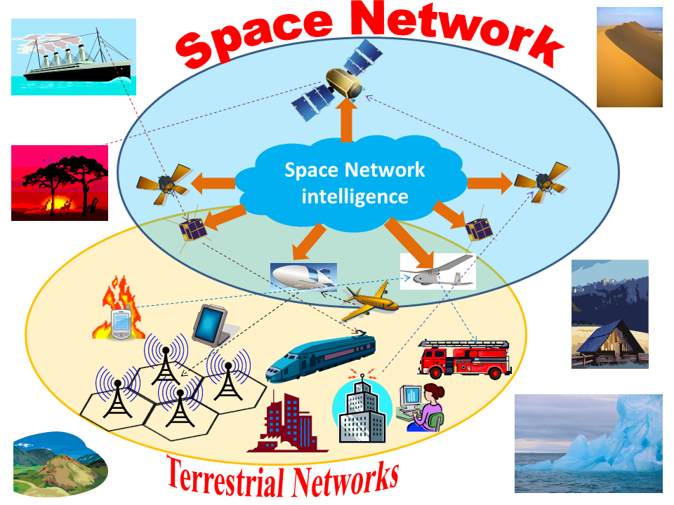
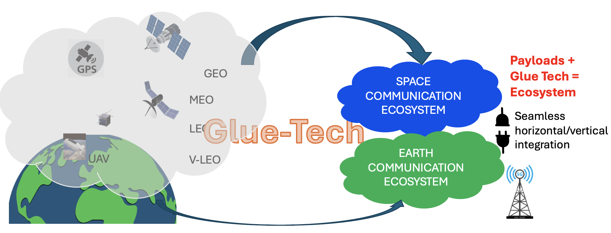
“Glue-Tech” panel
The mission of the “Glue-Tech” panel, funded in 2019, is to strengthen the cooperation of Academy, Industry, Research Institutions and Space agencies in innovating the vision of Space technology.
Space technology (satellite communications, aerial communications, navigation, signal processing) is regarded as the “glue” that seamlessly interconnects the ICT World in an integrated ecosystem, built around the concrete user needs. Nowadays, the “Glue-Tech” panel vision is one of the constitutive pillars of 6G.
In the figures below, the “vision” is pictorially described. The key role in realizing the vision is played by the extensive software-defined implementation of Space network layers and by the adaptive and intelligent network management (AKA: “Space network intelligence”):

Slide 29
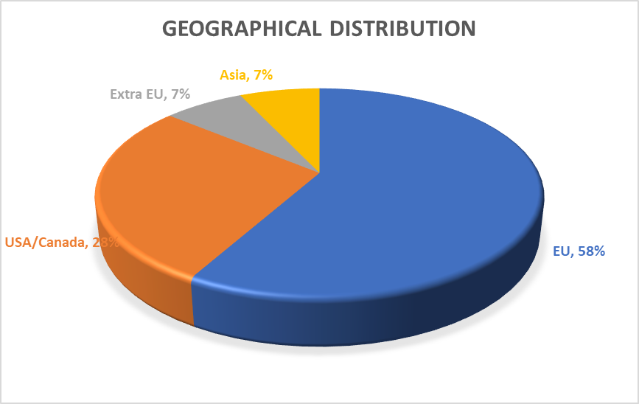
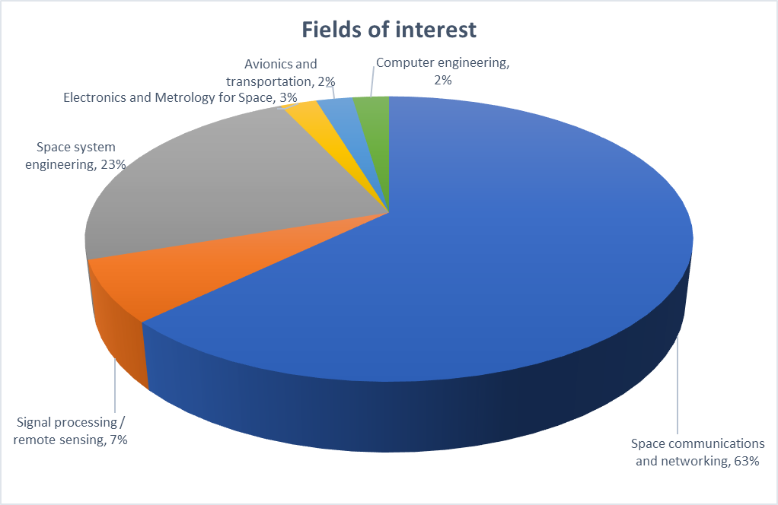
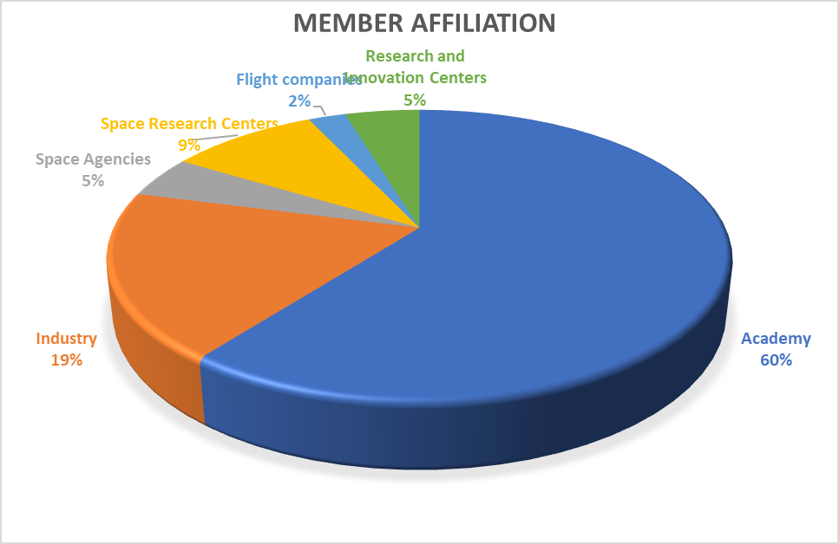
“Glue-Tech” panel: Organization and Committees
The “Glue-Tech” panel consists of 43 members coming worldwide from Academy, Industry, Research Centers and Space agencies. The current picture of the panel is shown in the following pie diagrams:
The panel chair is Cosimo Stallo (European Space Agency), the vice-chair is Gloria Tuquerres (UPS) - Interdisciplinary Lab. for Digital Sciences), the panel secretary is Ivan Iudice (Italian Aerospace Research Centre, CIRA).
No formal committee articulation has been established for the panel. The panelists are informally subdivided into areas of interest (communications, navigation, networking, signal processing, electronics, payload and platform engineering). Synergies are encouraged between the different areas.

Slide 30
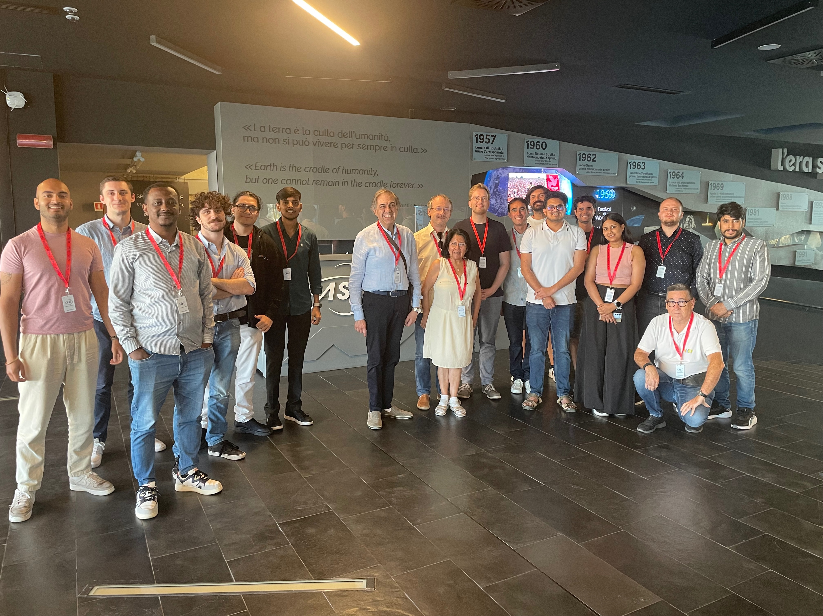
“Glue-Tech” panel: Summary of 2026 Activities
First Plenary Spring Panel Meeting held on May 5th.
Conference organization support (IEEE Aerospace Conference 2026 and 2027 IEEE MetroAeroSpace Workshop 2026, IEEE AESS Navicon 2026).
Promote research innovation in Space technologies coping with the mission of “Glue Tech” panel.
Organization of didactic and dissemination events concerning with the panel topics (invited talks, seminars, workshops, etc.) in the first half of 2026 and in the rest of the year.
The “Glue Tech” panel is actively working to strengthen the organization of the yearly Summer School: “Frontier Technologies for Space 2.0 Communications”.
Such an event has been successfully organized since 2021, with the participation of lecturers mostly coming from the panel. The event target is international, and the audience comes from every part of the World.
In March 2026, the “Glue Tech” panel submitted to AESS a proposal for 4,000 USD of funding a revamped, inter-panel version of the School. The revamping considered these points:
  Double-modality organization (in presence and in remote), choosing a location in the Space ecosystem of the Italian Lazio region (ESA site in Frascati (ESRIN) is the candidate one).
  Organization of two inter-panel keynote speeches (in cooperation with the Avionics and Cybersecurity technical panels). Various options are under consideration.
The proposal is in the approval cycle, and the panel will organize the School edition after its acceptance.
IEEE AESS Glue Tech Panel Summer School
in September 2025 at ASI premises

Slide 31
Gyro and Accelerometer Panel
Technical Operations Panel
Semi-Annual Updates
Jason Bingham
Chair, IEEE/AESS Gyro and Accelerometer Panel
AESS Board of Governors Meeting – Spring 2025
15-16 May 2026
Phoenix, AZ, USA

Slide 32
Gyro and Accelerometer Panel (GAP)
The Gyro and Accelerometer Panel (GAP) is composed of representatives of industry, government laboratories, educational institutions and professional societies, and who are active in the domain of inertial sensors and systems. Its main objectives are:
Create and maintain terminology, specification format, and test procedure standards for components and systems designed to detect or measure inertial motion.
Promote understanding of inertial components and systems.
Establish accepted ways to describe inertial technologies and products.
Create a common language that can be used by the inertial industry.

Slide 33
GAP Committees
The GAP currently has two working groups:
IEEE Std 836 Working Group
  Purpose: Revision of IEEE Std 836 to align with current industry technologies and practices.
IEEE Std 1431 Working Group
  Purpose: Revision of IEEE Std 1431 to align with current industry technologies and practices.

Slide 34
GAP Summary of Activities
The GAP held bimonthly meetings to address the following standards:
IEEE Std 836 Recommended Practice for Precision Centrifuge Testing of Linear Accelerometers
IEEE Std 1431 IEEE Standard for Specifying and Testing Coriolis Vibratory Gyros

Slide 35
Navigation Systems Panel Report
Semi-Annual Updates
Zak Kassas
Chair, Navigation Systems Panel
AESS Board of Governors Meeting – Spring 2026
15-16 May 2026
Phoenix, AZ, USA

Slide 36
About the Navigation Systems Panel (NSP)
The Panel shall address navigation systems for aircraft, spacecraft, ground and marine vehicles and pedestrians as well as history of navigation systems and navigation education.
Objectives
The objectives of this Panel are:
Work with the Institute of Navigation (ION) and the PLANS Executive Committee to select and support volunteers for PLANS (e.g., track chairs, session chairs, etc.).
Maintain a repository of past conference Budgets, Final Reports, Best Practices and lessons learned.
Promote the submission of navigation manuscripts to the IEEE Transactions on Aerospace and Electronic Systems and the AESS Magazine.
Facilitate NSP nominations/endorsements for Senior Member and Fellow Grade.
Develop, as needed, new conferences related to the NSP’s areas of interest.

Slide 37
About the Navigation Systems Panel (NSP)
Position | First Name | Affiliation | Affiliation Type | Region
Chair | Zak Kassas | Ohio State University | Academia | 2 (Eastern U.S.)
Vice Chair | Fabio Dovis | Politecnico di Torino | Academia | 8 (Africa, Europe, Middle East)
Member | Jason Gross | West Virginia University | Academia | 2 (Eastern U.S.)
Member | Pau Closas | Northeastern University | Academia | 1 (Northeastern U.S.)
Member | Gary McGraw | PNT Consultant – Collins Aerospace | Industry | 4 (Central U.S.)
Member | Randall Curey | Northrop Grumman | Industry | 6 (Western U.S.)
Member | Mohammad Tehrani | Innova Photonics | Industry | 6 (Western U.S.)
Member | Elena Lohan | Tampere University | Academia | 8 (Africa, Europe, Middle East)
Member | Thomas Pany | Universität der Bundeswehr München | Academia/Government | 8 (Africa, Europe, Middle East)
Member | Jindřich Dunik | University of West Bohemia/Honeywell | Academia/Industry | 8 (Africa, Europe, Middle East)
Member | Omar Crespillo | Isar Aerospace | Industry | 8 (Africa, Europe, Middle East)
Member | Andrew Depmster | University of New South Wales | Academia | 10 (Asia and Pacific)
Member | Micahel Meurer | DLR | Government | 8 (Africa, Europe, Middle East)
Member | Ali Abdallah | Google | Industry | 6 (Western U.S.)

Slide 38
Navigation Systems Panel Summary of Activities
Panel Meetings: (1) Virtual: March & May 2026; (2) Informal: January 2026 (ION ITM Conference, USA) & March 2026 (Munich Space Summit, Germany)
Distinguished Lectures (DL): Delivered by Panel Chair (Zak Kassas) at institutions including American University of Beirut, Embry-Riddle Aeronautical University, and German Aerospace Center.
Membership Updates: 1 member left (inactivity); 2 new members joined. Plans to recruit for greater diversity (geography, professional affiliation).
Publications: Collaboration with AESM EiC for NAVICON 2026-selected paper extensions.
AESS Awards: Finalized selection criteria for two prestigious awards (Kershner & Walter Fried Awards), to be presented at NAVICON 2026.
Conference Activities:
(1) Planning for IEEE/ION PLANS 2027 (key roles assigned).
(2) Established NAVICON 2026 as a flagship AESS event:
      Dates: Dec. 9-11, 2026 | Location: Munich, Germany
      Website launched: ieee-nav.org/2026

Slide 39
Integrated Sensing and Communications
Technical Working Group
Semi-Annual Updates
Kumar Vijay Mishra
Chair, ISAC TWG
AESS Board of Governors Meeting – Spring 2026
15-16 May 2026
Phoenix, AZ, USA

Slide 40
AESS ISAC TWG
AESS ISAC TWG Aims to foster research, innovation, and collaboration in integration-interaction-interplay of sensing, communications, and allied systems.
Established: 2023
Chair: Kumar Vijay Mishra (kvm@ieee.org)
Webpage: https://ieee-aess.org/technical-committee/integrated-sensing-and-communications-technical-working-group#committee
Members (27, including Chair and Past Chair)
  Elias Aboutanios, UNSW Sydney [RSP]
  Ravi Adve, U of Toronto [RSP]
  Bill Blackwell, MIT LL
  Eric Blasch, AFRL [CSP rep]
  Batu Chalise, NYIT
  Fabio Dovis, Politecnico di Torino [NSP rep]
  Ahmet M. Elbir, Istinye U
  Sandeep Gogineni, ISL
  Kazuya Kobayashi. Chuo U, Japan
  Visa Koivunen, Aalto U [RSP, former]
  Jungah Lee, Aura, Inc.
  Marco Lops, U of Naples Federico II, Italy [RSP, former]
  Patrick McCormick, KU [RSP rep]
  Justin Metcalfe, OU [RSP]
  Eric Mokole, NRL [Retired] [RSP Chair]
  Ivan Petrunin, Cranfield University [ASP rep]
  Neeli Prasad, SmartAvatar, The Netherlands
  Raghu G. Raj, NRL
  Shobha Sundar Ram, IIIT Delhi [RSP]
  Sumit Roy, UW
  Brian Sadler, UT Austin
  Md Saquib, UT Dallas
  M. R. Bhavani Shankar, U of Luxembourg
  Cosimo Stallo, ESA [GTSSP rep]
  Joseph Tabrikian, Ben Gurion U
Representation
Gender
  Male: 23
  Female: 4
Geographic Regions
  Americas: 13
  Europe: 9
  Asia-Pacific: 5
Work-sector
  Academia: 18
  Government/Retired*: 6
  Industry: 3
AESS Panels
  RSP: 10 (8 current, 2 former)
  ASP: 1
  NSP: 1
  GTSS: 1
  CSP: 1
  Non-panel: 13
*Includes individuals who are either formerly government sector or work predominantly with the government sector with complimentary academic positions
Highly diverse technical expertise in ISAC
TWG meets online every month

Slide 41
AESS ISAC TWG Committees
Best Readings Committee: Ahmet Elbir, Batu Chalise, Kumar Vijay Mishra
Seasonal School Organization Committee: M. R. Bhavani Shankar, Kumar Vijay Mishra, Visa Koivunen
2026 ISAC Tri-Society Conference Steering Committee/TPC Members: Maria Sabrina Greco, Visa Koivunen, Kumar Vijay Mishra, Elias Aboutanios, Patrick McCormick
Webinar Committee: Kumar Vijay Mishra, Md. Saquib, Brian Sadler
Publications Committee: Sumit Roy, Kumar Vijay Mishra
Panel Reps: Eric Blasch (Cyber Security Panel), Fabio Dovis (Navigation Systems Panel), Patrick McCormick (Radar Systems Panel), Ivan Petrunin (Avionics Systems Panel), Cosimo Stallo (Glue Technologies for Space Systems Panel)

Slide 42
AESS ISAC TWG Summary of Activities
2026 Tri-Society ISAC Conference (16-18 Nov, Lisbon, Portugal)
  Call for Papers open; Keynotes & panels finalized
  AESS Leadership: General Co-Chair - Olexander Yorovoy, TPC Co-Chair - Elias Aboutanios
  Website: isac2026.ieee.org
ISAC Summer School (30 Jun - 03 Jul, Univ. of Luxembourg)
  Comprehensive course, panels, tutorials & social events
  Registration open (40 confirmed), AESS-funded
  General Co-Chair: M. R. Bhavani Shankar
Publications
New ISAC Area in T-AES with 2 Lead SEs, 6 AEs
Special Sections:
  "Sensing-Centric ISAC": Published 2026
  "Top ISAC Papers (Tri-Society Conference)": Published 2027
Webinars
Topic: "Signals of Opportunity"
Speakers: Ashutosh Sabharwal, Daniel Bliss, Sanyogita Shamsunder, Hagit Messer
Recordings: Available via TWG homepage

Slide 43
IEEE Aerospace Electronic Systems
Low-Altitude Wireless Network (LAWN) Technical Working Group
Semi-Annual Updates
Weijie Yuan
Chair, Low-Altitude Wireless Network-TWG
AESS Board of Governors Meeting – Spring 2026
15-16 May 2026
Phoenix, AZ, USA

Slide 44
Low-Altitude Wireless Network
1. Aim of LAWN-TWG:
  To explore and support multi-disciplinary research efforts and application ecosystems around LAWN
  To establish a foundational platform connecting airspace communication, regulation, and intelligent service delivery in low-altitude environments
2. Objective of LAWN-TWG:
  Community Building: Establish a LAWN community via website, mailing list, seminars, and workshops
  Technical Leadership: Promote research on LAWN sensing, communication, control, and computing
  Education: Organize tutorials, summer schools, and student design challenges
  Cross-Society Collaboration: Strengthen collaboration with AESS panels and other IEEE societies
  Standardization: Support standardization efforts and structured dialogue with global regulatory bodies
  Deployment and Policy Impact: Develop open datasets, publish white papers, organize IEEE LAWN-focused events

Slide 45

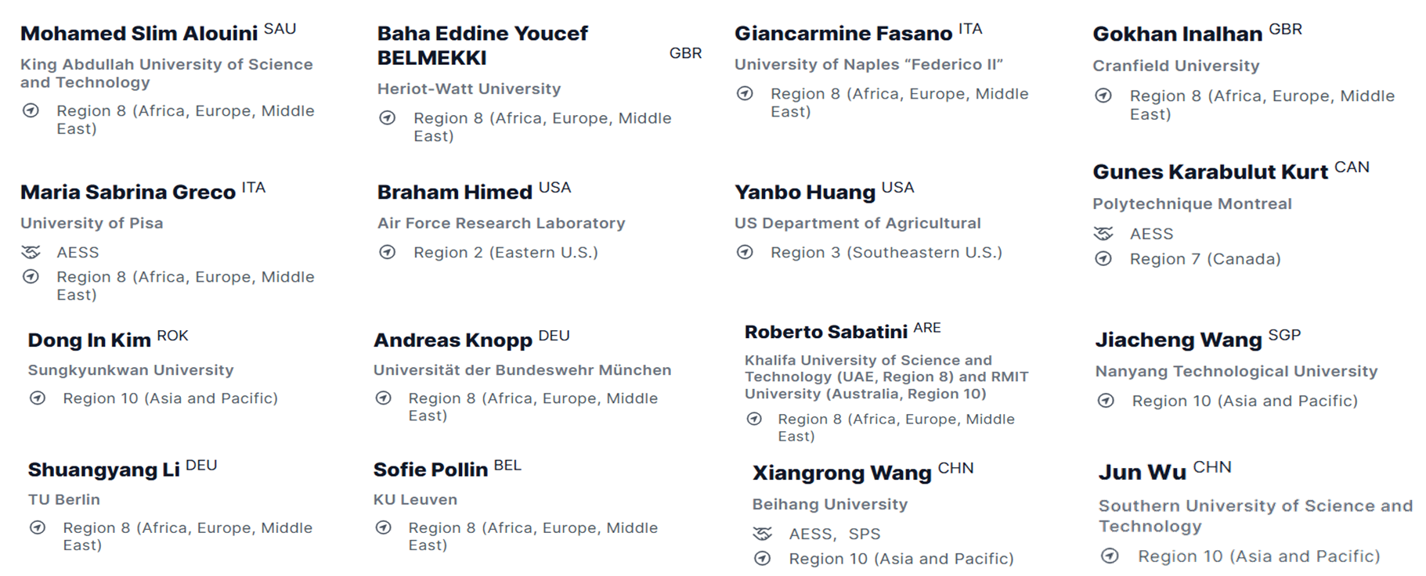
LAWN-TWG Members
Chair
TWG meets online regularly
Highly diverse technical expertise in LAWN
Founding members

Slide 46
LAWN-TWG Summary of Activities
1. AESS/ComSoc/SMC Ongoing Special Issues
  □ IEEE TVT SI on Low-Altitude Wireless Networks (LAWN)
  □ IEEE Communications Magazine SI on LAWN: Sensing, Connectivity, and Agentic Intelligence
  □ IEEE Transactions on Cybernetics SI on Advanced AI for Low-Altitude Sensing, Communication, Computing, and Control
  □ IEEE TNSE SI on Embodied AI for Low-Altitude Economy Networking
2. Conference Workshops and Special Sessions
  □ The 1st Workshop on Low-Altitude Wireless Networks in IEEE WCNC Conference,
    Location: Kuala Lumpur, Malaysia
    Time: 13 - 16 April 2026
    Organizers: Dusit Niyato, Weijie Yuan, Eirini Eleni Tsiropoulou, Geng Sun, Jiacheng Wang, Baha Eddine Youcef Belmekki
  □ The 20th International Symposium on Wireless Communication Systems
    Location: Gold Coast, Queensland, Australia
    Time: 24-26, August 2026
    General Co-Chairs: Weijie Yuan, Octavia Dobre, Giuseppe Caire, Rodrigo C. de Lamare
3. Continuing the LAWN seminar series with invited speakers from academia, industry, and government
  □ Urban Air Mobility (UAM) by Prof. Susan A. Shaheen from UC Berkeley
  □ Drone-enabled precision agriculture by Dr. Yanbo Huang from the US Department of Agriculture
  □ Signal processing for LAWN by Prof. Braham Himed from Air Force Research Laboratory
  □ Intelligent Aerial Robotics by Prof. Hugh Liu from the University of Toronto

