Slide 1
IEEE Aerospace Electronic Systems
Membership Services
Abir TABARKI
AESS Board of Governors Meeting – Spring 2026
15-16 May 2026
Phoenix, Arizona, USA

Slide 2
2026 Objectives
Support a smooth transition from student membership to Young Professionals (YP) engagement by creating initiatives that help recent graduates stay connected and involved within IEEE.
Organize more networking and mentorship sessions to strengthen connections between students, Young Professionals, industry experts, and IEEE leaders.
Promote diversity, inclusion, and a strong sense of community by encouraging participation from members of different backgrounds and fostering a welcoming environment for all.

Slide 3
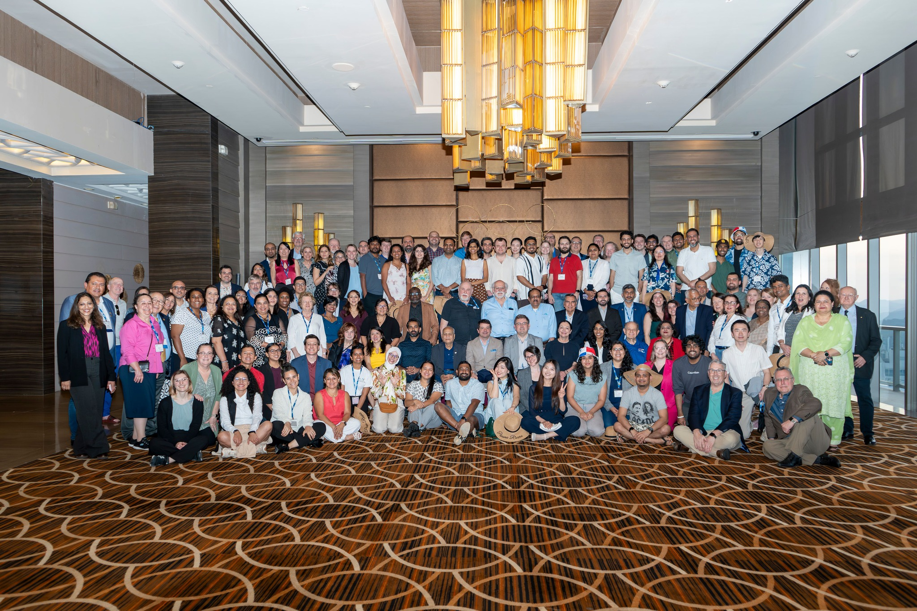
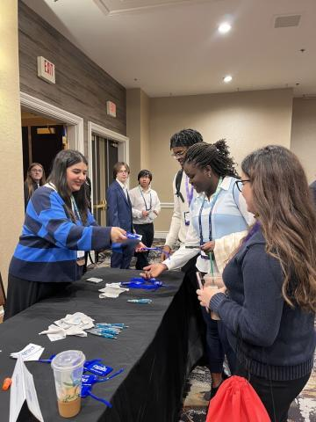
What we did so far
IEEE Rising stars
IEEE Mga meeting

Slide 4

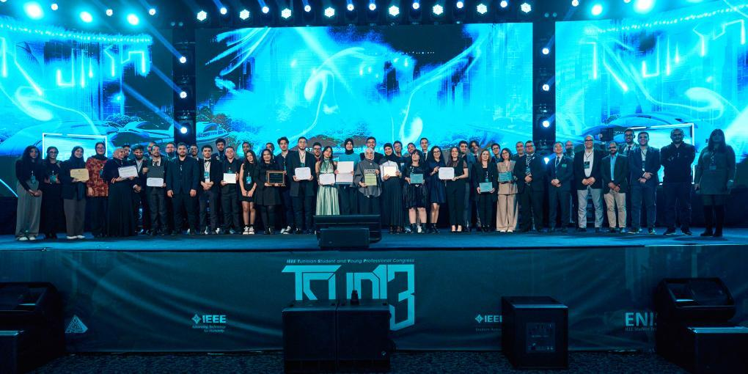
What we did so far
Online Talks /webinars and workshops
IEEE TSYP aess representation

Slide 5
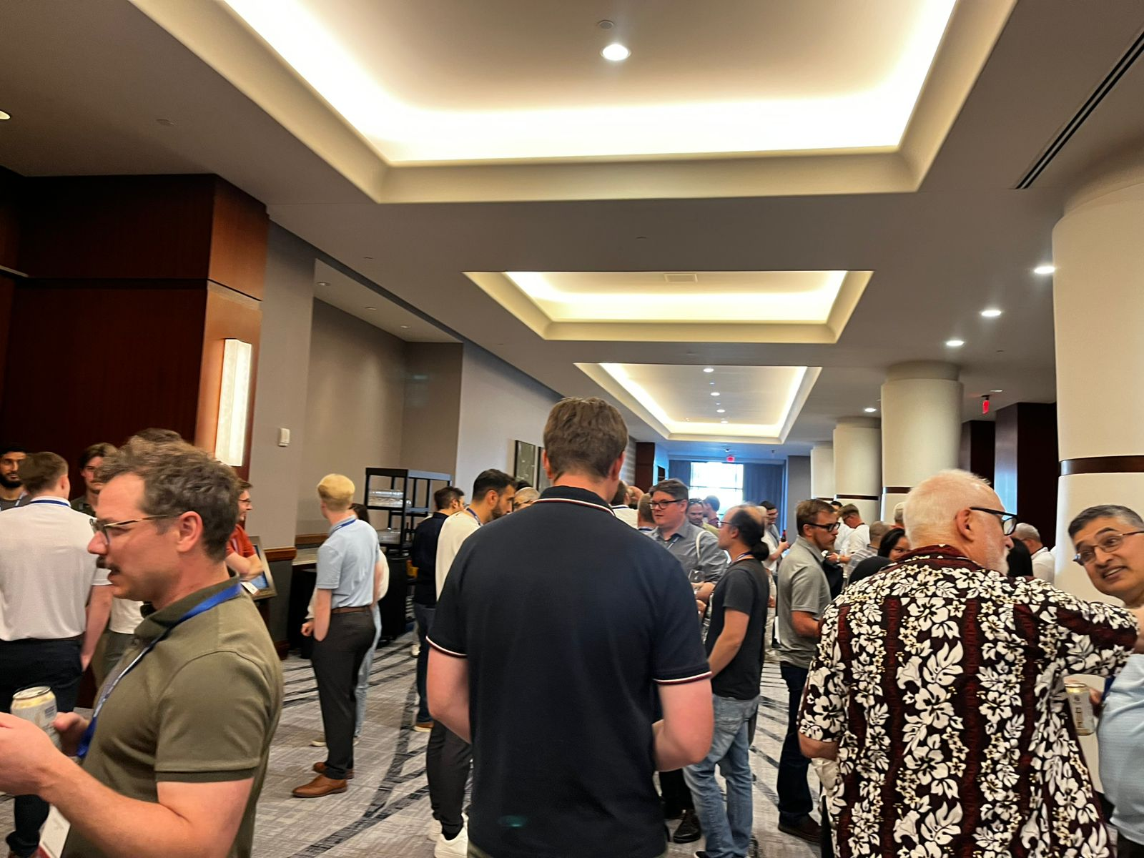
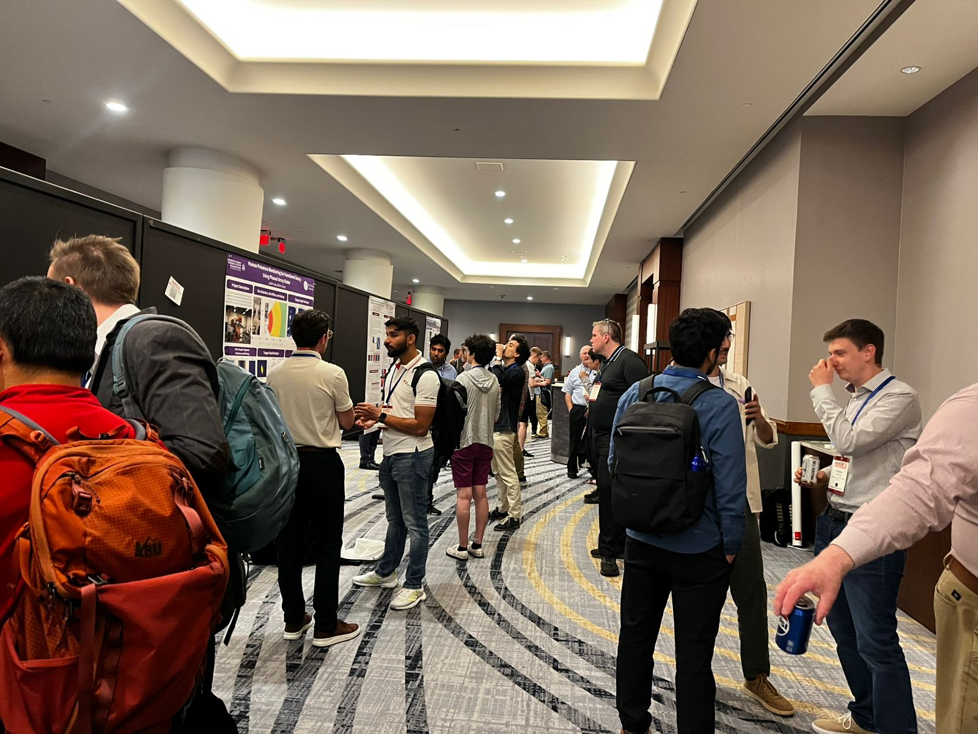
What we did so far
IEEE Young Professionals Networking Event – IEEE Radar Conference, Phoenix, Arizona, USA : Done!
IEEE Young Professionals Session – IEEE Space, India
IEEE Young Professionals Activity – IEEE ISAC, Portugal

Slide 6
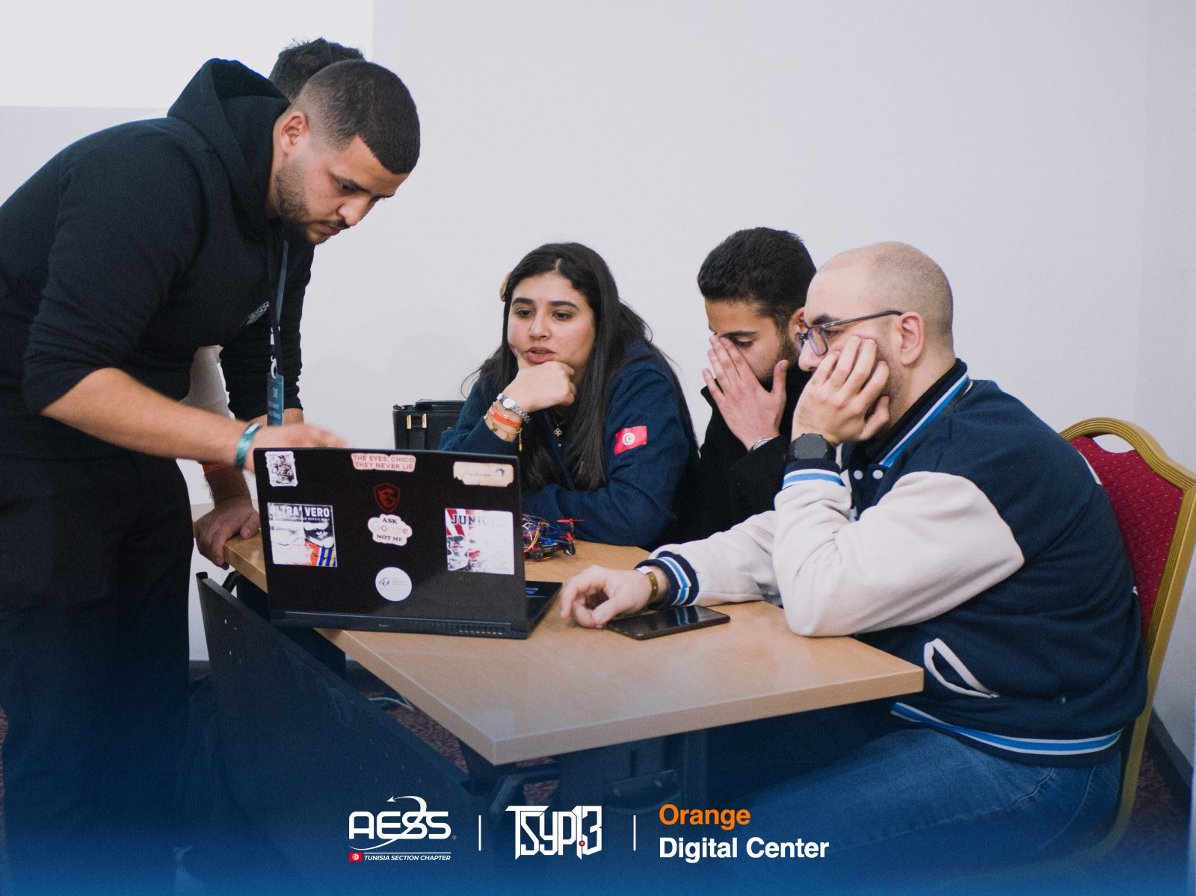
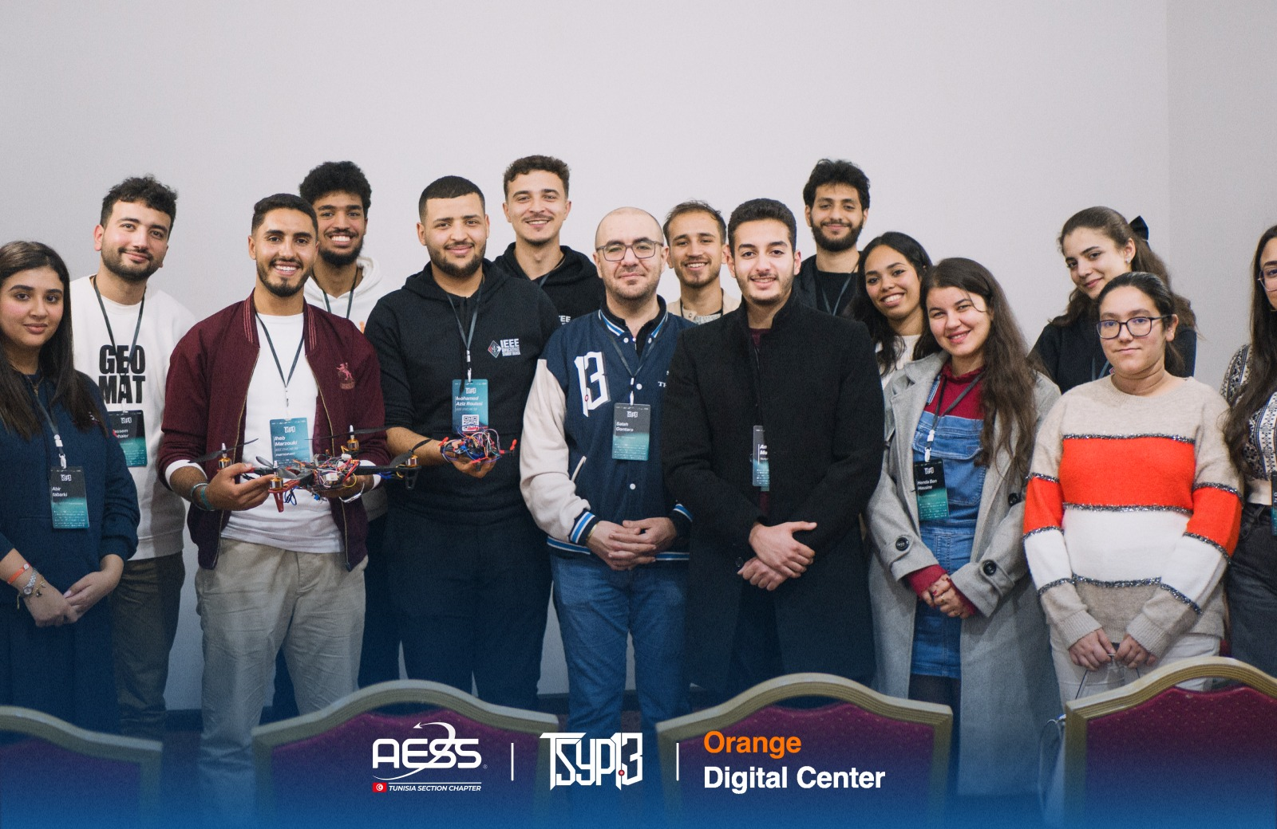
IEEE YP Networking and Mentoring
IEEE Tunisia syp AESS Mentroship Program

Slide 7
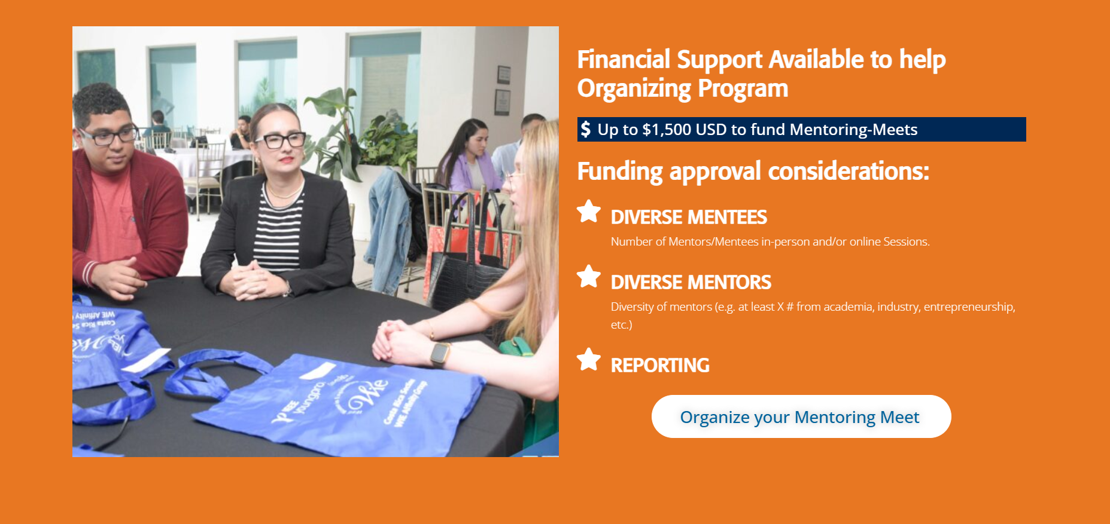
IEEE YP Networking and Mentoring
IEEE space india up and mentorship program in collaboration with ieee yp

Slide 8
Establishing an IEEE Young Professionals Committee
Objective
Create a diverse and inclusive IEEE Young Professionals (YP) Committee composed of representatives from different regions to strengthen engagement, collaboration, and participation within the community.
Key Goals
Encourage more students and young professionals to get involved in IEEE activities and leadership opportunities.
Ensure representation from different regions, cultures, and technical backgrounds.
Build stronger communication between local chapters, student branches, and Young Professionals.
Promote collaboration on international events, networking sessions, and mentorship initiatives.
Create a supportive community that empowers members through shared experiences and opportunities.
Expected Impact
Increased participation in IEEE AESS YP activities
Stronger global networking opportunities
Better support for students transitioning into Young Professionals
More inclusive and connected IEEE AESS communities worldwide

Slide 9
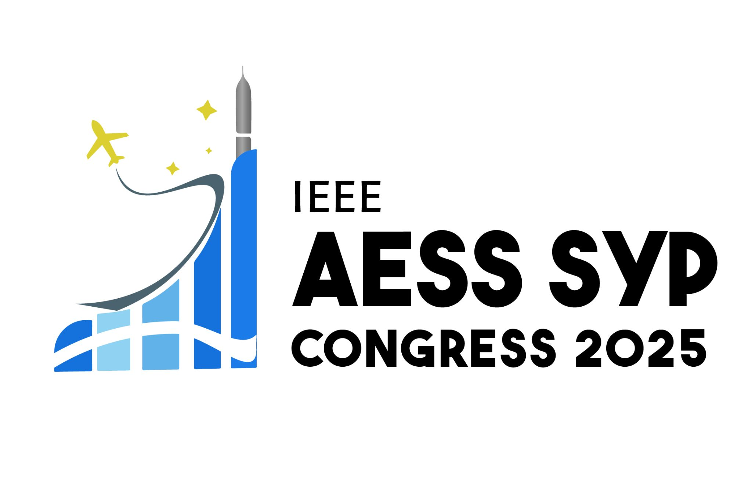
IEEE AESS SYP 2027 Call for Host & Preparation
Initiate early preparation for the IEEE AESS SYP 2027 by opening the official call for host applications and identifying interested IEEE regions and chapters.
This will build on the strong success of the first and only previous edition, which demonstrated high value in:
Increasing engagement of Students and Young Professionals
Strengthening networking and mentorship across IEEE AESS
Encouraging active participation and leadership development
Creating meaningful global collaboration opportunities
The 2027 edition aims to further expand this impact by increasing accessibility, regional involvement, and community-driven organization.

