Slide 1

IEEE Aerospace Electronic Systems
Graduate Student Representative
Kayoum Djedidi
15 and 16 May 2026
Phoenix, Arizona, USA

Slide 2

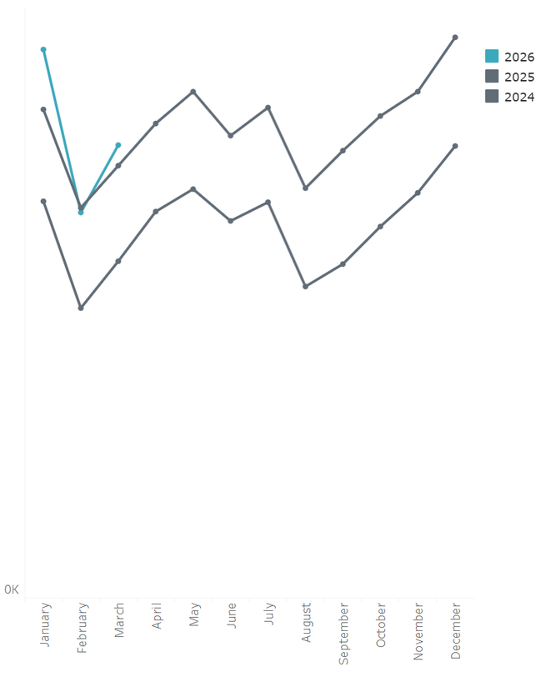
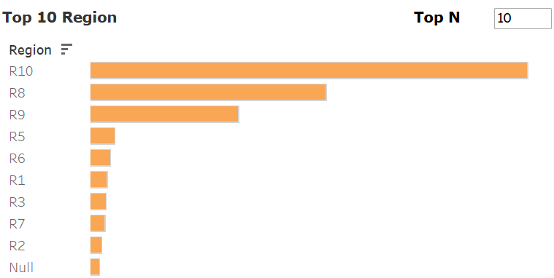
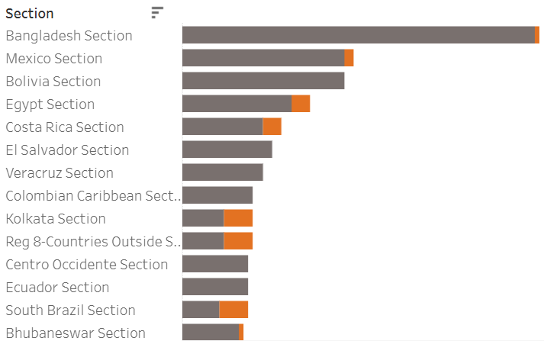
.1 | Students/Graduate Students within AESS
Some Stats
(as of January - March 2026, compared to march 2025)
  Total Number of members: 5751, 4.81% Increase from 5487
  Student members: 1451 (25.23%), 27.39% Increase from 1139
  Graduate Student members: 483 (8.40%), 4.77% Increase from 461
  Number of SBCs: 153, 14.18% Increase from 134
Top 10 Regions
Potential Chapters

Slide 3
.2 | Graduate Students within AESS
Observed Priorities
  Connection: Graduate students need stronger links across chapters, technical committees, and research areas.
  Career Pathways: Many seek clearer visibility into academic, industry, and standards-related opportunities.
  Support Structures: Funding, mentorship, and access to professional networks remain important factors in graduate student engagement.
Current Gaps to Address
  Low visibility of graduate student work: Many student research projects are not connected to AESS platforms such as conferences, panels, publications, or technical committees.
  Weak transition from student member to active volunteer: Graduate students often join AESS but lack a clear path into chapter leadership, technical activities, or society-level roles.
  Limited career-facing engagement: Students need more direct exposure to aerospace and electronic systems employers, senior researchers, standards work, and applied R&D pathways.

Slide 4
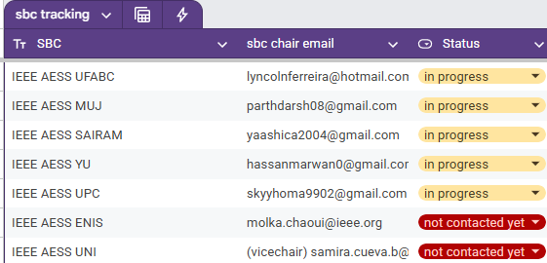
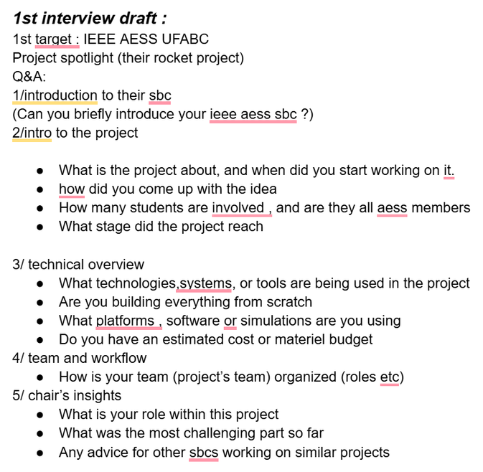
.3 | Results: Student Engagement and Development
Graduate student newsletter corner in AESS QEB

Slide 5
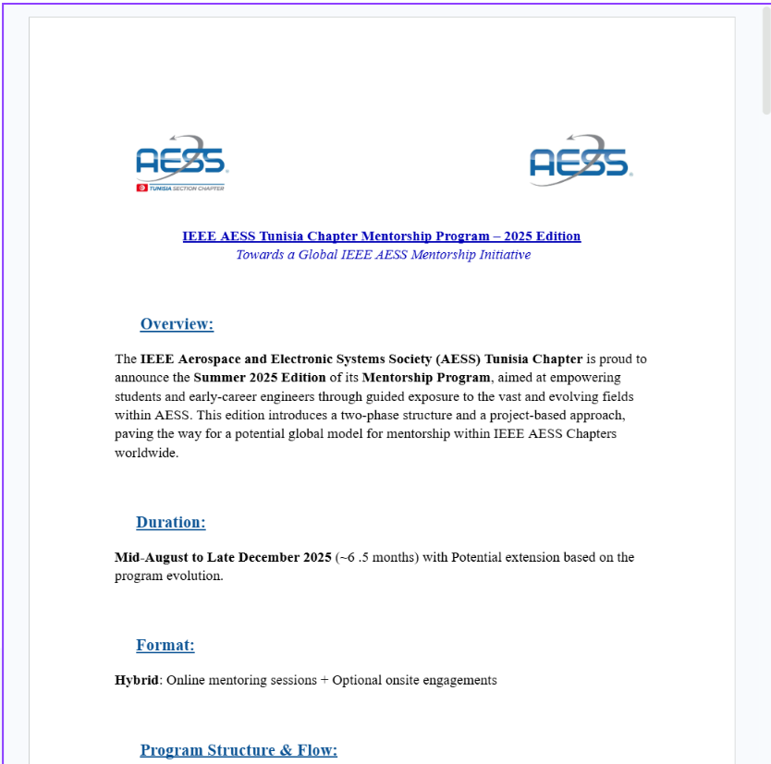
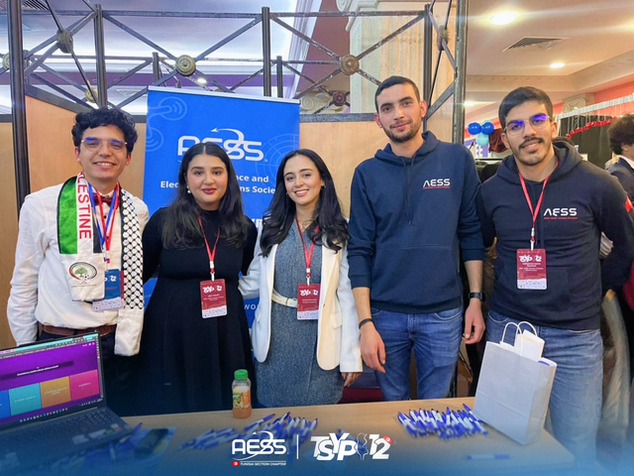
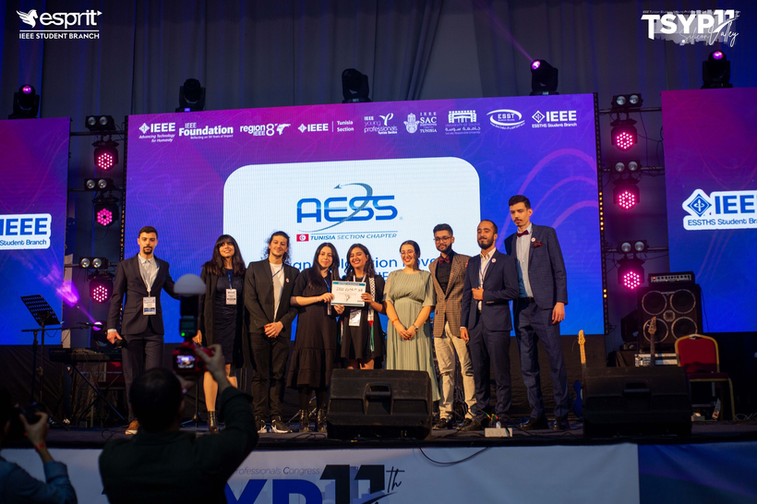
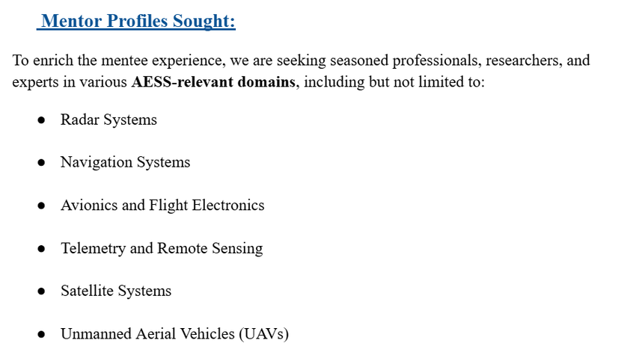
.4 | Results: Student Engagement and Development
Student / Graduate student mentorship program 1st pilot
Integration within TSYP12 & 13

Slide 6
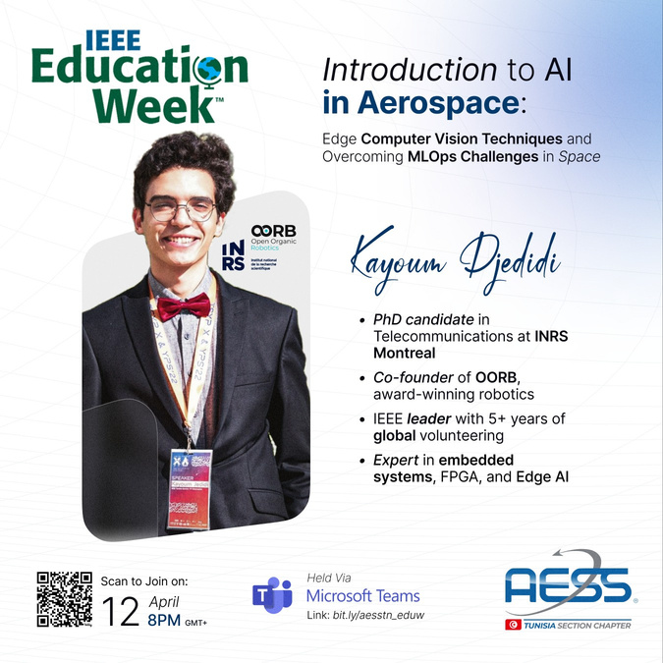
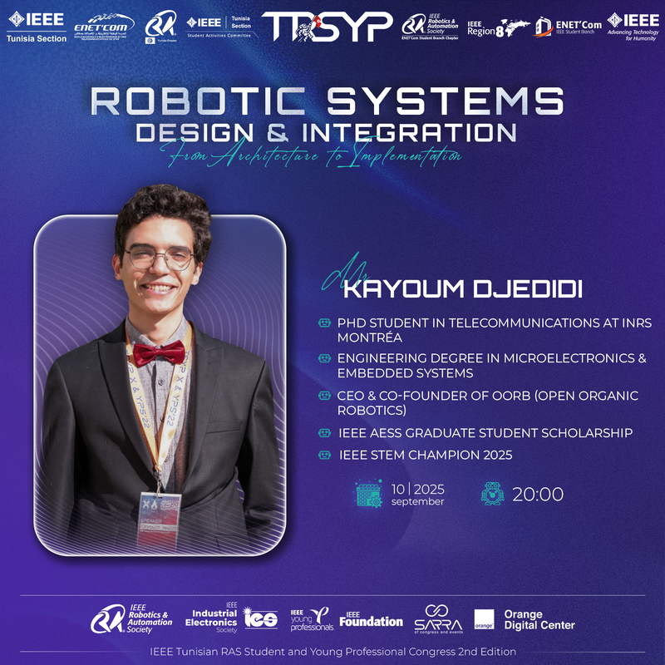
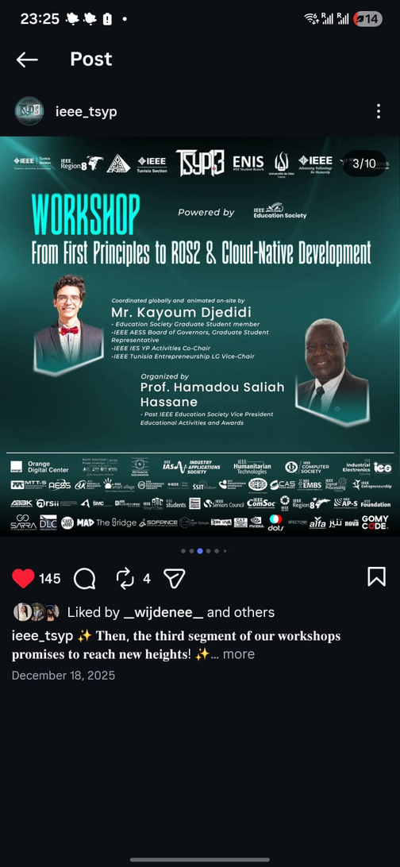
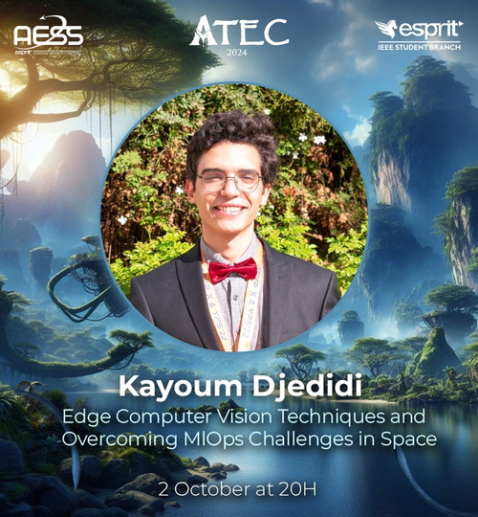
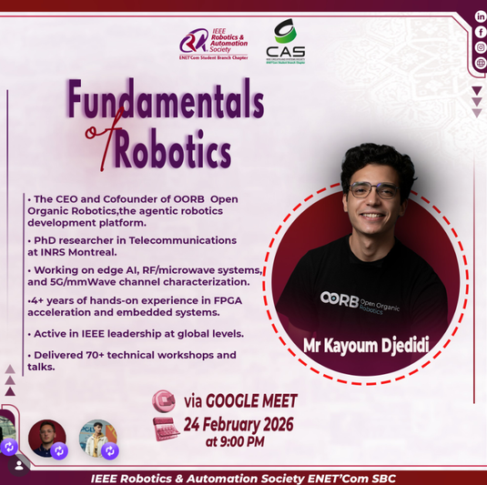
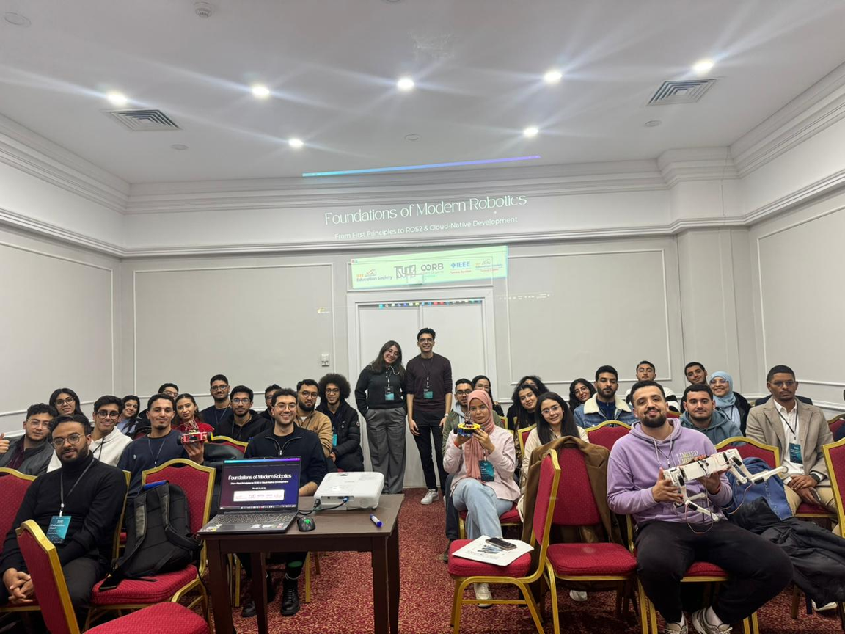
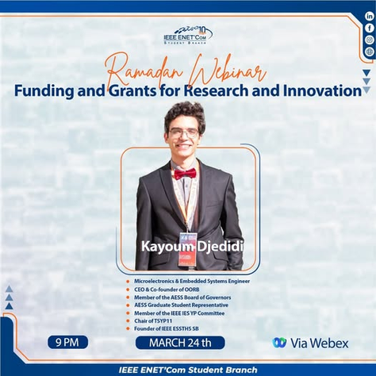
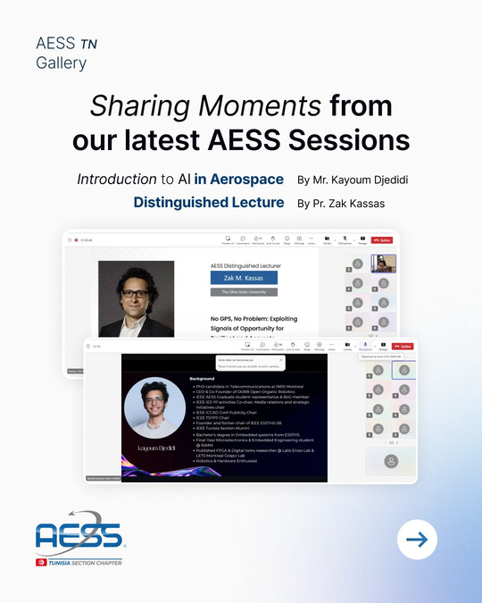
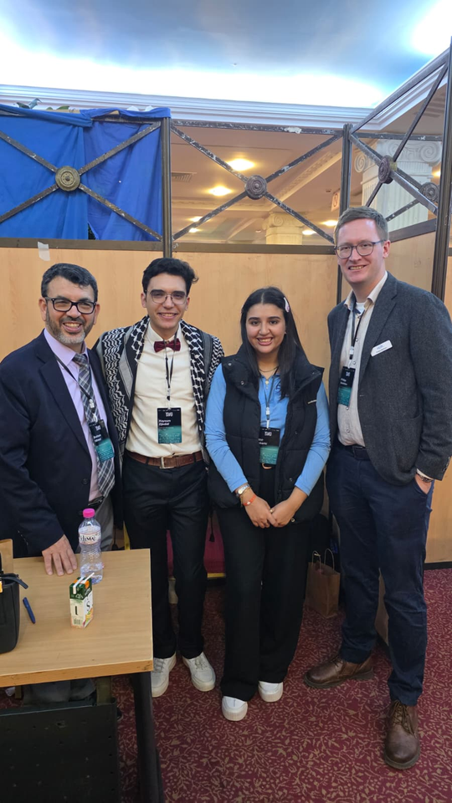
.5 | Results: Student Engagement and Development
Sessions, webinars, and workshops

Slide 7
.6 | Objective 1 - Student Engagement and Development
Focus:
Enhance student engagement and professional development within IEEE AESS.
Actionable Steps:
  Organize quarterly webinars and workshops on topics like "Emerging Technologies in Aerospace Systems" and "Career Pathways in Embedded Systems."
  Develop a mentorship program with at least 15 mentor-student pairs within six months.
  Launch a Graduate student newsletter highlighting opportunities, scholarships, and events.
  Encourage Paper contests and works-in-progress competitions
OKRs:
  Objective: Increase student engagement in AESS activities.
  Key Result 1: 10% increase in participation within 12 months.
  Key Result 2: Establish a mentorship program with 15 mentor-student pairs.

Slide 8
.7 | Objective 2: Graduate Student Activation Pipeline
Current Progress:
  Sharing AESS Initiatives and Call for challenges among my network, responding to questions, and assisting members ( especially around grants and AESS programs).
  Supporting the creation of 2 new AESS Student Branch Chapters in the Montreal Section + Assisting with finding interested volunteers.
  Both groups are preparing their petition submissions and can serve as a repeatable model for other sections.
Action Plan
  SBC Launch Pipeline: Turn the experience into a simple playbook: petition template, officer roles, first-event plan, and reporting checklist.
  90-Day Activation Rule: Every new graduate student lead should receive one concrete AESS task within 90 days: chapter event, technical committee support, conference support, or membership outreach.
  Technical Committee Entry Points: Match interested graduate students with AESS technical committees as junior contributors, not just attendees.
2026 Targets
  Assist in submitting at least 5 more petitions, using the OU analytics tool as a guide and reaching out to members directly.
  Create 1 reusable Section chapter launch&Success kit for sections + SBC launch&success kit for SBs
  Appoint 10 graduate student liaisons across chapters/sections.

Slide 9
.8 | Objective 3: IEEE Empower Education Proposal - Graduate Student Track
Opportunity:
  IEEE Empower call can fund structured education programs.
  Since our response is being led by Prof. Sabrina, I will support the graduate student component.
  Initial proposal deadline: 27 May 2026.
Proposed Concept
AESS Graduate Technical Readiness Modules
  Short, reusable modules led by our AESS experts in radar, aerospace systems, navigation, autonomy, and sensing.
  Built for graduate students moving from research into applied technical roles.
  Delivered through live sessions + recorded material + chapter/SBC discussion kits.
  Make a call to appoint student / graduate student participants and collect needs/feedback.
BoG Support Needed
  Confirm AESS sponsorship for the proposal.
  Identify 3-5 technical experts willing to lead the first modules.
  Structure the Innitiative

Slide 10
.9 | Objective 4 - Feedback and Communication
Focus:
Serve as a liaison between the Graduate student community and the AESS Board of Governors.
Actionable Steps:
  Conduct regular surveys and focus groups to gather feedback.
  Establish an online communication hub on Collaboratec for direct interaction.
  Implement a bi-monthly communication plan to update students on AESS programs and opportunities.
OKRs:
  Objective: Ensure clear communication and responsiveness between students and AESS leadership.
  Key Result 1: Achieve a 60% satisfaction rate in annual student feedback surveys.
  Key Result 2: Publish 6 bi-monthly newsletters with an open rate of at least 50%.

Slide 11
.10 | Program Proposal: AESS SYPS: Student Young Professional Showcase
Focus:
Separate from conference-specific initiatives, A new society-wide program to fund select SYP authors with accepted papers at AESS flagship conferences, honoring them as "AESS Conference Scholars" at a dedicated ceremony.
The Win-Win Rationale
Leverages vetted, high-quality authors for mutual benefit.
  For AESS: Boosts SYP membership, increases AESS visibility, and builds a future leadership pipeline.
  For Scholars: Provides a prestigious award, travel funding, and invaluable networking opportunities.
Strategic Goal: Connect Academia & Industry
This program serves as a direct platform for collaboration.
  Exclusive Panels: Scholars meet industry & academic leaders.
  Facilitate Research: Spark new joint projects through focused networking.
OKRs:
  Key Result 1: Increase student and graduate student paper submissions by 15% YoY for flagship conferences.
  Key Result 2: Achieve a 20% increase in overall SYP attendance at conferences featuring the Scholars program.
  Key Result 3: Convert 50% of non-member Scholars into AESS members.

Slide 12
Thank You!

