Slide 1


IEEE MTT-S 2026 Activity Highlights
AESS BoG Meeting
Phoenix, AZ
Gregory Lyons
2026 MTT-S IMS General Co-Chair
2026 IEEE Trans. Radar Systems Steering Comm. Chair & Treasurer
2023-2026 Systems Council MTT-S Primary Representative
2021 MTT-S President
2019 MTT-S Treasurer

Slide 2




MTT-S Today
01
Global Coverage Expanding
18,000 members and counting
Top Tier Publications
02
Long outstanding history, scope expanding
Primary Conferences
03
Top brand in the field, regional coverage increasing
04
Finance is Healthy
Well balanced income/expenditure

Slide 3
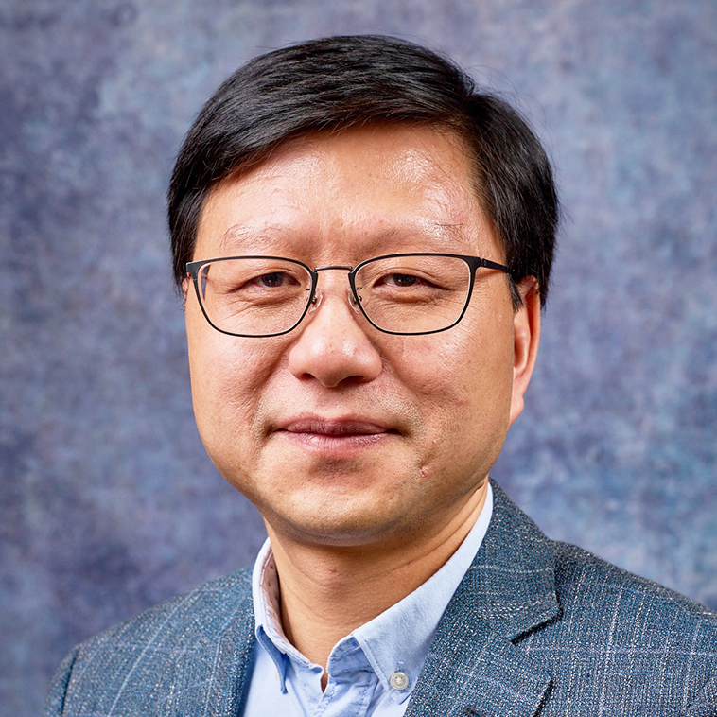
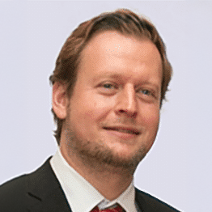
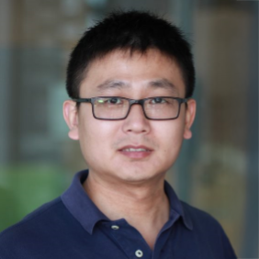
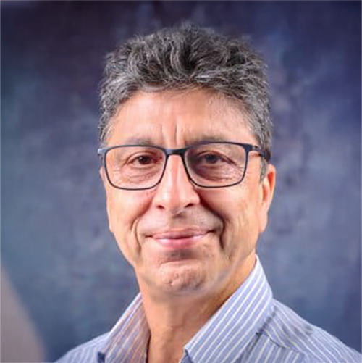
2026 MTT-S AdCom Officers
Anding Zhu
Dietmar Kissinger
Yang Yang
Kamran Ghorbani
President
President-Elect
Secretary
Treasurer

Slide 4
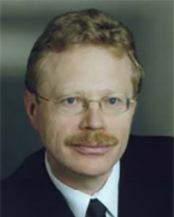
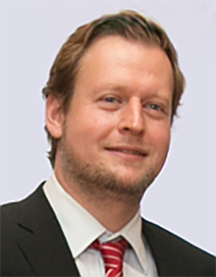
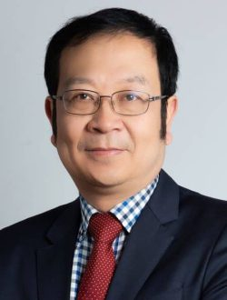
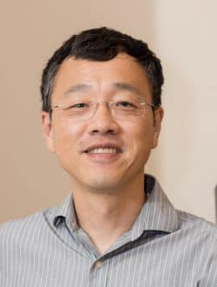
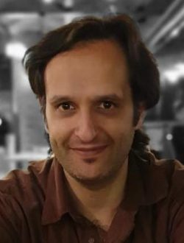
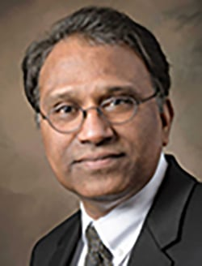
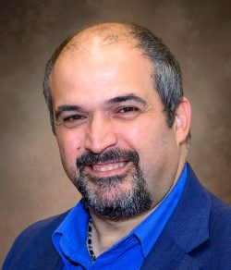
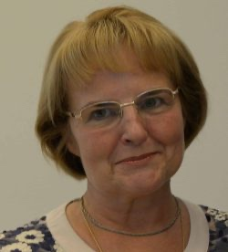
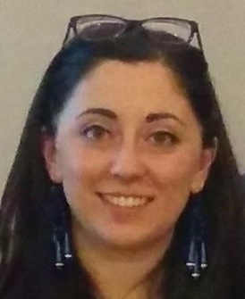
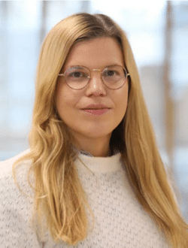
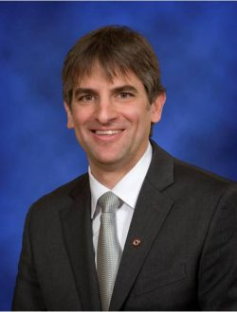
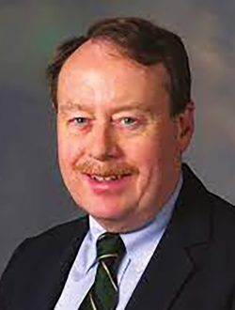
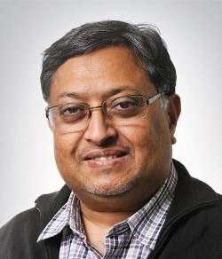
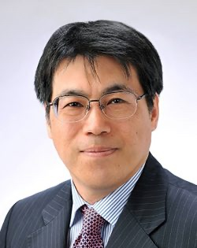
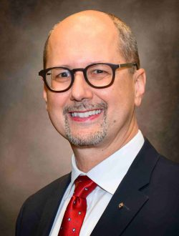
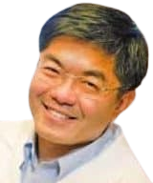
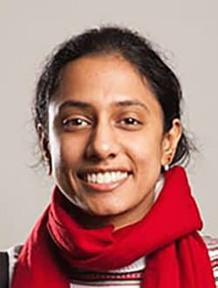
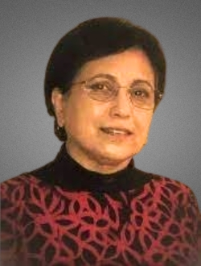
2026 Standing Committee Chairs
Awards
Budget
Education
Electronic Information
Fellow Evaluation
IMSEC
Intersociety
MarCom
Meetings & Symposia
MGA
Nominations
& Appointments
Operations
Publications
Standards
Strategic
TCFDC
Young Professionals
Broadening Participation

Slide 5
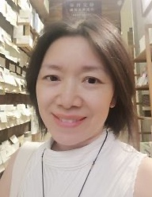
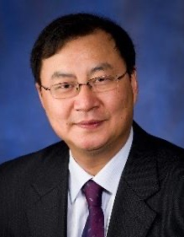
2026 AdHoc Committee Chairs
Sustainable Microwave Tech
MTT-S China
75th Anniversary
75th Anniversary
2026 MTT-S Administrative Committee roster
lists over 200 individual volunteers
DML/SB Review

Slide 6
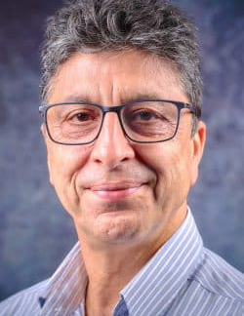
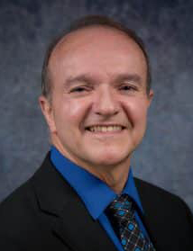
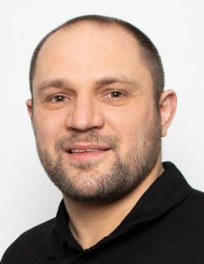
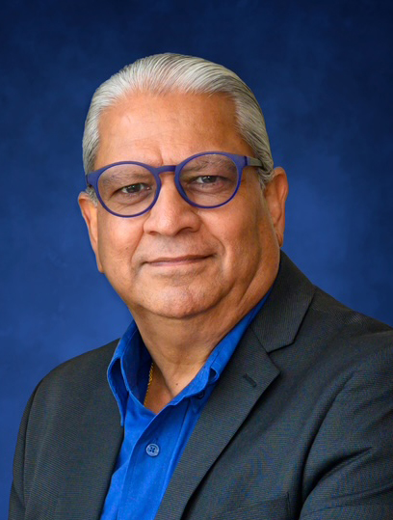
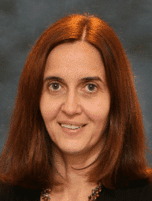
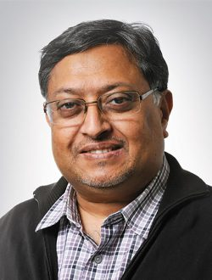
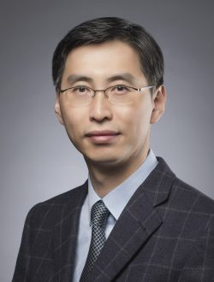
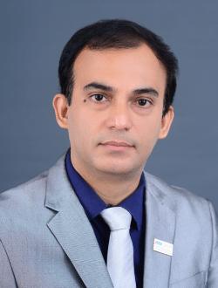
Elected AdCom Voting Members
- 6 -

Slide 7
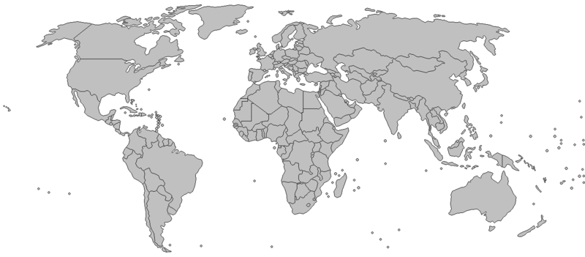
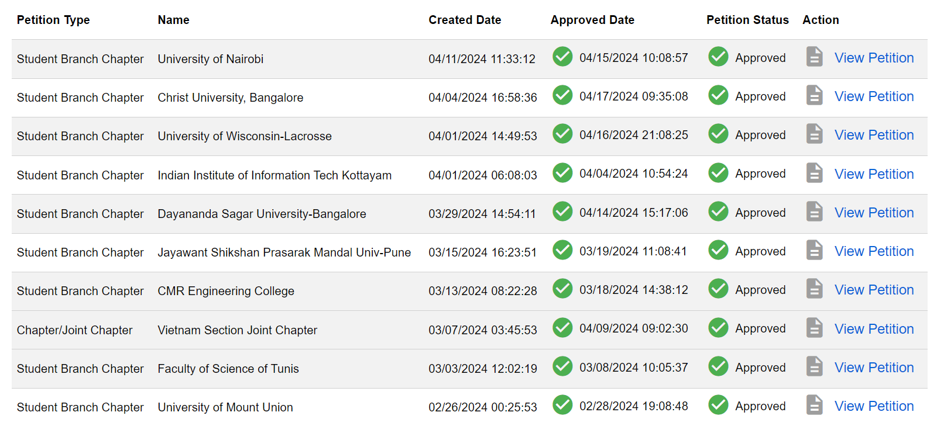
Membership Development
Focus on Students and YPs
Mentoring and ‘soft-skill’ sessions at 10+ conferences and at chapter level in North Africa, India, and Latin America (D&I Initiative)
Newly established standing committee for YPs (more than 15 events worldwide).
Subcommittee for Student Chapter Development (formation of 20+ new chapters)
Additional scholarships and travel grants to conference best student paper winners

Slide 8
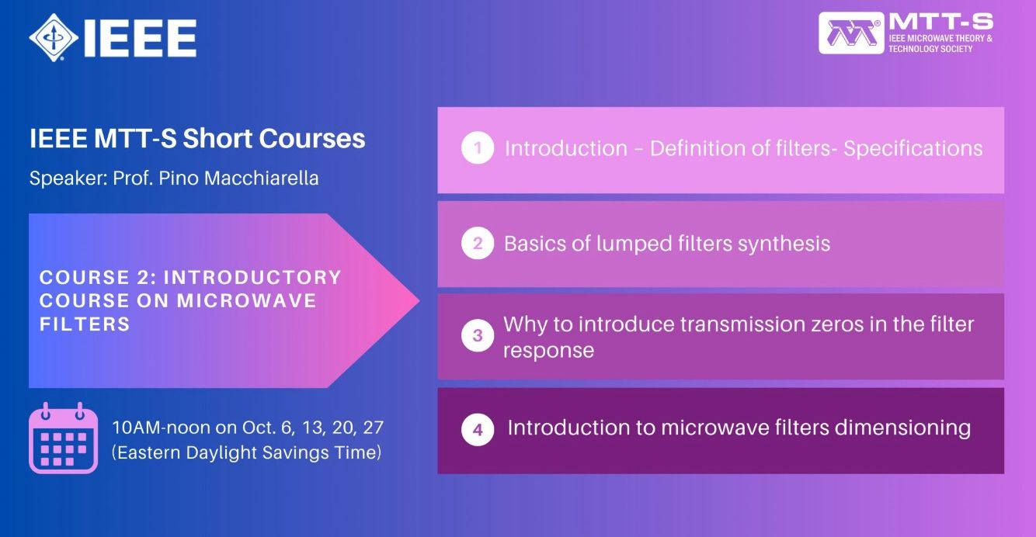
Membership Development
Focus on Industry
LinkedIn group “Ask MTT” (approx. 700 members)
New online course series (such as Filters and Nonlinear Modeling)

Slide 9
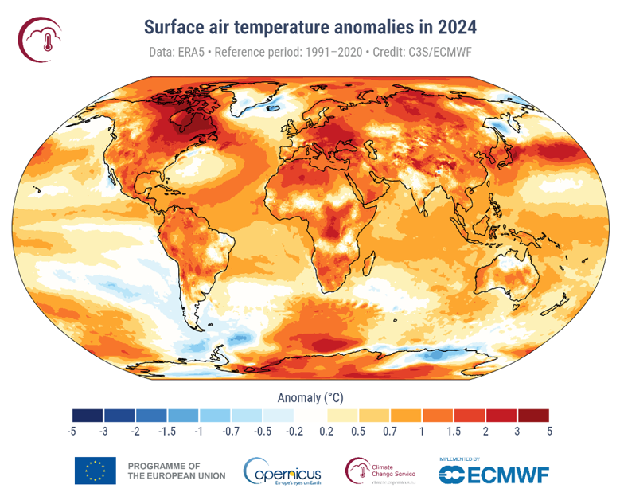

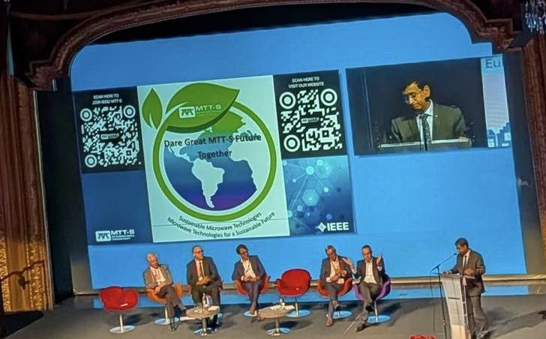
Microwave Technologies for a Sustainable Future

Slide 10
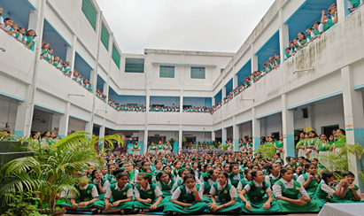
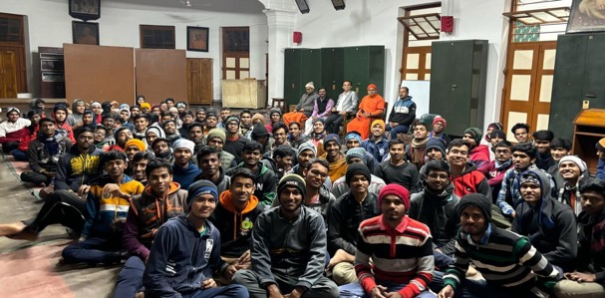
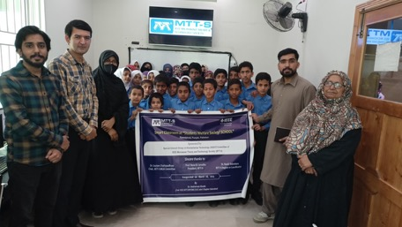
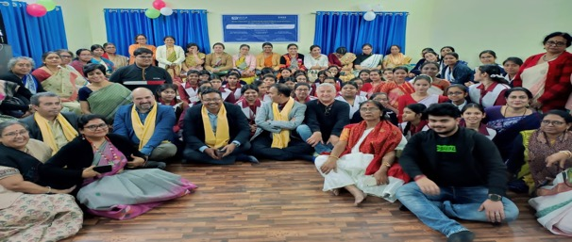
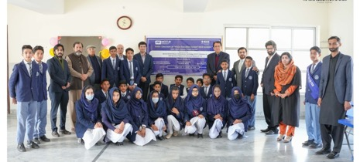
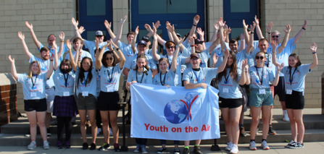
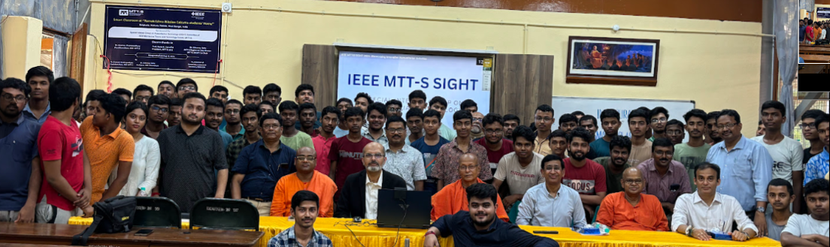
MTT-S SIGHT Program
(Special Interest Group in Humanitarian Activities)

Slide 11
IMS Reorganization for IMS2026
IMS is MTT-S flagship event (conference and exhibition)
Cross-cutting coordination positions reside at IMS Level
Technical symposia execution roles pushed into individual symposia
IMS 2026
General Chair(s)
Executive Committee
Advisory Committee
Technical Program Committee Coordinator
MP3, LAOC & Focus Group Committee
Exhibition Management
Common Budget
Independent Budget/MoU
RFIC
RFSA
RFTT
ARFTG
Symposium Chair
TPC Chair and Vice Chair
Steering Committee
Executive Committee
Advisory Committee
Symposium Chair
TPC Chair and Vice Chair
Steering Committee
RF Systems Dialogue
Executive Committee
Advisory Committee
Symposium Chair
TPC Chair and Vice Chair
Steering Committee
Executive Committee
Advisory Committee
Symposium Chair
Steering Committee

Slide 12





IMS Rebranding and Reorganization
IMS scale:
2nd or 3d largest IEEE event (even or odd years)
8000+ attendees (3000+ technical, 5000+ exhibition)
$7.5M revenue event
525 companies with 850 exhibition booths
~1000 paper submissions with ~45% acceptance rates
IMS – 40 volunteers; each symposium 20 volunteers

